Slide 1
Attaining Equalities in Outcomes for IMGs: A Pipe Dream?
@subodhdave1
Dr. Subodh Dave
Associate Dean, Trainee Support
Hon. Asso. Professor, University of Nottingham and Consultant Psychiatrist, Derby

Slide 2
Differential Attainment
What is Differential Attainment?
Why does it occur?
How can we reduce it?

Slide 3
Notes:
Global vs International The medical workforce is getting more mobile and the previous one way traffic from LAMIC to UK has been replaced by using UK as a stopover en route to Canada, Aus, Singapore, Middle East etc. And efforts at going abroad to recruit doctors have not been very easy or successful – This attitudinal issue is quite important in understanding DA and in dealing with it

Slide 5
Differential Attainment
Total percentage of IMGs in Psychiatry is over 40% but disproportionate spread
Most non-Consultant grade doctors (probably >80%) are IMGs
Under-represented at Consultant level
IMGs in Psychiatry more likely to face suspensions and referrals to regulators
IMGs in Psychiatry more likely to fail summative and formative exams

Slide 6
Pass rates for Candidate Groups- Paper A
Notes:
So let me talk to you about Psychiatry- though the picture is similar for other branches of medicine too

Slide 7
Pass rates for Candidate Groups First Attempt candidates only

Slide 8
Notes:
The main problem however is in relation to the CASC 0OSCE-style) exam – where the pass rates are abysmally low for IMGs

Slide 9
Exam Factors
Notes:
Ehtnicity again playing some role – though not as significant statistically for UK trained doctors.

Slide 10
Exam Factors
Differential attainment seen in knowledge, skills and values assessment in US, UK, Canada, Australia etc.
Differential attainment seen in exams at all levels of medical education (UG onwards..) and also outside medical education
Differential attainment seen in knowledge, skills and values-based assessments
Differential attainment – low/medium effect for ethnicity and large effect for country of primary medical qualification

Slide 11
IMG Factors: GMC (2009)
Major differences in the ethical frameworks of their country of training and in the UK
The greater emphasis on autonomy, duty of confidentiality and informed consent may come as a surprise
Lack of awareness of Good Medical Practice
not always read, understood, or interpreted accurately
Notes:
I am not proposing to spend too much time on each slide but the key themes are clear..

Slide 12
IMG factors
PLAB and UK graduates’ performance on MRCP(UK) and MRCGP examinations: data linkage study McManus, BMJ 2014; 348 - GMC commissioned UCL study)
PLAB (Professional and Linguistic Assessment Board) exam marks good predictors of future performance in MRCP and MRCGP exams
IMGs’ lagged behind UK trained examinees – equivalence would be achieved by raising PLAB pass mark by 13-20%

Slide 13
What trainees say
Be kind to us
Help us by understanding what we need to do
Connect with me, be curious about me as a person – not asking questions as a tick box

Slide 14
What trainees say
Lack of Empathy
“If they’re coming to work in the UK- they must be prepared to work like a local trainee – Tough”
“We can’t dilute standards”
“They’re untrainable”

Slide 16
Cultural Communication
Differing values (extended family for e.g.)
Fee-paying Health Service
Hierarchical structures
Patriarchal structures
Holistic v/s disease focus
Rote learning
Shame/embarrassment in making/admitting to mistakes/ignorance

Slide 18
Systemic Factors
Lack of clear structures to deal with IMG issues in LETB/Deanery hierarchy
?IMG Lead

Slide 19
Systemic Factors
Lack of early identification/remediation measures
Lack of individualised learning plan for IMGs taking into account their IMGness (their training abroad, what they bring to working in the UK)
Focus on diagnosis of performance issues, much less on identifying learning gaps
Lack of focus on prevention leads to focus on CASC courses etc. rather than on designing an individualised learning plan

Slide 20
Solutions
Supporting Trainers
Supporting Trainees
Maintaining Accountability

Slide 21
Supporting Trainers – RCPsych
>30 engagement events across the country
Raise awareness of IMG issues
Training videos – feedback and supervision skills (dealing with the “insightless trainee”, appraising strengths as well as weaknesses)
Improved Trainers’ knowledge of the MRCPsych exams

Slide 22
Supporting Trainers Workshop
Experiential workshop using Forum Theatre to help train supervisors to
identify the strengths and needs of IMGs
to learn how to provide consistent support in the acculturation process
Initiate “awkward” conversations about “IMGness”
4 workshops > 150 trainers
92% increase in awareness of IMG need
100% effectiveness rating for the learning activities used within the workshops.

Slide 23
Mentoring Training
Annually for ALL trainers of MTI trainees
Mentors NOT trainees’ clinical supervisors
Sustainable model involving joint enterprise between Employer Trusts, Deanery and RCPsych
>100 trainers

Slide 24
Supporting Trainers
Resource webpage:
https://www.rcpsych.ac.uk/training/international-medical-graduates?searchTerms=IMG
Notes:
>300 trainers/trianees - hits

Slide 25
Supporting Trainees
Early identification of learning gaps and early remediation
Mentorship

Slide 26
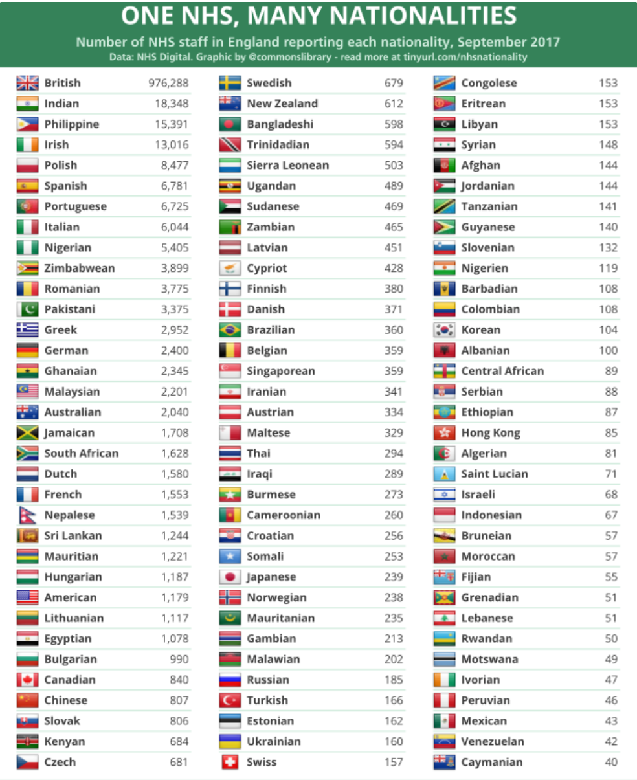
Notes:
A quick comment on the conflation of IMGs and BAME – for a very long time the bulk of IMGs working in the UK have been from BAME backgrounds. With tighter visa controls over the past decade this picture has changed and welsaw a larger number of IMGs from EU countries who were mainly non-BAME But – look at this 202 countries all represented in the NHS.. Richness of experience

Slide 27
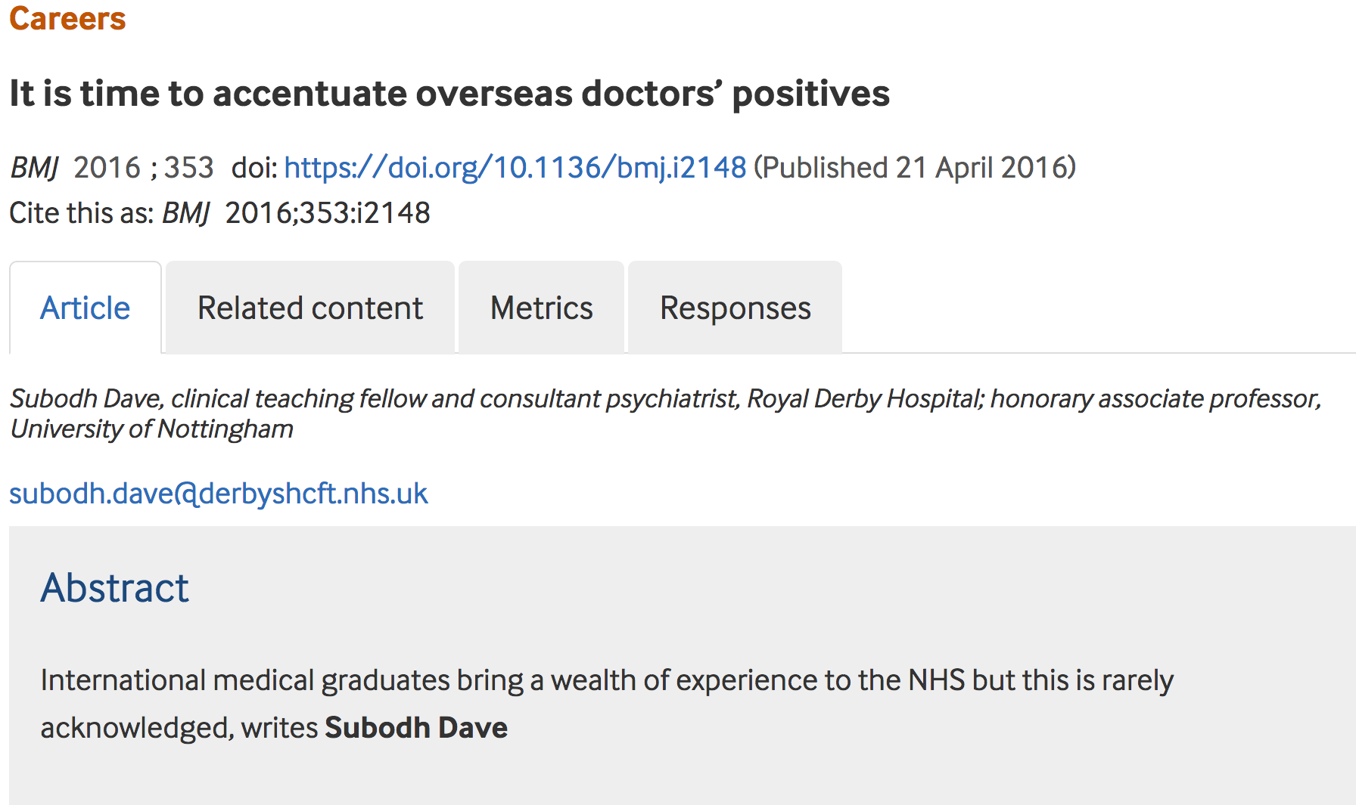

Slide 28
MTIs
Every MTI – Induction to working in the NHS at RCPsych
Every MTI assigned a mentor
Trainees can choose a mentor but matching service also offered

Slide 29
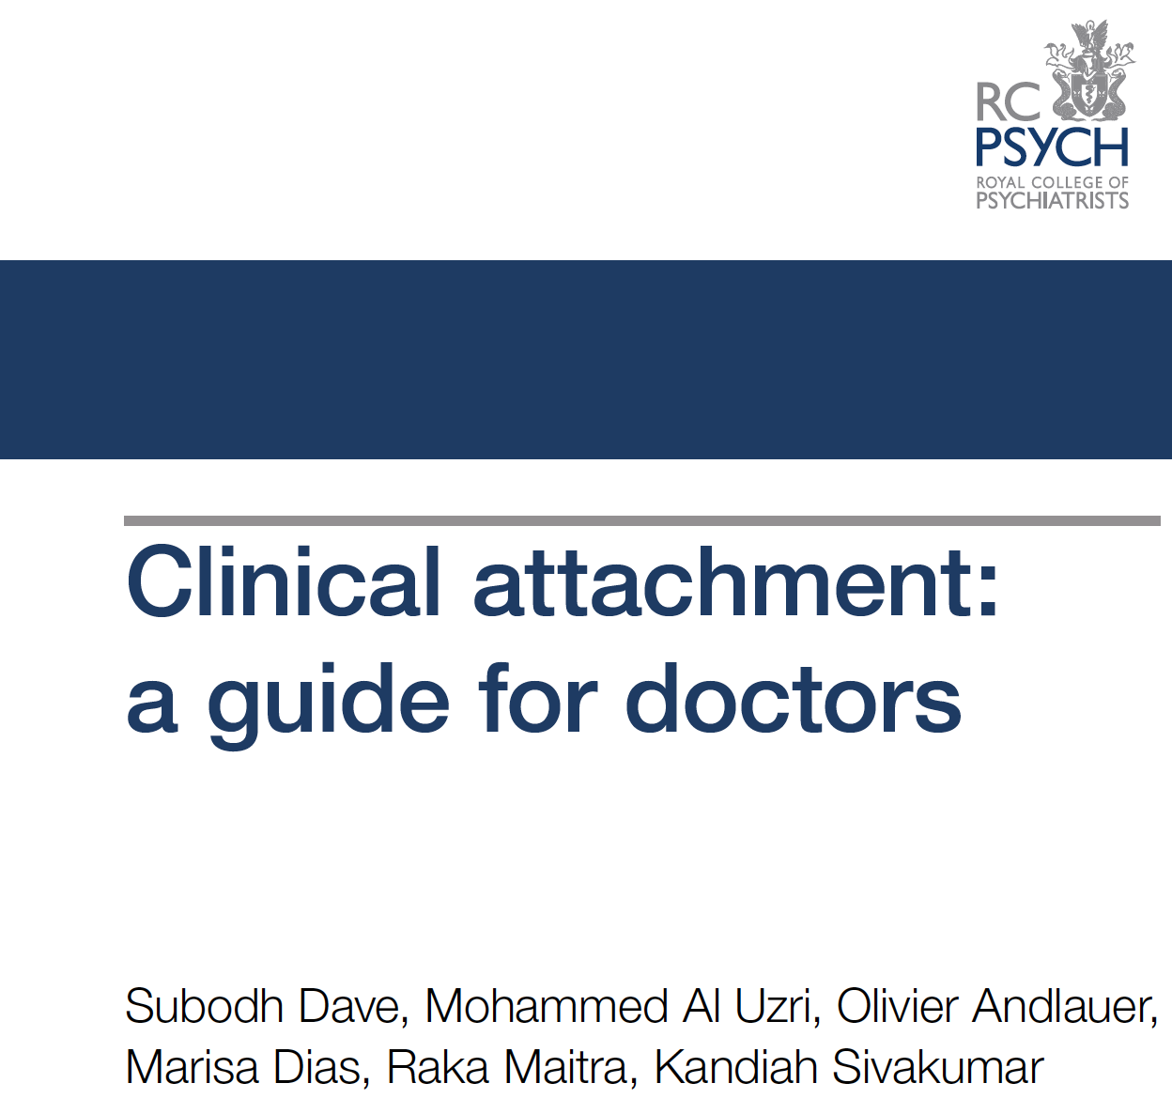

Slide 30
Maintaining Accountability
Notes:
I put this as my wish list 3 years ago – and I am really glad that a fair few of these will feature in the Quality assurance process – being overseen by the GMC

Slide 31
What can you do?
Appreciate not all IMGs are the same
Getting a sense of their cultural experience is helpful- is your trainee Indian (South or North)/Pakistani/Bangladeshi – does that matter?
Providing a sense of the local culture/history/tradition is helpful too
Acculturating them – each IMG is different
Notes:
For those of you who are IMG trainers- it may be tempting to skip this step – as you may feel you already understand this – remember not all IMGs are the same!

Slide 32
What can you do?
Broach the subject early
Discuss IMGness (their training abroad, what they bring to working in the UK)
Get a sense of their experiences of training and working abroad v/s in UK and of “living in the UK” (IMGs want you to do this)
Have a chat about the strengths they bring to their NHS work & the learning needs they might have

Slide 33
What can you do?
Facilitate patient-centredness
ACEs
Aid with improvement in communication skills
Language (tonal elements)
Accent
Role plays
Video feedback
Conversation (verbal and non-verbal analysis)
Notes:
e.g. Only ask questions about colleague’s case- then brainstorm- which are the best questions/Only listen –and then discuss- watch videos and discuss non-verbal language;

Slide 34
What can you do?
Supervision and training
Use supervision proactively- understand your trainee’s learning style
Provide feedback especially positive feedback helping them find their strengths
Be explicit about expecting trainees to learn how to learn

Slide 35
What can you do?
Acknowledge your own training needs
Do you know enough about MRCPsych course/curriculum/exams?
Would you know what to do if your trainee speaks too fast/has a strong accent leading to communication difficulty?
Would you know where to signpost for help
Seek feedback and support from TPD, Associate Dean etc.

Slide 36
What can you do?
Familiarise yourself with resources that you can signpost your trainee to
Professional Support Unit – Deanery/University based
Psychiatrist Support Service http://www.rcpsych.ac.uk/workinpsychiatry/psychiatristssupportservice/resources.aspx
Doctors’ Support Network
Diaspora Network @RCPsych
Tea & Empathy
Big White Wall
Self-help resources

Slide 37
Final Tips
Lead with the Culture
Start at the Top
Involve every layer
Make a rational AND emotive case
Engage Engage Engage
Leverage Formal Solutions
Leverage Informal Solutions
Assess and Adapt
Notes:
Involve every later- Heads of Schools
PTC
Examination Sub Committee
Recruitment Committee Getting people in a room far more effective than sending them to a diversity course! Encourage mixed peer groups – Use social media to facilitate social interactions
Divisions
Diaspora Network

Slide 38
Engagement Event
#IMG2019 @rcpsych @subodhdave1
17th Jan 2020

Slide 39
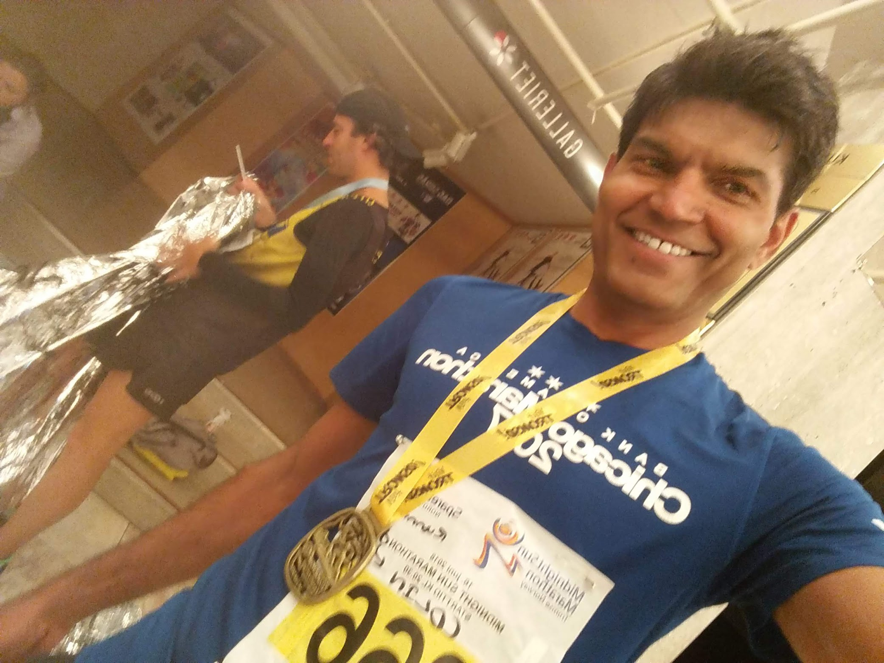
From “We Should” to “I will”
@subodhdave1
subodhdave@nhs.net

Slide 40
Next Steps?
One thing that I can do differently is

