Slide 1
PG Certificate in Health Research and Statistics
Dr Elena Ratschen
Associate Professor in Health Services Research
PGCert Programme Lead

Slide 2
The PGCert: what is it?
Postgraduate taught degree
Emphasis on quantitative methods training to enable students to design, critically appraise and conduct research in health and related sciences

Slide 3
Key learning outcomes
At the end of the Programme, you will be able to:
formulate clear and concise research questions
carry out scientific literature searches
understand and apply constructs and concepts central to the design and conduct of high quality health research
plan and undertake data analysis using appropriate statistical methods
interpret and critically appraise research publications

Slide 4
Time span & module credits
2 years (part-time)
60 credits
30 compulsory credits (20 + 10)
30 optional credits (3*10)

Slide 5
Compulsory Modules
* Health Research Methods (20)
Distance learning via VLE, Autumn 2021 & Spring 2022
* Introduction to Regression Analysis (10)
Online every Tuesday, 1pm -4pm, Spring 2022 (9 half-day sessions)

Slide 6
Optional Modules* (10 credits)
Further regression analysis
Measurement in Health & Disease
Introduction to Applied Multi-Level Analysis (online over 4 days)
Epidemiology
Randomised Controlled Trials
Qualitative Health Research
Health Economics
Systematic reviews
Practical Randomised Controlled Trials
* half-day sessions unless otherwise stated

Slide 7
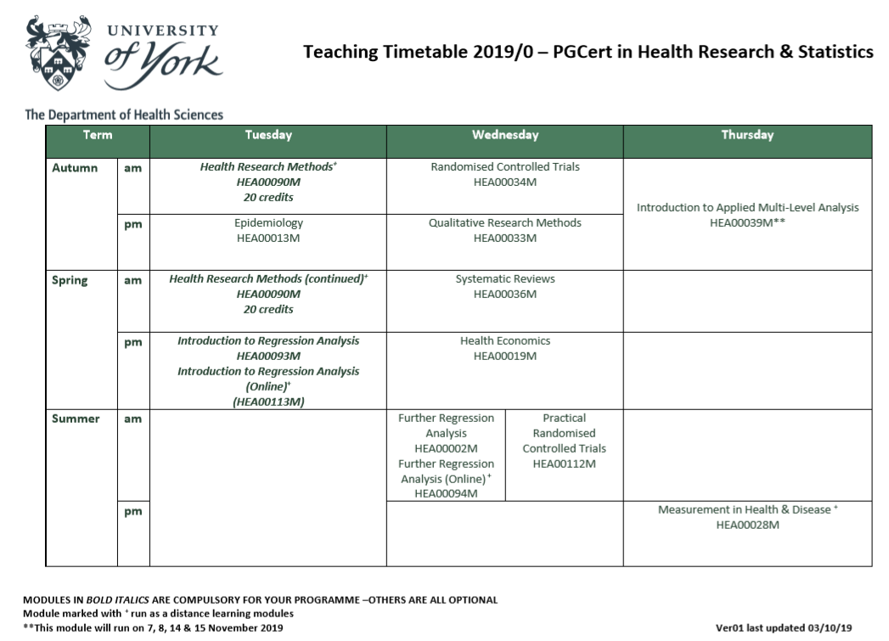
Timetable (will be published here): https://www.york.ac.uk/healthsciences/student-intranet/timetables/timetables/

Slide 8
Core/ Option | Module title | Credit value | Prerequisites, Corequisites, Prohibited combinations (name of modules(s)) | Timing of module (eg. AuT – Autumn, SpT – Spring, SuT – Summer Term, Year long)
Core | Health Research Methods | 20 |  | AuT, SpT
Core | Introduction to Regression Analysis | 10 |  | SpT
Option | Epidemiology | 10 |  | AuT
Option | Randomised Controlled Trials | 10 |  | AuT
Option | An Introduction to Applied Multilevel Analysis | 10 | Pre-requisite: Further Regression Analysis | AuT
Option | Systematic Reviews | 10 |  | SpT
Option | Health Economics | 10 |  | SpT
Option | Further Regression Analysis | 10 | Pre-requisite: Introduction to Regression Analysis | SuT
Option | Measurement in Health and Disease | 10 |  | SuT
Option | Practical Randomised Controlled Trials | 10 | Pre-requisite Health Research Methods or Randomised Controlled Trials | SuT
Core | Introduction to Regression Analysis online | 10 |  | SpT
Option | Qualitative Health Research | 10 |  | AuT

Slide 9
Optional Modules
Please Fill in the optional modules document and return to Di Stockdale (diane.stockdale@york.ac.uk) by 08 October.

Slide 10
Mandatory tutorial
Academic Integrity Tutorial:
Via the VLE
To be completed by 1 October 2021
No credits

Slide 11
Assessment
Schedule available here:
Assessment styles:
Open-book exam (Health Research Methods, Further regression analysis, Introduction to Applied Multi-Level Analysis)
Projects/Essays (Introduction to Regression Analysis, Randomised controlled trials, Systematic reviews, Health Economics)
https://www.york.ac.uk/healthsciences/student-intranet/timetables/assessment-schedules/#tab-6

Slide 12
Enrolment
Are you enrolled?
https://www.york.ac.uk/students/studying/enrolment/
Enrolment deadline - Friday 1 October 2021

Slide 13
Leave
Between 3 days and 4 weeks: discuss with personal supervisor/module leaders/AFP programme lead in the first instance
More than 4 weeks: ‘Leave of absence’ (University Special Cases Committee)
→ see PGCert handbook for details

Slide 14
Academic Support
Personal Supervisor (Elena Ratschen or Noreen Mdege – you will be allocated)
Module leaders (and helpers)
Resources on Study Skills Development
https://www.york.ac.uk/students/studying/develop-your-skills/study-skills/

Slide 15
Academic Support
VLE (Yorkshare)
https://youtu.be/jhH15upB-cM
*In order to access a module you need to log on using the following address: http://vle.york.ac.uk then enter your username (format ‘abc123’) and your password.

Slide 16
Wellbeing, Health & other support
Welcome Site: https://www.york.ac.uk/healthsciences/postgraduate-welcome/
Student and Academic Support: housing; employment; finance; childcare; etc.
‘Togetherall’: free online mental health & wellbeing support for UoY students
Career Support
Student Representatives
Exceptional Circumstances

Slide 17
Support ctd.
IT:
http://www.york.ac.uk/it-services/info/newusers/
https://www.york.ac.uk/students/computing/
Health:
https://www.york.ac.uk/students/health/
https://www.york.ac.uk/students/health/mental-illness/

Slide 18
Student Intranet
https://www.york.ac.uk/healthsciences/student-intranet/

Slide 19
University Email
ALL emails from the University will be sent to your University account. This includes emails regarding times/dates/venues of exams.
Important to check email regularly/Webmail (Gmail)!
Consider email forwarding

Slide 20
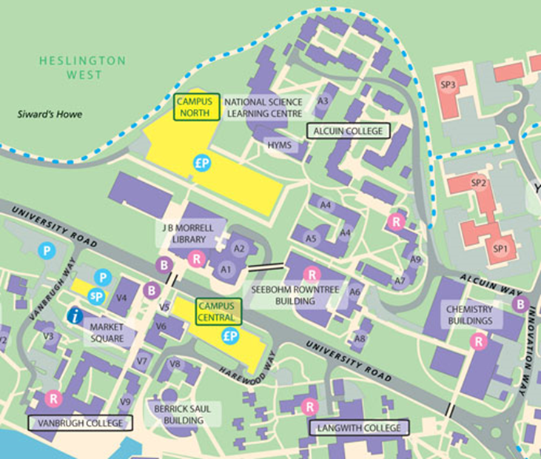
Campus Map & Room finder
https://www.york.ac.uk/map/
https://www.york.ac.uk/admin/estates/operations/Room%20number%20finder.pdf

Slide 21
Health Sciences News
Follow us on Twitter for updates about department news and events
@HealthSciYork
Read and contribute to Megaphone – the Health Sciences newsletter sent to your York email address 6 times a year

Slide 22
Handbook
All the above and further information can be found in the PGCert Handbook:
https://www.york.ac.uk/healthsciences/student-handbooks/#tab-6

Slide 23
Health Research Methods Module
Dr Mona Kanaan & Dr Elena Ratschen Module Leaders

Slide 24
Our contact details
Mona Kanaan (Autumn Term) – stats queries
mona.kanaan@york.ac.uk
Elena Ratschen (Spring Term) – methods queries
elena.ratschen@york.ac.uk
You can also use the blog on the VLE (Module Materials Q & A)

Slide 25
Module Aims
To provide a foundation for students who are expected to engage with research findings and/or the research process.
To introduce and contextualise knowledge that will be further developed in other modules.

Slide 26
Module Aims ctd.
Understand, critically appraise and interpret research findings
Develop research questions
Plan an appropriate methodological approach to study designs
Select appropriate methods of research data collection
Undertake appropriate statistical analysis of study data

Slide 27
Module Content
Autumn Term (Statistics) – Mona Kanaan (from September)
Collecting data and questionnaire design
Summary statistics
More on summary statistics
Comparing means of two samples
Independent/dependent t-tests
Cross-tabulations of categorical variables
Scatter diagrams and correlation coefficient
Making sense of statistics I
Making sense of statistics II
Spring term (Study designs) – Elena Ratschen (from January)
Introduction to study designs in health research
Observational studies
Randomised controlled trials
Systematic reviews
Meta-analyses
Qualitative approaches to research
Ethics in health research
Searching for information & information handling

Slide 28
Formative assessment
Each session will end with a quiz not exceeding 10 multiple-choice questions.
Students need to answer all questions correctly (multiple attempts are allowed) to be able to access the next session materials (adaptive release).

Slide 29
Summative Assessment
Autumn term (stats): Quizzes in weeks 3, 6 and 9 = 15% of final module mark
Spring term: (study designs): short answer test in week 5 = 10% of mark
Final Exam: 75%: remote open-book exam. Research extracts (e.g. abstracts from research papers) will be provided, each accompanied by several short-answer questions. The mixed-methods questions will cover the content of the module across the autumn and spring term.

Slide 30
Any questions?
Elena.ratschen@york.ac.uk

