Slide 1
The value of research
Prof Else Guthrie

Slide 2
Me
Liaison Psychiatrist
Academic and clinician
Research interests-
Psychological treatment: several large RCTs
Medically unexplained symptoms: novel treatment approaches
Self harm: psychological understanding and treatment
Liaison services: organization, outcome measure

Slide 3
Plan
Introduction
Barriers to research
Value
Examples of projects

Slide 4
Prestwich Lunatic Asylum
3,000 patients at its height
Built for 500
Farm
Cricket pitch
Laundry

Slide 7
Reasons for admission other than insanity
ill treatment by husband;
laziness;
immoral life;
masturbation for 30 years;
novel reading;
politics and bad company;
desertion by husband;
suppression of menses;
vicious vices;
seduction;
greediness;
women’s trouble.
All treatment was a combination of moral and occupational

Slide 8
Treatments available when I started psychiatry
Chlorpromazine
Haloperidol
Modecate depot
Depixol
Psychoanalysis
Behavioural treatment
Operant conditioning

Slide 9
Advances in research over last 30 years
Major advances in:
Pharmacology
Psychological treatment
Brain mechanisms-imaging
Genetics

Slide 10
Current state of research

Slide 11
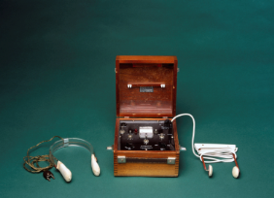
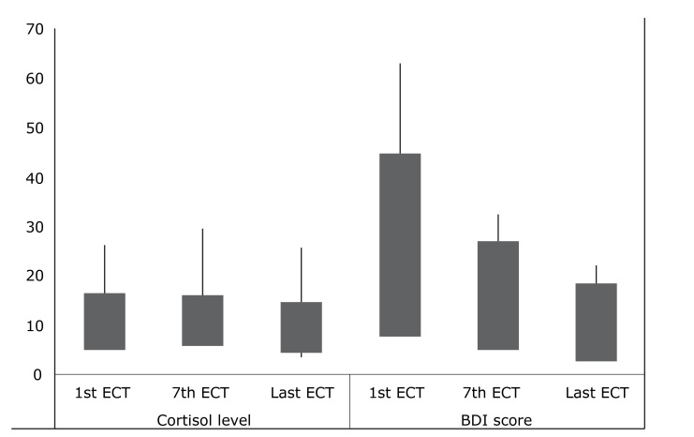
My first research project: prolactin levels following ECT
Prolactin

Slide 12
What did I learn?
Literature review
Formulate a question
Design a study and write a protocol
Ethics
Engage and consent patients
Tenacity in recruiting patients
Simple statistical analysis
Interpretation
Write up
Acceptance of robust criticism
Background knowledge of ECT
Self-motivation

Slide 13
Research is an apprenticeship
Can’t learn to do it from a course

Slide 14
Starting from scratch
Supervisor
Systematic review
Protocol
Scientifically sound
Feasible
Funding?
R&D
Ethics approval
Data collection/recruitment/consent
Data governance
Analysis
Write up
Publication

Slide 15
The Golden Days
Research an integral part of higher training training
One full day per week for 4 years.
Lecturer and research posts more accessible
Full time research posts for six months as part of training
MSc and higher degrees expected
Many consultants in teaching hospitals had PhD or the equivalent
Large pool of supervisors and more time within the clinical work to devote to research and supervision

Slide 16
The Golden Days
Virtually no research governance
Ethics approval required for major projects but process relatively straightforward
Medical student projects exempt from ethics approval
NB: No computers so time constraints re data entry/writing up work/literature searches etc

Slide 17
Alder Hey Organ Retention Scandal
Unauthorised removal, retention, and disposal of human tissue -children’s organs.
Professor van Velzen ordered the "unethical and illegal stripping of every organ from every child at postmortem".
104,000 organs, body parts and entire bodies of fetuses and still-born babies were stored in 210 NHS facilities.
480,600 samples of tissue taken from dead patients.
Birmingham Children's Hospital and Alder Hey had also given thymus glands, removed from live children during heart surgery, to pharma for research in return for financial donations.

Slide 18
Research Governance

Slide 19
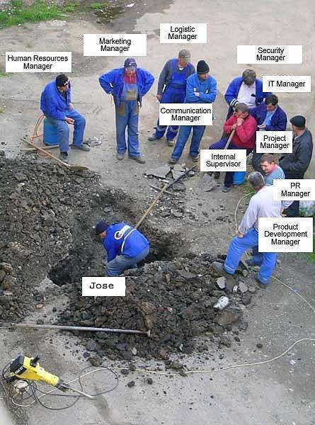
Ethics
Trust R&D
user rep
supervisor
Ex/internal reviewer
CRN
collaborator
Stats reviewer
funder
Sponsor
researcher

Slide 20
Cost of clinical trials
Picture of exponential costs

Slide 21
Present Day
Dramatic erosion in time available for research for trainees
Governance and ethics more demanding
Few consultants have research training
Reduction in university staff
Consultant job contracts allow little time for research activities
Research methodologies more highly developed and stringent
Less flexibility –trainees have to decide earlier

Slide 22
Academic attachments: Foundation Training
4 months full time
A taster of research
Example
Systematic review of grey literature/internet re help for self-harm
Currently writing up for publication

Slide 23
Academic Clinical Fellowships-Basic Training
3 year posts
75% clinical 25% research
Aim- to prepare for a PhD application
e.g. The role of inflammation in depression
Piggy back onto a trial of anti-inflammatory agents in rheumatoid arthritis

Slide 24
Basic skills required to do research
Be able to write English

Slide 25
Desire to think creatively

Slide 26
Self-determination and drive

Slide 27
Value
Expertise in a small area
Break from day to day work
Different kind of working
Benefits patients to have consultants with areas of expertise
Better outcomes for patients in studies
Can gain great experience from clinical practice
But need to read the literature
Most doctors are incapable of evaluating research papers

Slide 28
NHS Culture
Evidence base
Rudimentary evaluations

Slide 29
Treatment for insomnia

Slide 30
Ethics application

Slide 31
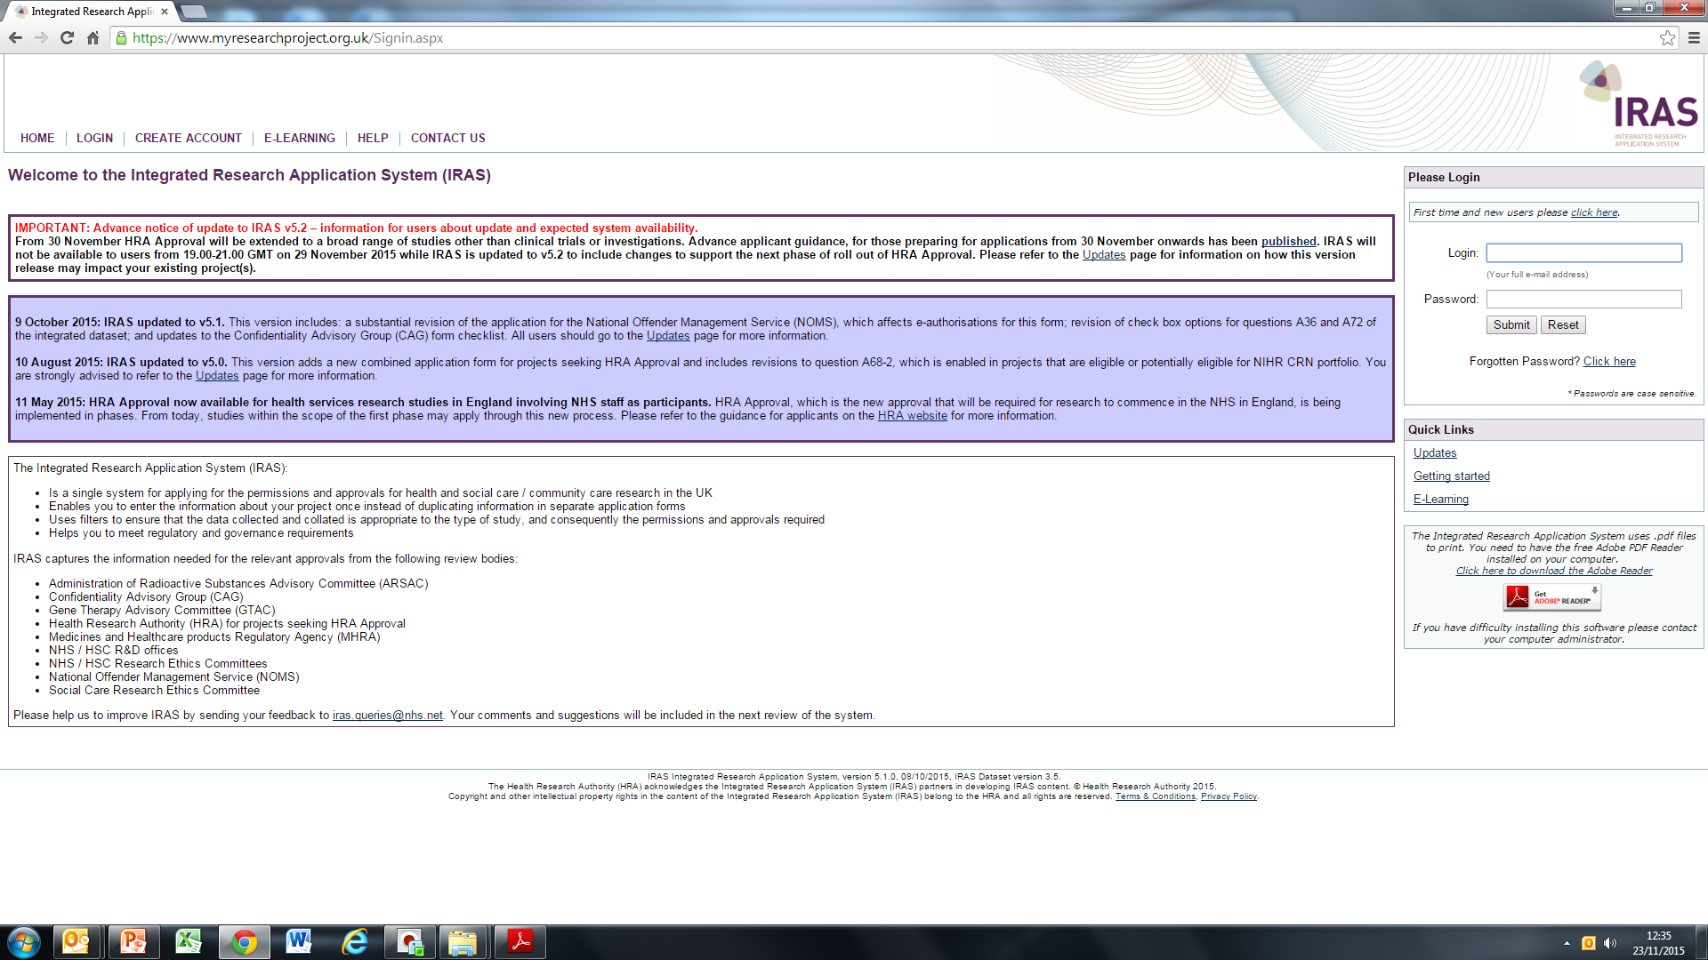

Slide 32
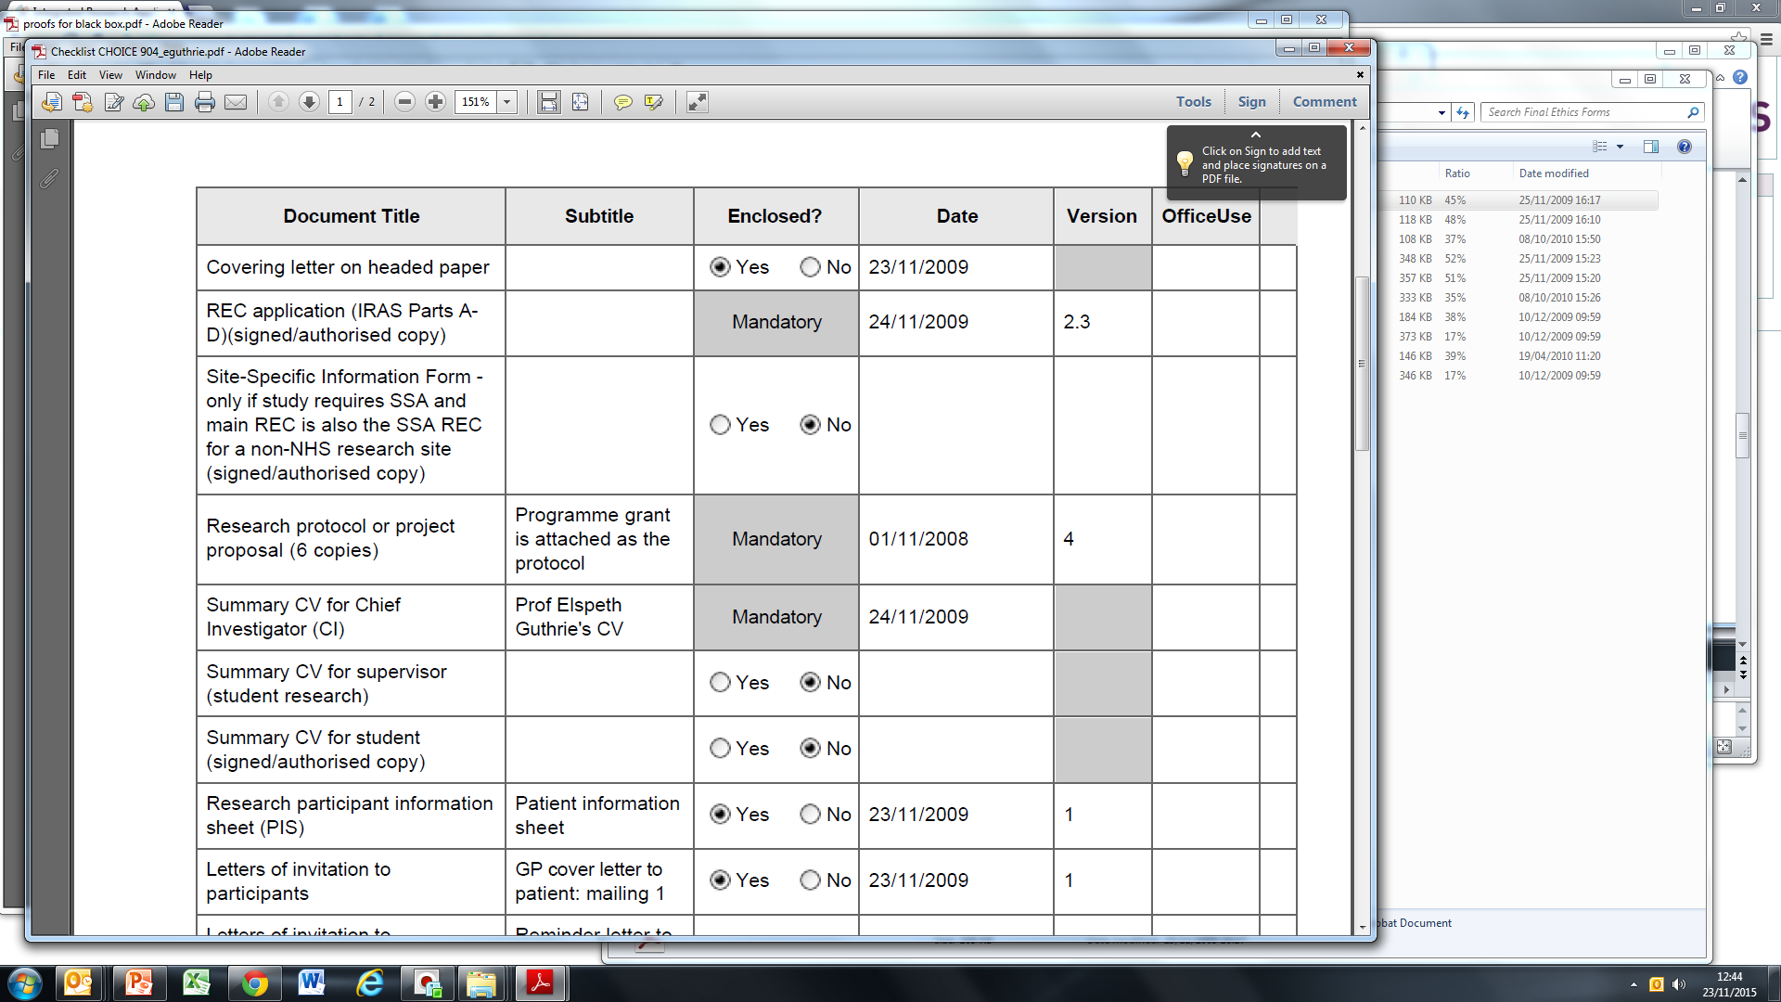
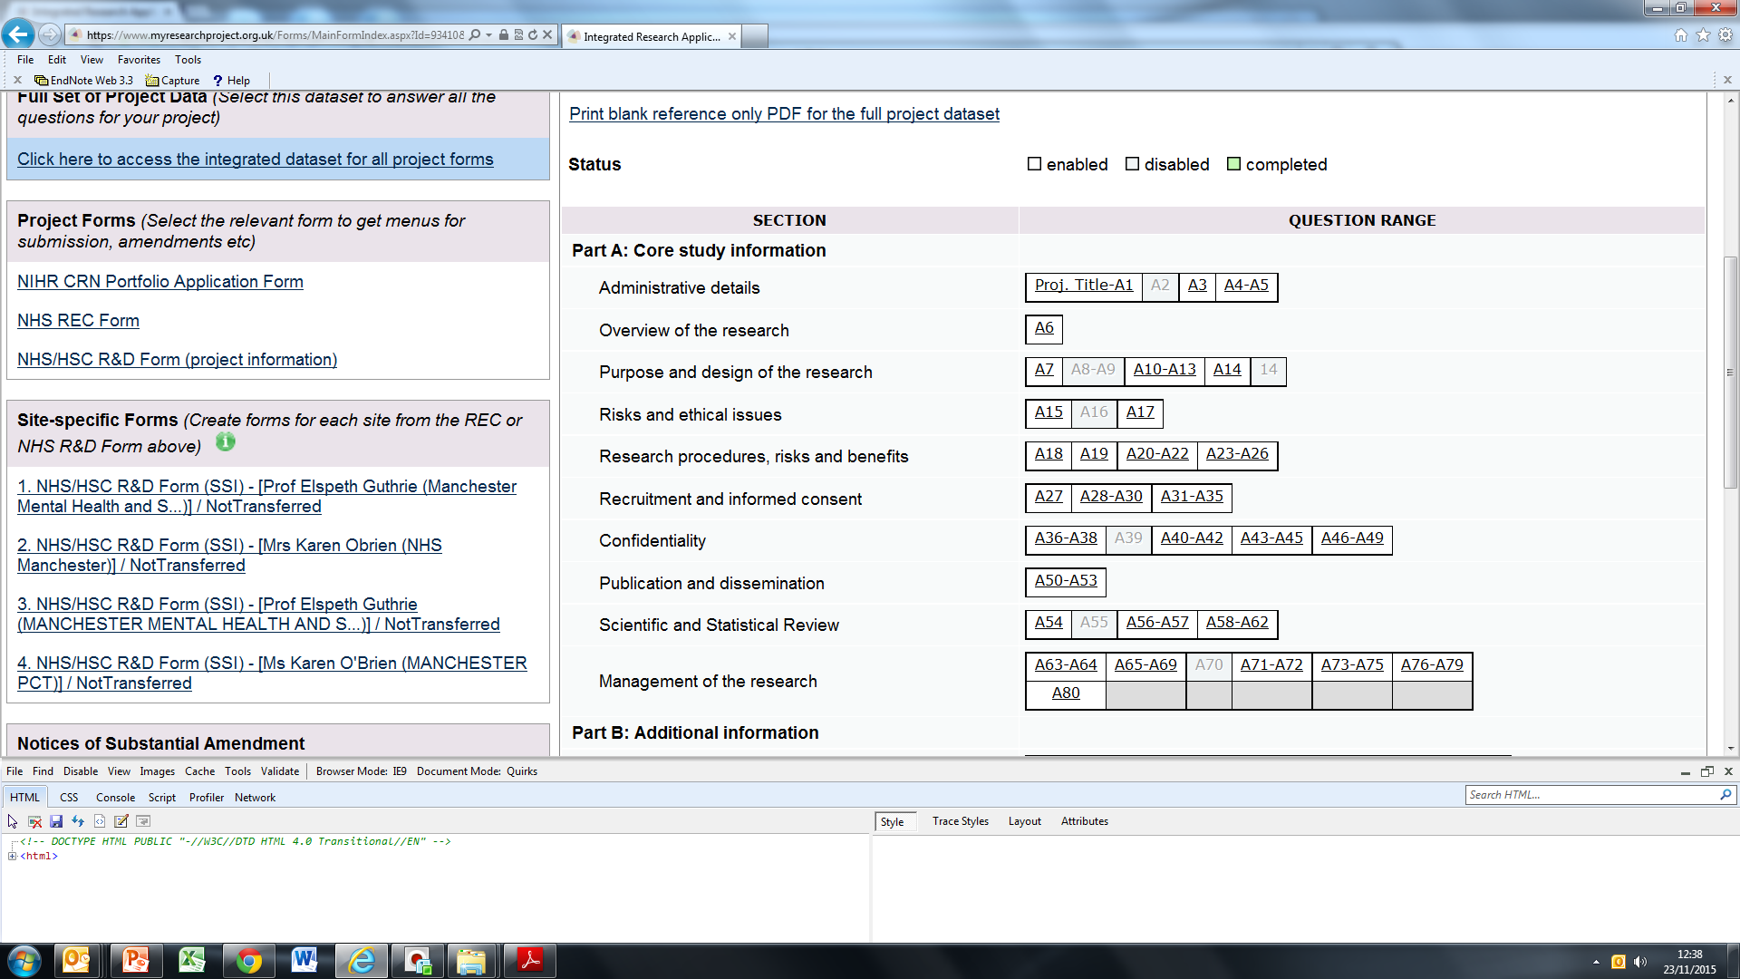

Slide 33
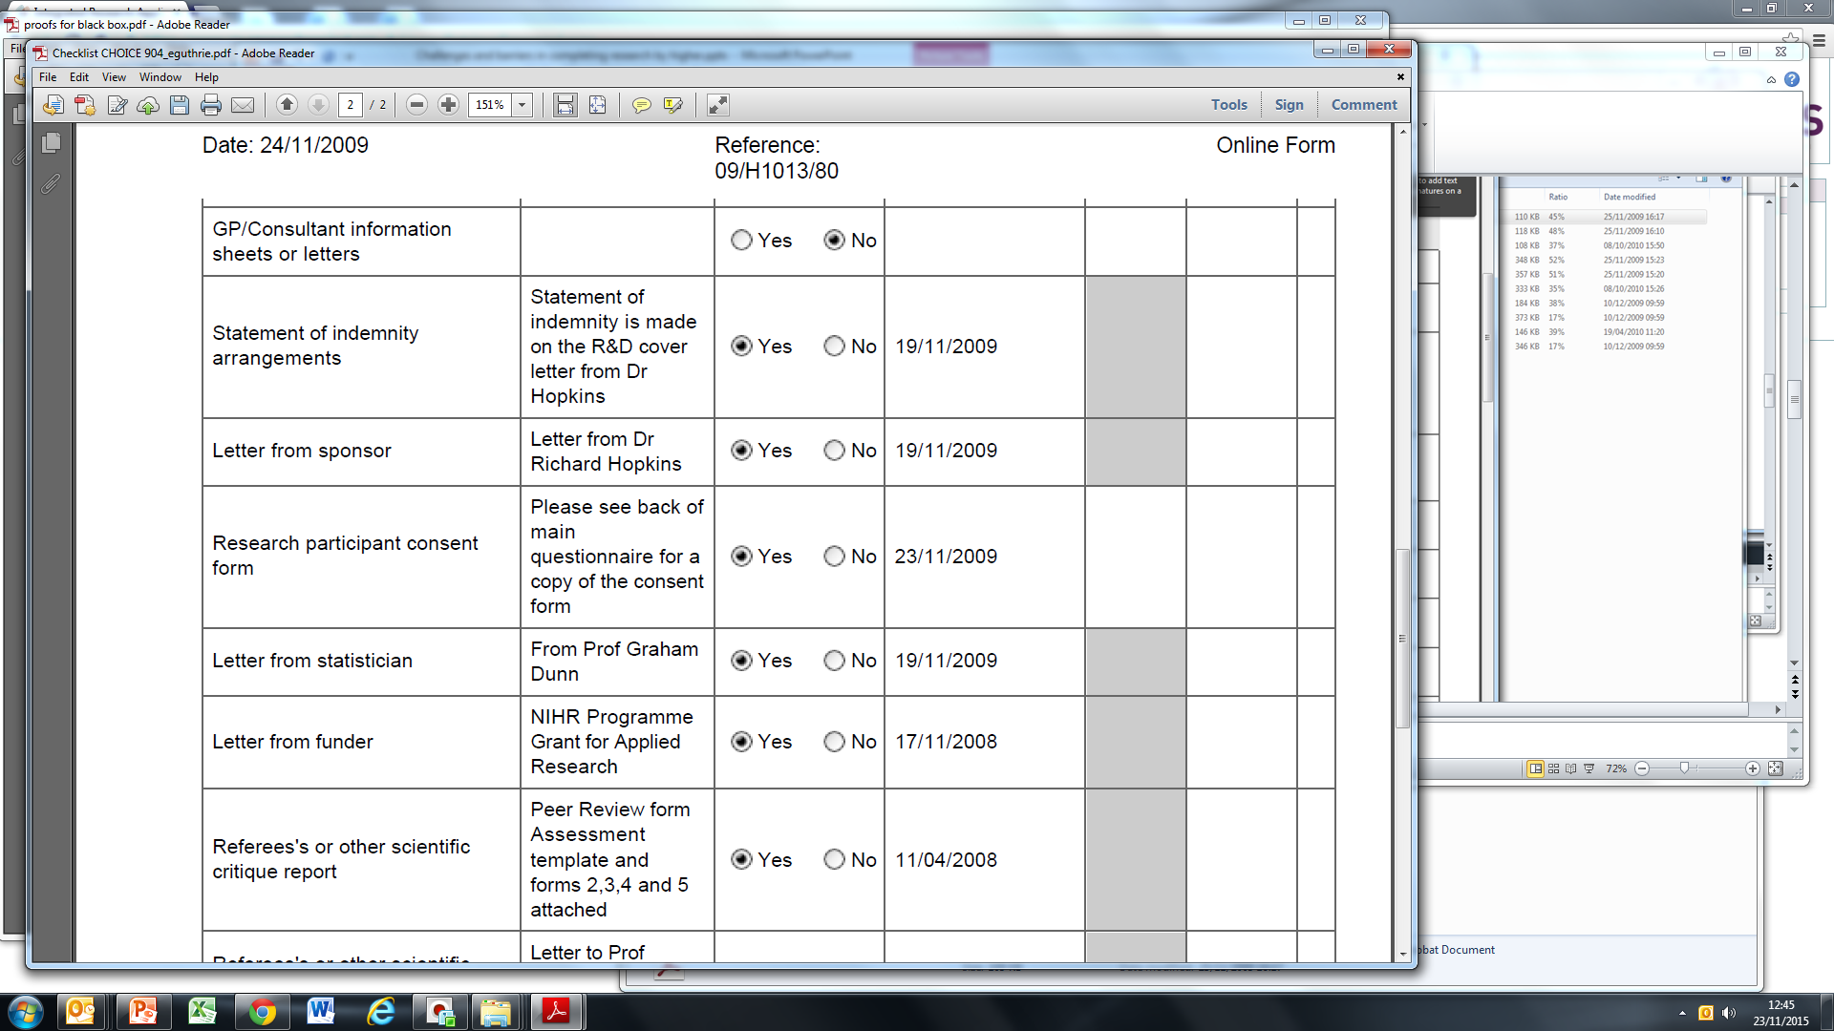

Slide 34
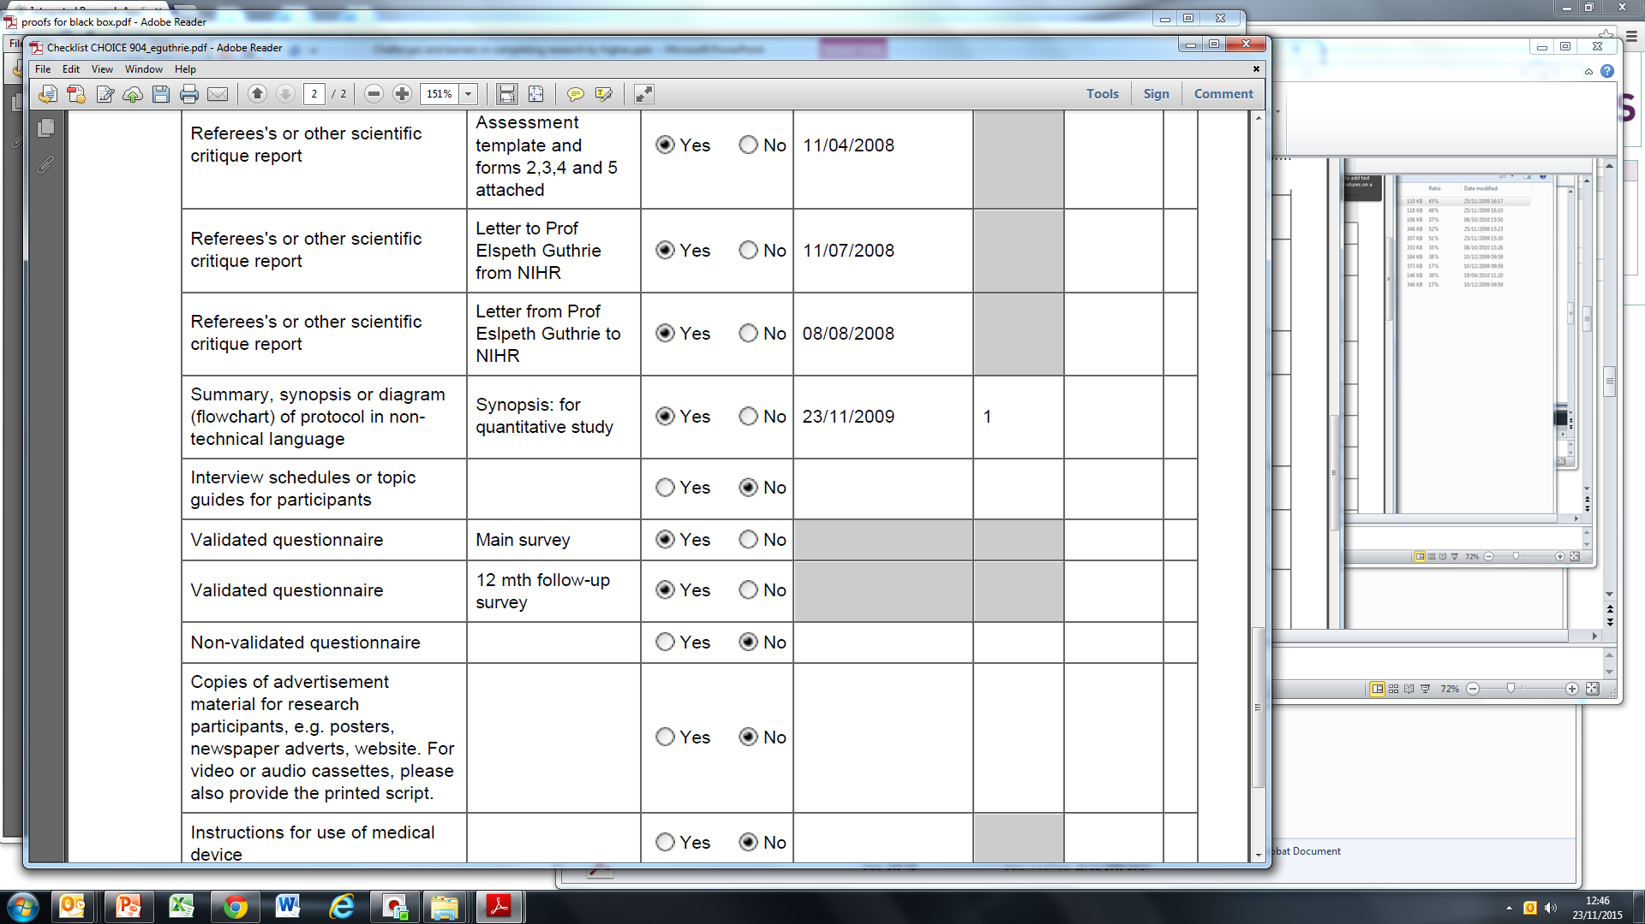

Slide 35
Biggest problem with trainee’ projects is a failure to complete

Slide 36
Solutions
Tack onto a bigger study with a recognised researcher
Ownership of a specific part of the study
Experience in carrying out research
Authorship of paper
Supervisor more important than actual project: research is an apprenticeship so need good role model

Slide 37
Summary
Many barriers to conducting research
Requires flexibility and opportunistic attitude
Starting a stand alone project from scratch and bringing it to fruition with acceptable methodology is a challenge
Tack onto to larger project
Work in a team
Supplement experience with research methods course
Case reports with a high quality discussion and reviews may be more clinically relevant, more feasible and more worthwhile.
Psychosomatics publishes really excellent case reports of a very high standard.

Slide 39
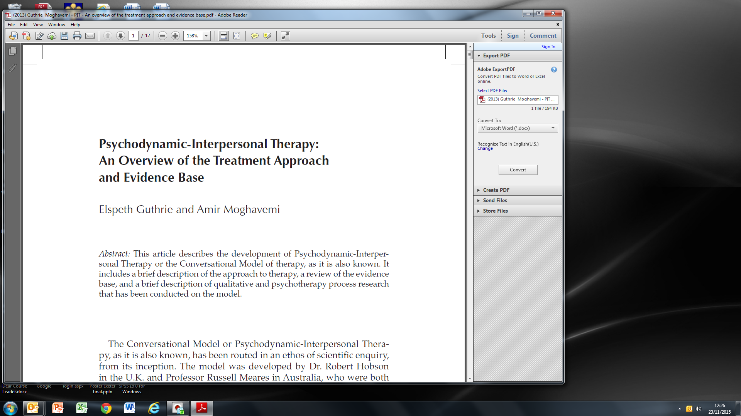

Slide 40
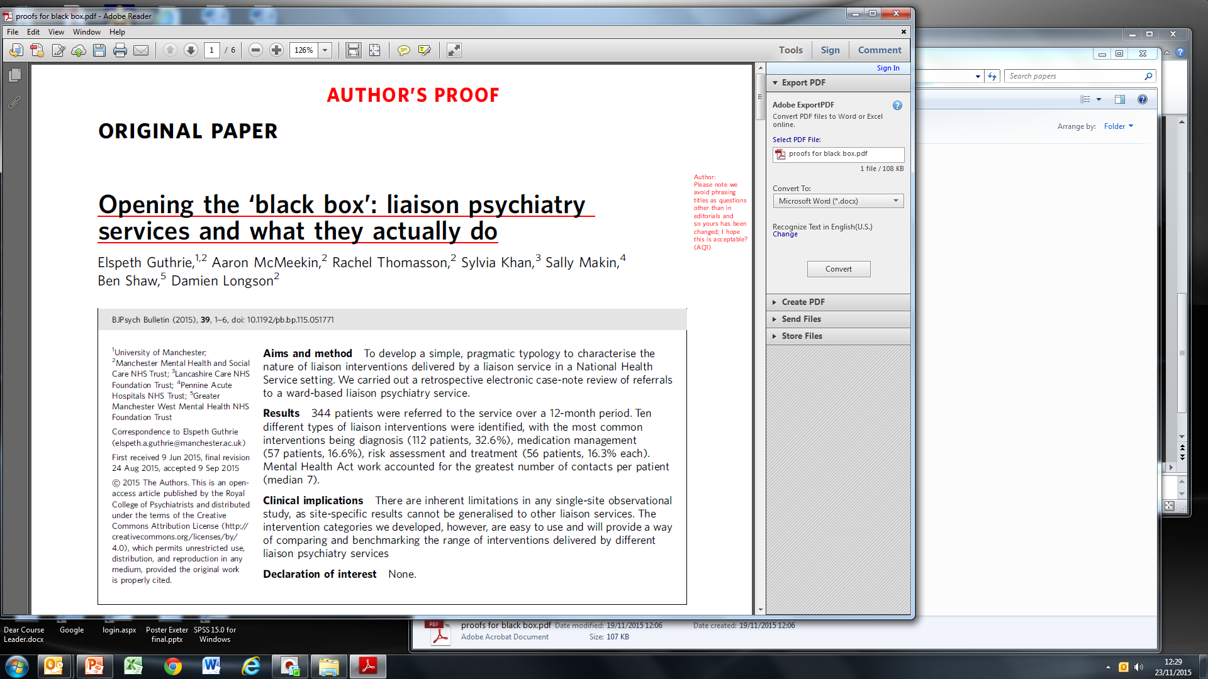

Slide 41
Intervention | Definitions
Diagnosis | Joint working with medical or surgical teams to establish a diagnosis following uncertainty regarding symptom presentation
Risk Assessment | The assessment and judgement of an individual’s immediate risk of self harm or harm to others. The assessment is usually followed by a management plan.
Medication Management | Consultation about psychotropic medication which requires stopping, restarting, switching or adjusting because of physical health problems. Such decisions entail expert knowledge re use of psychotropic drugs in the medically ill.
Treatment | The starting or continuation of a treatment for a diagnosed mental health problem.
Management of Disturbed Behaviour | The active management of a patient with disturbed behaviour as a consequence of some form of mental health problem, whilst in the general hospital setting.
Mental Heath Act | The use of the MHA⁴ in the general hospital setting, to detain an individual for assessment or treatment of their mental health problems.
Capacity | The assessment of capacity to consent to a therapeutic procedure, or post-discharge placement, or ability to self-discharge.
Signposting | The individual is given information about other relevant statutory or non-statutory agencies, or referred to another service by a liaison team member.
Guidance/Advice | Verbal or written guidance or advice provided by the liaison team about common psychological problems, lifestyle changes or alcohol consumption, etc.
Brief Psychological Interventions | The treatment of an individual’s mental health or psychological problems using a brief psychological intervention.

Slide 42
Methods
Retrospective case note review of 344 referrals to the C/L service over a 12 month period.
Age, gender, medical diagnosis, number of contacts, duration of time under C/L care, psychiatric diagnosis.
Each patient was assigned to one of the ten intervention categories.
Basic statistical analyses using non-parametric statistics were used for main comparisons.

Slide 43
Number of referrals and workload of the service according to the principal intervention categories
Type of Intervention | Referrals n % | Contacts n % | Contacts freq Med (IQR) | Duration (dys) Med (IQR)
Diagnosis | 112 33 | 316 25 | 2 (1 to 3) | 3 (1 to 8)
Risk Assessment | 56 16 | 139 11 | 1 (1 to 2) | 1 (1 to 7)
Medication Management | 57 17 | 208 17 | 3 (1 to 5) | 6 (1 to 14)
Treatment | 56 16 | 20 | 3 (1 to 6) | 7 (1 to 21)
Management of disturbed behaviour | 28 8 | 105 8 | 2 (1 to 5) | 5 (1 to 9)
Mental Health Act | 23 7 | 230 18 | 7 (3 to 12) | 14 (6 to 30)
Capacity | 8 2 | 10 1 | 1 (1 to 2) | 1 (1 to 6)
No engagement | 4 1 | 6 <1 | 1 (1 to 1) | 1 (1 to 10)
Signposting | -
Guidance/advice | -
Psychological Rx | -
Total | 344 | 1259 | 2 (1 to 5) | 4 (1 to 13)

Slide 44
Intervention | Case Examples
Diagnosis | 18 year female. Admitted for tonsillectomy. Developed ‘fits’ post surgery ward round. NEAD. Nature of symptoms explained, patient engaged with psychosocial formulation. Referred for out-patient psychological treatment.
Risk Assessment | 62 year old man. Lacerated throat with box cutter. Severe trauma to neck requiring tracheostomy and later PEG. Ongoing risk assessment whilst on surgical ward with initiation of treatment and discharge to home treatment team when medically fit.
Medication Management | 55 year old man with schizophrenia. Admitted to ITU with severe chest infection. Noted to have ejection fraction of 30%. Clozapine stopped. As physical condition improved, cardiac output improved and after discussion with patient, clozapine was restarted 5 days later (dose gradually titrated back to therapeutic levels).
Treatment | 63 year man. Admitted with weight loss and confusion and weakness. Psychotic depression. Treatment with neuroleptics and antidepressants started immediately. Safe re-feeding. Discharged to home treatment team 2 weeks later.
Management of disturbed behaviour | 49 year old man. Repeated self laceration whilst on medical ward. Admitted for control of epilepsy. Personality difficulties. Liaison team worked with ward staff to de-escalate his behaviour and plan safe discharge with appropriate follow-up.
Mental Health Act | 45 year old woman admitted with confusion, but condition developed into hypomania, dancing, singing and taking clothes off. Detained under MHA.
Capacity | 54 year old with schizophrenia. Renal failure. Refusing dialysis as believed he was Christ and would be resurrected. Determined not to have capacity and liaison worked with renal team to treat his psychosis at the same time as delivering dialysis.

Slide 45
Discussion
Relatively little previous work which has addressed what liaison services actually do.
By using the typology it is possible to easily describe a service.

Slide 46
What proportion of patients referred to a liaison service need to be seen by a psychiatrist, as opposed to any other member of the liaison team?
Dr Aaron McMeekin
Dr Sylvia Khan
Dr Sally Makin
Dr Ben Shaw
Professor Damien Longson
Professor Else Guthrie

Slide 47
Method
Development of ‘psychiatrist’ criteria
Employment of Mental Health Act
Existing Psychotropic Medication management
Commencing Psychotropic medication
Diagnosis requiring medical expertise
Behavioural disturbance requiring medication advice
Complex capacity assessments
Specific request for psychiatric opinion
Notes:
Mental Health Act – Situations where the Mental Health Act has been applied or its potential use has been seriously considered
Medication Management - Consultation in which there was a specific issue about psychotropic medication the patient was taking due to a change in their physical health. This may involve stopping, switching or another action.
Management of Behavioural Disturbance in the general hospital – Involving advice about medication, where a psychiatrist has provided assessment, advice and guidance about using sedating medication. The psychiatrist will have considered the patient’s underlying physical health problems (e.g. renal failure) in making the decision regarding type and dosage of medication. Other non-pharmacological aspects for management of acute behavioural disturbance in physically unwell patients are not considered here, as they are not exclusively carried out by liaison psychiatrists.
Diagnosis - Diagnosis or understanding of a clinical problem which required medical knowledge of organic psycho-syndromes and /or a complex presentation of psychogenic/ factitious disorders.
Capacity - Requests for complex capacity assessments, where the patient has a history of a mental health condition which may be interfering with their judgment to give informed consent to treatment (usually involving a life saving treatment).
Treatment with Psychotropics commenced in the general hospital – Treatment with a psychotropic agent that was commenced in the general hospital by the liaison team, in a patient who had ongoing physical health concerns
Specific Request for Consultant Liaison Psychiatric Opinion – The referring consultant specifically requested a consultant psychiatric opinion or involvement

Slide 48
Results
Type of Clinical Problem | Referrals Number (%) | Face to Face Number (%) | Face to Face Mean Median (IQR) | Time in contact with service (Days) Mean Median (IQR)
Requires Psychiatrist | 241 (70.1) | 1039 (82.5) | 4.3 2 (1 to 5) | 13.2 7 (1 to 14)
Does NOT require Psychiatrist | 103 (29.9) | 220 (17.5%) | 2.2 1 (1 to 2) | 5.1 1 (1 to 7)
Total | 344 | 1259 | 3.7 2 (1 to 5) | 10.8 4 (1 to 13)

Slide 49
Development of a generic outcome measure for liaison psychiatry
Mathew Harrison
Shazada Nawaz
Seri Abraham
Peter Kelsall

Slide 50
Development of measure
Face validity
Concurrent validity
Inter-rater reliability
Test-re-test
Ability to show change
Feasibility/practicality

Slide 51
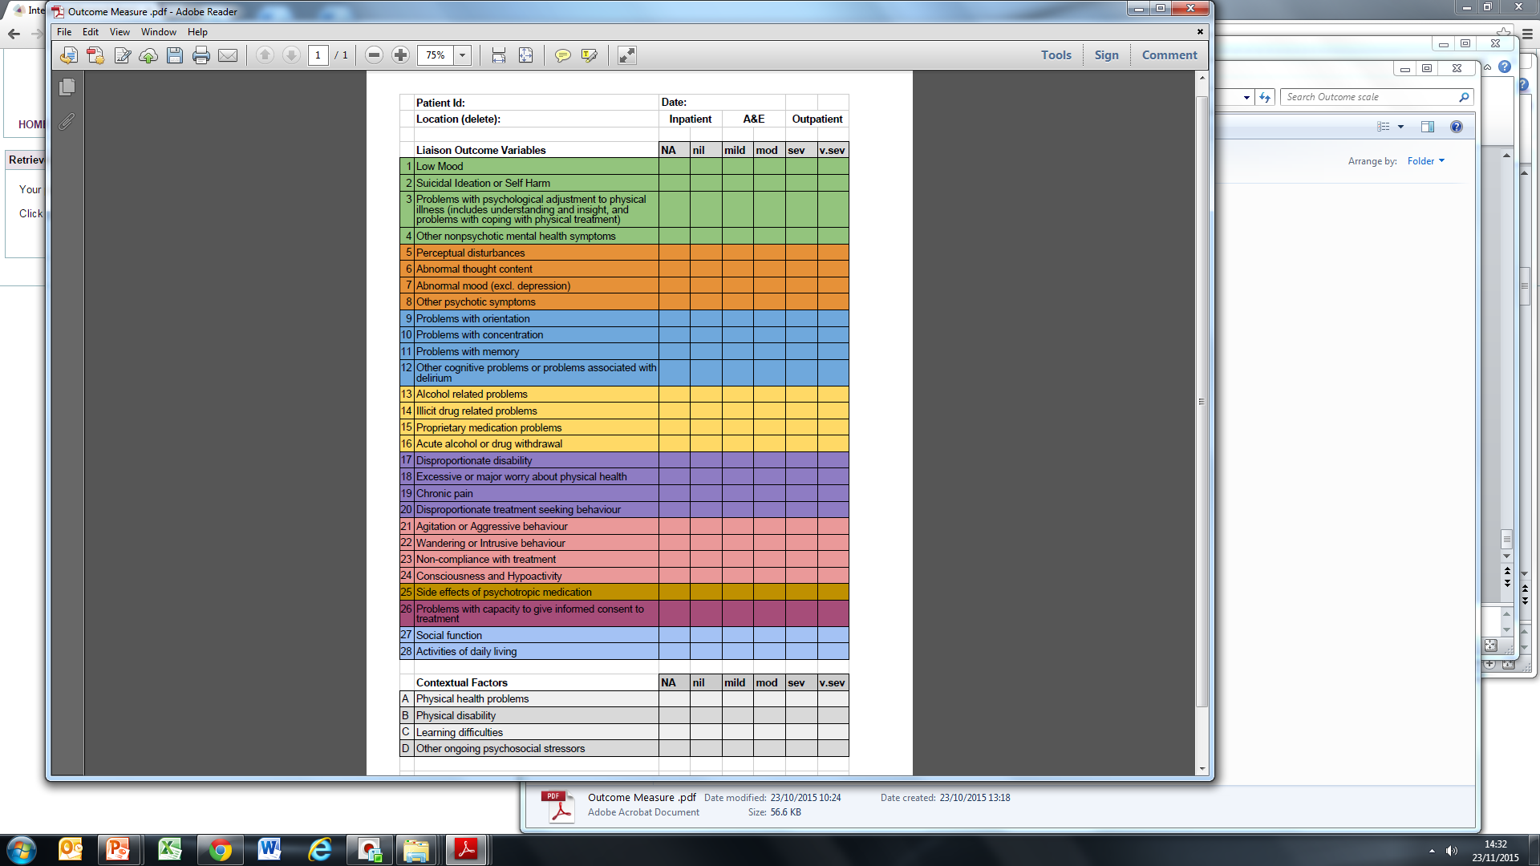

Slide 52
Summary
Rate limiting steps are probably:
supervision
Time available
Governance demands
e.a.guthrie@leeds.ac.uk

