Slide 1
Curriculum Overview ACCS & Anaesthesia
Dr Phil Bonnett (South TPD)
Notes:
Welcome I’m Phil Bonnett south tpd prev accs and core but I’ve just moved to looking after the registrars
This is a curriculum overview to set the scene. We’ve then get break out rooms which will add a bit more detail and support.
The last two of these I’ve done have been virtual It’s so nice to see everyone in person.
The program isn’t overly full so there will be plenty of time to chat and catch up.

Slide 2
Notes:
First of all the accs curiclulum if you are core you can switch your brain off or feel smug that you don’t need to do any of this

Slide 3
ACCS
2 years
6mths Acute Medicine
6mths Emergency Medicine
6mths ICM
6 mths Anaesthesia

Slide 4
Notes:
8 clinical
3 non- clinical

Slide 5
Notes:
New for both the anaestheitc and accs curriculum that supervised learning events habve an entrustment scale.
Which is to do with supervison
The caveate is though which CS’s are still getting to grips with is that it is if you were to do the procedure again in the same situation what we your supervision be

Slide 6
Notes:
LO 1,2 & 4 should have been achieved by the end of ACCS CT1
LO 7 EPA 1 and 2 plus a HALO in Sedation
LO 8 ICM
LO 3, 6, 9, 10, 11 may well need signing by ES at the end of CT2.

Slide 7
Trainer Reports
MTR: Multiple Trainer Report (RCoA)
MCR: Multiple Consultant Report (FICM)
FEGS: Faculty Educational Governance Statement (EM)

Slide 9
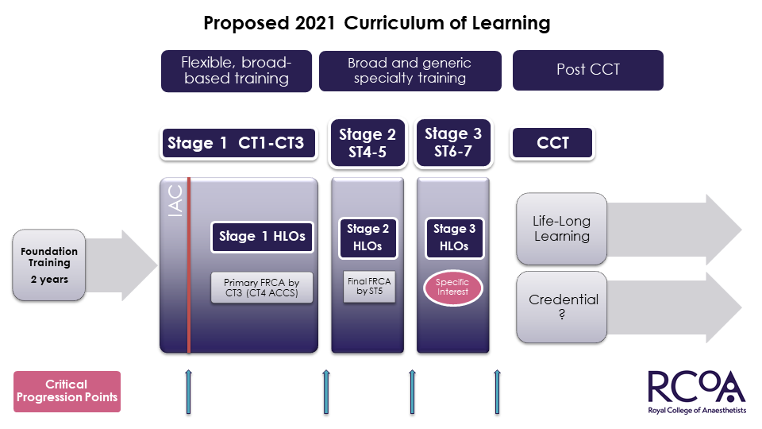
Notes:
Remains 7 year program
3 year to achieve primary FRCA, thus reducing massively the number of extensions at CT level
Final by end of ST5
Stages 1, 2 and 3
HALOs

Slide 10
Stage 1 Domains
Professional Domains
Professional Behaviors
Management
Teamworking
QI & Safety
Safeguarding
Teaching
Research
Clinical Domains
Peri-Op Medicine
General Anesthesia
Regional Anesthesia
Resuscitation and Transfer
Sedation
Pain
ICM
Notes:
Curriculum moving away from a surgical specialty based approach to broader aspects
14 Domains running throughout the curriculum
7 professional domains born from GPCs
7 Clinical domains, obviously not all of equal size

Slide 11
Notes:
New for 2021
Entrustable professional activivties
Moviung away from tick boxes to a sign off which is really about are ready to work more indepenantly and that is where the supervison levels come in.

Slide 12
Now Coffee
Afterwards break out rooms …
ACCS CT 1 – Main room
ACCS CT 2-
Core CT1 and ACF -

