Slide 1
OPPORTUNITIES IN NORTH/EAST yORKSHIRE
Dan Greenwood
Trainee Rep for ACCS/Core

Slide 2
Your trainee reps!
Dan
ACCS CT4
Worked in Scarborough, Hull and York
Daniel.greenwood@doctors.org.uk
07969744772
Claudia
ACCS CT4
Worked in Hull, NLAG
Claudia.dyball@nhs.net
07748546059

Slide 3
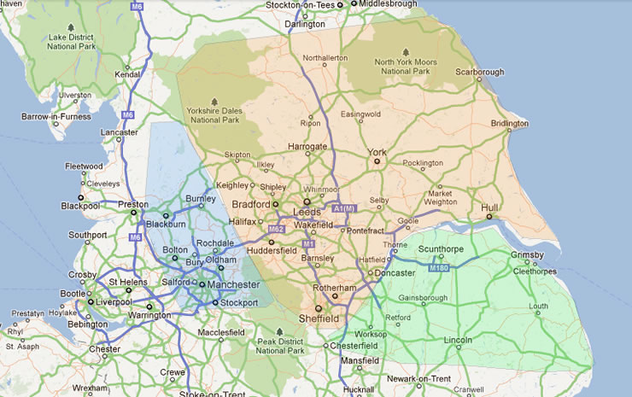
The region
Notes:
Colour coding if you want warm air heating specialist in the north of england

Slide 4
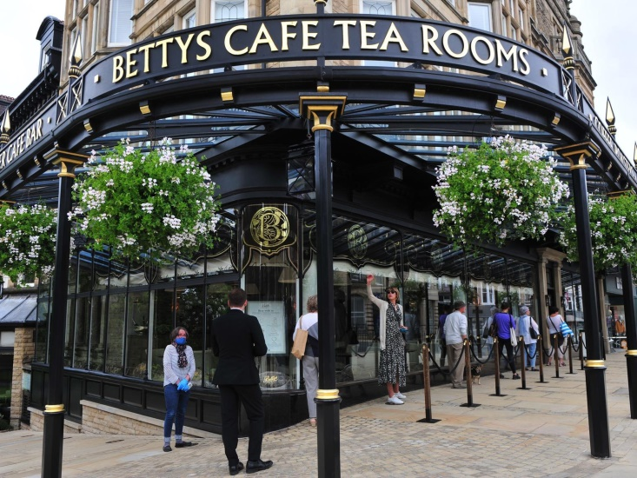
harrogate
ACCS CT1
Good Access
Positive feedback from trainees
Teaching opporunities
Friendly maternity department

Slide 5
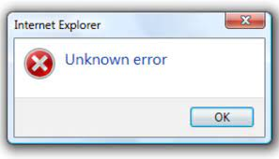
(nlag) scunthorpe and grimsby
Active journal club
Simulation
Opportunity for solo working
Transfers
Examiners
YGAS

Slide 6
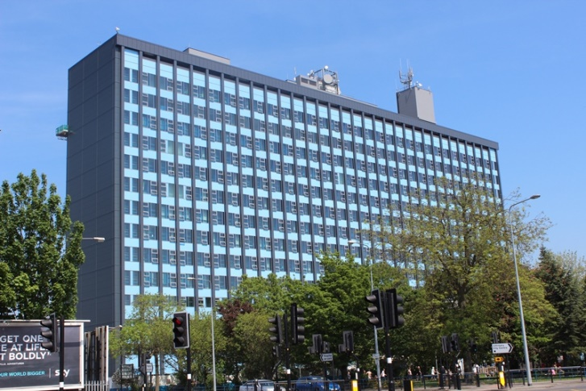
HUll
Multiple disciplines
Obstetrics
MTC/ED
HILS
Sim Fellowship
ITU
(Former) City of Culture

Slide 7
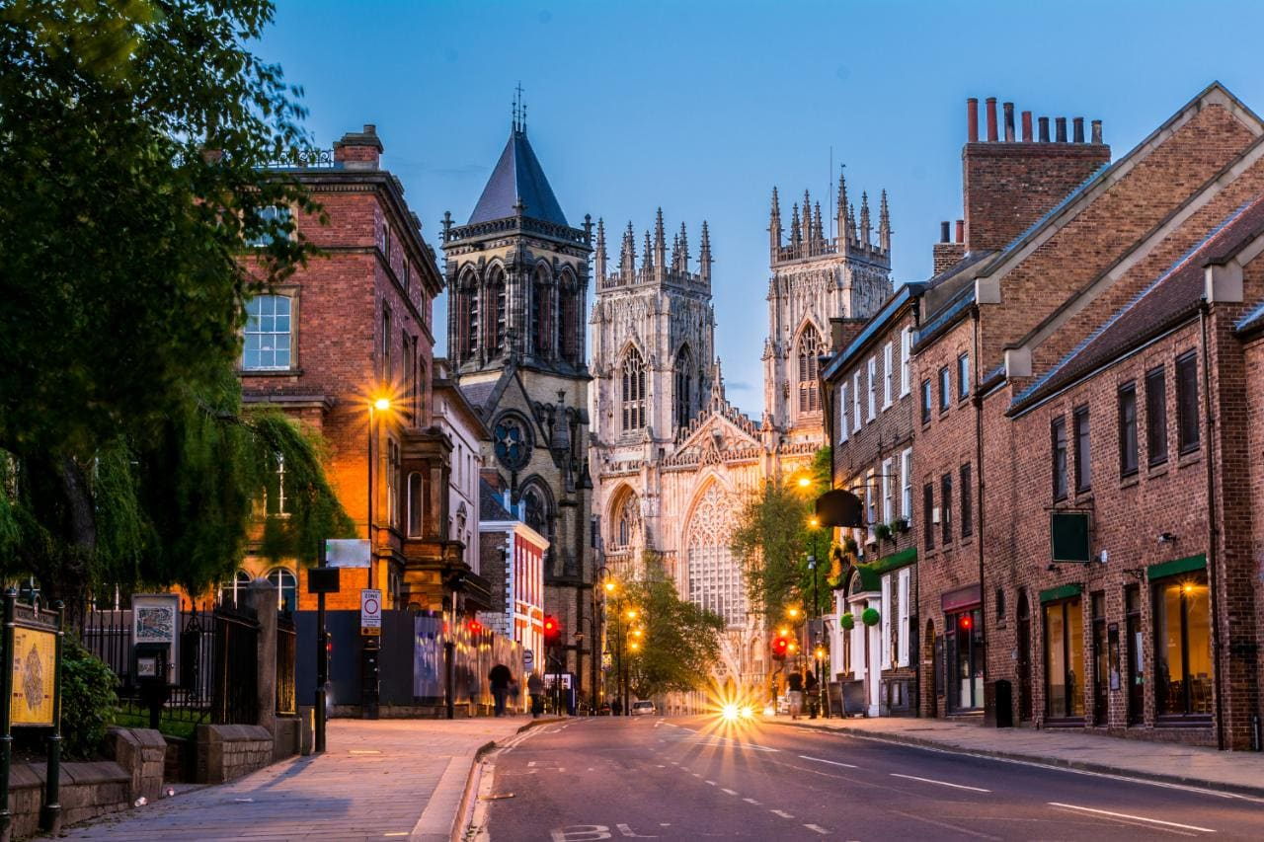
YORK
Balanced
Peri-op
CPEX
New ED
Cohesive Anaesthetic department
(YACC) + pizza

Slide 8
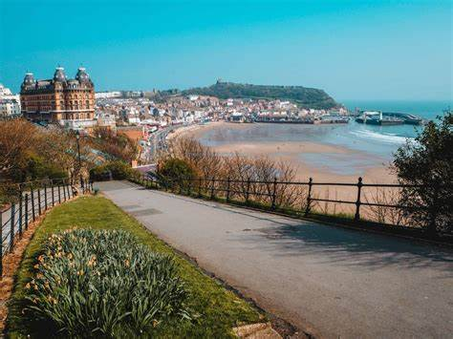
SCARBOROUGH
Small, supportive team
Medicine
Transfers
True DGH work
Location, location, location!

Slide 9
North/east yorkshire
Trainee conference
Numerous FRCA courses
Trainee network
East York Gas trainees whatsapp group
Well-being day
Trainee Reps

Slide 10
Questions?

Slide 11
ta

Slide 12
Your trainee reps!
Dan
ACCS CT4
Worked in Scarborough, Hull and York
Daniel.greenwood@doctors.org.uk
07969744772
Claudia
ACCS CT4
Worked in Hull, NLAG
Claudia.dyball@nhs.net
07748546059

