Slide 1
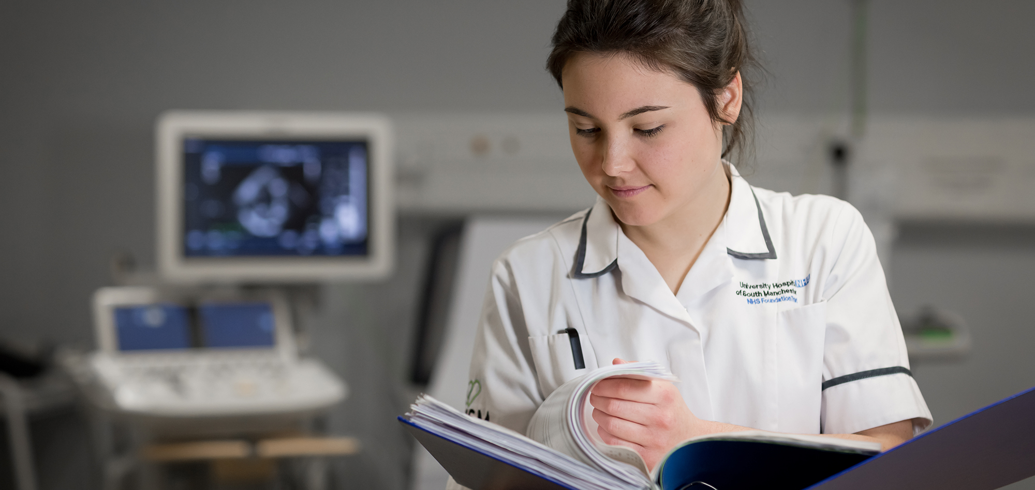
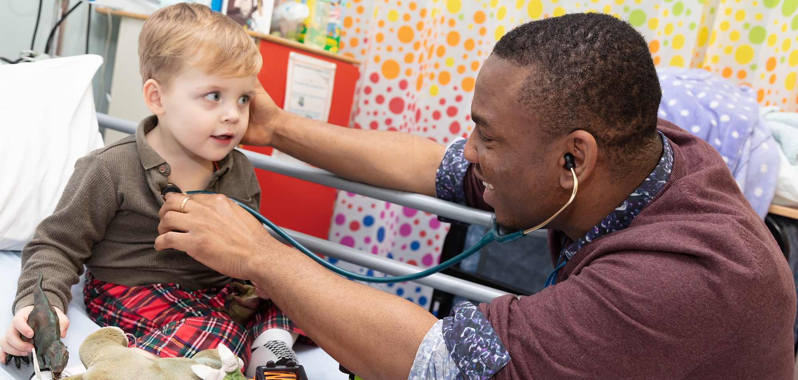
Advice, appraisal and assessment

Slide 2
Advice Appraisal

Slide 3
Assessment

Slide 4
Getting Advice & Guidance

Slide 5
Getting Advice & Guidance
Royal Colleges
HEE YH
Associate Deans
Specialty Training Committee
Director of Medical Education
College Tutors
Clinical Supervisors
Educational Supervisors
Postgraduate Education Manager
Medical Personnel Department
Mentors

Slide 6
The Royal Colleges
CCT / regulations
Curriculum
Assessments
Exams

Slide 7
HEE YH
Training Posts
Trainers
Structure
http://www.yorksandhumberdeanery.nhs.uk/

Slide 8
Associate Deans
Associate Deans work part time for HEE YH.
They have special areas of responsibility, as described on the HEE YH website.
There is an Associate Dean with responsibility for each specialty e.g. GP.
You will not have much personal contact with them. (Unless you need advice on something specific e.g. "Less Than Full Time Training”)

Slide 9
Speciality Training Committee
Oversee training in speciality – ST1 to CCT
Oversee Assessment in speciality
Includes Training Programme Directors (TPDs)

Slide 10
Director of Medical Education
Postgraduate Education Centres in each Trust
Overview of training in Trust
Organise Programmes
Career advice & counselling

Slide 11
College Tutors
Specialist representatives of Royal Colleges
In the workplace / Trust
Oversight of programmes
Career advice & counselling
Quality assurance
May also be DME
Link between Trusts and Colleges

Slide 12
Clinical Supervisors
Local representative of HEE YH
In the workplace / Trust
Responsible for programmes and training
Career advice & counselling

Slide 13
Educational Supervisors
Appraisal - confidential
- developmental
- what do you need?
Assessment - open
- external
- how good are you?
- are you ready to progress?

Slide 14
Appraisal
Identify needs
Set goals
Review progress
Feedback
Plan for future

Slide 15
Postgraduate Education Manager
Runs postgraduate centre
Administers study leave
Good starting point for advice

Slide 16
Medical Personnel Department
Trust employment process
Looking after employees

Slide 17
Mentors
In HEE YH there is at least one mentor in each Trust
Senior doctors available to help overseas doctors

Slide 18
Other useful contacts:
British Medical Association (trade union)
Defence Societies
General Practitioner (personal health)
Occupational Health
Confidential Counselling (“Take Time”)

Slide 19
Get your advice from the right person
Clearly it is important to go to the right resource to get advice and guidance.
Most important and relevant information is available online and you should take time to locate the most important websites e.g. your College, HEE YH and Trust websites.
Get to know the staff in your education centre. Above all treat them with respect – they can do a lot to make your life easier if you relate to them properly.

Slide 20
Get your advice from the right person
If you want to know about GMC registration, then ask the GMC
If you want to know about prospects in a particular specialty, then speak to the relevant College Tutor or Regional Advisor
If you want to know about your contract, then speak to Medical Staffing Dept. of your employer
Be wary of advice from your friends and relatives
Make sure your decisions are based on accurate information
Use your appraisals for discussion about what you should do

Slide 21
The end? Any questions?

