Slide 1
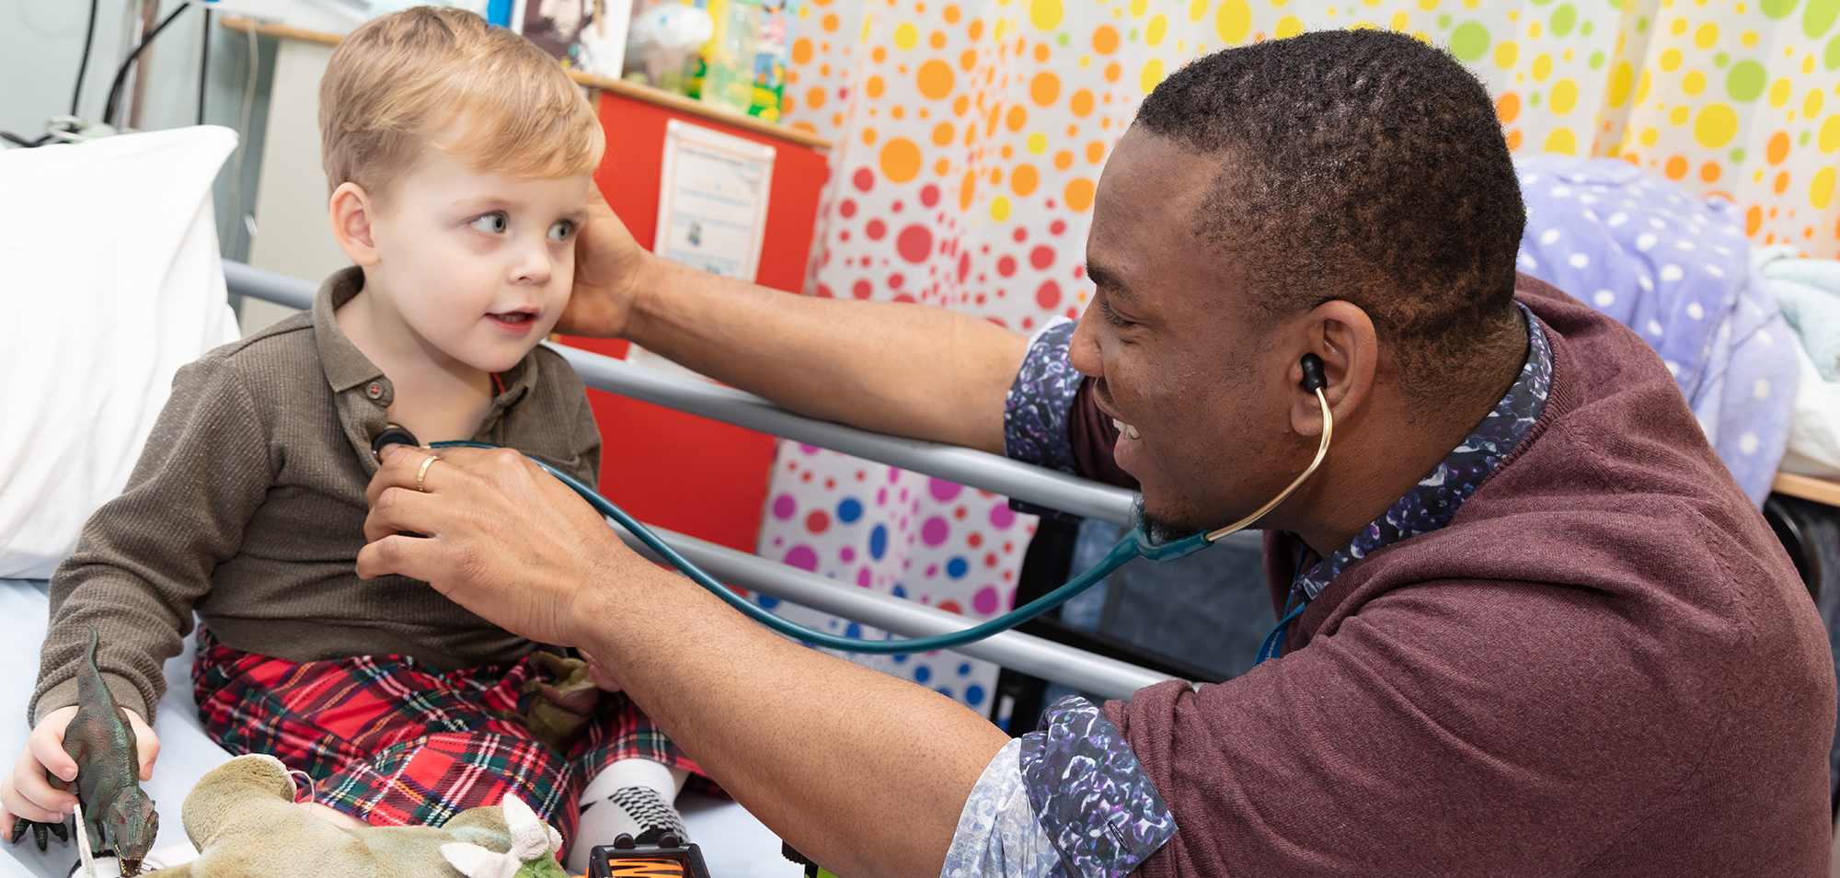
Clinical Incidents & Complaints

Slide 2
Learning Objectives
Be able to recognise and react correctly to a clinical incident
Understand why patients/families complain
Know ways to behave which can reduce the risk of provoking a complaint
Be able to recognise adverse events and complaints as a source of learning

Slide 3
Questions for you to reflect on:
What is a clinical incident ?
What should you do ?
Who should you tell ?

Slide 4
Definition
Clinical Incident: a situation or event causing potential or actual harm to the patient or staff.
Diagnosis
Investigations
Treatment planning
Prescribing
Clinical Procedures
Record keeping
Failure of team working

Slide 5
Who to tell?
Ward sister/matron
Ward registrar
Consultant
Enter on Trust reporting system e.g. ‘DATIX’ in Hull

Slide 6
What happens to clinical incident reports ?
The Trust clinical governance department collates them into categories and severity.
Departmental governance leads review all their own reports and investigate/feedback. Becomes part of departmental internal governance and learning.
The most serious (involving serious injury or death) are called Serious Incidents (SI), and move onto a much higher level of reporting and investigation.

Slide 7
Complaints
Why do patients/relatives complain?
What do Trusts do with complaints?
How can we avoid them?

Slide 8
Why do patients complain?
Bereavement reaction
Denial / Anger / Grief / Acceptance
‘I don’t know what happened’
‘Why did it go wrong?’
‘It went wrong – someone must be blamed”

Slide 9
What do Trusts do with complaints?
Early meeting, not letters
Senior clinicians
Openness

Slide 10
How can we avoid them?
Anticipate when a problem may be arising
Address patient concerns early
Avoid mis-communication
Involve senior staff
Involve PALS (Hull) or equivalent Patient Advocacy Liaison Service)

Slide 11
“Information from complaints is
under-exploited as a learning resource”

Slide 12
Have you achieved the learning objectives?
Final Assessment
What do you think you have learned?
What are you going to study further?
What could be done to improve this module?

