Slide 1



End of Life Issues: Organisation of Palliative Care in the UK

Slide 2
History
1905 St Joseph’s Hospice, London
1967 St. Christopher’s Hospice, London, Dame Cicely Saunders
1987 Palliative Medicine as a specialty
+ 200 hospices in the UK
Each hospital should have the input of a palliative care specialist

Slide 3
Main areas of
Palliative Care
Hospices (free standing, day care, clinics)
Hospitals (consultations by nurses and doctors, clinics)
Community (consultations by Macmillan Nurses)

Slide 4
Palliative Care is the integration of:
Physical
Psychological
Social
Spiritual

Slide 5
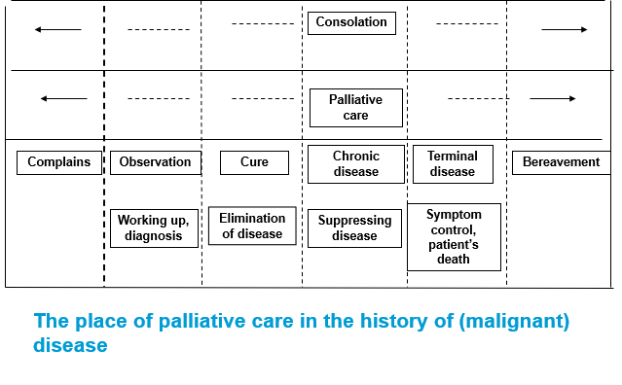

Slide 6
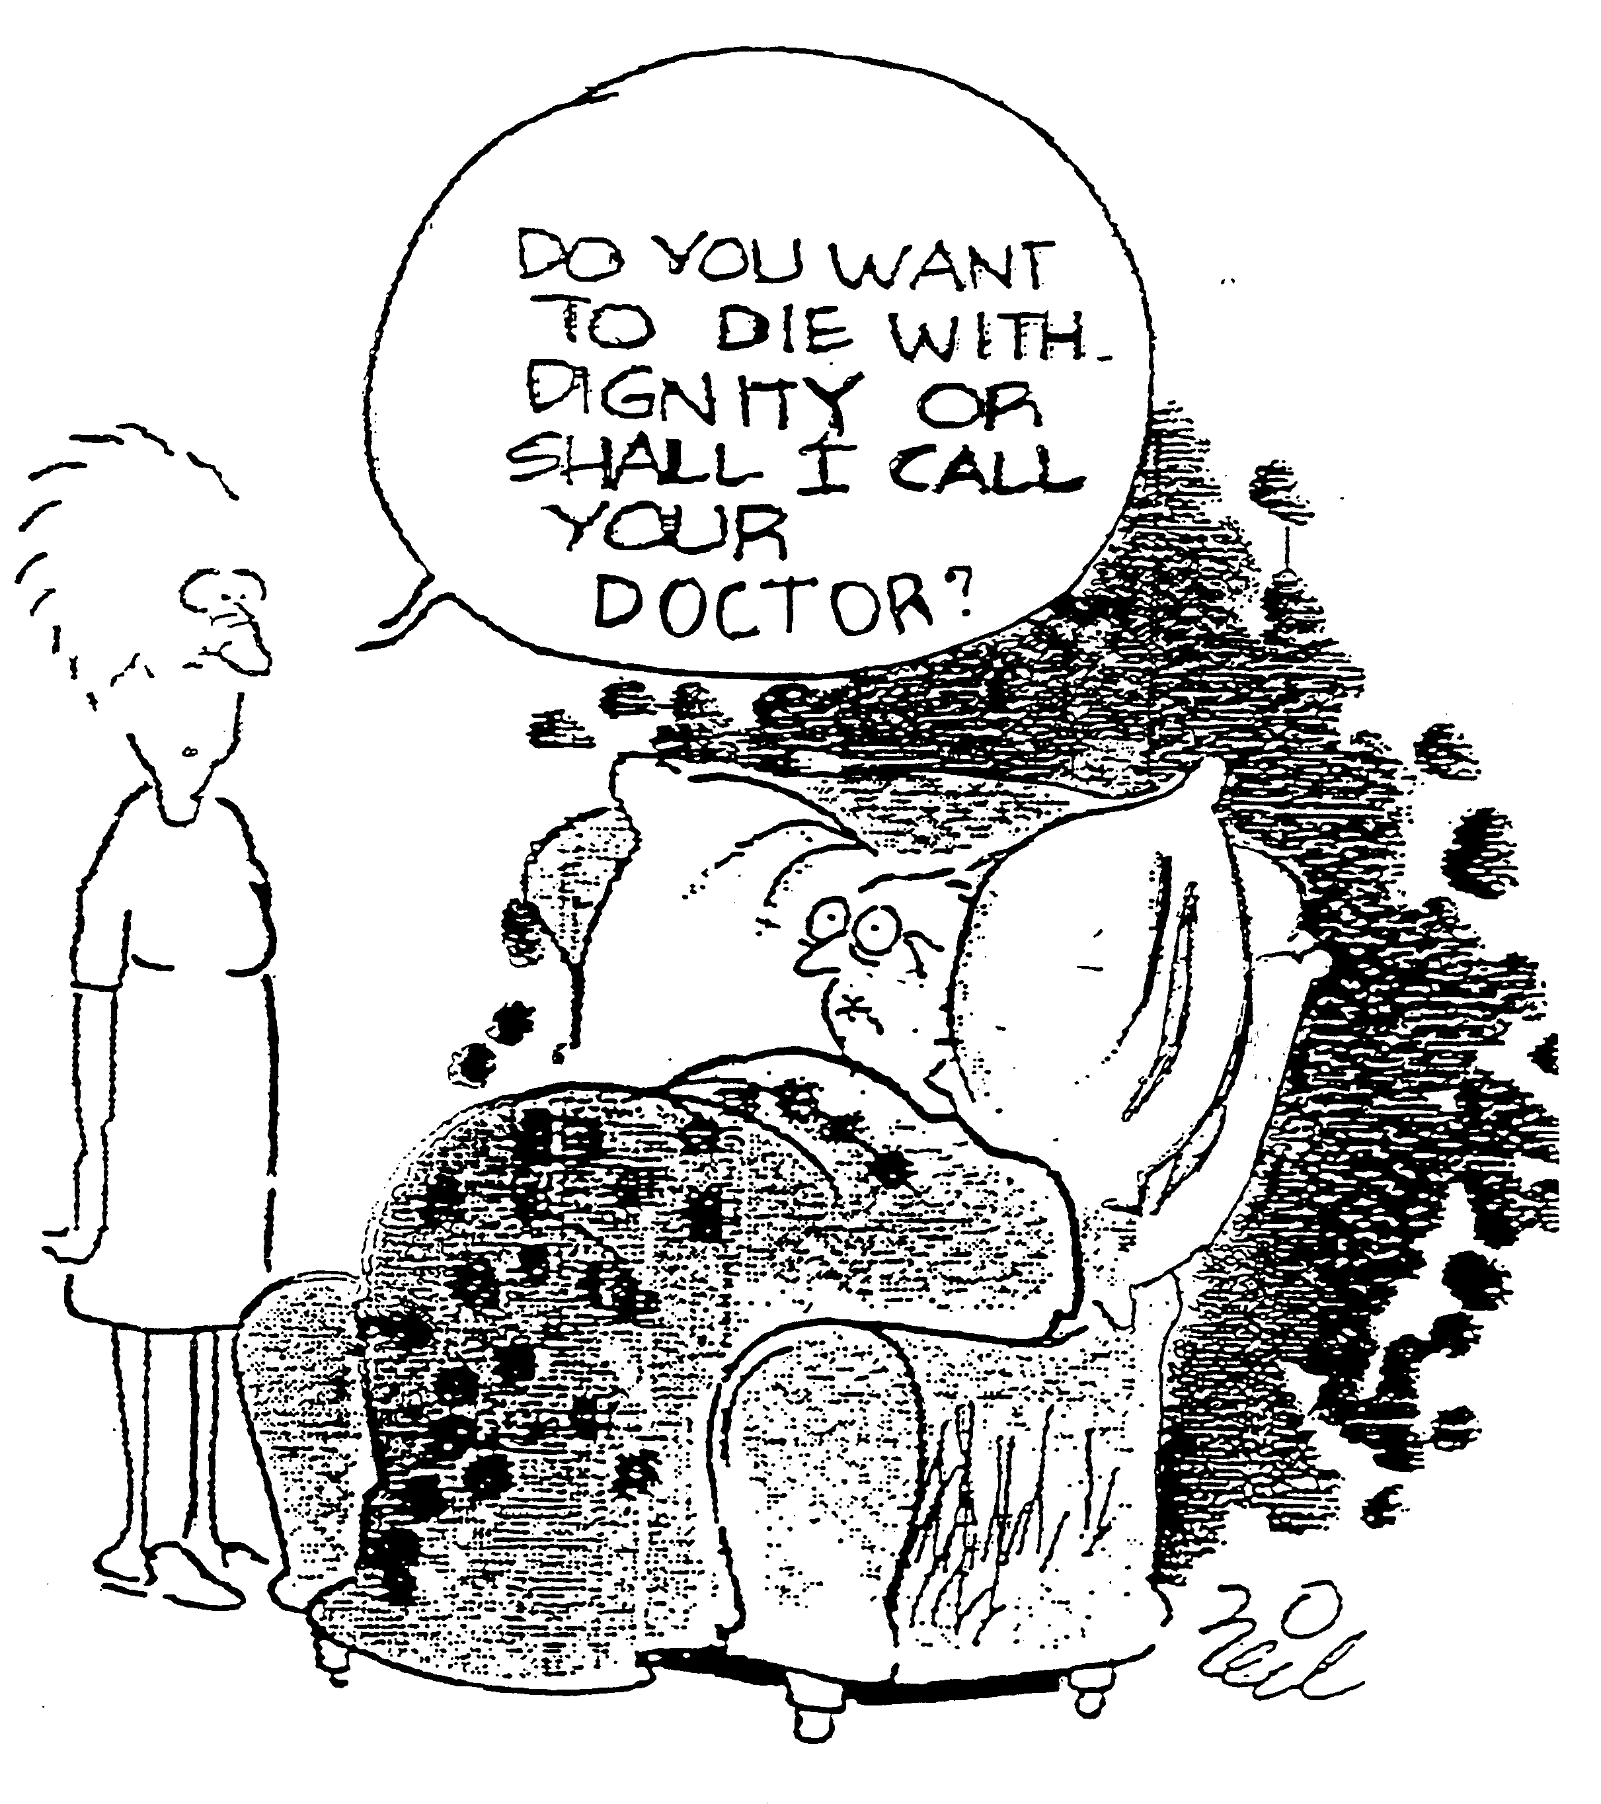

Slide 7
Types of treatment
Curative
Revalidative (rehabilitation)
Palliative
Symptomatic

Slide 8
Components needed for the feeling of dignity
Distress caused by symptoms
Lucidity
Quality of relationships
Spiritual “space” for the adaptation process
Acceptance
Safety
Peace and quiet
Caring surroundings/able to receive care
Good communication between the family and carers

Slide 9
Patterns and predictors of place of cancer death
Married men with cancer usually die at home
Women with cancer tend to die in care homes & hospices
Those dying of lymphatic & haematopoietic malignancies tend to die in hospital
Young people (< 30) tend to die in hospital or at home

Slide 10
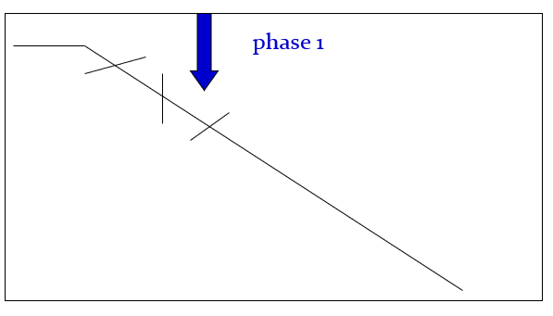

Slide 11
Phase 1
Lack of balance between facts and emotions
Disappointment, disbelief, lack of confidence
Lack of acceptance
The goals are unclear
“trial and error” in symptom control
Important: preserve the cognitive functions
Many patients contemplate euthanasia

Slide 12
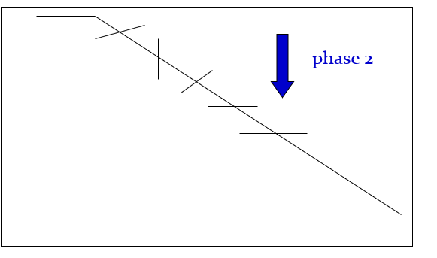

Slide 13
Phase 2
Balance is recovered
Confidence is back
(Physical) symptoms are not at the foreground
The patient gets space for his adaptation process
Intact cognitive functions of paramount importance
Euthanasia requests practically fade away

Slide 14
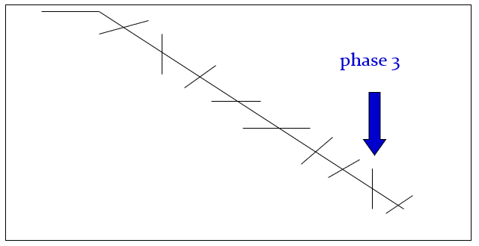

Slide 15
Phase 3
Every day a new symptom/complication
Increased intensity of symptoms (pain, breathlessness)
Patient not able to swallow
Further lack of balance
Cognitive functions less important
The patient may not be competent to take decisions any more
Sedation, if symptoms are refractory, maybe a good solution.

Slide 16
The Liverpool Care
Pathway
To improve the care of the dying patient
Imminent and inevitable death diagnosed by Team
Based around achieving goals of care and recording and managing “variances”

Slide 17
LCP Key Elements
An explicit statement of goals of care based on evidence and best practice
To facilitate communication between teams/patient/families
Co-ordinate care by co-ordinating and sequencing the activities of the MDT
Documenting, monitoring and evaluating variances and outcomes
Identification of appropriate resources

Slide 18
Terminal Sedation in
Palliative Care
Refractory Symptom
“A symptom that cannot be adequately controlled despite aggressive efforts to identify a tolerable therapy that does not compromise consciousness”
Cherny and Portenoy, 1994

Slide 19
Arguments in Favour
Dying patients are more comfortable with parenteral hydration
No evidence fluids prolong life
Dehydration can cause confusion, restlessness and neuromuscular irritability
Parenteral hydration is a minimum standard of care

Slide 20
Arguments Against
Comatose patients do not experience symptom distress
Parenteral fluids may prolong dying
Fewer urine results and less need to void or use catheters
Less gastrointestinal fluid, nausea and vomiting

Slide 21
When you seek advice
www.Palliativedrugs.com
www.pallcare.info
www.biomedcentral.com/bmcpalliatcare

