Slide 1
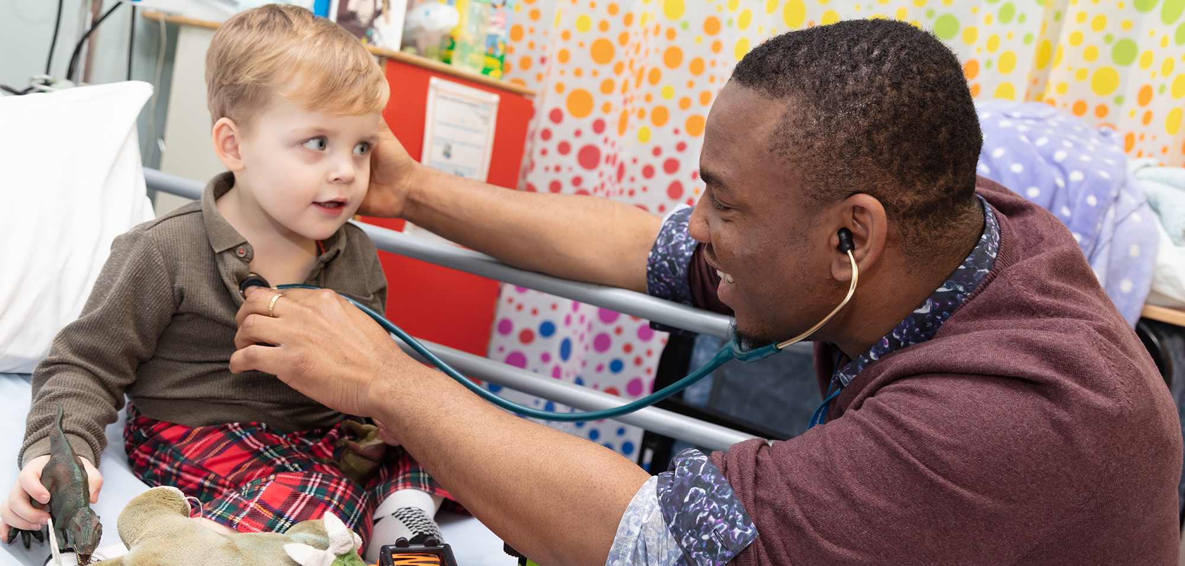
How the NHS works

Slide 2
History
5 July 1948
Healthcare for all free at the point of delivery
Post-war socialist ideals of fairness
Intended to reduce healthcare need
Access to and through primary care
Funded from taxation (1997 33bn; 2010 104bn)

Slide 3
History
https://www.gov.uk/government/organisations/department-of-health
http://www.nhs.uk/NHSEngland/thenhs/nhshistory/Pages/NHShistory1948.aspx

Slide 4
Continuous Change
Reorganisation, reorganisation, reorganisation
There is an excellent short history of the NHS that can be reviewed by following the links below: www.nhshistory.net/shorthistory.htm
www.nuffieldtrust.org.uk/talks/slideshows/new-structure-nhs-england
(Acknowledgement to Nuffield Trust for the use of this link / information below)

Slide 5
How the NHS works
General practice; approximately 30,000 doctors
Independent contractors
Office based, “surgery” or health centre
Principals, partners, assistants, salaried
Registered patients ~1700/doctor
New contract 2004 https://www.gov.uk/government/publications/the-health-and-care-system-explained

Slide 6
The Department of Health
Health protection
Health Improvement
Reduce inequalities
www.gov.uk/government/organisations#department-of-health
The NHS
Public Care
Social Care
Public Safety and emergencies

Slide 7
NHS Commissioning Board
NHS Constitution
Values
Commitments
Clinical Commissioning Groups (CCGs)
GP / Primary care
Some specialist services
https://www.gov.uk/government/publications/the-health-and-care-system-explained/the-health-and-care-system-explained
http://www.england.nhs.uk/
High Standards of care

Slide 8
Other organisations
Medical Schools
GMC (General Medical Council) http://www.gmc-uk.org/
CQC (Care Quality Commission)
NICE (National Institute for Health and Care Excellence)
Royal Colleges
BMA (British Medical Association) www.bma.org.uk
Trusts
HEE (Health Education England)
LETB (Local Education and Training Board)

Slide 9
Trusts
Acute Trust – hospital or group
Board, Chairman and Directors
Chief Executive
Medical Director
Management structure locally determined - clinical directorates
Consultants salaried employees
Junior doctors in training
Foundation Trusts

Slide 10
HEE YH
Doctors in training
Employed by Trust or lead employer
Salaries (part or whole) from HEE / HEYH
HEE / HEYH
Commissions training and monitors quality
Runs recruitment
Monitors progress in training

Slide 11
HEE YH
Health Education England, Yorkshire and the Humber works to:
“Plan, commission and manage the provision of postgraduate medical, dental and inter-professional education that meets professional requirements and the needs of the service.
Deliver sustained increases in the medical and dental workforce, especially GPs and consultants, in line with the NHS Plan, National Service Frameworks and Health Education England's Local Delivery Plans”
http://www.yorksandhumberdeanery.nhs.uk/

Slide 12
HEE YH
Administration of training programmes and Schools
Facilitating education (and support/remediation)
Quality management & assurance of training programmes (and solutions)
Planning
What should a doctor do?
How should we recruit?
What will the training environment be?
What future ‘product’ do we need?
What will happen to the workforce ?

Slide 13
Any questions?

