Slide 1
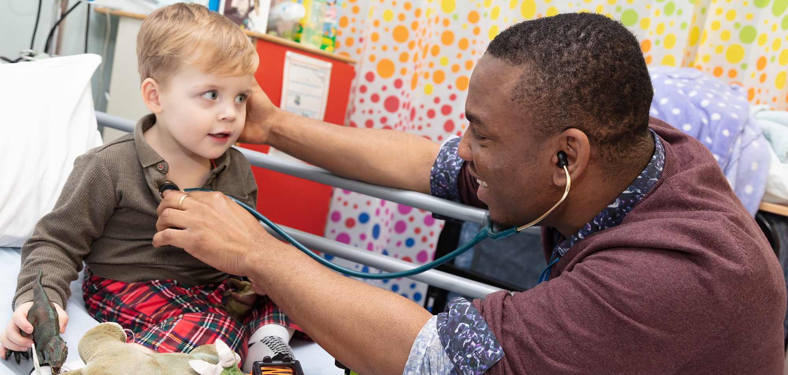
Overseas Induction 2022

Slide 2
Introduction​ Mr Craig Irvine The modules on the website can be done in any order. ​ ​ You will choose how long you spend on each of them. The longer you spend, the more use they will be. ​ ​ At the course day we will spend time talking about what you have learned from them, and will seek your views on what could be done differently. ​

Slide 3
What do you feel?​
Trepidation​
Fear​
Anxiety​
Uncertainty
Excitement​
Opportunity​
New challenge​
Boredom / Don’t need it” ​
What are you expecting?

Slide 4
Factors to consider​
Environment ​
Separation ​
Uncertainty​
Financial​
Documentation​
Health ​

Slide 5
Purpose​

Slide 6
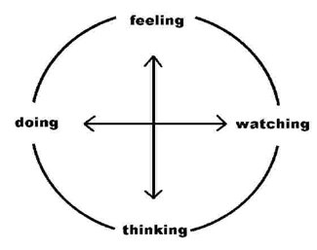
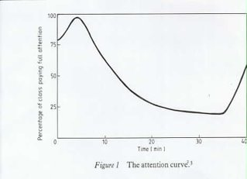
Learning
Adult/self directed learning​
Learning styles ​ less didactic ​ more interactive​
Technical and generic skills ​

Slide 7
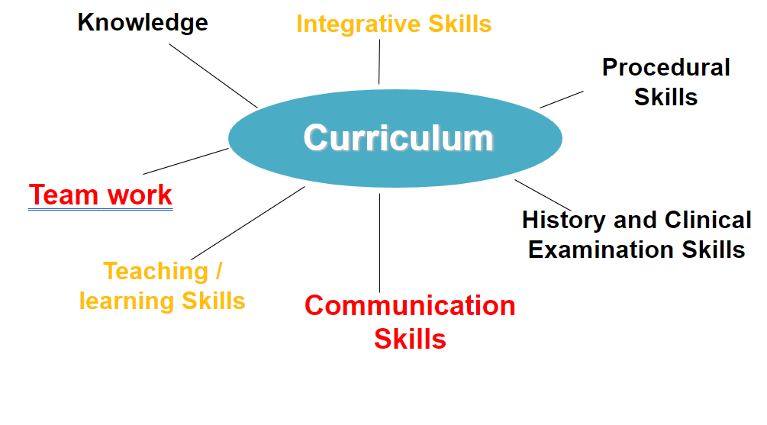
Integrated Learning

Slide 8
No problem in medicine can be made worse by good communication​

