Slide 1


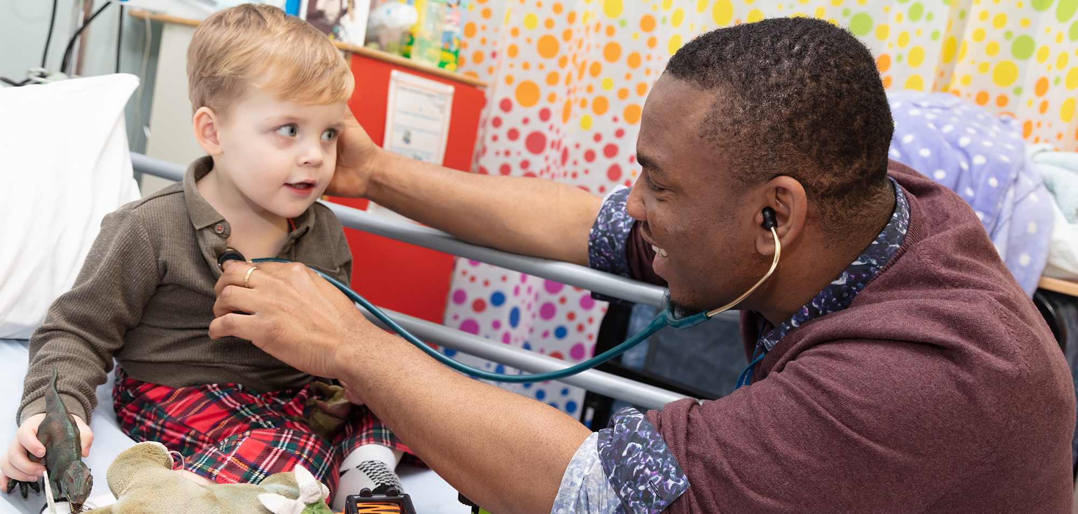
Overseas Induction 2022

Slide 2
Introduction​
Mr Craig Irvine
The modules on the website can be done in any order. ​
​
You will choose how long you spend on each of them. The longer you spend, the more use they will be. ​
​
At the course day we will spend time talking about what you have learned from them, and will seek your views on what could be done differently.
​

Slide 3
What do you feel?​
Trepidation​
Fear​
Anxiety​
Uncertainty
Excitement​
Opportunity​
New challenge​
Boredom / Don’t need it” ​
What are you expecting?

Slide 4
Factors to consider​
Environment ​
Separation ​
Uncertainty​
Financial​
Documentation​
Health ​

Slide 5
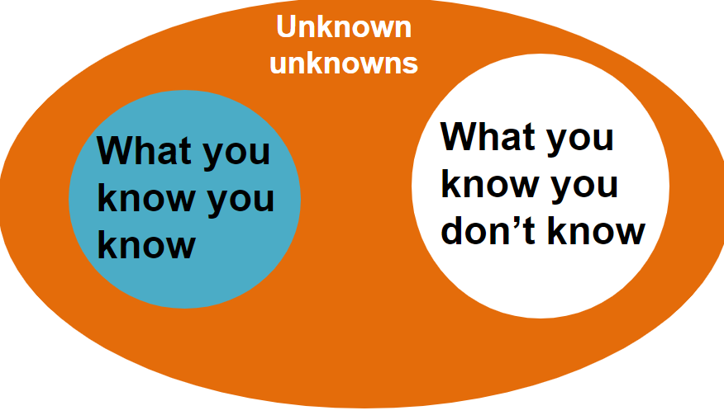
Purpose​

Slide 6
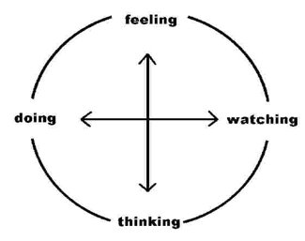
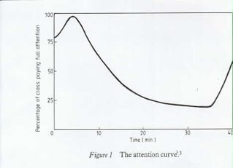
Learning
Adult/self directed learning​
Learning styles ​
less didactic ​
more interactive​
Technical and generic skills ​

Slide 7
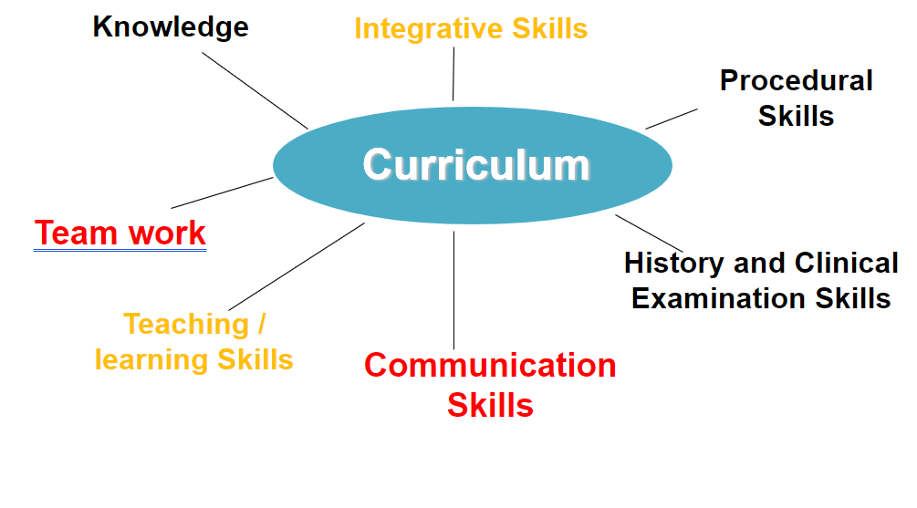
Integrated Learning

Slide 8

No problem in medicine can be made worse by good communication​

