Slide 1


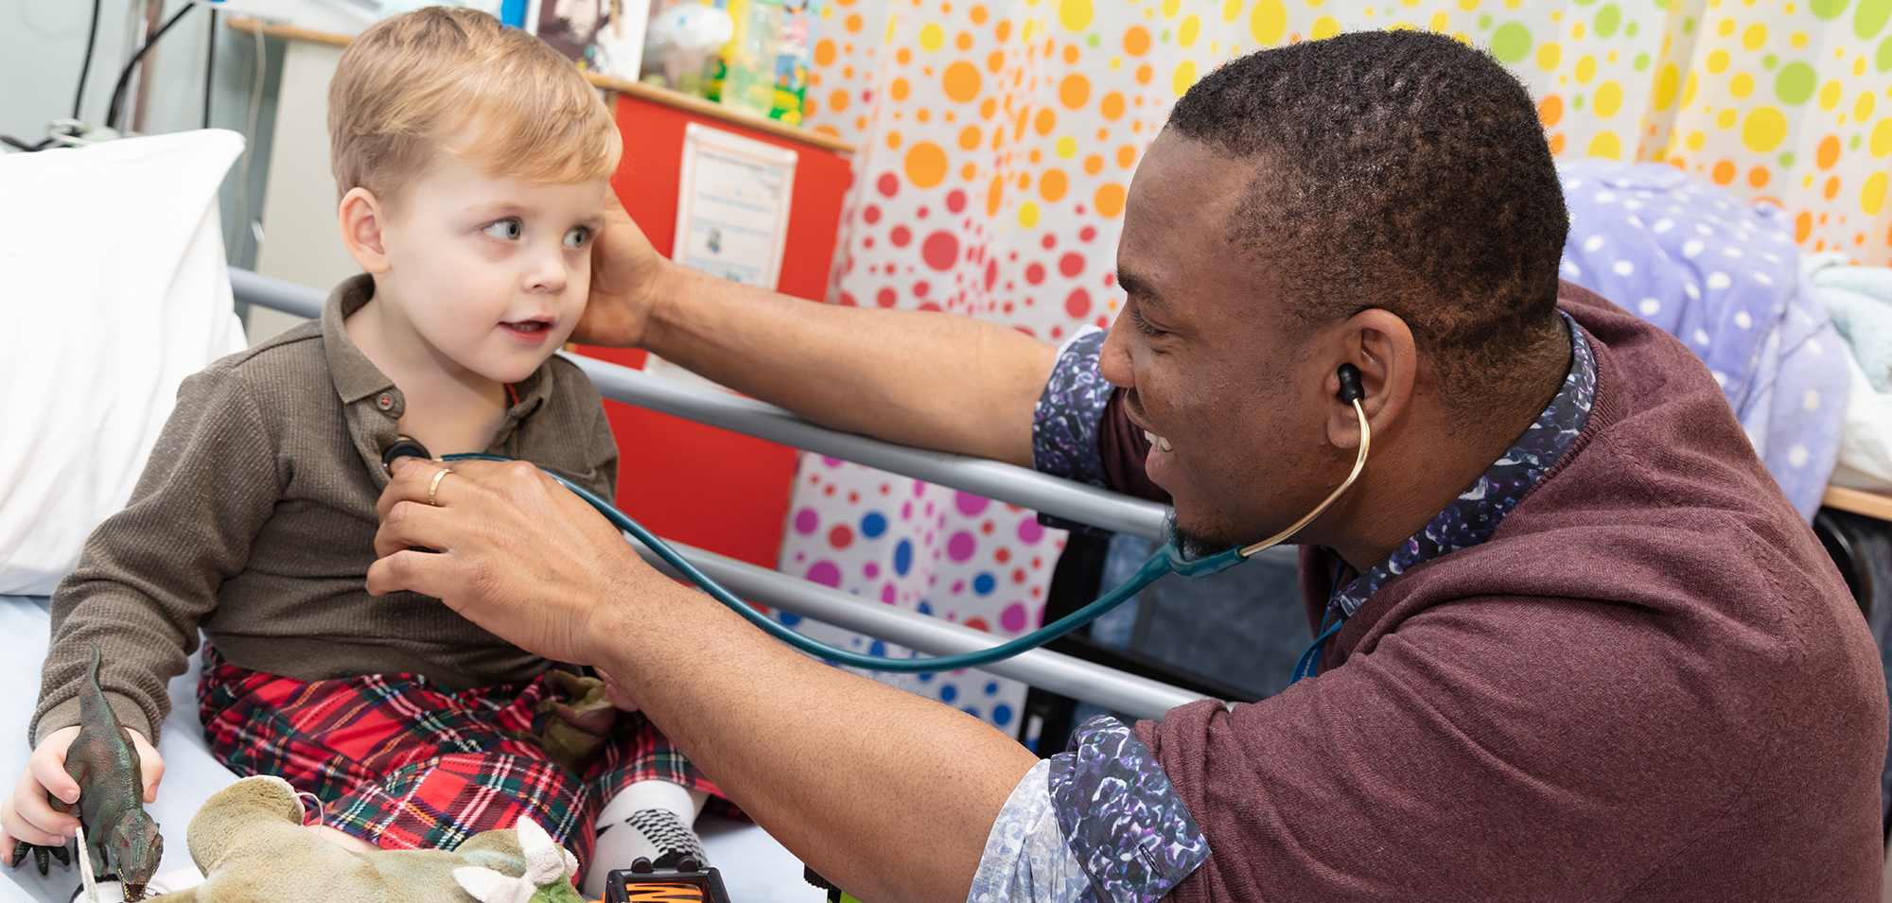
Making useful medical records: an individual responsibility

Slide 2
Learning Objectives
Be able to explain why record keeping is important
Understand how personal factors lead to poor records
Be able to analyse case notes for errors
Recognise the importance of record keeping as part of training

Slide 3
Why is record keeping important?
Immediate care
Future care
A legal record

Slide 4
Why is record keeping important?
What do you record?
Or not record?

Slide 7
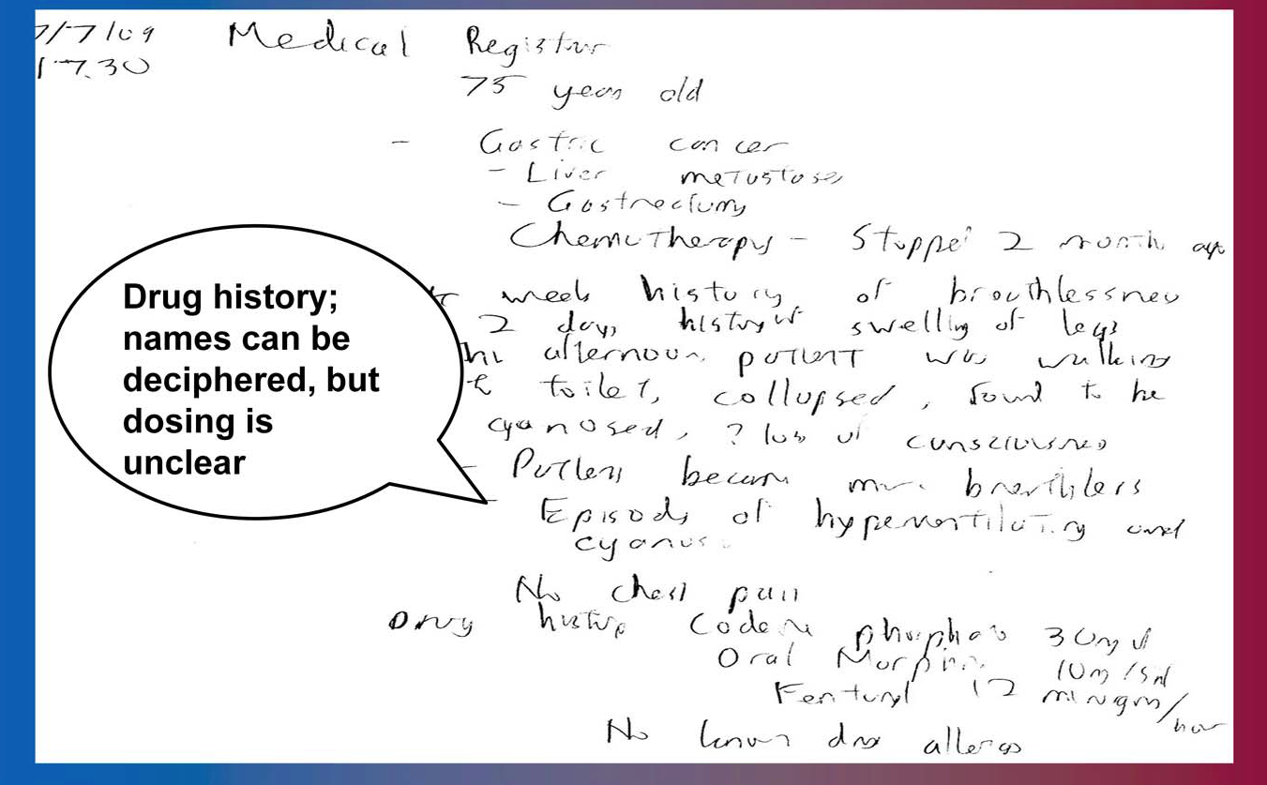

Slide 8
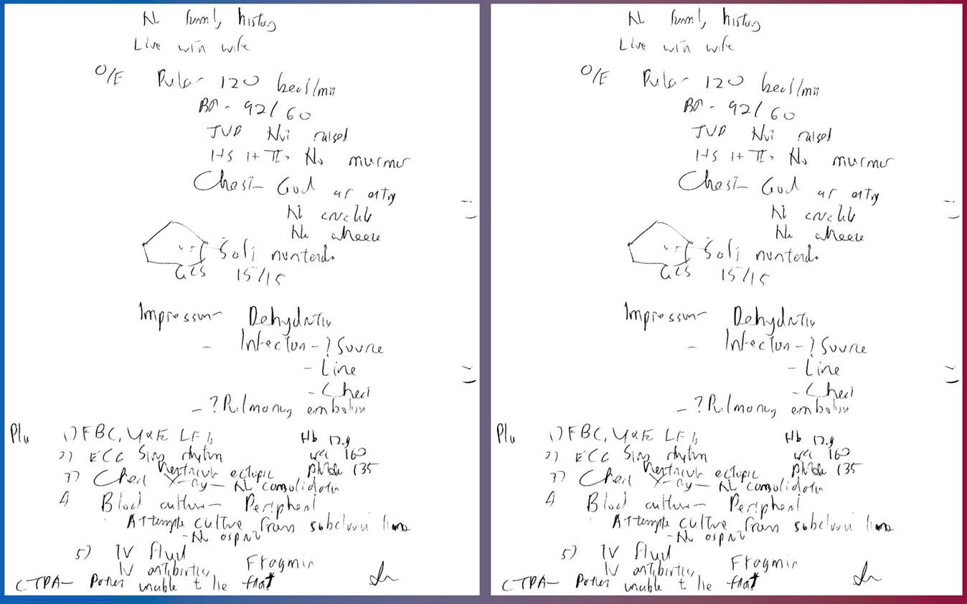

Slide 9
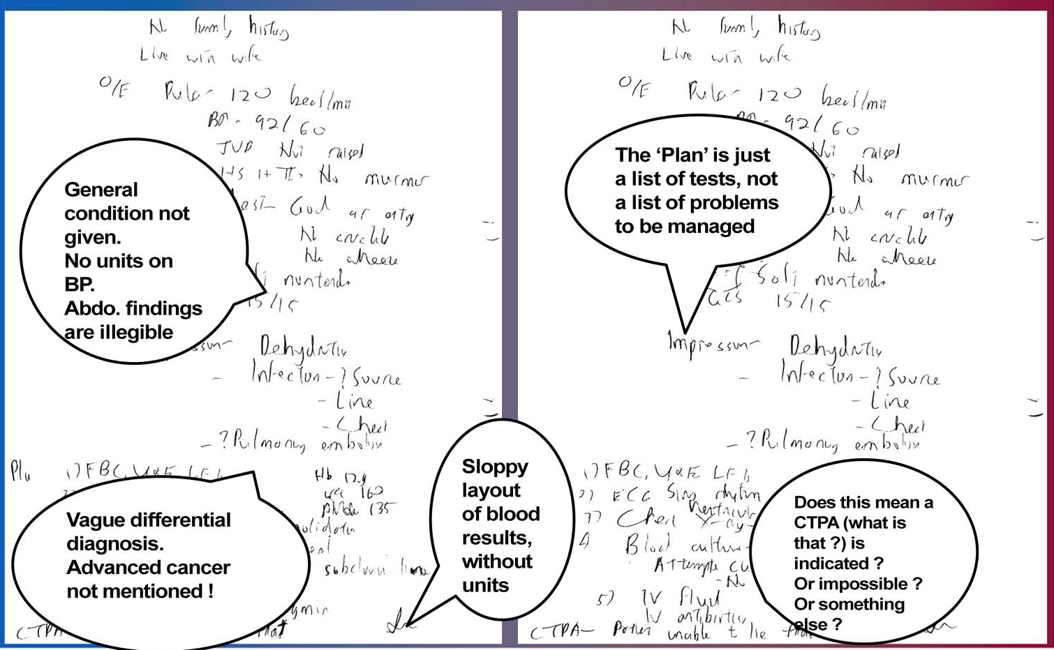

Slide 10
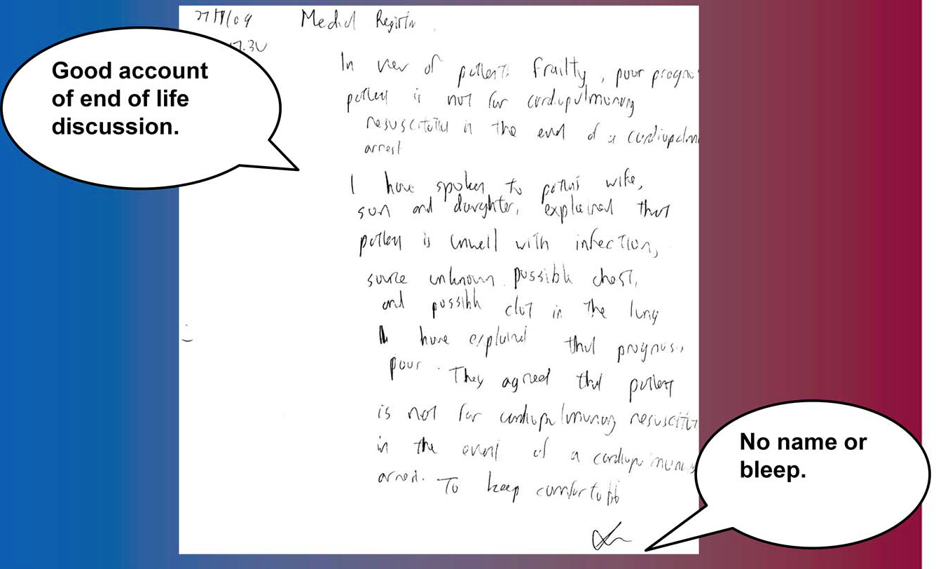

Slide 11
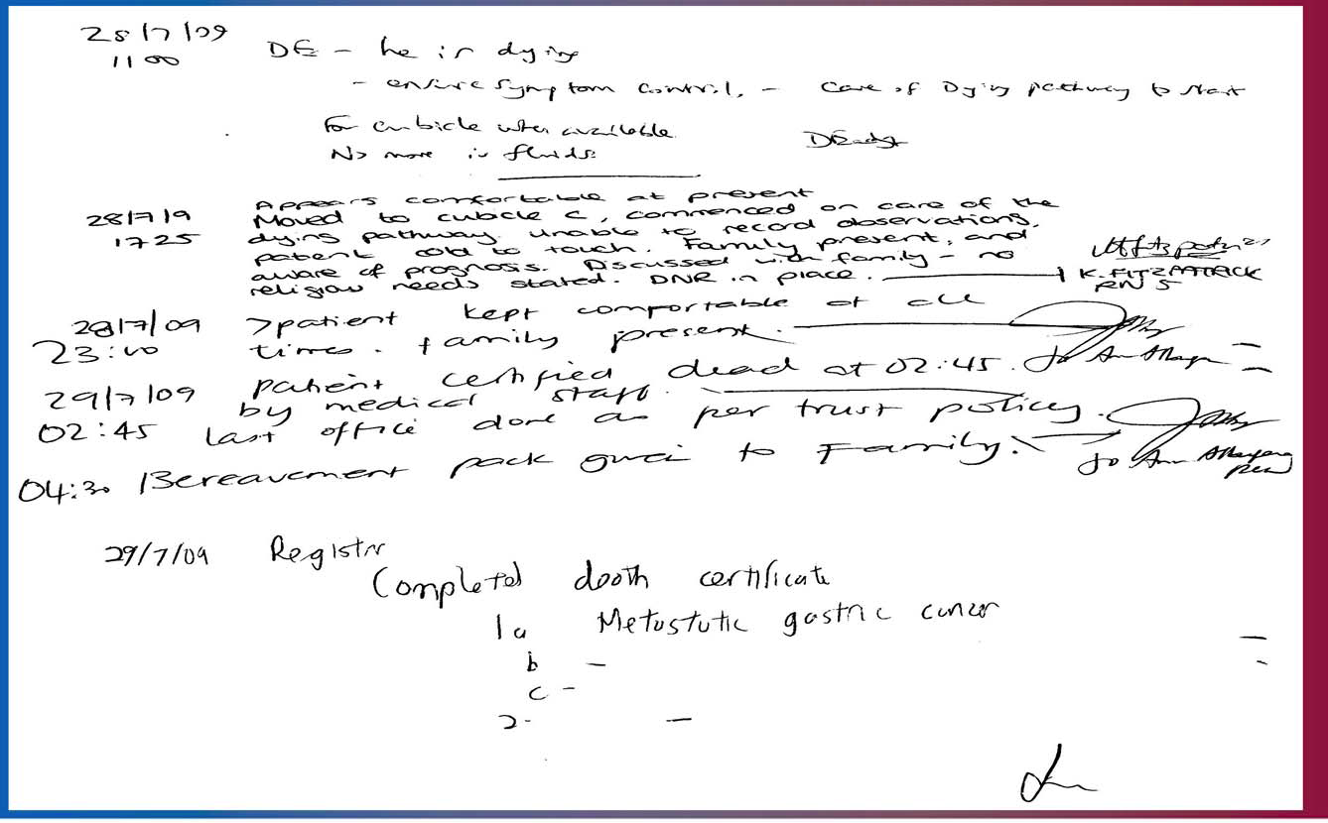

Slide 12
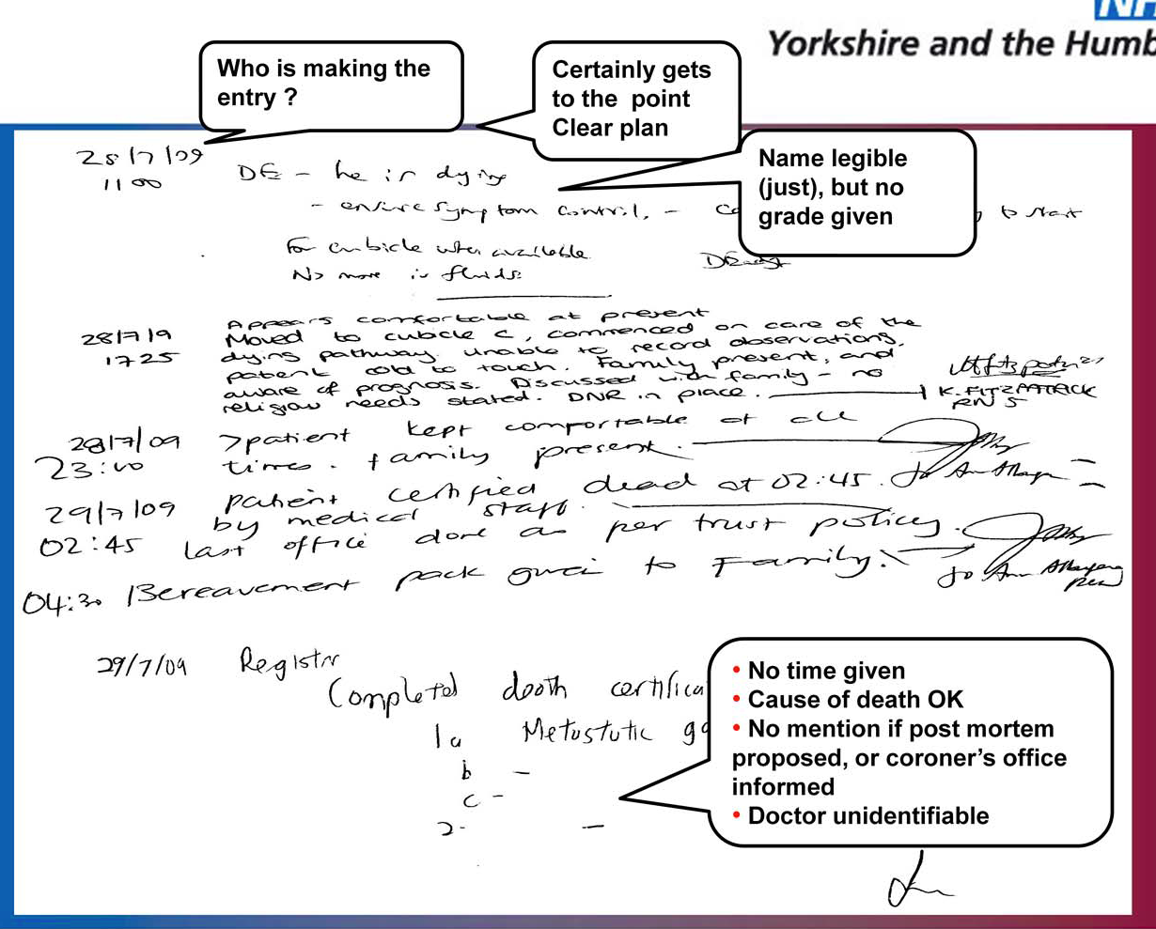

Slide 13
Put symptoms in the history
Drug doses matter
Put diagnoses at the end
Avoid abbreviations
Show your thinking
Do not write “for senior review”
DNAR (Do Not Attempt Resuscitation) forms

Slide 14
Final Assessment
What do you think you have learned?
What are you going to study further?
What could be done to improve this module?

Slide 15
Any questions?

