Slide 1
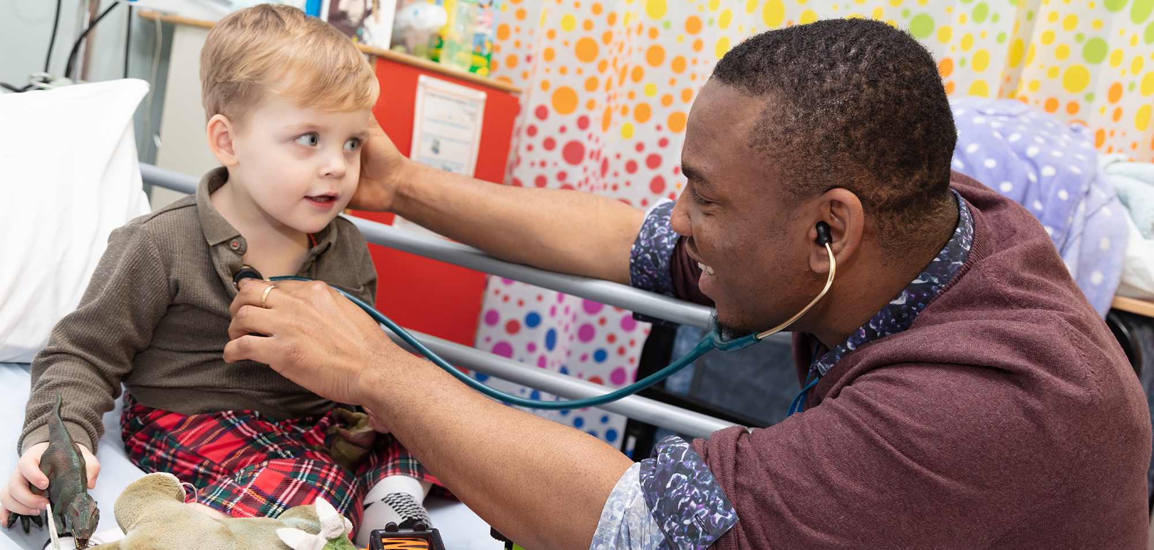
When a Patient Dies

Slide 2
When a Patient Dies
Confirming death
Talking to relatives
Reporting to the coroner
Death Certification
Cremation Forms

Slide 3
Confirming Death
No respiratory effort
at least one minute
No Cardiac output
pulse
heart sounds
Fixed and dilated pupils - unreliable

Slide 4
After Confirming Death
Record confirmation of death in the medical notes
List examination undertaking
Time and date of death
Signature (legible) and bleep number

Slide 5
After Confirming Death (2)
If you think the death should be reported to the Coroner ALWAYS speak to a consultant or SpR first.
Record in the notes when a death has been reported to the coroner

Slide 6
Talking to Relatives
Usually advisable to be accompanied by a nurse
Be considerate and sympathetic
Explain clearly – avoid technical terms
Check that you have been understood
If the death is being reported to the Coroner the implications need to be conveyed with tact

Slide 7
Talking to Relatives (2)
Registering the death, collection of personal belongings etc.
Done best by the nursing staff
Leaflets available
Any questions answer honestly
Ask if they would like anything else
A drink
To speak to a priest

Slide 8
The Coroner
Appointed by county authorities
To find the medical cause of death if unknown
To enquire into unnatural deaths
Registered lawyers / doctors
Assisted by a team of officers who investigate on their behalf.
Often former police officers, NHS managers or former members of the legal profession.

Slide 9
The Coroner (2)
Once a death is reported to the Coroner, the Registrar of deaths is unable to register the death until the Coroner’s inquiry is completed.
12% of deaths result in an inquest
Telephone number available on ward or from mortuary

Slide 10
When to refer to the Coroner
Patient not seen by a doctor within 14 days prior to death
Cause of death unknown
Violent, unnatural or suspicious death
Accident
Poisoning
Drug dependence, misuse or overdose
Suicide
Self Neglect

Slide 11
When to refer to the Coroner (2)
Deaths within 24 hours of admission
During an operation or before recovery from the effect of anaesthetics
Following any medical procedure due to an abortion
Industrial disease / related to employment
In police custody
Detained under the mental health act

Slide 12
Issuing a medical certificate of cause of death
Legal duty
A doctor must have made a diagnosis prior to death and be satisfied that no other condition or event, that is not a natural disease, has contributed significantly to the death. The doctor has expected the death to occur roughly when it did and be satisfied that the mode and circumstances of the death are compatible with the diagnosis.

Slide 13
Death Certification
Complete all the boxes
(remember the second side of the form)
Use capital letters
No abbreviations
No vague phrases
Be as accurate as possible
Sign the certificate AND print your name / GMC number next to your signature

Slide 14
Useful Links
https://www.e-lfh.org.uk/
http://www.gmc-uk.org/guidance/ethical_guidance/end_of_life_certification_post-mortems_and_referral.asp
http://www.justice.gov.uk/downloads/burials-and-coroners/cremations/cremation-doctors-guidance.pdf
http://www.gro.gov.uk/images/medcert_July_2010.pdf
https://www.gov.uk/government/publications/death-certification-reforms
https://www.gov.uk/after-a-death/register-the-death

Slide 15
Terms to use with care
Septicaemia
Organ failure e.g. CCF, Renal failure
Old Age
Cardiac arrest
Cerebrovascular accident
Carcinomatosis

Slide 16
George Lewis – DOB 17.11.29
PMH: COPD – ex smoker
IHD – MI 2003
CCF
DM
Admitted to AAU 13th September at 4:15pm
3 day history of increasing dyspnoea, cough productive of purulent sputum.

Slide 17
O/E:
Temp 37.7⁰ C
RR 24 Central cyanosis + (O₂ sat.87%)
BP 110/70
PR Irregular
JVP↑ (difficult to assess)
Oedema to mid calf
Chest emphysematous
basal crackles R>L

Slide 18
Investigations
A Blood gases pH 7.26 pO₂ 5.4 pCO₂ 8.7
Hb 16.7 WBC 16 CRP 87
Urea 10.6 Creatinine 154
ECG AF, LBBB
CXR over inflated lung fields
bulky right hilum
patchy shadowing right lower zone

Slide 19
Admitted to HDU
for NIPPV
+ nebulisers
+ steroids
+ i/v antibiotics
Died 14th September at 2:20pm

Slide 20
Death certificate for G Lewis
1a Bronchopneumonia
1b Chronic obstructive pulmonary disease
II Ischaemic heart disease
Diabetes mellitus
(after discussion with Coroners office)

Slide 21
Cremation Forms
70% of deaths are followed by cremation
1 in 4 forms are completed incorrectly
Part 3 – completed by the doctor who writes the death certificate
If any doubt refer to the Coroner for advice – speak to a consultant or SpR first
A fee is paid for this certification

Slide 22
Cremation Forms (2)
Part 3
Completed by a second independent doctor, full registration for at least 5 years
Must discuss case with first doctor
Examine the body and agree with the cause of death

Slide 23
Summary
Confirming death
Talking to relatives – being considerate
Reporting to the Coroner
Certifying death and issuing a death certificate
Cremation forms (sensible, accurate completion)

