Slide 1
Working in the NHS

Slide 2
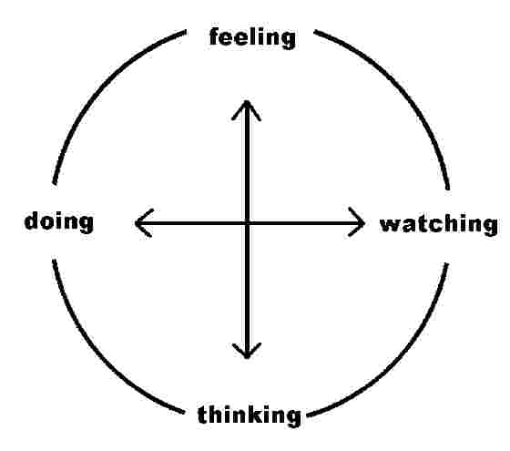
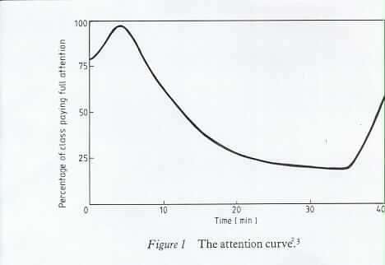
Learning
Adult/self directed learning
Learning styles
- less didactic
- more interactive
Technical and generic skills

Slide 3
Expectations
Hierarchies and democracies
Authority and authority figures
Challenging senior figures

Slide 4
Patient expectations of us are conflicting…
objectivity
emotional detachment
competence
reliability
emotional intelligence
Intuition
sensitivity

Slide 5
Trusted
 | 2006 (%) | 2008 (%) | Change
Doctors | 92 | 90 | -2
Teachers | 88 | 86 | -2
Judges | 81 | 78 | -3
Clergy/Priests | 75 | 73 | -2
Scientists | 72 | 65 | -7
Newsreaders | 66 | 61 | -5
Police | 61 | 59 | -2
Civil Servants | 48 | 44 | -4
Trade Unionists | 41 | 38 | -3
Ministers | 22 | 22 | 0
Journalists | 19 | 18 | -1

Slide 6
‘Cultural Competence’
Understanding and valuing diversity
Having the capacity for cultural self-assessment
Being conscious of the dynamics inherent when cultures interact
Having institutionalized cultural knowledge
Having adaptations of service delivery reflecting understanding

Slide 7
Adapting ‘Cultural Competence’
Clinical – differences amongst people of different racial and ethnic background
Communication – differences in style, method and meaning in communications, even when dominant language is used well
Ethics – different belief systems will challenge firmly held Western beliefs inculcated through years of professional development
Trust/respect – different levels of trust where individuals have come from countries where authority figures have misused their positions. Respect in that some cultures will so respect a clinical authority figure that they will agree with the clinician and seek to provide ‘acceptable’ answers.

Slide 8
Facilities & Support
Chaplaincy – 24 hour multi-faith service
Occupational Health Service
Professional Registration
Responsibility to maintain registration where applicable
Working Hours Set out in Terms & Conditions, employees not expected to work over 48 hours per week
Internet Access
Pay - paid directly into bank/building society account, details on payslip
NHS Pension Scheme – available to all employees between the ages of 16 and 70

Slide 9
Key Policies / Procedures
Equality & Diversity Zero tolerance of any discrimination
Attendance Expected to attend work punctually. Persistent lateness may lead to disciplinary action
Sickness Absence Notify manager ASAP, follow procedure, attend review meetings. Procedures vary
Capability Every effort to be made to support employees
Discipline & Conduct All expected to maintain highest standards of performance and conduct, formal action for poor conduct or behaviour

Slide 10
Key Policies / Procedures
Study Leave Based on needs of service, must obtain authorisation from manager
Annual Leave Based on NHS service, must obtain authorisation from manager
Grievances & Disputes Right to raise concerns and to have concerns dealt with promptly, informal resolution wherever possible
Whistle blowing Encouraged to express concerns at an early stage to manager, HR or Trade Union representative
Harassment & Bullying Zero tolerance of any harassment or bullying
All HR policies and procedures on Trust Intranet

