Slide 1

Working in the NHS
Dr David Eadington
Notes:
There is an enormous amount of detailed information about contracts, GMC registration etc. that you have already understood enough about to get yourself into a job. There is a lot more that will come from your Trust and Departmental induction meetings.
This module is intended just to look briefly at some of the general points that you need to think about in getting used to working in the UK.

Slide 2
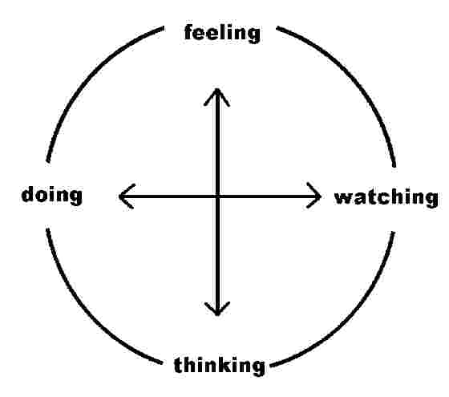
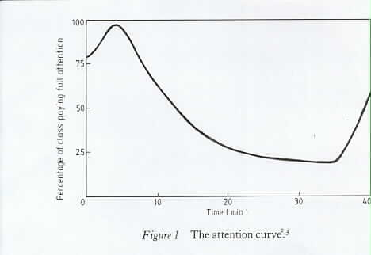
Learning
Adult/self directed learning
Learning styles
- less didactic
- more interactive
Technical and generic skills
Notes:
This slide is repeated deliberately from the Introduction module, to emphasise its central importance to your training experience.
The graph shows how one’s attention span falls quickly with time, illustrating the main reason that we have moved away from lecture style teaching. Little information is retained short term, even less long term, and the influence on long term behaviour and performance is minimal.
You will encounter much less didactic teaching than you may be used to (so called ‘talk and chalk’), and much more interactive learning, where you need to be an active participant.
The term self-directed learning emphasises that you are responsible for identifying your own learning needs, and identifying how you achieve those. This is not a single handed effort, there will be lots of help for you in doing this.

Slide 3
Expectations
Hierarchies and democracies
Authority and authority figures
Challenging senior figures
Notes:
You are working within a hierarchy which recognises that everyone has a voice that needs to be heard. Your trainers will expect you to be an active member of the team, not a silent presence. You are an important stimulus to the team; one of the useful ways for senior staff to update their own learning and development is contact with students and junior doctors.
Medicine and society are continually changing. Consultants still carry a lot of authority within various spheres of influence – although it is reduced compared to previous generations. They still control all major clinical decisions, hence much of the resource allocation around the hospital. They also influence you, as role models and examples of how to behave.
One of the differences you may encounter from your previous workplaces is that senior figures in the clinical hierarchy expect to be challenged on their decisions or opinions, an openness summed up in the phrase ‘supportive culture’. Challenge should always be polite and constructive of course, but senior doctors now accept this as an important part of managing clinical risk and maintaining their own skills.

Slide 4
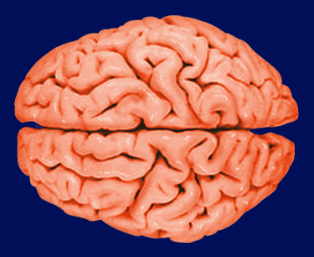

Patient expectations
of us are conflicting…
objectivity
emotional detachment
competence
reliability
emotional intelligence
Intuition
sensitivity
Notes:
Patient expectations in the UK are also very different to what you may be used to. One effect of liberal Western consumerism in the second half of the 20th century has been to make people tend to regard healthcare as another commodity, to be delivered like any other service industry. Politicians have supported (if not actually created) this cultural trend.
Patients in the UK expect the doctor to involve them in their decision making. This involves a lot more time spent explaining first the nature of the problem, then the options for treatment (and the risks). Younger patients express such attitudes far more than the elderly.
Another part of this change is that patients now expect doctors to behave intelligently both intellectually AND emotionally. The skills required for those two purposes are very different. Some people innately possess the ability to apply the right balance of those skills according to the context you are working in. Practising that balance is one of the central parts of developing clinical expertise and showing professionalism.

Slide 5
Trusted
 | 2006 (%) | 2008 (%) | Change
Doctors | 92 | 90 | -2
Teachers | 88 | 86 | -2
Judges | 81 | 78 | -3
Clergy/Priests | 75 | 73 | -2
Scientists | 72 | 65 | -7
Newsreaders | 66 | 61 | -5
Police | 61 | 59 | -2
Civil Servants | 48 | 44 | -4
Trade Unionists | 41 | 38 | -3
Ministers | 22 | 22 | 0
Journalists | 19 | 18 | -1
Notes:
Despite all the changes in working patterns and increasing clinical pressures, you should remember that doctors remain highly trusted by patients. The reduction in other groups over time is greater.

Slide 6
‘Cultural Competence’
Understanding and valuing diversity
Having the capacity for cultural self-assessment
Being conscious of the dynamics inherent when cultures interact
Having institutionalized cultural knowledge
Having adaptations of service delivery reflecting understanding of cultural diversity.
Notes:
This slide is taken from a tutorial aimed at giving UK trained doctors a perspective on how to understand and adapt to the different expectations and backgrounds of patients from ethnic minority groups.
Can you see how the bullet points also illustrate some of the areas you will need to consider as non-UK trained doctors looking after UK patients ?
Similar cultural boundaries exist which need to be overcome.

Slide 7
Adapting
‘Cultural Competence’
Clinical – differences amongst people of different racial and
ethnic background
Communication – differences in style, method and meaning in communications, even when dominant language is used well
Ethics – different belief systems will challenge firmly held Western beliefs inculcated through years of professional development
Trust/respect – different levels of trust where individuals have come from countries where authority figures have misused their positions. Respect in that some cultures will so respect a clinical authority figure that they will agree with the clinician and seek to provide ‘acceptable’ answers.
Notes:
More of the same idea.

Slide 8
Facilities & Support
Chaplaincy – 24 hour multi-faith service
Occupational Health Service
Professional Registration
Responsibility to maintain registration where applicable
Working Hours Set out in Terms & Conditions, employees not expected to work over 48 hours per week
Internet Access
Pay - paid directly into bank/building society account, details on payslip
NHS Pension Scheme – available to all employees between the ages of 16 and 70
Notes:
The final slides simply list some of the practical aspects of living and working in the UK. You are already familiar with many, and specific details on many more will be given at Trust induction.

Slide 9
Key Policies /
Procedures
Equality & Diversity Zero tolerance of any discrimination
Attendance Expected to attend work punctually. Persistent lateness may lead to disciplinary action
Sickness Absence Notify manager ASAP, follow procedure, attend review meetings. Procedures vary
Capability Every effort to be made to support employees
Discipline & Conduct All expected to maintain highest standards of performance and conduct, formal action for poor conduct or behaviour
Notes:
All Trusts have strong policies to deal with any sort of discrimination and bullying behaviour. Very few junior doctors will get into disciplinary trouble, but again there are detailed policies. Similarly on sickness absence and helping staff recognise the need to manage their own health

Slide 10
Key Policies /
Procedures
Study Leave Based on needs of service, must obtain authorisation from manager
Annual Leave Based on NHS service, must obtain authorisation from manager
Grievances & Disputes Right to raise concerns and to have concerns dealt with promptly, informal resolution wherever possible
Whistle blowing Encouraged to express concerns at an early stage to manager, HR or Trade Union representative
Harassment & Bullying Zero tolerance of any harassment or bullying
All HR policies and procedures on Trust Intranet
Notes:
Trust intranet sites contain a lot more information.
Study leave applications are handled by the postgraduate centre. The policy will be in the Trust, and is on the Health Education Yorkshire and the Humber website – www.yorksandhumberdeanery.nhs.uk/policies
Annual leave and study leave need to be planned and booked as far in advance as possible. You should meet with your colleagues as early as possible in a post to plan your absences and ensure that clashes with colleagues’ wishes are avoided.

