Slide 1
ACCS CT1
Dr Paige Baylis-Jones (ACCS CT3)
Dr Sue Walwyn (Consultant Anaesthetist)

Slide 2
First off

Slide 3
ACCS Structure

Slide 4
Important Contacts
Most of ACCS CT1 is run by Emergency medicine
ARCP/training admin organised by emsupport.yh@hee.nhs.uk
Clincal supervisors – one per rotation
Educational supervisor – from your parent specialty
TPD
Prolonged illness Parental Leave OOPT
Inter-deanery transfer Placement requests LFTF

Slide 5
Important Contacts - TPDs
West
Dr Colhoun – alison.colhoun1@nhs.net
North & East
Dr Dilley – Jonathan.dilley1@nhs.net
South
Dr Robinson – Michael.robinson20@nhs.net

Slide 6
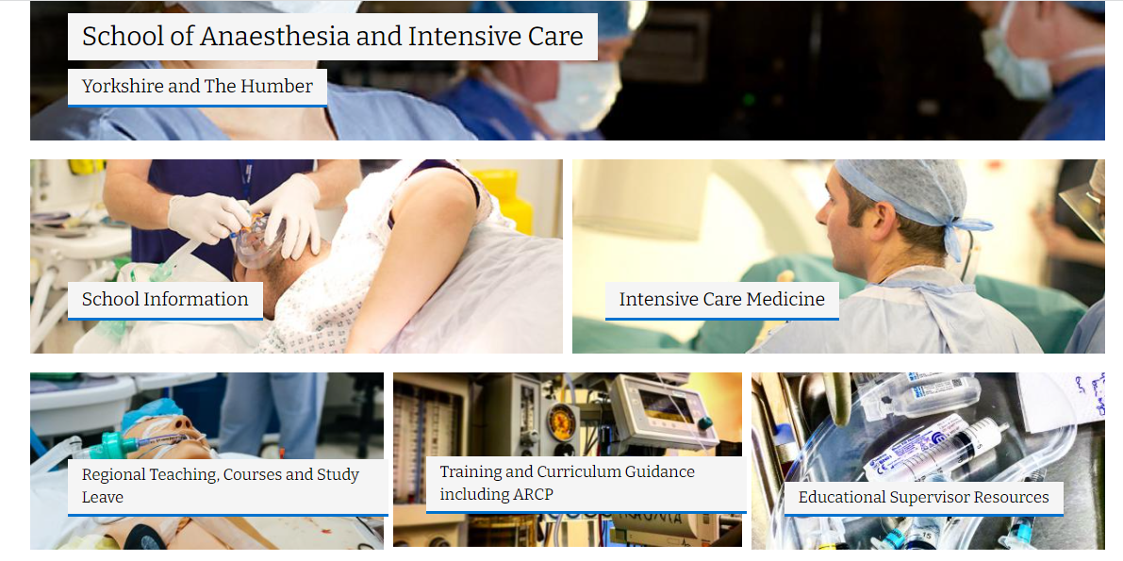
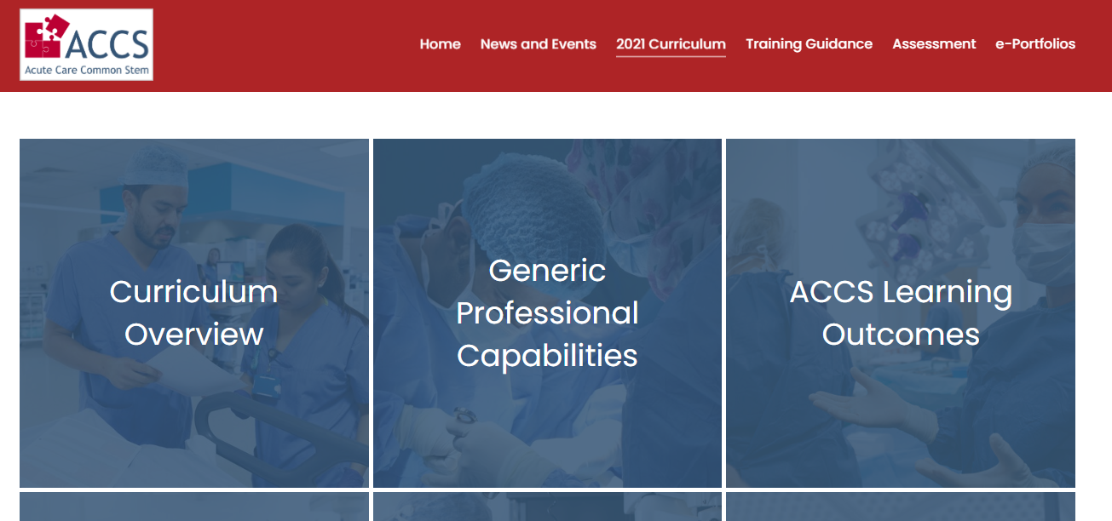
Useful Information
Yorkshire & Humber Deanery page
https://www.yorksandhumberdeanery.nhs.uk/anaesthesia
ACCS Curriculum
https://www.accs.ac.uk/2021-curriculum

Slide 7
Getting started
Lifelong Learning
Portfolio
Log book
Add you placement, your ES & your CS
ES & CS Meeting
May need to register your CS
Training days
Register early
Book SL

Slide 8
Portfolio
MCR/MTR
FEGS
PDP
Acute medicine
Like an MSF but just consultants
Pick as many consultants as you can – need a minimum of 3
Emergency medicine
Same as MTR /MCR
Aims for placement
Usually do it after a few weeks when I have a feel of what I can get out of the placement

Slide 9
Portfolio
11 ACCS LOs
7 generic Los
Can mostly ignore LO7 & LO8
Try and sign of Los 1-6 this year
Contribute to the rest ready for sign off at the end of CT2
Need all of ACCS LOs by end of CT2

Slide 10
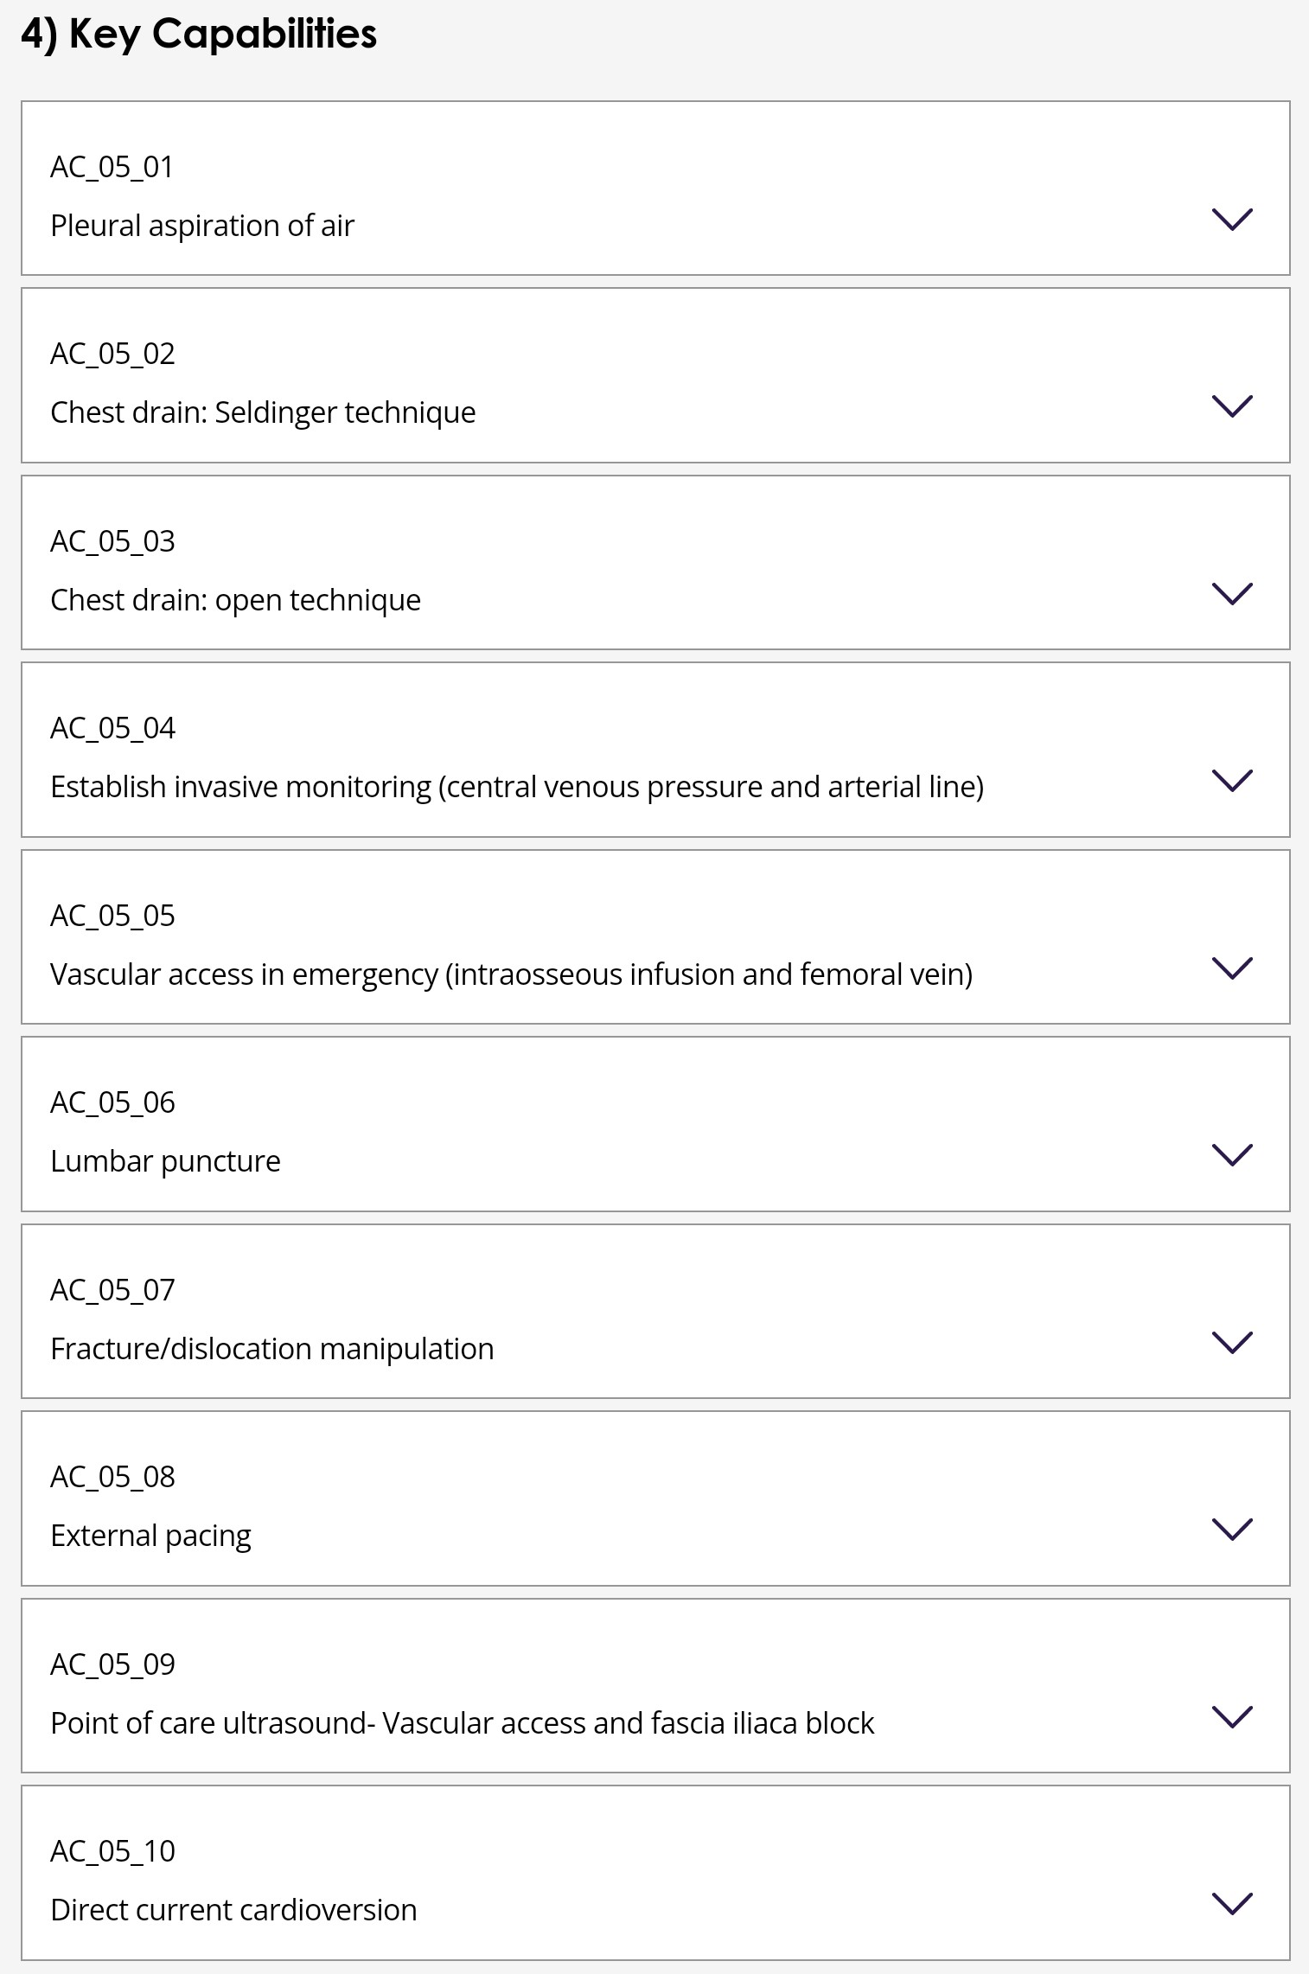
Portfolio

Slide 11
Entrustment Scales
1 Direct supervisor observation/involvement
2a Supervisor nearby, monitoring at regular intervals
2b Supervisor within hospital for help
3 Supervisor on call from home for queries/help via phone
4 Independent practice

Slide 12
Entrustment Scales
Learning Outcome | Entrustment
1 Care for physiologically stable adult presenting to acute care across the full range of complexity | 2b
2 Support the team by answering questions and making safe decisions | 2a
3 Identify sick patients, be able to resuscitate and stabilise and known when its appropriate to stop | 2a
4 Care for acutely injured patients across the full range of complexity | 2b
6 Deal with complex and challenging situations in the work place | 2a

Slide 13
Entrustment Scales LO5
Procedure | Entrustment
Pleural aspiration of air | 2a
Chest drain - Seldinger | 2a
Chest drain - open | 1
Establish invasive monitoring (CVC/Art) | 2a
Vascular access in an emergency (IO/Femoral) | 1
Fracture/dislocation manipulation | 1
External Pacing | 2a
DC Cardioversion | 2a
US guided access & fascia-iliaca block | 2a
LP | 2a

Slide 14
HALO
Holistic Assessment of Learning Outcomes
Need signing by ES/CS
CT1 – 1-6
Add to as many as possible for each piece of evidence
Don’t forget about the core ones too

Slide 15
ARCP
Acute Medicine | Emergency Medicine
MTR AM specific skills eg LP LO5 | FEGS EM Specific skills ACCS LO4
Both
CEX/CBDs/DOPs Reflections Training days Supervisor meetings – both CS & ES
Once a year
MSF – although try to do one per placement Educational supervisor summative report Form R HALOs
Notes:
Also a decision aid

Slide 16
Final Tips
Make sure you get your SDT
Get involved in audit/QIP early
Remember, CT2 is only a year away

Slide 17
Questions?
Feel free to email me:
Paige.roberts5@nhs.net

