Slide 1
Enhanced AKT Course
Dr Chris Webb
HEE Yorkshire & Humber Exam Lead
RCGP Examiner

Slide 2

Group Introductions

Slide 3
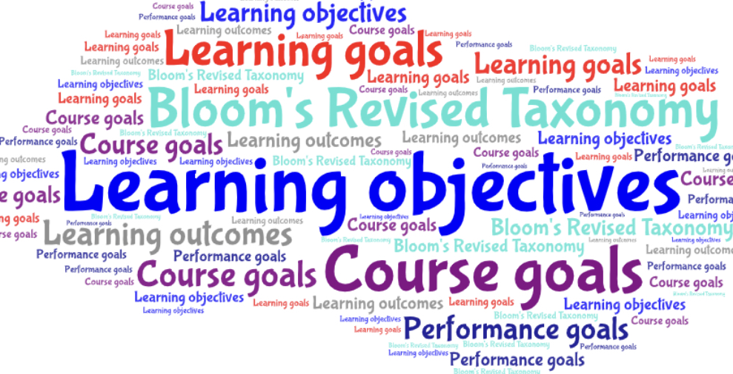

Slide 4
Background

Slide 5
Summative assessment of the knowledge base underpinning independent UK General Practice
Tests the application of this knowledge
Tests the critical interpretation of information
Mapped to the latest RCGP Curriculum updates
Each question is intended to explore a topic which an ordinary GP in the UK could be expected to have a working knowledge

Slide 6
Format

Slide 7
200 item multiple choice test lasting 190 minutes (3h 10m)
No negative marking
Delivered on a computer terminal (subject to reasonable adjustments) at an invigilated test centre
Offered 3x per year Jan/Feb, April/May, Oct/Nov

Slide 8
Rules

Slide 9
Training starting from 1/8/10 onwards
Only eligible to take in ST2 or ST3
Maximum number of attempts usually 4, but due to COVID-19 a single unsuccessful attempt at either July or August 2020 AKT will not count towards the total number of permitted attempts
In accordance with GMC guidance an AKT pass is valid for 7 years, but due to COVID-19, trainees due to CCT in the first 12m of the pandemic will be allowed an exam currency of 7y 6m
In exceptional circumstances candidates are allowed to make exceptional 5th attempts on the basis of additional educational attainment

Slide 10
Exam taking strategies

Slide 11
Many factors need to be considered including confidence, learning style, preparation, organisational skills and personal situations
Most examiners view the second half of the ST2 year as the optimum time, especially if you have completed a GP placement
The pass rates for first-time ST2 takers in the April sitting of the exam are as good as first- time ST3 takers in the October sitting, and a pass in ST2 means one large assessment “hoop” is removed from the busy ST3 year

Slide 12
Many trainees who defer a sitting into ST3 find that the pressure of taking RCA and AKT and WPBA is distracting and detrimental when there is so much to learn about being a GP - apart from the exam!
A prolonged gap between AKT preparation and taking RCA (which requires an up-to-date knowledge base) is best avoided so a balance needs to be struck
Following a failure you are often into ST3 and occasionally into extension

Slide 13
Despite this, it is vital you get yourself ready to sit the exam
Begin by looking carefully at the AKT sections of the RCGP website and allow at least 3/12 of efficient exam preparation
Know your own learning style and reflect on previous exam successes/problems

Slide 14
If this is not your first AKT sitting, review with your ES / TPD how you prepared previously, what changes to preparation you intend to make and whether or not you need any additional support
Dyslexia Screening - IF POSITIVE ADAPTATIONS MAY BE VITAL FOR SUCCESS
Do you and your ES agree that you are ‘ready to sit’ the AKT?
Review, repeat or undertake a needs assessment(s) and concentrate on weaker areas as opposed to reinforcing strengths!

Slide 15
These could include prioritising your personal development plan based on the results of any of:
  RCGP curriculum self-assessment excel spreadsheets
  RCGP Essential Knowledge Updates and Challenges
  Patient Unmet Needs + Doctor Educational Needs
  Trainer feedback
  RCGP Curriculum
  Results from on-line commercial exam preparation websites

Slide 16
How has failure made you feel?

Slide 17


Slide 18
Why do trainees fail?

Slide 19
Don’t bother with dyslexia screening after an unsuccessful attempt
Failure to change revision tactics / exam technique
Failure to answer all 200 questions
The exam itself - turn up late, pacing, don’t take the right stuff
Ignore findings of any learning needs assessment
Revise too much for stats / practice administration (only 10%)
Ignore stats altogether because many questions are simple data interpretation and not complex calculations
Don’t look at the AKT Exam website
Lack of curriculum coverage
Lack of experience in UK medicine
Exam taken too early in training
Lack of time to study
Doing endless practice questions without using them to direct study

Slide 20


Slide 21
Cumulative pass rate after four attempts for all those who take AKT is around 92%

Slide 22
AKT 40 - October 2020
1594 candidates
Scores 72-195/199 questions
Mean 74.72%
Clinical knowledge 74.82%
Evidence-based practice 72.84%
Organisation & management 75.8%
Pass mark 139/199 = 69.84%
Pass rate = 70.14%

Slide 23
AKT 39 - August 2020
1207 candidates
Scores 65-189/200 questions
Mean 143.42 (71.71%)
Clinical knowledge 72.34%
Evidence-based practice 67.25%
Organisation & management 71.20%
Pass mark 135/200 = 67.5%
Pass rate 66.8%

Slide 24
AKT 38 - July 2020
221 candidates
Scores 84 to 178 / 200
Mean 139.48 (69.61%)
Clinical medicine 69.61%
Evidence interpretation 69.03%
Organisation & management 71.47%
Pass mark 135 = 67.5%
Pass rate 66.06%

Slide 25
Topics causing most difficulty

Slide 26
Professional Topics
Consulting in General Practice
Communication of risk and the use of risk tools
Evidence-based practice, Research and Sharing Knowledge
Basic understanding of concepts and terms in research (absolute and relative risk)
Data interpretation (both research and other data sources)
Research methodology
Improving Quality, Safety and Prescribing
Antibiotic indications and resistance
Drugs: monitoring; adverse reactions; interactions; dose calculations; end of life care
Safe prescribing and medicines management (including MHRA alerts)
Leadership and management
Death certifications and notifications to Coroner / Procurator fiscal
Staff health and health and safety in the workplace

Slide 27
Life Stages Topics
Children and Young People
People at the End-of-Life

Slide 28
Clinical Topics
Diagnosis of common oral conditions
Different presentations of multi-system disease
Eye problems
Immunisation schedules
Recognising presentations of mental ill health (including physical symptoms)
Management of hearing loss
Normal findings, minor illness, and infections in childhood
Respiratory medicine - including asthma, COPD and rarer diagnoses
Suspected cancer: diagnosis and investigation (including less common presentations)
Timely but appropriate referral (including emergencies and when to do nothing)
Prescribing in diabetes, including insulin

Slide 29


Slide 30
Questions in the AKT sample across the breadth of the curriculum
The previous ‘AKT Content Guide’ has been subsumed within the GP Curriculum and can be found in the Knowledge and Skills subsections of each Topic Guide
Don’t be put off by the lengthy list of topics!

Slide 31
Use the topic guides as needs assessment tools
Carefully review the sections relevant to:
  Organisation and management - including administrative, statutory, ethical and regulatory frameworks
  Evidence-based practice - including research, statistics and epidemiology

Slide 32
MRCGP AKT Exam website

Slide 33
Look carefully at the website
The ‘How to prepare for the AKT’ section contains helpful resources including:
  ‘Preparing to take the AKT’ pdf
  50 AKT Sample questions with answers
  How trainers can help with AKT preparation
  Evidence and data interpretation in the AKT
  AKT FAQs
‘AKT Summary Reports’ dating back to October 2007 should help to guide revision plans

Slide 34
Exam construction

Slide 35
Ensures
Reliability, validity and fairness
Adequate coverage of the topics that appear in the blueprint
The correct balance of question formats

Slide 36
Principles
Relevance
The AKT should be relevant to general practice
High prevalence
Any topic covered can be one which occurs commonly
High impact
Any topic covered can be one that is significant but less common

Slide 37
Content
80% of questions
Core clinical medicine and its application to problem solving in a general practice context
10% of questions
Data interpretation, critical appraisal, and evidence based clinical practice
10% of questions
Ethical and legal issues as well as the organisational structures that support UK general practice

Slide 38
Clinical Medicine
The broad topic of clinical medicine is subdivided into groups of body systems, in approximately equal numbers
Each group will comprise questions on:
  Disease factors
  Symptoms
  Investigation
  Management

Slide 39
Cardiovascular
Dermatology
Endocrinology
ENT
Gastroenterology
Genetics
Haematology
Immunology
Infection
Mental health and learning disability
Musculoskeletal
Ophthalmology
Paediatrics
Renal
Reproductive - male ‘ female
Respiratory
Therapeutic indications and adverse reactions

Slide 40
Common, (mostly) low impact - eg sore throat, contraception, IBS
Rare, high impact - eg child abuse, meningitis, phaeochromocytoma
Topical - eg guidance, COVID-19, optimum use of antibiotics

Slide 41
Evidence-based practice
A range of resources are used to test data interpretation, including the types of graphs and tables regularly sent to practices from CCGs and local health boards

Slide 42
Organisation and management
NHS organisations
Legal aspects eg DVLA
Medical certification eg death certificates
Professional regulation eg GMC
Business aspects eg GP contract
Prescribing eg controlled drugs
Appropriate use of resources eg drugs
Health and Safety eg needle stick injury
Social services eg safeguarding
Ethical eg mental capacity, consent

Slide 43


Slide 44
How do the questions get written?
Topical
Practice issues
Scenarios derived from clinical work
All questions are referenced and the draft questions are then carefully scrutinised by a panel of experienced question writers
Care is taken to consider any conflict between national guidance and regulations across the four devolved nations
All question writers are working GPs

Slide 45
Common reference material used
GMC Good Medical Practice
NICE guidelines
SIGN guidelines
CKS
BMJ review articles and original papers
BJGP
Cochrane
Vaccine update (www.gov.uk) / Green Book
BNF - including the initial ‘generic’ chapters in the print version

Slide 46
Big Tip
Learn Therapeutics
A recent review highlighted that up to 27% of AKT questions require a knowledge of therapeutics
Although the question might appear to be about a respiratory, cardiovascular or endocrine issue, the management will often involve recommending the correct medication - also requiring an awareness of the potential for interactions and monitoring requirements

Slide 47
Question formats

Slide 48
Single Best Answer (SBA)
Multiple Best Answer (MBA)
Extended Matching Questions (EMQ)
Photographic image
Data interpretation
Free text
Drug calculation

Slide 49
Single Best Answer (SBA)
‘According to National Guidelines’ means recommended by nationally accepted guidelines of the BNF, not local practice
Often use a clinical scenario
Only one answer is correct
Other incorrect options may be plausible but not ‘most likely / most appropriate’

Slide 50
Single Best Answer (SBA)
Example
A 37yo male suddenly develops chest pain and dyspnoea after a morning swim. There is hyper-resonance and decreased breath sounds on the right side
Which is the most likely diagnosis? Select one option only
  A. Asthma
  B. Intercostal muscle strain
  C. Pleural effusion
  D. Pneumothorax
  E. PE

Slide 51
Multiple Best Answer (MBA)
Often uses a clinical scenario
Two answers are correct
Both answers must be chosen to score one mark
Other options may be plausible but not the ‘most likely / most appropriate’

Slide 52
Multiple Best Answer (MBA)
Example
A 35yo man has persistent dyspepsia. A stool test for Helicobacter pylori is positive. He is allergic to penicillin
According to national guidance, which are the most appropriate antibiotics to combine with omeprazole to eradicate H.pylori? Select two options only and both must be correct to score one mark
A. Amoxycillin
B. Cefalexin
C. Clarithromycin
D. Co-amoxiclav
E. Doxycycline
F. Erythromycin
G. Lymecycline
H. Metronidazole

Slide 53
Extended Matching Questions (EMQ)
These questions have a list of possible options
There will usually be two or more scenarios
Choose the most likely / most appropriate option that best matches each given scenario
Each option can be used once, more than once, or not at all

Slide 54
Extended Matching Questions (EMQ)
Example
For the patient described, select the most appropriate diet from the list of options
A 23yo female has had mild diarrhoea, abdominal pain and bloating for several years. Her bloods are normal, including IgA anti-tTG antibodies test
A 62yo male has recurrent swelling of his great toe which responds to naproxen. He drinks 18 units of alcohol a week and his urate level is 540 μmol/L (Normal < 450 μmol/L)
A. Elemental diet
B. FODMAP
C. Food elimination
D. Gluten-free
E. High fibre
F. Lactose-free G. Low purine
H. Mediterranean

Slide 55
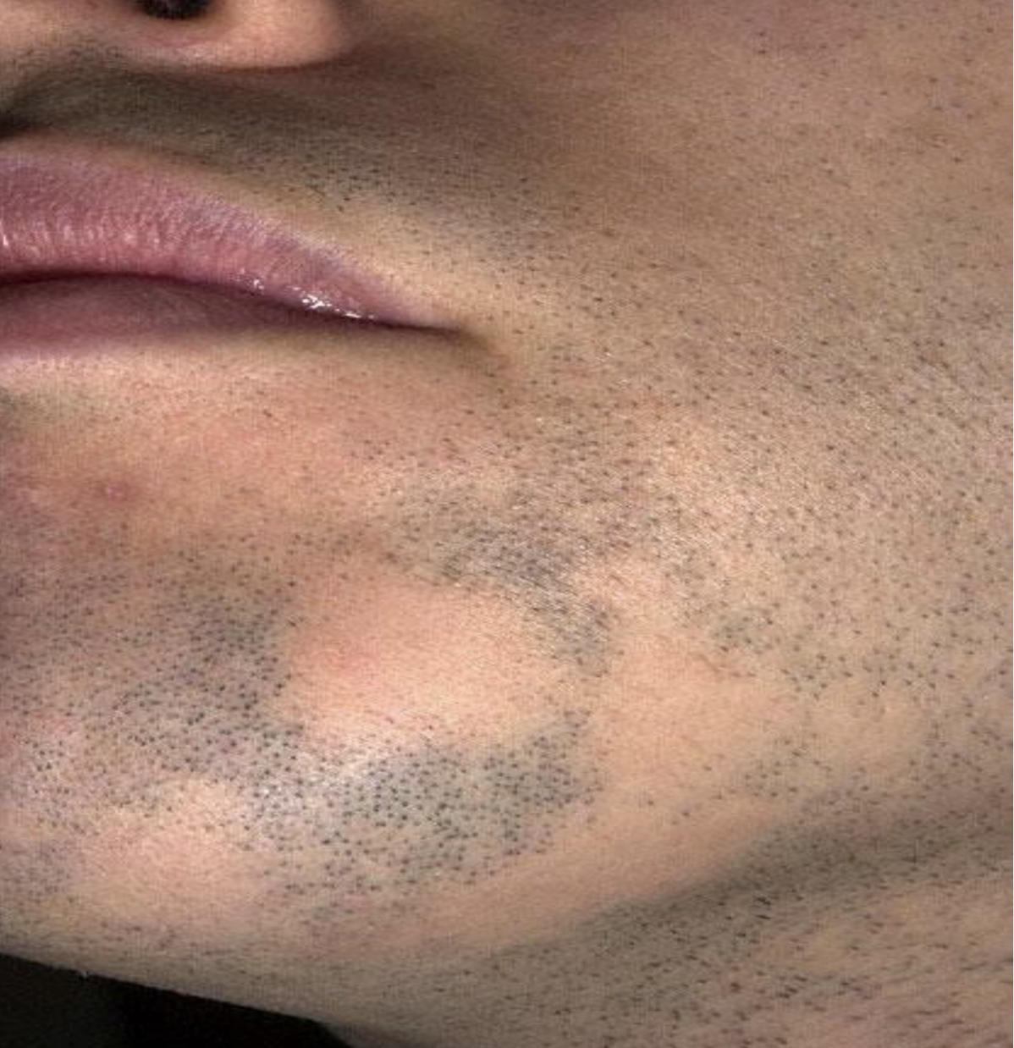
Photographic image
A 32-year-old man has noticed painless non- itchy patches of hair loss on his beard area and scalp
Which is the single most likely diagnosis? Select one option only.
A. Alopecia areata
B. Eczema
C. Lichen sclerosus
D. Tinea infection
E. Vitiligo

Slide 56
Data Interpretation
Interpretation of data, e.g for groups of patients with chronic conditions
Interpretation of research and audit results
Understanding and application of common statistical terms, e.g number needed to treat (NNT) and absolute or relative risk
Which single study shows superiority of levonorgestrel over Yuzpe in preventing pregnancy?
Select one option only
  A. Farajkhoda
  B. Ho
  C. Hoseini
  D. Sheng
  E. Sun
  F. WHO

Slide 57
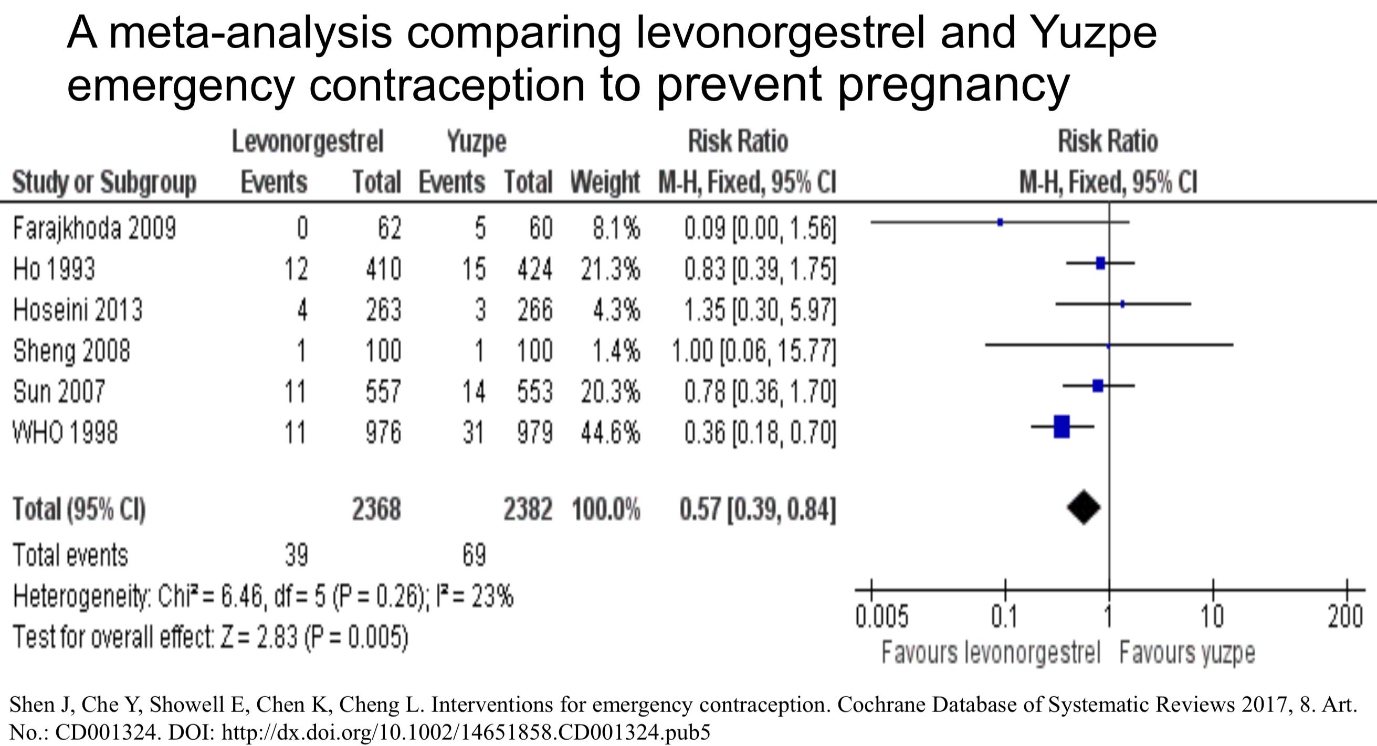

Slide 58
Free Text Questions
Require the candidate to generate the correct answer without a list of options to choose from
For example:
  Dose calculation
  Name of first-line medication
Eliminates guessing from a list of answers
All answers are screened manually to check for minor typographical errors which may be counted as correct
Candidates will be expected to spell drug names correctly
A 67-year-old man has type 2 diabetes and a BMI of 33 kg/m2. His HbA1c is 62 mmol/mol on diet alone and his renal function is normal
Which is the single most appropriate initial drug treatment? Give one answer only

Slide 59
Free Text Questions
... numerical
An on-screen calculator is available
Any arithmetic required in an AKT question (e.g. drug dose calculations) is basic and simple and most candidates do not need to use it
Remember to check that your given answer is credible!
A 12-year-old boy is to start carbamazepine 2.5 mg/kg bd. He weighs 40 kg and carbamazepine liquid is available as 100mg/5ml
What volume of liquid is required for thirty days use? Use figures not words. Percentages and fractions are not acceptable

Slide 60


Slide 61
All question formats have equal weighting
Each correctly answered question is awarded one mark
Total score on the paper is the number of correct answers given
No negative marking – it is important to answer all the questions

Slide 62


Slide 63
Time management - this is everything
Keep watching the countdown clock on the computer
200 questions in 3 hours 10 minutes = an average of 57 seconds per question
You should skip questions you find difficult rather than waste time. Electronically ‘flag for review’ the ones you have left out but don’t forget to leave time to go back before the end
Cover test – can you answer the question with the option list covered? If so, it’s probably the correct answer
Go through unanswered questions 2nd time round using the review facility
Do not leave any questions unanswered – educated guessing is worthwhile
Check for silly mistakes if you still have time

Slide 64
All the AKT question formats, apart from the free text, require the candidate to identify the best answer(s) from a given list of plausible alternatives, using all of the information in the question
There may be other answers which are not included in the option list, but you have to focus on the best available answer listed for the specific question asked

Slide 65


Slide 66
RCGP Resources
AKT Summary Reports
How to prepare for the AKT
  AKT sample questions with answers
  AKT presentation for candidates and trainers
  Pearson Vue testing tutorial and practice exam
Essential Knowledge Updates and Essential Knowledge Challenges
RCGP InnovAiT
RCGP Faculty preparation courses
RCGP One-day Essentials courses
RCGP eLibrary

Slide 67
Patients, Trainees, Trainers and GP Educationalists
Your trainer and training practice are excellent resources. Review consultations with your trainer in order to specifically examine the evidence for what was done?
The best preparation really is from your day-to-day work at your practice and with your VTS peers. Make sure you record and action any identified educational needs promptly and efficiently
All AKT examiners are working GPs and the questions are grounded in real-life. Previously the RCGP asked for a group of Trainers to sit the AKT and (reassuringly) they all passed, so please don’t forget to ask your Trainer! This should include asking about the sort of paperwork and graphs/data interpretation they receive on a daily basis, which you may not otherwise see, such as: insurance reports, Department of Work and Pensions reports and practice performance information from the local primary care organisation

Slide 68
Non-RCGP Resources
Essential resources that should be regarded as ‘mandatory’ include the BNF, BNFC and GMC Good Medical Practice
There are a large number of commercial resources specifically created for AKT preparation and all can be very helpful to identify and address your learning needs. Many on-line commercial organisations have hyperlinks to the related evidence, so use these links to read around a topic in more detail, rather than just trying to recall the answer to an individual question. Discuss with other trainees and GP Educators which sites they have found most relevant
I would caution against the over-reliance of repeatedly answering questions from one resource alone without looking at other resources

Slide 69
The AKT examiners do NOT write questions for any commercial organisation
Historically some trainees have reported that the style and difficulty of online/textbook questions can be very different from that of the exam. Avoid relying on MRCP style revision aids
Whichever resource you use, ensure you take some questions under ‘exam conditions’ i.e. with the same time limitations (200 questions in 3 hours 10 minutes)
GP Update and NB Medical Hot Topics courses remain ever popular with AITs and qualified GPs alike

Slide 70
Recommended Reading
BNF first few chapters – essential reading, plus the main drug classes InnoVAIT journal
NICE guidance/pathways
NICE Clinical Knowledge Summaries
SIGN guidance
Oxford Handbook of General Practice
British Medical Journal
British Journal of General Practice
DVLA At a glance guide to the current medical standards of fitness to drive Good Medical Practice for General Practitioners (RCGP)
Good Medical Practice: Good Medical Practice (GMC)
Medical defence organisations’ educational resources

