Slide 1
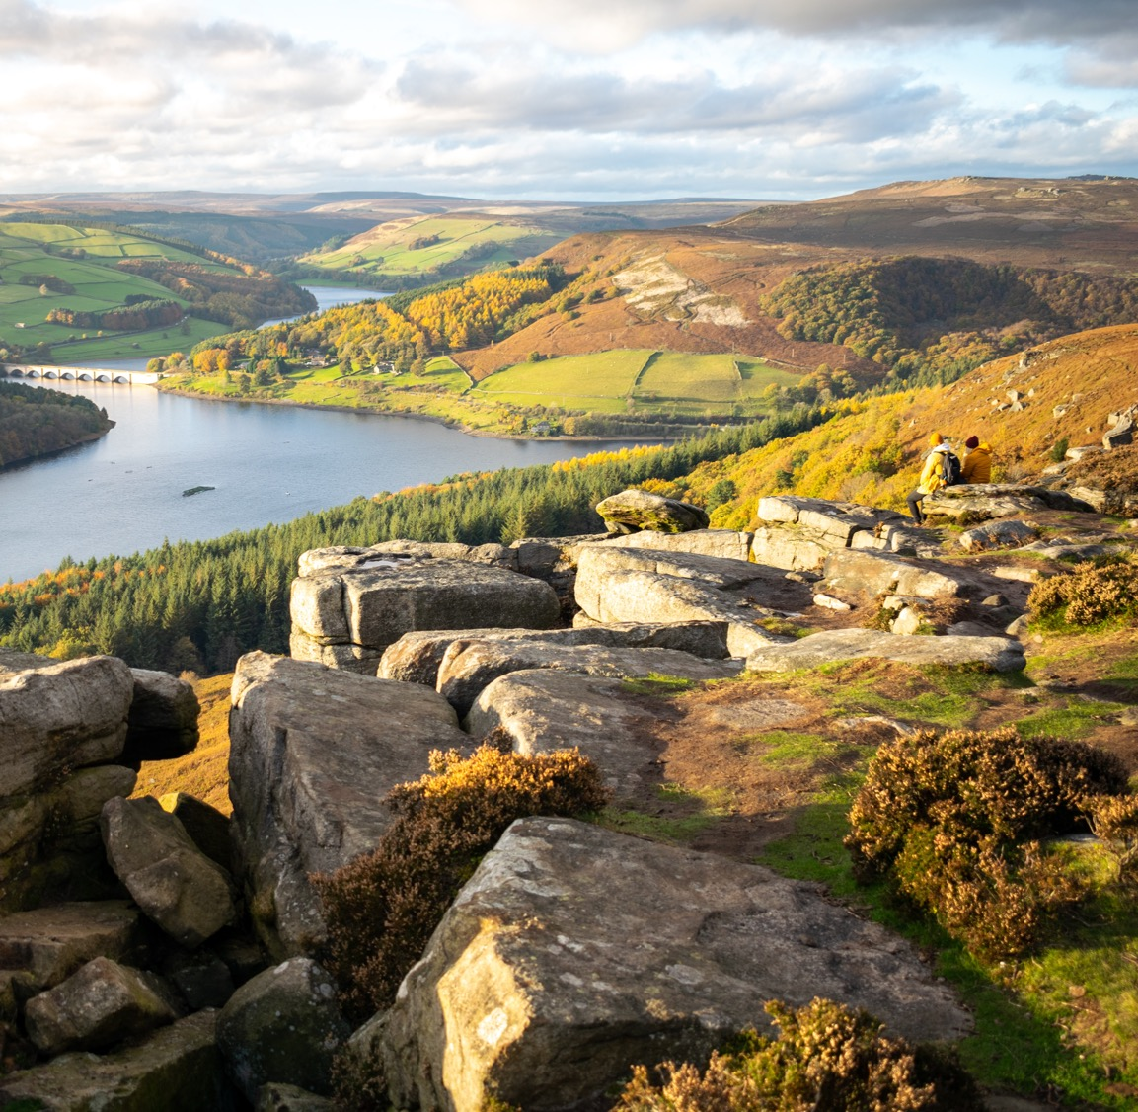
CAT South Yorkshire
Committee of Anaesthetic Trainees

Slide 2

What is CAT?
Informal group of anaesthetic trainees who represent South Yorkshire about training/welfare issues
Organise events (wellbeing, socials, conferences)

Slide 3
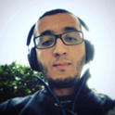

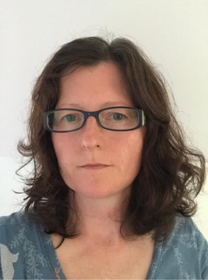
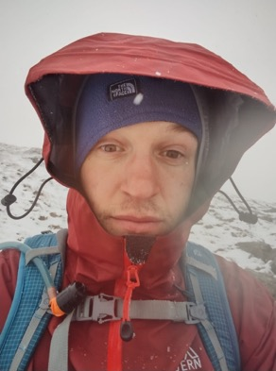

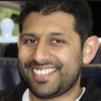
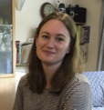
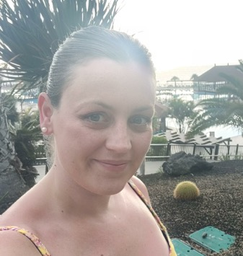
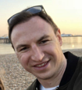

Who are we?
Ahmed – Stage 3 Rep
Julia – Co-Chair
Annette – Stage 2 Rep
Ben – TOOT
Jenny - LTFT
Kab – Treasurer
Morwenna - Secretary
Chloe – Co-chair
Will - Socials
Kim – Stage 1 Rep

Slide 4
Where to find us
Northern General - Julia Brown, Ahmed Atewah and Morwenna Read
Rotherham - Annette Haines, Ben Marshall, Kim Newton and Kabir Nepal
Doncaster - Will Reilly
Children’s hospital - Chloe Billingham
Barnsley and RHH - No one!

Slide 5
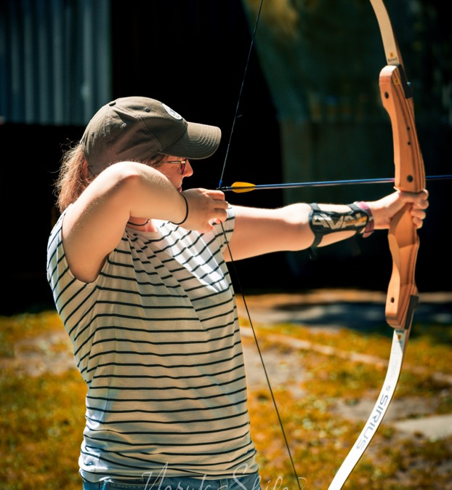
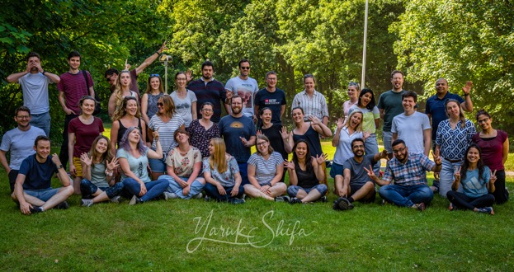
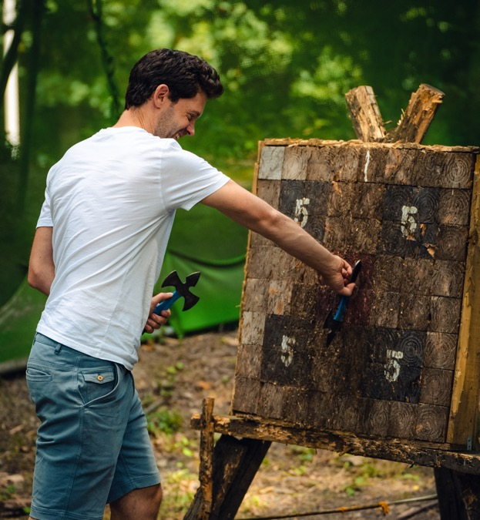
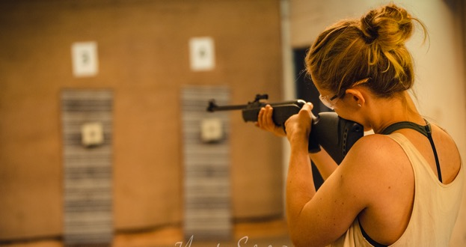
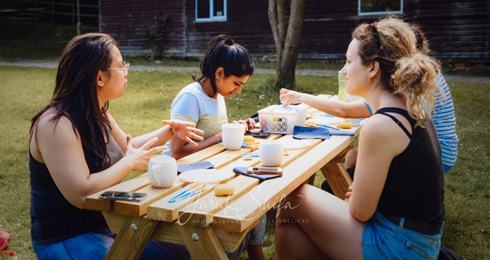
Away Day

Slide 6

South Yorkshire Ball
8th October
Inox Dine in Sheffield
£40 for 3 course meal, drink and dancing!
Anaesthetists/partners/theatre staff/mates etc welcome
Email SheffieldCATball@gmail.com for tickets
Notes:
Hi everyone,
This is a reminder that tickets are selling quickly for the Anaesthesia ball 2022. They are £40 and will be available until the end of August. Included in the ticket price is a 3 course meal, a drink on arrival followed by music and dancing until 1am.
For tickets please email sheffieldcatball@gmail.com

Slide 7
Yorkshire Anaesthetic Trainee Conference (YAT)
Chance to present your projects at a regional conference
Prizes for best presentation
Usually October with half day mini-YAT in Feb

Slide 8
Novice Guide
Written this year as a “how to” guide for anaesthesia
Is it useful? What could be improved?
Please fill out the survey at the end of the guide to let us know! (please!)
Notes:
This year a few of use wrote a novice guide
We did this because we felt that novice period was so overwhelming and sometimes a bit inconsistent in your experiences so wanted to show you the basic patterns that are present in most anaesthetics, can sometimes be difficult to decode at first
Also has some information on how to use the portfolio and admin things
Ask other/senior trainees questions about how to do stuff!

Slide 9
How you can contact us
Email: ShefGasCAT@gmail.com
Twitter: @shefgascat
Instagram: @shefgascat

