Slide 1
Consultation skills for RCA

Slide 2
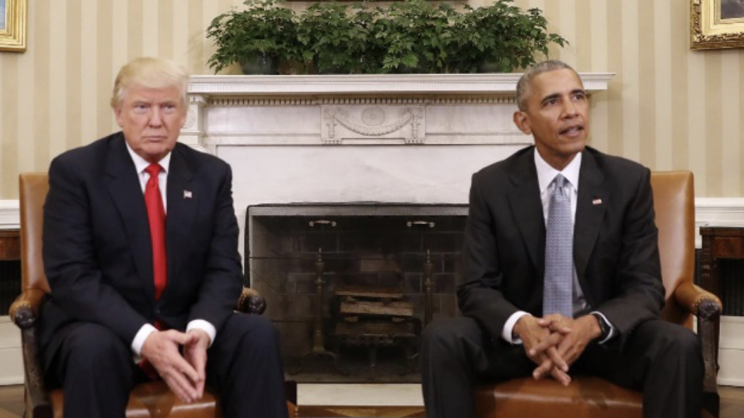
Consultation behaviour

Slide 3

Why do patients consult with their GP?
It is common to assume most patients initiate contact with a GP because they assume a new symptom indicates a disease - OFTEN WRONG
In hospital symptoms often = disease
In the community lots of people have symptoms regularly and they don’t attend their GP because the symptoms go away on their own
In general practice symptoms rarely = disease
How we deal with symptoms is called illness behaviour and this is influenced by a whole variety of factors

Slide 4
Factors influencing a patient’s illness behaviour
Family
Friends
Internet
Culture
Previous experience
Social triggers - work, life, pressure from others
Psychological triggers - stress levels, anxiety, depression
Personality

Slide 5
In UK nobody goes to GP with just a symptom
They will have:
IDEAS about their symptom
CONCERNS about their symptom
EXPECTATIONS about what you will do for them
It is important to discover them and use them in your consultation

Slide 6
Hospital Consultation Model
Symptoms = Disease
History
Examination
Investigations
Diagnosis
Management plan
Follow up
The doctors’ job is to diagnose disease

Slide 7
GP consultation model
Open the consultation
Discover psychosocial context, patients ICE, identify cues
Generate and test diagnostic hypotheses, excludes serious disease (red flags)
Appropriate examination and investigations
Make and explain a working diagnosis
Offer a safe patient centred management plan
Provide appropriate follow-up and safety netting

Slide 8
RCA marking scheme

Slide 9
Data gathering, Technical and Assessment Skills
Takes a focussed history to allow for a safe assessment to take place
Elicits and develops relevant NEW information
Rules in or out serious or significant disease
Considers and/or generates any appropriate diagnostic hypotheses
Explores where appropriate the impact and psychosocial context of the presenting problem
Plans, explains and where possible, performs appropriate physical/mental examinations and tests
Appears to recognise the issues or priorities in the consultation

Slide 10
Decision Making and Clinical Management Skills
Appears to make a safe and appropriate working diagnosis/es
Offers appropriate and safe management options for the presenting problem
Where possible, makes evidence-based decisions re prescribing, referral and co-ordinating care with other health care professionals
Makes appropriate use of time and resources whilst attending to risks
Provides safety netting and follow up instructions appropriate to the nature of the consultation

Slide 11
Interpersonal Skills
Encourages the patient's contribution, identifying and responding to cues appropriate to the consultation
Explores where appropriate, patient’s agenda, health beliefs & preferences
Offers the opportunity to be involved in significant management decisions reaching a shared understanding
When undertaken, explains and conducts examinations with sensitivity and obtains valid consent
Provides explanations that are relevant, necessary and understandable to the patient

Slide 12
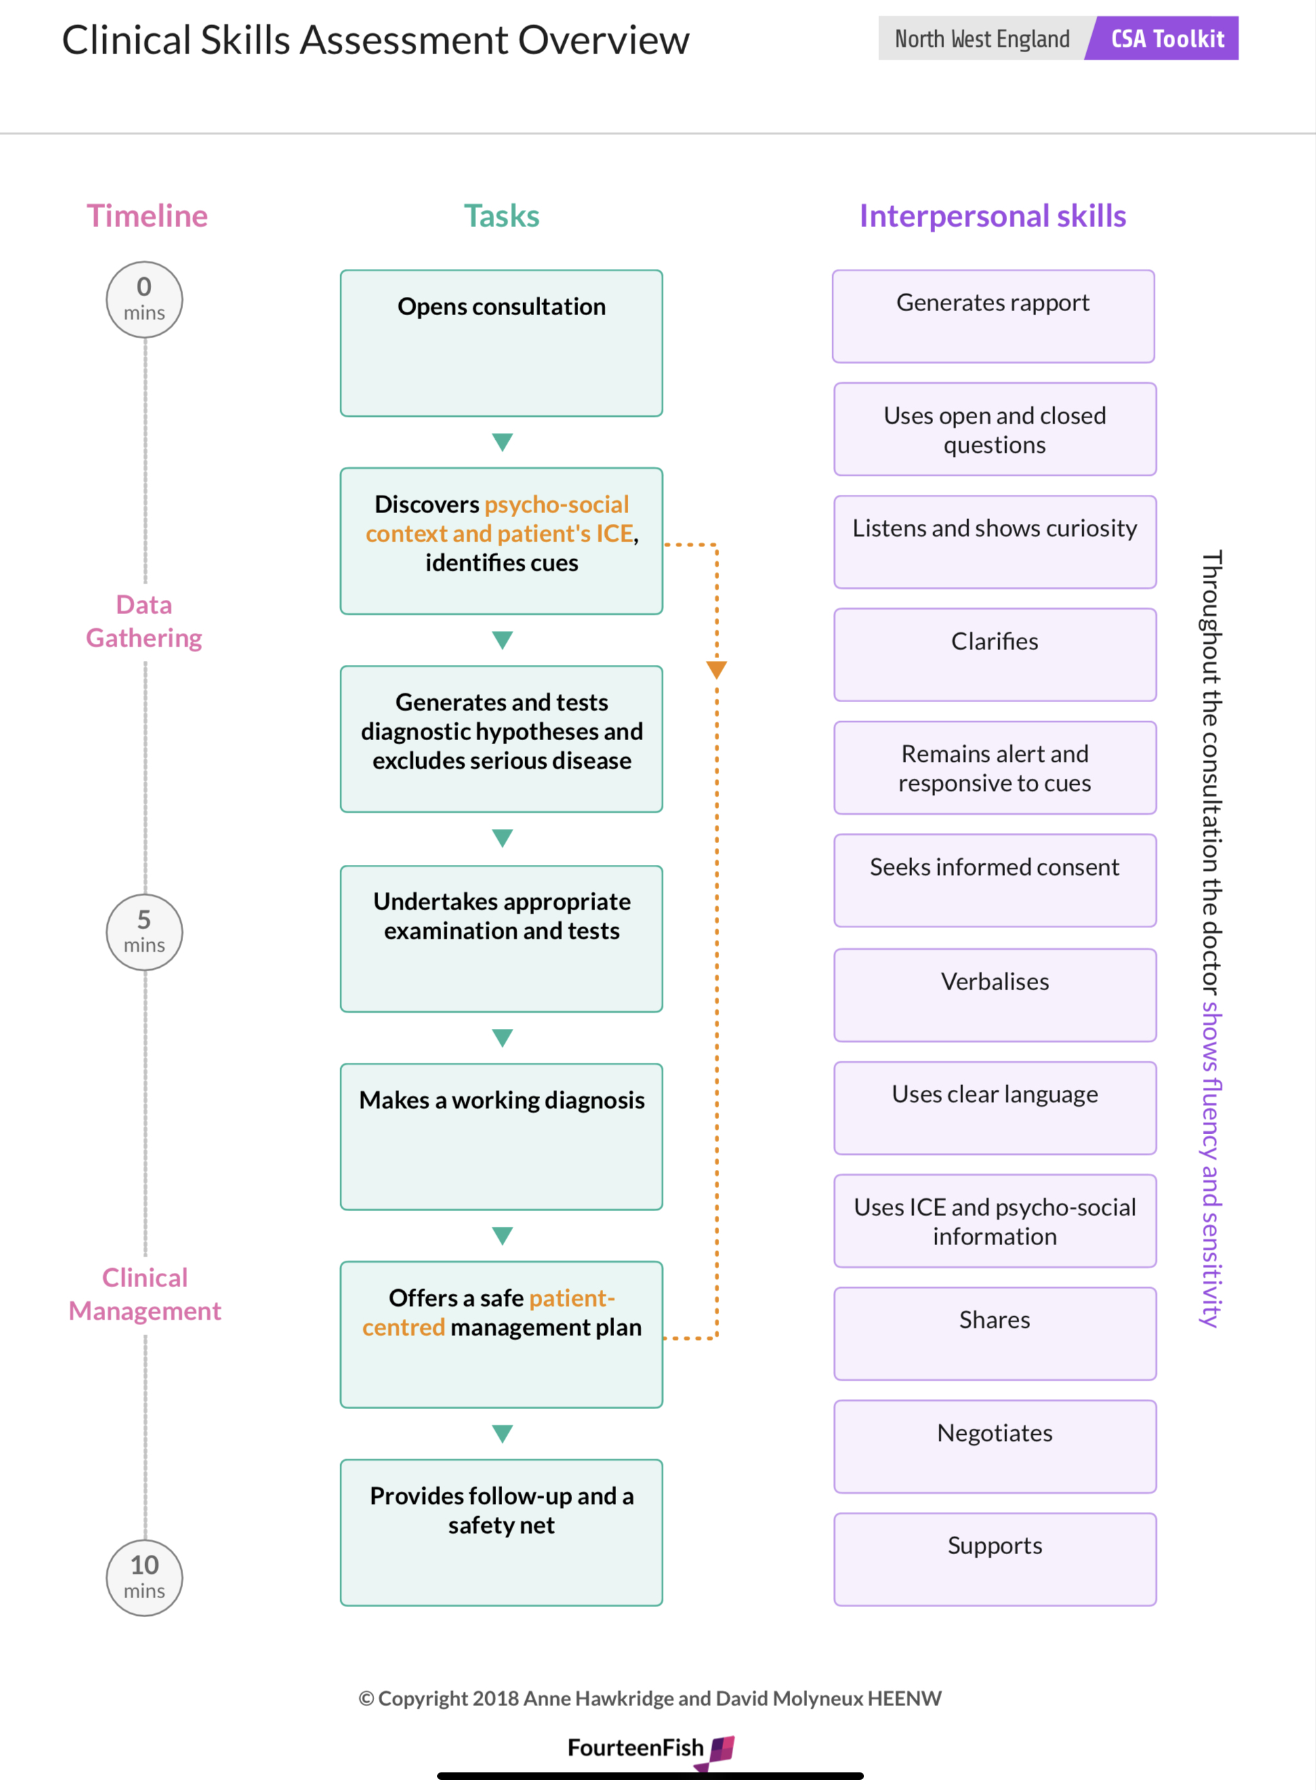
Consultation structure

Slide 13
In order to get through the consultation in 10 minutes and score well in all 3 domains you need a clear structure

Slide 14
Consultation structure
Open the consultation
Discover psychosocial context, patients ICE, identify cues
Generate and test diagnostic hypotheses, excludes serious disease (red flags)
Appropriate examination and investigations
Make and explain a working diagnosis
Offer a safe patient centred management plan
Provide appropriate follow-up and safety netting

Slide 15
Data gathering, Technical and Assessment Skills
Find out about the patient’s problem
Open the consultation
Discover psychosocial context, patients ICE, identify cues
Generate and test diagnostic hypotheses, excludes serious disease (red flags)
Appropriate examination and investigations

Slide 16
1. Opening the consultation

Slide 17
The opening of the consultation is very important, and sets the scene. If it goes badly, subsequent tasks can be adversely affected. A good opening contributes to the establishment of rapport and puts the patient at ease

Slide 18
Useful behaviours
Introduce yourself to the patient
Demonstrate interest in them
Your non-verbal body language encourages the patient and helps them to feel ‘at ease’
Begin with an open question (for example, “How can I help today?”)
Do not interrupt until they have said what they need to say
Remain focussed on the patient with good eye contact and positive non verbal body language

Slide 19
2. Discover psychosocial context, patients ICE, identify cues

Slide 20
Psychosocial context
Discovering the psycho-social context of the patient’s problem is vital in developing patient centred management plans
You need to be able to:
  Discover the relevant psycho-social information from the patient - including aspects of work life and home life
  Discover the impact of the problem on patient’s work and home life
  Discover the way that home and work life impacts on the presenting problem

Slide 21
Patients ICE, identify cues
Discovers the patient’s perspective which includes their ideas, concerns and expectations
Identifies both verbal and non verbal cues offered by the patient

Slide 22
3. Generate and test diagnostic hypotheses, excludes serious disease (red flags)

Slide 23
It is important to demonstrate a safe approach to making diagnoses and to ensuring that important diagnoses are effectively ruled in or ruled out. You should think about a list of differential diagnoses based on the presenting symptom or problem. Test each weighing up their probability using focussed history taking. Rule in and out serious disease during questioning

Slide 24
Red flags
Weight loss
Excessive fatigue, new unexpected tiredness
Blood
Bone pain, pain that wakes at night
Night sweats
Family history
Previous cancer / illness
Anaemia
Unexpected lumps and rashes

Slide 25
Cancer as a diagnosis
The average full-time (8 session) GP will see:
8 new lung cases per year per 2000 patients
1 lung per 6m
1 great per 12m
1 colorectal and skin per 18m
1 prostate per 2y
1 cervix, ovary and uterus per 6y
1 brain per 10y
1 thyroid per 25y

Slide 26
4. Appropriate examination and investigations

Slide 27
Lots can be done in an audio & video setting. Lots of patients have a thermometer, BP machine, BS monitor, Sats monitor. You may want to bring them into surgery but explain what you would like to examine and why

Slide 28
Clinical Examination is considered an important component of the assessment and remains essential within the practical and ethical constraints of a recorded consultation. It is not sufficient to merely state that an examination is required
Clinical examination forms part of data gathering where you confirm or refute your differential diagnoses from your history by examining the patient. In the current environment, many consultations are by telephone and it is then arranged for the patient to attend the surgery for an examination if required - it is expected that you would explain clearly to the patient what that examination might involve and how that would influence their subsequent management. Simply stating “we need to examine you” does not satisfy this criterion

Slide 29
Swimsuit area
For children up to age 2 years the area which would normally be expected to be covered by a “nappy”
For all male patients over the age of 2 years the area which would be covered by “Trunks”
For all female patients over the age of 2 years the area which would be covered by a “bikini” ie the “trunks area and breast”

Slide 30
Decision Making and Clinical Management Skills
Explain and deal with their problem
Make and explain a working diagnosis
Offer a safe patient centred management plan
Provide appropriate follow-up and safety netting

Slide 31
Share your working diagnosis with the patient bearing in mind what they have told you about their theory. Share and discuss the your plan of action with the patient. Agree on the plan. Arrange suitable follow up to check the action plan is working and what to do if it does not work (safety net)

Slide 32
5. Make and explain a working diagnosis

Slide 33
In order for this part to go well, you need to make a diagnosis or tell the patient what you are thinking, tell them what the diagnosis is and be as sure as possible that the diagnosis is correct. Unfortunately sometimes the diagnosis is not made or not shared, or the diagnosis is wrong

Slide 34
6. Offer a safe patient centred management plan

Slide 35
It is common for the trainee to show an inability to manage a condition according to up to date guidelines. This is likely to be a knowledge problem. Many are disorganised and do not manage time well, so the management part of the consultation is rushed and/or doctor centred
You need to be have sufficient knowledge to offer to the patient effective management strategies
You need to involve the patient so that the final management plan is patient centred
There needs to be sufficient time to allow the necessary discussion to occur

Slide 36
7. Provide appropriate follow-up and safety netting

Slide 37
Follow up and safety net
Offer appropriate follow up the patient, which is dependent on the nature of the condition
Develop a safety net for the patient that is SMART (Specific, Measurable, Achievable, Relevant and Timely)

Slide 38

Why candidates fail

Slide 39
Poor choice of cases eg multiple problems, follow up
Insufficient evidence for independent UK GP : Low challenge
Fail to score in each domain: DG, CM, IPS..
No structure to consultation
Hospital based / Dr centred / rigid consulting
Failing to involve the patient
Don’t listen and lack empathy
Unable to see / discover the issue
Poor clinical knowledge
Poor technical quality: Usually internet connection

