Slide 1
Core anaesthetics
CT1 Year 2022 - 2023
Ed Knights CT3

Slide 2
Where to find all the info
HEEYH:
https://www.yorksandhumberdeanery.nhs.uk
RCoA:
https://www.rcoa.ac.uk
https://rcoa.ac.uk/documents/novice-guide/introduction
RCoA LLP:
https://lifelong.rcoa.ac.uk/dashboard/learning

Slide 3
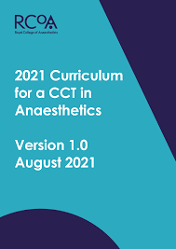
The Curriculum

Slide 4
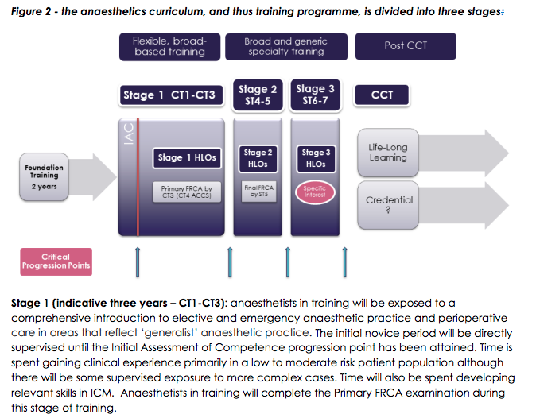
The curriculum

Slide 5
Glossary
HALO- Holistic Assessment of Learning Outcomes
SLE- Supervised Learning event
MSF- Multi-source feedback
MTR- Multiple Trainer Report
IAC- Initial assessment of competence
EPA- Entrustable professional activities

Slide 6
CT1 ARCP checklist

Slide 7
ARCP outcomes
Outcome 1: Progressing as expected. Trainee anticipated to move on to their next training module.
Outcome 2: Development of specific competencies required, but no additional training time needed. Trainee is anticipated to move on to their next training module, but may require some additional competencies or training exposure during this period.
Outcome 3: Inadequate progress by trainee, additional training time required. This is for trainees who have specific training requirements that cannot be obtained without extra training time. This is usually for trainees who haven't yet passed the FICM exam and are not eligible to move into the next training phase without it. They may be given extra time ("on an extension") to obtain this missing component (e.g. the exam). The trainee's CCT date is likely to be extended.
Outcome 4: Trainee leaves the training programme without completion of training
Outcome 5: Incomplete evidence presented. ie. the panel cannot make a judgement on whether a trainee is progressing or not, because the required evidence is not available.
Outcome 6: Gained all required competencies and successfully completed the training programme
Notes:
https://www.yorksandhumberdeanery.nhs.uk/anaesthesia/assessmentappraisal/arcps__guides

Slide 8

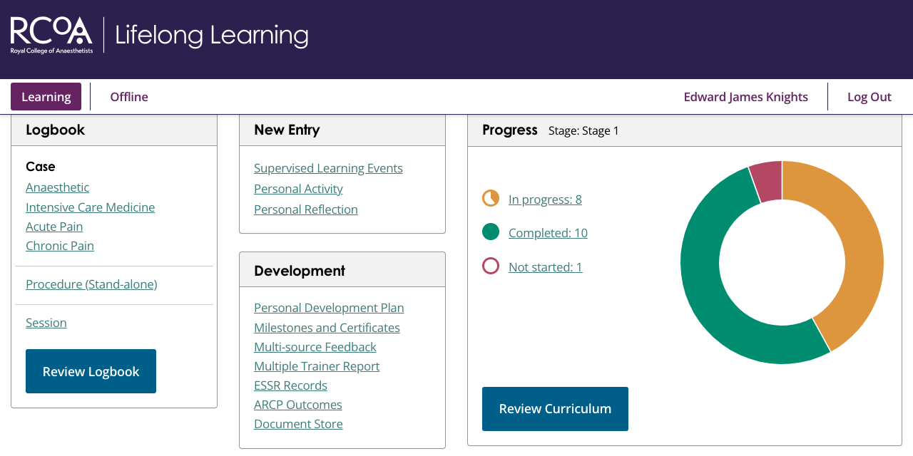
The lifelong learning platform

Slide 9
PDP

Slide 10
Supervisory meetings

Slide 11
Structured training report
Send to your Educational Supervisor
Need to do towards the end of the year
Make sure all your evidence is finalized before sending – you can’t add after it’s been sent
NB the ARCP panel can’t see any of your evidence until your ESSR has been completed by your ES & college tutor so don’t leave it until the last minute… or day… or week!

Slide 12
Surveys
AKA “NETS Survey”
Usually
Mar / Apr
Usually
Nov / Dec
Screenshot completion page and upload as “Personal Activity”

Slide 13
Exams – primary frca
MCQ | SOE (Viva) | OSCE
September November February | November January May
£370 | £685
 | £340 | £370
Do it when it works best for you!

Slide 14
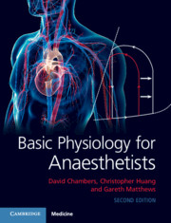
Learning resources
Books:

Slide 15
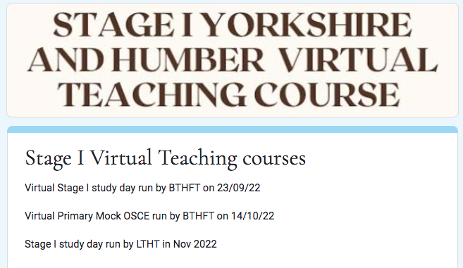
Teaching
Regional Primary FRCA Teaching:
Check HEE website for dates
Bradford
Leeds
Hull
E-mail to book & BOOK STUDY LEAVE 6/52 IN ADVANCE

Slide 16
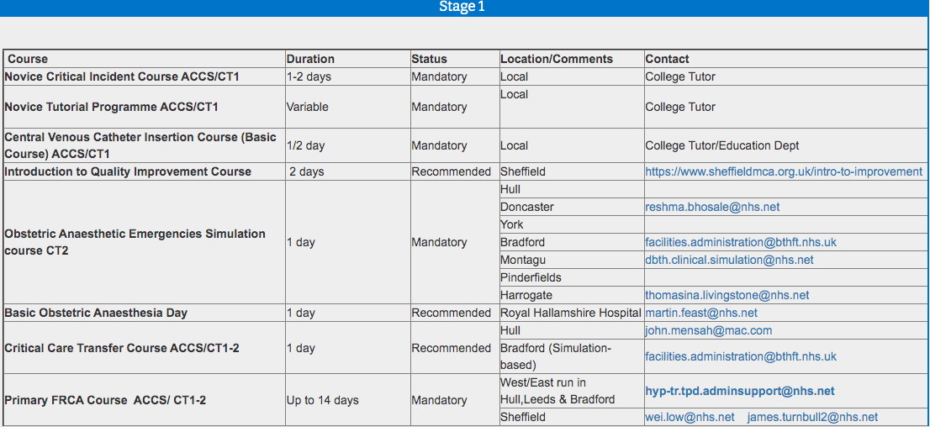

Courses
https://heeyhanaesthetics.blackboard.com/ultra/institution-page

Slide 17
logbook

Slide 18
Supervised Learning Events

Slide 19
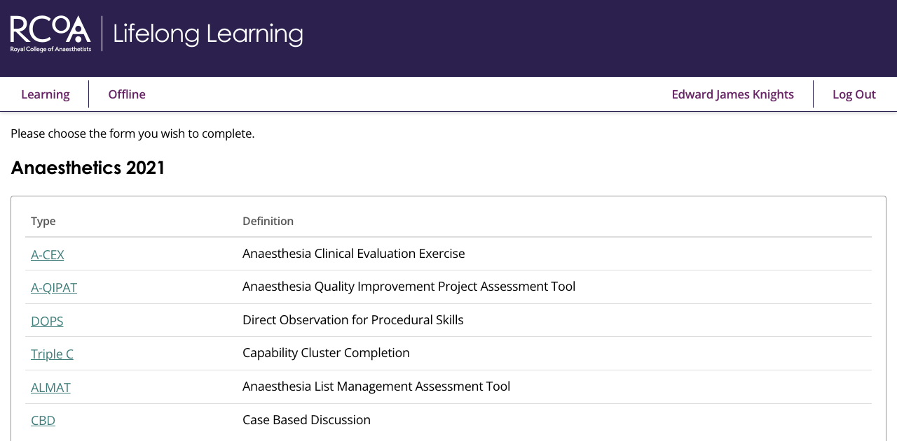
Supervised Learning Events

Slide 20
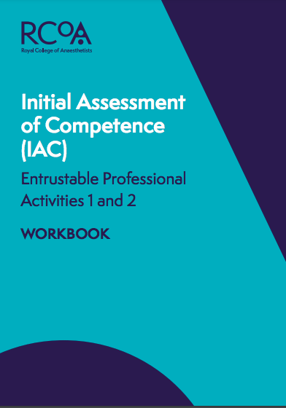
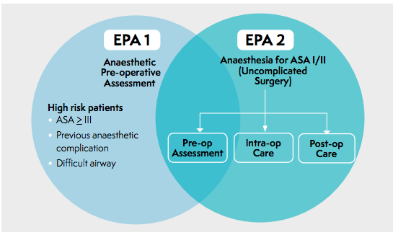
EPA 1&2
(IAC)

Slide 21
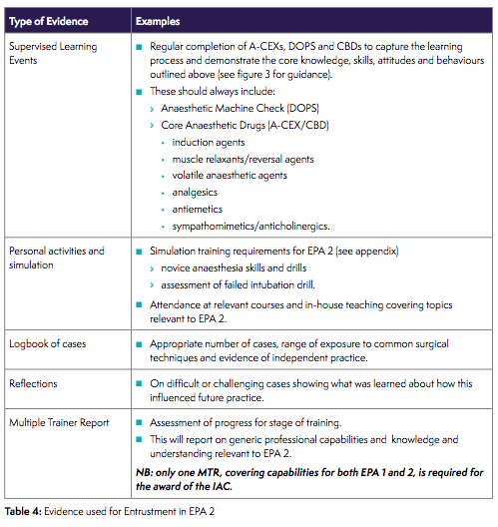
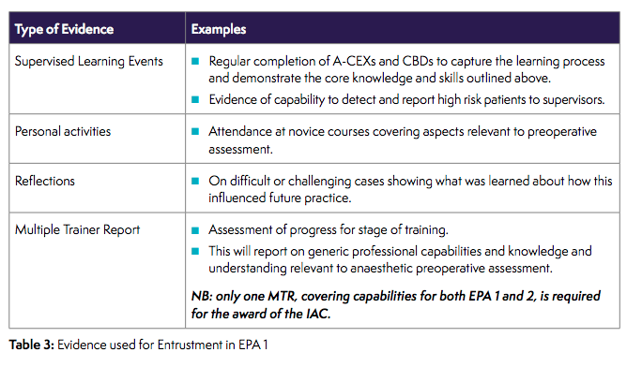
EPA 1&2
(IAC)

Slide 22
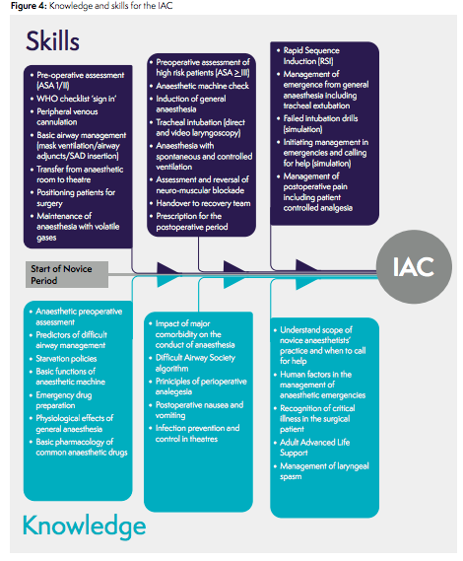

Slide 23
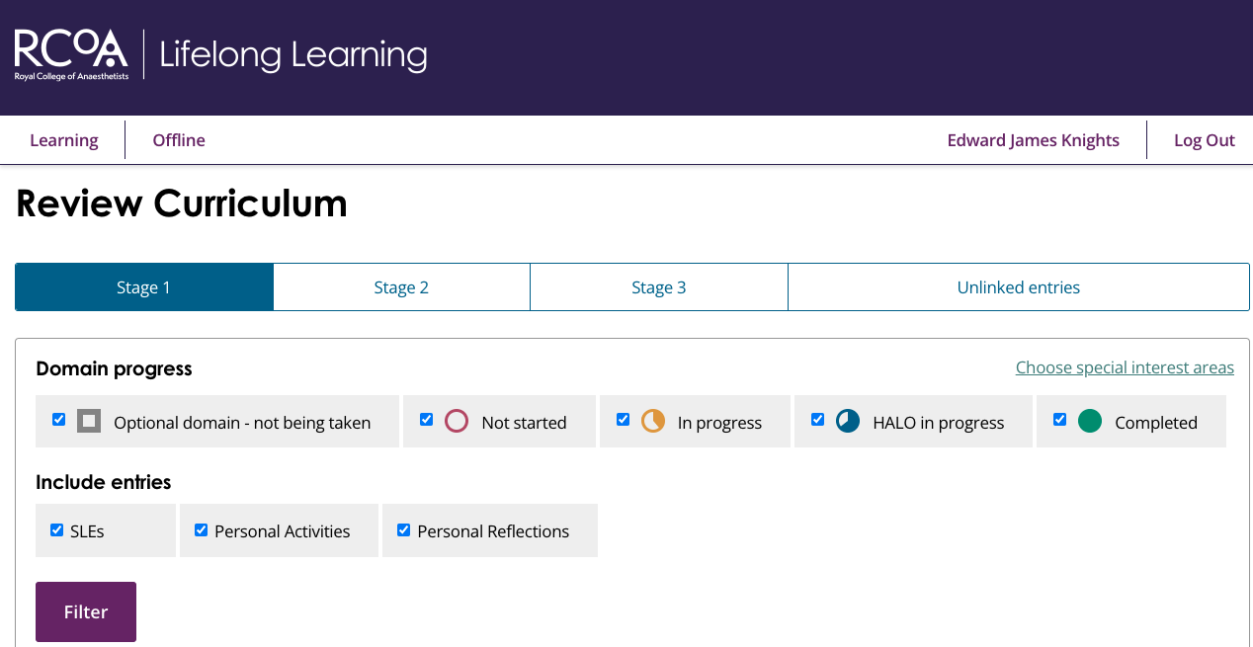
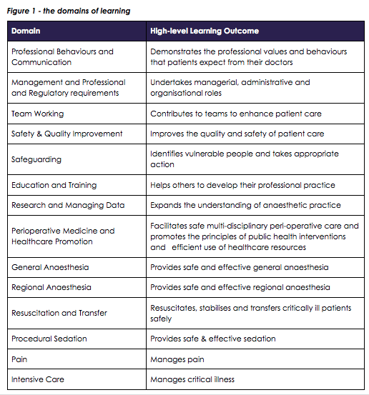
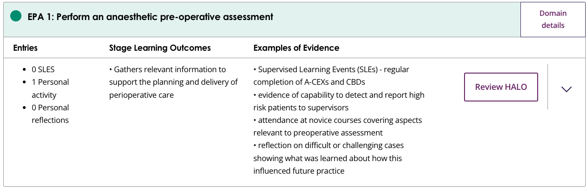
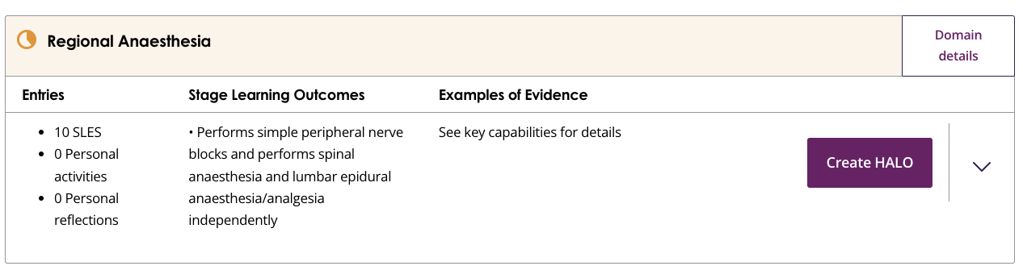

Slide 24
msf
1 per year
12 respondents per MSF
(min 2 consultants)
Can add as you go along
No minimum requirements for each type of health professional, but as broad as possible
LEAVE PLENTY OF TIME

Slide 25
MTR
MTR for EPA1/2 (IAC)
MTR for ICU
MTR for EPA3/4 (IACOA)
Similar to MSF, consultants only, more clinically based

Slide 26
audit

Slide 27
Reflective practice

Slide 28
Form r
Normally e-mailed out with instructions in
May / June
Or can be found on the Deanery Website:
https://www.yorksandhumberdeanery.nhs.uk/anaesthesia/revalidation-and-form-r

Slide 29
Questions

