Slide 1
Consultation Observation Tool
COT
Dr Chris Webb December 2020

Slide 2
The COT considers the trainee’s consultations with real patients in real time during their primary care placements. It assesses the clinical skills and professionalism necessary for good clinical care within their consultations and this includes their performance of the more holistic judgments needed to consult in General Practice

Slide 3
How many are needed?
In ST1 and ST2 when in a primary care post 2 COTs need to be completed for each 6-month placement
Some areas of the UK have 4 month primary care placements in ST1 and ST2. It is recommended that 2 COTs are also completed in these posts
A total of 4 COTS/mini-CEXs are required in each training level in ST1 and ST2
7 COTs are required in the ST3 year. For trainees working less than full time these requirements will be pro-rata

Slide 4
How the COT works
The trainees are encouraged to video record and then review their consultations as these are an essential way of improving their consultations
The COT assessment can then be carried out using a recorded consultation; or they can arrange for their supervisor to observe their consulting directly
The assessment can be completed using face to face, video or telephone (audio) consultations
If a telephone consultation is being assessed then please use the Audio-COT assessment form and not the standard COT form

Slide 5
Selecting consultations
Any consultations recorded will require the patient’s consent. A sample consent form is available below
The choice of consultations should cover the full breadth of Clinical Experience Groups and be in different settings, such as surgery consultations, home visits and Unscheduled urgent care / Out of Hours
When selecting a recorded consultation, it is natural to choose one where the trainee feels they have performed well. Complex consultations or consultations that they found challenging are more likely to generate learning
Please note that WPBA and RCA are independent components of the MRCGP Tripos and therefore evidence submitted for one assessment cannot also be used for the other. All recordings submitted for the RCA should not be utilised for evidence for WPBA. Similarly, a consultation that has previously been assessed e.g. as a COT or Audio-COT may not be submitted for the RCA as it has already been used as evidence for WPBA

Slide 6
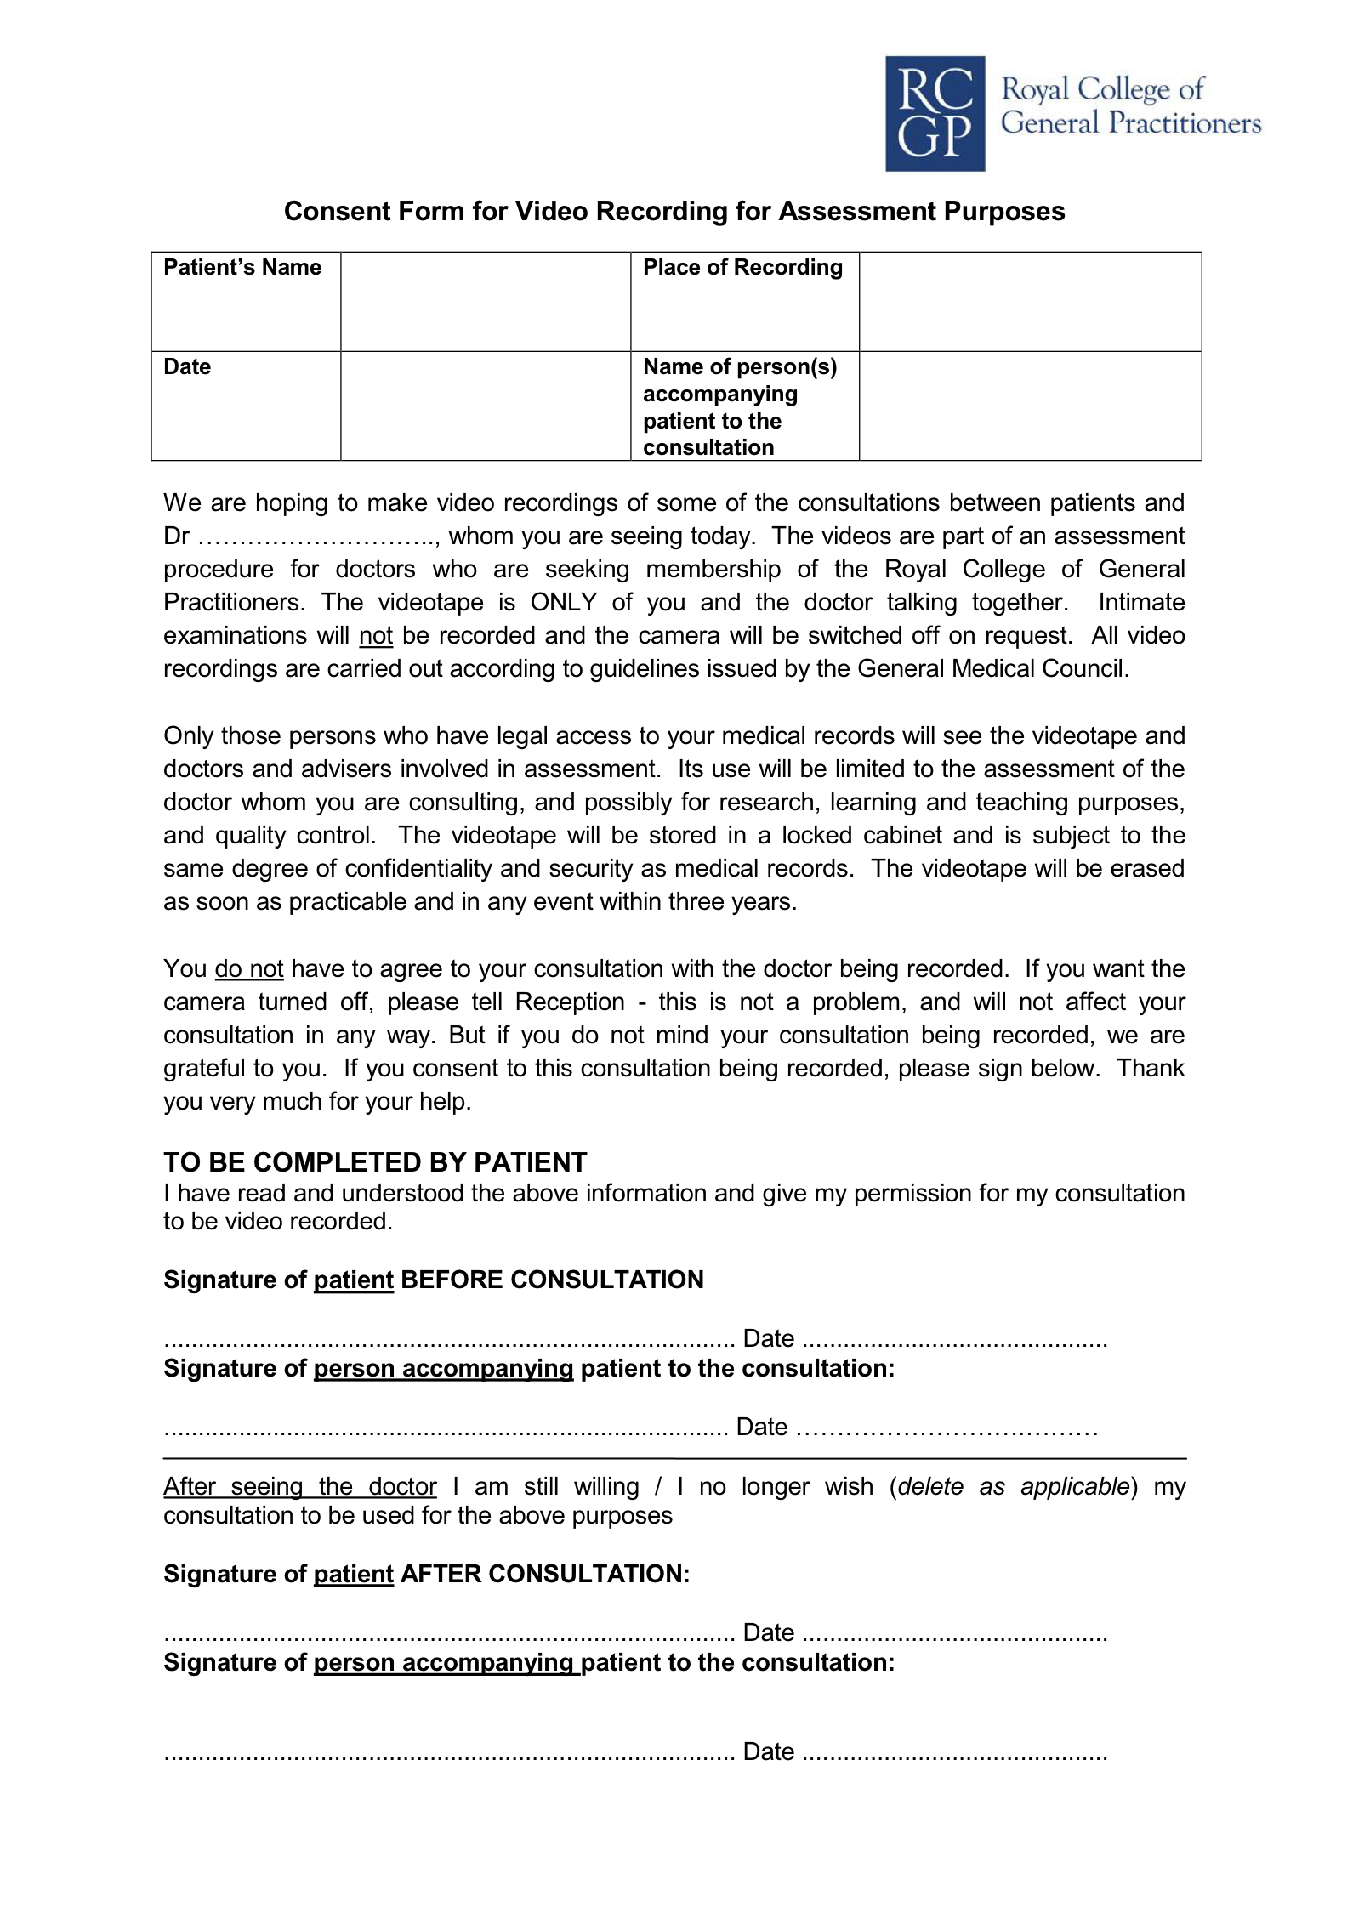

Slide 7
Collecting evidence from the COT
The trainee reviews the consultation with their supervisor, who will relate their observations to the WPBA Capability framework and COT or Audio-COT criteria
The supervisor grades each section of the consultation, makes an overall judgement on performance and provides formal feedback with recommendations for further development

Slide 8
Performance criteria

Slide 9
The doctor is seen to encourage the patient’s contribution at appropriate points in the consultation
PC1
This Performance Criterion is particularly looking for evidence of a doctor’s active listening skills, the ability to use open questions, to avoid unnecessary interruptions, and the use of non-verbal skills, in exploring and clarifying the patient’s agenda
Remember to think of the competences as active ones
In many consultations there is little need to encourage; the patient comes in and states what the matter is, and the doctor may not necessarily be given credit for that
You should seek for evidence that the doctor can encourage a contribution from a patient when encouragement is needed

Slide 10
The doctor is seen to respond to signals (cues) that lead to a deeper understanding of the problem
PC2
The competence is to respond appropriately to important, significant (in terms of what emerges afterwards) cues
Take account of non-verbal cues, if these are evident
However, the doctor’s response to a non-verbal cue may either be verbal (commenting that a patient seems upset, worried etc), non-verbal (use of silence) or active (a change in body posture, a touch to the patient, offering the patient a tissue)
It is important that you are alert for these responses
This PC certainly incorporates “rapport” and/or “showing empathy”, and if you notice an empathic response, consider whether it represents a response to a cue (i.e. the “cue” may be explicit, but the emotional significance that is being responded to may be quite subtle)

Slide 11
The doctor uses appropriate psychological and social information to place the complaint(s) in context
PC3
We expect candidates to consider relevant psychological, social (including occupational) aspects of the problem
These may be known beforehand, or offered spontaneously by the patient, or elicited
The competence is to use the information in exploring the impact of the problem e.g. “how does your backache affect your life as a builder”
It may also be appropriate to consider how the patient’s lifestyle impacts on the problem

Slide 12
The doctor explores the patient’s health understanding
PC4
This PC incorporates exploring the patient’s perspective of the problem (including health beliefs and “ideas, concerns and expectations”)
Has (s)he read something on the internet, been told something...?
The competence is the curiosity to find out what the patient really thinks - a cursory “what do you think?” without any response to the answer will not do.
But questions like “what did you think was going on...what would be your worst fear with these symptoms...were you concerned this was serious...what were you hoping I would do for this condition?” are much more likely to get a valuable response

Slide 13
The doctor obtains sufficient information to include or exclude likely relevant significant conditions
PC5
Trainees demonstrate this competence by asking questions around relevant hypotheses. It is important to remember the context of general practice, and especially that trainees are not (usually) specialist-generalists in any field
This is the medical safety PC, which addresses the focused enquiry that commonly occurs during the consultation, not necessarily at a particular stage: it may happen during an examination, or later, during the explanation, or even as an afterthought
This is an occasion when closed questions may be the most efficient method of obtaining the information, for example to determine whether or not a patient with headaches might have a serious illness such as raised intracranial pressure. It does not mean that the doctor has to go into every conceivable detail or chase rare diagnoses. Remember that it is part of the element obtain sufficient information about symptoms and details of medical history which in turn is part of defining the clinical problem(s). It is about taking a history in the degree of detail which is compatible with safety but which takes account of the epidemiological realities of general practice

Slide 14
The physical/mental examination chosen is likely to confirm or disprove hypotheses that could reasonably have been formed, OR is designed to address a patient’s concern
PC6
The competence will usually be the choice of examination, not the way it is done
Video may not be the best place for that to be assessed - however it may generate discussion
It is still usually possible to hear what examination is being undertaken and what explanations are being given
A mental state examination would be appropriate in a number of cases
Intimate examination should not be recorded!

Slide 15
The doctor appears to make a clinically appropriate working diagnosis
PC7
Whilst this is included in the consultation summary form there should be evidence on the video of a clinically appropriate diagnosis or hypothesis having been made
On occasions, however, it may not be possible to make a diagnosis, but discussion of what has been ruled out will be important

Slide 16
The doctor explains the problem or diagnosis in appropriate language
PC8
There must be evidence of an explanation of the patient’s problem. The element states that the findings should be shared with the patient. As educational supervisors we need to judge the quality of the explanation. A short explanation may be enough but it must be relevant, understandable and appropriate. Using diagrams or language aids for non-English-speaking patients may be appropriate
Excellent trainees will incorporate some or all of the patients’ health beliefs - in other words, one that responds to the health beliefs considered in PC4. It is unlikely that this PC could be demonstrated in the absence of PC4. However, on occasion, the patient will volunteer their health belief without prompting
Essentially it requires a reference back to patient-held ideas during the explanation of the problem/diagnosis

Slide 17
The management plan (including any prescription) is appropriate for the working diagnosis, reflecting a good understanding of modern accepted medical practice
PC9
It is important that the management plan relates directly to the working diagnosis and must represent good current medical practice
Management must be a safe plan even though it may not be what you would do
Investigations and referral should be reasonable
The prescribed medication (if any) should be safe and reasonable, even if not your preferred choice!

Slide 18
The patient is given the opportunity to be involved in significant management decisions
PC10
This was formerly “sharing management options” - the new version seeks to reward the underlying competence of doctor and patient engaging in shared decision making
Included in this competence is establishing the conditions for shared decision-making, such as the patient’s willingness to be involved (at least a third are unwilling), their ability to take decisions (some are not able), and the evidence-base on which any decisions are being made
The trainee should be rewarded for addressing any of these aspects of the competence: they do not need to take the patient right through to a decision

Slide 19
The doctor checks that there is a shared understanding of the diagnosis, management plan, treatment, safety-netting and follow-up arrangements
PC11
A surprisingly high proportion of patients do not understand or remember what their doctors tell them about diagnosis or treatment. Cultural differences may exacerbate this. Uncertainty and lack of information or clear explanation can lead to patient anxiety and dissatisfaction. Feedback from patients suggests that information should not just be ‘given’ but shared and made accessible so that they can enter into a discussion with the GP
This competence is about ensuring, as appropriate to the individual patient, the accuracy of the patient’s understanding of the diagnosis and management plan. It may be necessary overtly to check the patient’s understanding of red flags and safety-netting, or of the follow- up arrangements and attention to medication compliance. A cursory “Is that OK?” or the patient simply nodding is not enough. It must be an active seeking out of the patient’s understanding, agreement and an encouragement to accept appropriate responsibility
It is essential that this should not be formulaic, but, if it is appropriate with the patient involved, phrases such as “We’ve covered a lot today, would you mind just running through our plan, so I can be sure we are in agreement?” or “Can I just check how you will take the medication and when?” may be valuable

Slide 20
Makes effective use of resources
PC12
Time management is important here. Was the consultation completed in 10 minutes? Providing Structure by summarising, signposting and sequencing, Aiding Recall and Understanding by restating, ...all of these are also important techniques
This area will include use of resources to help those with disabilities, for example, or those patients whose first language is not English
Referrals, investigations and follow-up appointments should be appropriate, being mindful of limited resources

Slide 21
The doctor specifies the conditions and interval for follow-up or review
PC13
This criterion within the unit Make effective use of the consultation should be straightforward
It should be interpreted broadly, so that any reference to returning (“next week”, “when the tablets run out”, “if not better in a few days”, “see the nurse for a BP check in 1 month”, etc.) may be rewarded

