Slide 1

Tackling Differential Attainment in the GP School Yorkshire and Humber
Our interventions 2023

Slide 2
Differential Attainment
“Differential attainment (DA) is what we call the gap between attainment levels of different groups of doctors”. (GMC)
Notes:
IMG – International medical graduate
BAME- Black and minority ethnic.
These terms will discussed a minute or two and they are not idea!
Protected characteristics under the Equality Act 2010:
Age, disability, gender reassignment, marriage/civil partnership, pregnancy+maternity, race, religion+belief, sex, sexual orientation
The gap in attainment between different demographic groups taking the same assessments. ‘Attainment’ is not just about exams and should be interpreted broadly: exams, WPBAs, ARCP outcomes, recruitment, fitness to practice complaints.
International problem, also seen in USA, Canada, Australia, Netherlands and in UK higher education generally

Slide 3
Interventions
Enhanced Induction
Trust shadowing for New to NHS GP PGDiT (Postgraduate Drs in Training or GP Trainees) and Practical Simulation course
1 to 1 meetings with an educator – Hello my story is…….
Personal Learning Plans
Peer buddy system/Mentoring
Communication and Linguistics support – Near peer mentoring
British Language and Culture for GP consultations courses
Neurodiversity screening

Slide 4
Interventions
Social Prescribing
Blackboard resources – International graduate support, Supported Return to Training, Consultation skills and Community orientation modules
Virtual Primary Care pilot
Self directed learning package and videos on reflection
AKT package
Trainer curriculum and Trainer resources
Trainers DA overview workshops
Evaluation - Meeting with PGDiT and obtaining feedback

Slide 5
Enhanced IG Induction - August 2022/2023
Day 1: Thursday 25th August 2022 (this year - Wednesday 30th and Thursday 31st August 2023)
GMC Presentation
Introduction to the UK
Introduction to the e Portfolio and WPBAs
Working in teams in the NHS and in Primary care
Small Group work
SuppoRTT team
Neurodiversity video

Slide 6
Enhanced IG Induction – Day 2
Day 2: Friday 26th August 2022
Linguistics and consulting like a GP
PGDiT experience
Take Time -
How to look after yourself and your mental well being
Self-directed learning and reflective writing (Videos)
‘Light relief” Colloquial session
Final thoughts, questions

Slide 7
Trust shadowing for New to NHS GP PGDiT and Practical Simulation course
In line with all Schools, we offer our New to NHS PGDiT a 2-week enhanced support placement along with a practical simulation course
For PGDiT starting in GP posts, we facilitate New to NHS trainees being released up to 2 weeks early from their GP placement to shadow the outgoing trainee in the department they are moving to in February.
The Shadowing period and Practical Simulation course have set aims and objectives set by the GP School.

Slide 8

Hello My Story is………..
https://forms.office.com/Pages/ResponsePage.aspx?id=K5Gn_5ewMUGcD9DoB1Wyq6_NFnz2u6RFqiL93FGQzDdURjFUQk9MWUFYT0lMVkhMRTcxMktDWjFNUy4u

Slide 9
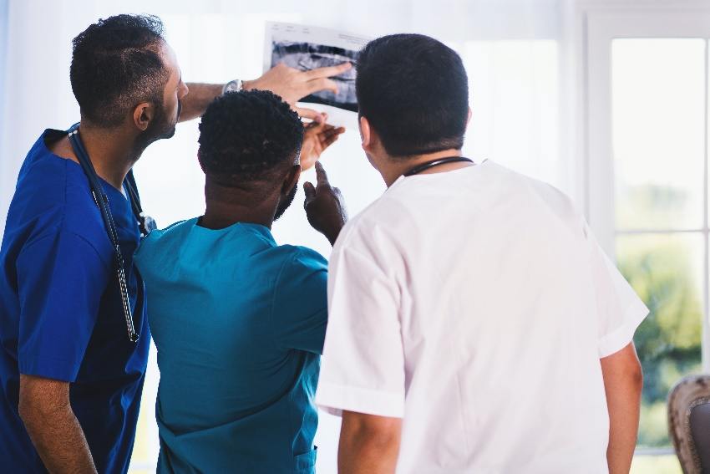
Social Prescribing - What is the offer?
A confidential, safe space to talk
1 to 1 appointments for international GP PGDiT (and their families) who are aligned ALL GP and other Speciality Training Schemes
8 sessions / 12 weeks of intervention
Post intervention welfare checks
New starter GP PGDiT are proactively contacted by the social prescriber before they start training unless they opt out

Slide 11
Mentoring/Peer buddy programme
ST2 GP PGDiT are offered the opportunity to become trained mentors
ST1 GP PGDiT are offered mentoring by trained GP PGDiT mentors
Some GP training Schemes offer a more informal Peer buddy system
Some Schemes operate a Peer family system across all ST years
85% of our Training Schemes are currently involved in the mentoring/buddy process

Slide 12

Mentoring/Peer buddy programme

Slide 13
Linguistics
Near Peer Mentoring – 3 sessions for New to NHS GP PGDiT
First session within 2 weeks of starting
1 to 1 sessions are arranged with Linguistic student volunteers from the local Universities
Second session in the Autumn with a follow up session in the Spring
Sessions cover – local dialect, humour and answers to any language barriers they may have (nothing clinical)
Student volunteers asked to flag (with consent) anyone in need of additional support

Slide 14
Linguistics
Consulting like a GP at the Enhanced induction
Full day course run on 3 different dates in January – British Culture and Language in GP consultations
International graduates are invited to attend one of the 3 days
Any PGDiT flagged up on the course or by their TPDs in need of extra support are offered two 1 hour coaching sessions with our Linguistics expert

Slide 15
Linguistics course
British Culture and Language in GP consultations for international graduates which runs over 3 dates in January 2023/24
Course Aims:
To provide an intensive interactive language and communications day tailored to the needs of international GP PGDiT.
To focus on language structures associated with the kind of patient-centred consulting expected in the UK’s healthcare culture.
To provide an opportunity for each participant to be given individual feedback on their communication skills through GP consultation roleplays.
To provide a safe space to share ideas on how language and culture manifests itself in different healthcare environments.

Slide 16
Neurodiversity screening
We offer all GP PGDiT free online screening tool through Genius Within
https://y-h.geniusscreening.com
Video presentation on Neurodiversity at our Enhanced Induction
Presentation at the induction by recently qualified GP with neurodiverse condition
Full screening funded by HEE for those who screen positive

Slide 17
Neurodiversity screening
Uptake so far…..
1036 GP PGDiT completed the initial screening
PGDiT who have had a full assessment with a definite diagnosis can get an extra 25% time in the AKT examination
Diagnoses include Dyslexia, ADHD, Dyspraxia and other specific learning difficulties
PGDiT with neurodiverse conditions are offered small group coaching sessions with a psychologist – two 2-hour sessions
Some PGDiT struggle with the diagnosis and do not want group sessions
Individual sessions can be arranged

Slide 18
Blackboard resources for PGDiT
1 new items in Support - Resources for International Graduates

Slide 19
Blackboard resources for trainers
Content / 06-EDUCATORS: education resources (blackboard.com)

Slide 20
Trainer curriculum
Primary Care School YHGP Differential Attainment Trainer Curriculum
Aims: To ensure all Trainers have the knowledge skills and attitudes required to provide PGDiT centred training to support all PGDiT to meet their full potential.
Ensure understanding of the reasons that some PGDiT need additional support and interventions and what these are.
Ensure Trainers are able to identify and pro-actively manage PGDiT needs early in their training.

Slide 21
Trainer curriculum
Overview trainers workshops covering:
Background to DA
Understanding why DA may exist in different PGDiT groups
Tackling DA as a Trainer
Extended knowledge modules
Two recent Y&H TPD and Trainers conference being DA focused
Incorporating DA training in New and Intending Trainer pathway
Trainers are our best resource!

Slide 22
Evaluation
Analysis of Hello my story is….. forms
Formal evaluation of Social prescribing pilot by HYMS
Feedback from PGDiT focus groups
Independent evaluation by external company Verve communications of:
Interventions funded by the HEE Covid recovery fund
Part of a National evaluation of all DA interventions
Independent HYMS evaluation of all Y&H DA interventions planned

