Slide 1
DCT National Recruitment
Ghazala Ahmad-Mear
Associate Postgradaute Dental Dean HEEYH
TPD Development Day 24th November 2016

Slide 2
DCT National Recruitment
From 2017 for all DCT Posts
HEEWM leading project nationally
National Working Group
Standardised application, selection and recruitment process in accordance with values in line with other national recruitment programmes
Centralised Recruitment process will be adopted

Slide 3
DCT National Recruitment
Within a centralised model
a single centre (West Midlands) leads DCT recruitment
there will be a single national round of recruitment to all DCT vacancies
HEE local teams are directed by the West Midlands Team re support eg post numbers, shortlisting, submission of post information, delivering selection centres.
Applications, long-listing, preferencing for posts, applicant guidance and training post offers will all be managed centrally
Applicants are given a single transferable score following assessment
Local teams will lead/be involved with one of the five DCT selection centres.

Slide 4
DCT National Recruitment
Dates 28th 29th +/-30th March 2017
2 day process
3rd Day - pending numbers in some centres
717 DCT posts
2 vacancy types DCT1(441) DCT2/3(276)

Slide 5
DCT National Recruitment
National Recruitment to DCT posts working group, COPDEND and legal advice:
DCT2/3 posts will not be separated out into two vacancies.
Rotational posts for DCT2/3 will continue – annual adjustment
Applicants for DCT posts based in Primary Care.
Entry onto the performers list - essential.
All other applicants’ entry onto performers list - desirable.
Primary Care posts will be identified through the post descriptions and additional information regarding these posts will be provided through the applicant guide.

Slide 6
DCT National Recruitment
Applications and Preferencing of posts by applicants
In line with a centralised recruitment model applicants can apply to any post in any locality advertised as part of National DCT recruitment, within their level of training
All applicants will submit their application and their post preferences at the same time through Oriel.
Applicants will be asked to rank their preferences for posts at the time of application.

Slide 7
DCT National Recruitment
Longlisting, shortlisting and Situational Judgement Test (SJT)
Longlisting will be carried out by the National Recruitment Team using the agreed longlisting criteria.
All longlisted DCT 1 applicants will be invited to selection centre.
Dependent upon the number of DCT2/3 applications shortlisting maybe required and shortlisting criteria will be defined in advance.
At Present we will plan to see all longlisted applicants.
The SJT for DCT recruitment will be paper based and administered in the selection centre.
Applicant SJT scores will contribute towards the final selection centre score for all applicants.

Slide 8
DCT National Recruitment
DCT Selection Centres
All eligible applicants will be invited to book an interview slot via Oriel at one of the national selection centres.
All DCT selection centres will run 28th 29th and 30th March 2017
The five selection centres

Slide 9
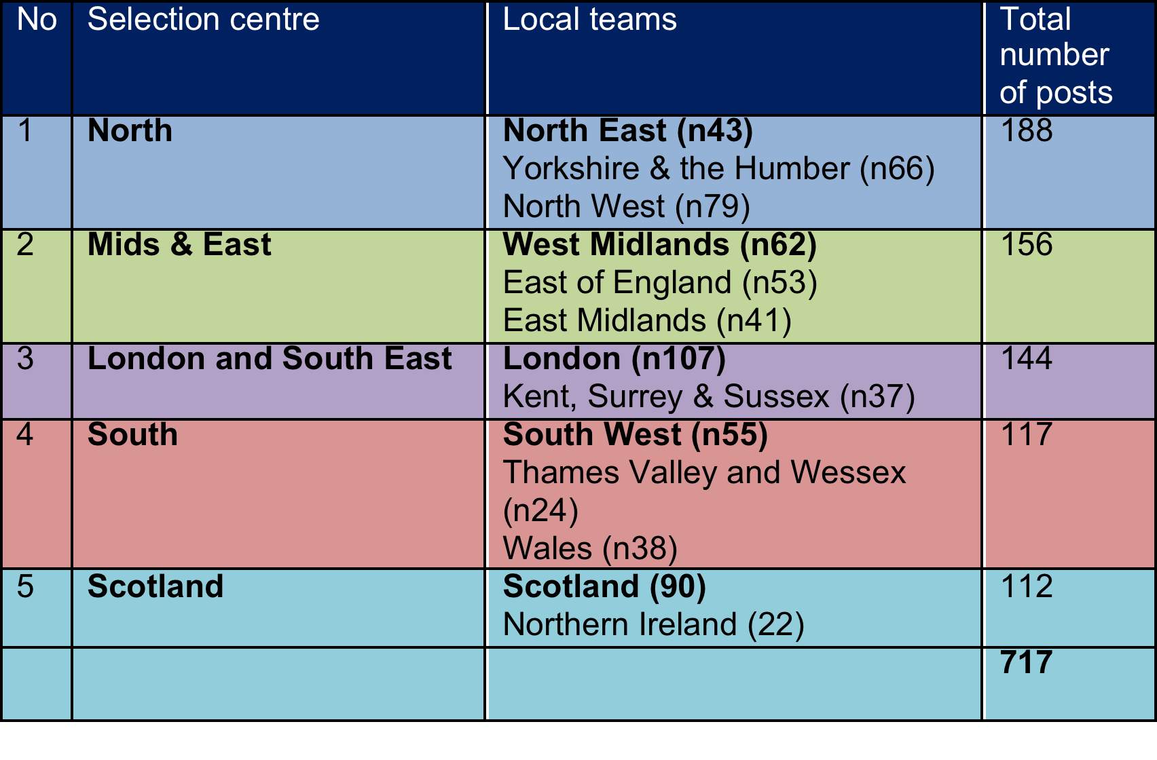
DCT National Recruitment
DCT Selection Centres and Process

Slide 10
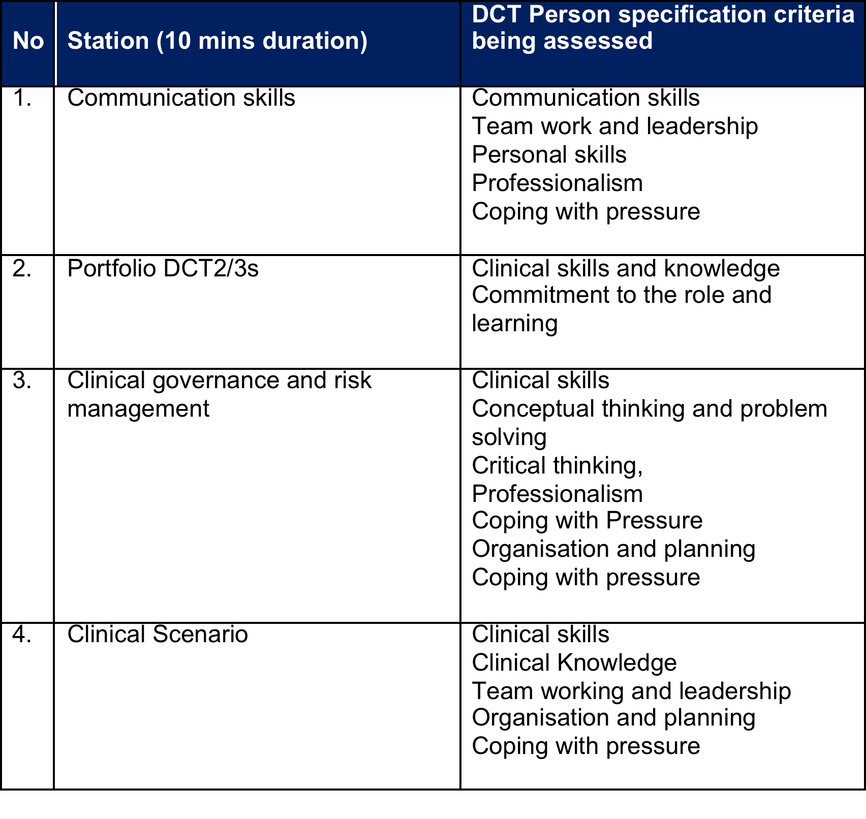
DCT National Recruitment

Slide 11
DCT National Recruitment
Applicant score following selection process
Each applicant will be assigned a unique rank based on their single transferrable score.
All offers will be made using Oriel in line with a nationally agreed timeline for offers, timescale for applicants to hold and upgrade offers received. Oriel allows applicants to hold or accept one offer only.

Slide 12
DCT National Recruitment
Applicant offers
Applicant Offers will be made centrally via the National Recruitment team.
Applicants can accept/hold posts in line with their stated preferences once they have been assigned their single transferrable score from the selection and SJT assessments.
An offer protocol will be established which will includes a policy on whether individuals who reject posts will be allowed back in later. 48 hour turnaround time on accepting/ holding/ declining offers will be given.
Offers will continually recycle and in effect the Oriel system will provide a form of clearing. Reserves will remain active. The round will only closes once all applicants who are deemed appointable have made a firm acceptance of a post.

Slide 13
DCT National Recruitment
Applicant Feedback – In progress
It is understood that HEE are moving towards giving every applicant detailed feedback.
Currently only scores are released, but the system for more detailed feedback is through subject access requests.
It would be advisable to plan for all information to be able to be released by all i.e. removing the question detail and scoring criteria from the paperwork which needs to be released and keeping that in separate document.
Centre leads will need to scan documents and upload to Oriel.

Slide 14
DCT National Recruitment
References and clearance paperwork
Will be collated and uploaded electronically for employers via Oriel within agreed timescales by each selection centre.
It has been confirmed that referees can print off any references they write for trainees to retain a copy for their records.

Slide 15
DCT National Recruitment
Expenses
Candidates who are on hospital terms and conditions of service are eligible for reimbursement of expenses in connection with interview attendance as specified in their terms and conditions of service.
Those who are in foundation posts are not eligible.
Expenses up to a maximum of £100 will be reimbursed by the local centre with recharges divided by Deaneries/ HEE local teams as appropriate.

Slide 16
DCT National Recruitment
Round 2
Plans will be made for a round 2 if at the end of recruitment/ clearing.
This will be planned in the West Midlands, but not advertised.
It will only be used if there are insufficient reserves to populate all posts. Staff for the localities with vacancies will be required to participate as administrative support and panel members in the West Midlands centre.
It is hoped that this will be contingency only and not be required.

Slide 17
DCT National Recruitment
Questions?
Ghazala Ahmad-Mear
Associate Postgradaute Dental Dean HEEYH
TPD Development Day 24th November 2016

