Slide 1

Dental Core Training Workforce Training & Education Yorkshire and Humber Region
Notes:
Hello and welcome to your dental core training programme here in Yorkshire and the Humber region.
Congratulations not only getting this far but for choosing us – this is a very beautiful part of the country and I urge you all to explore and enjoy your home for the next year.

Slide 2
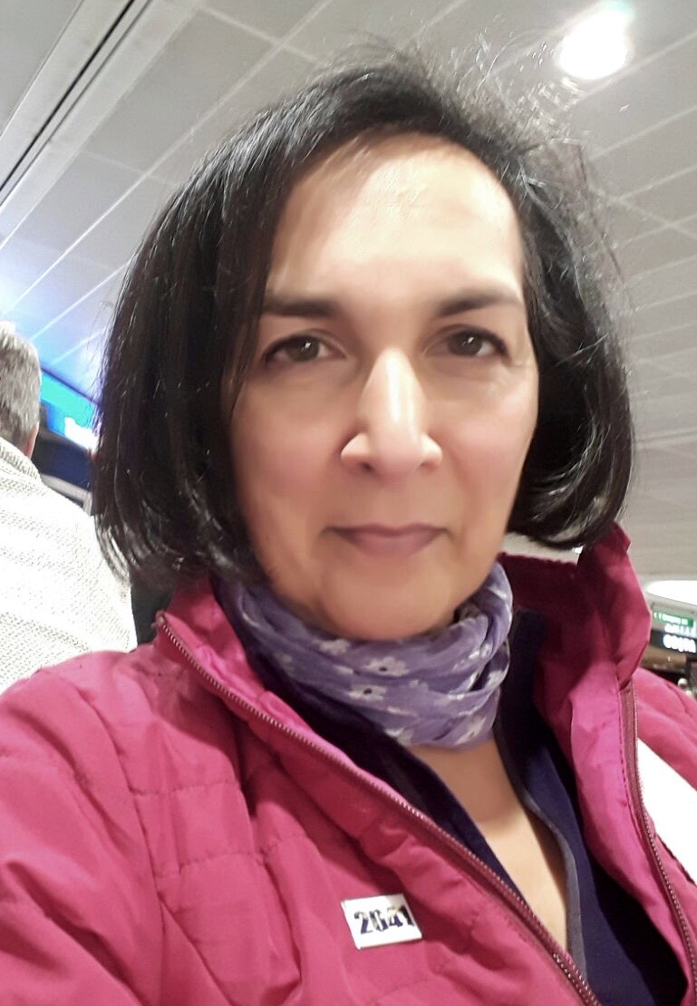
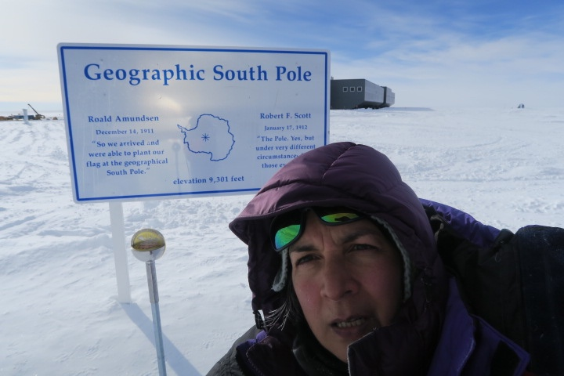
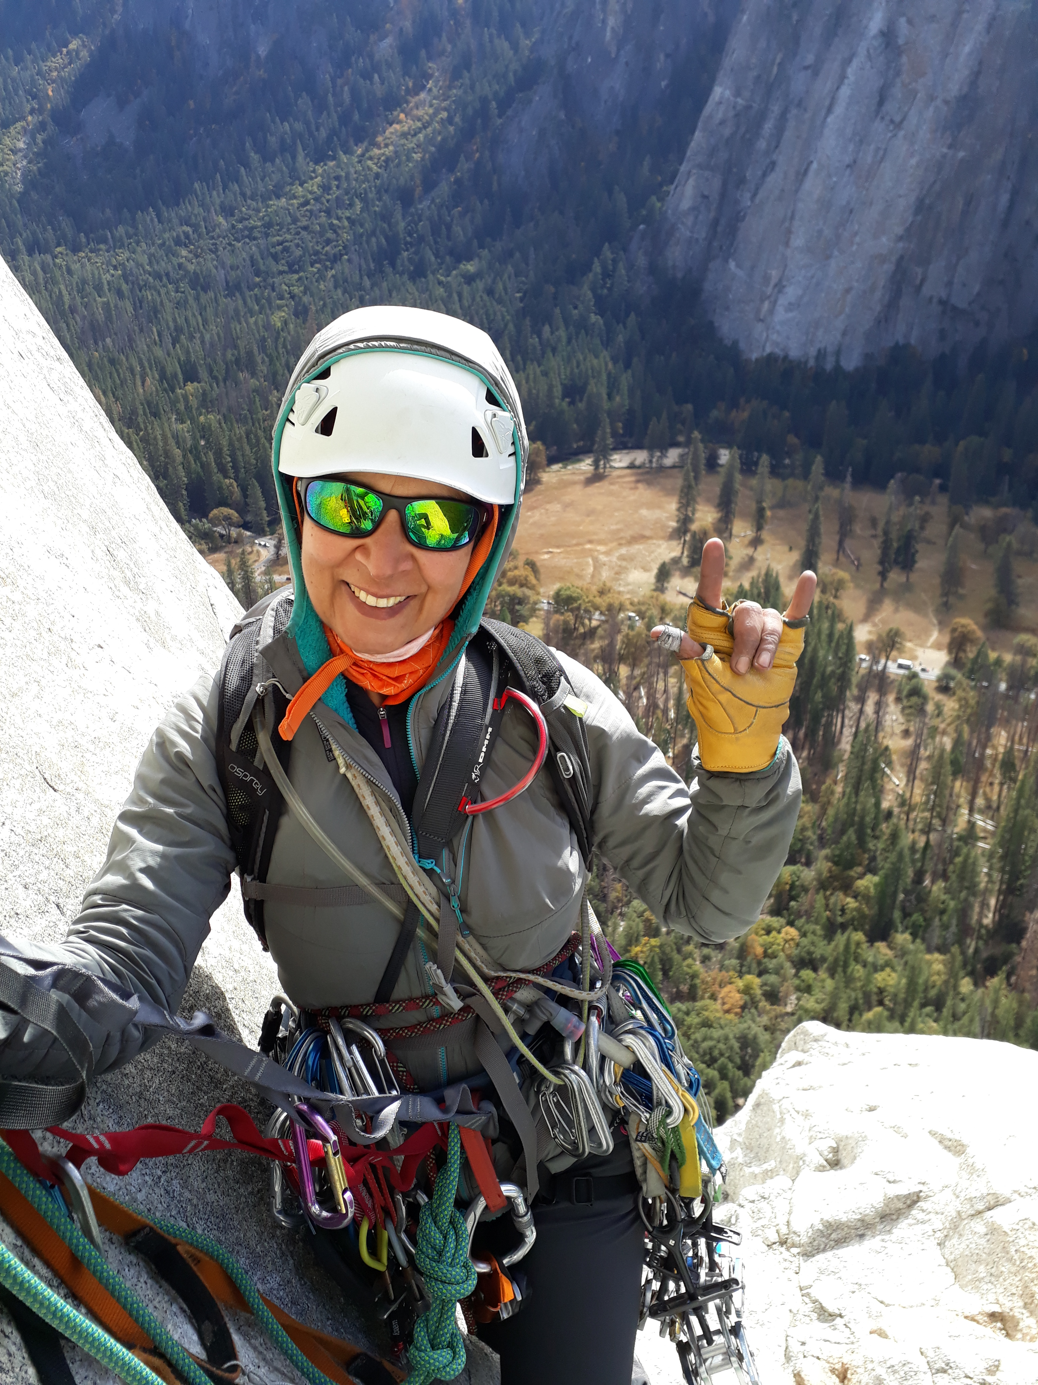
Ghazala Ahmad-Mear Outgoing Associate Postgraduate Dental Dean
Text content goes over one column. Text content goes over one column. Text content goes over one column.
Notes:
My name is Ghazala Ahmad-Mear - your outgoing Associate Postgraduate Dental Dean for Dental Core Training – I retired in June, and the Deanery are in the process of recruiting a successor. However,

Slide 3
You are already Special ❤️
Notes:
Having succeeded in choosing to train in the Yorkshire and Humber region – you are already special to us!

Slide 4
Overview of the session
This beautiful region in pictures!
Your Support package
Your Resources
Regional DCT Study Days
Study Leave and Expenses
Review of Competence Progression
Timing/Requirements/Outcomes
Our expectations of you – our contract

Slide 5
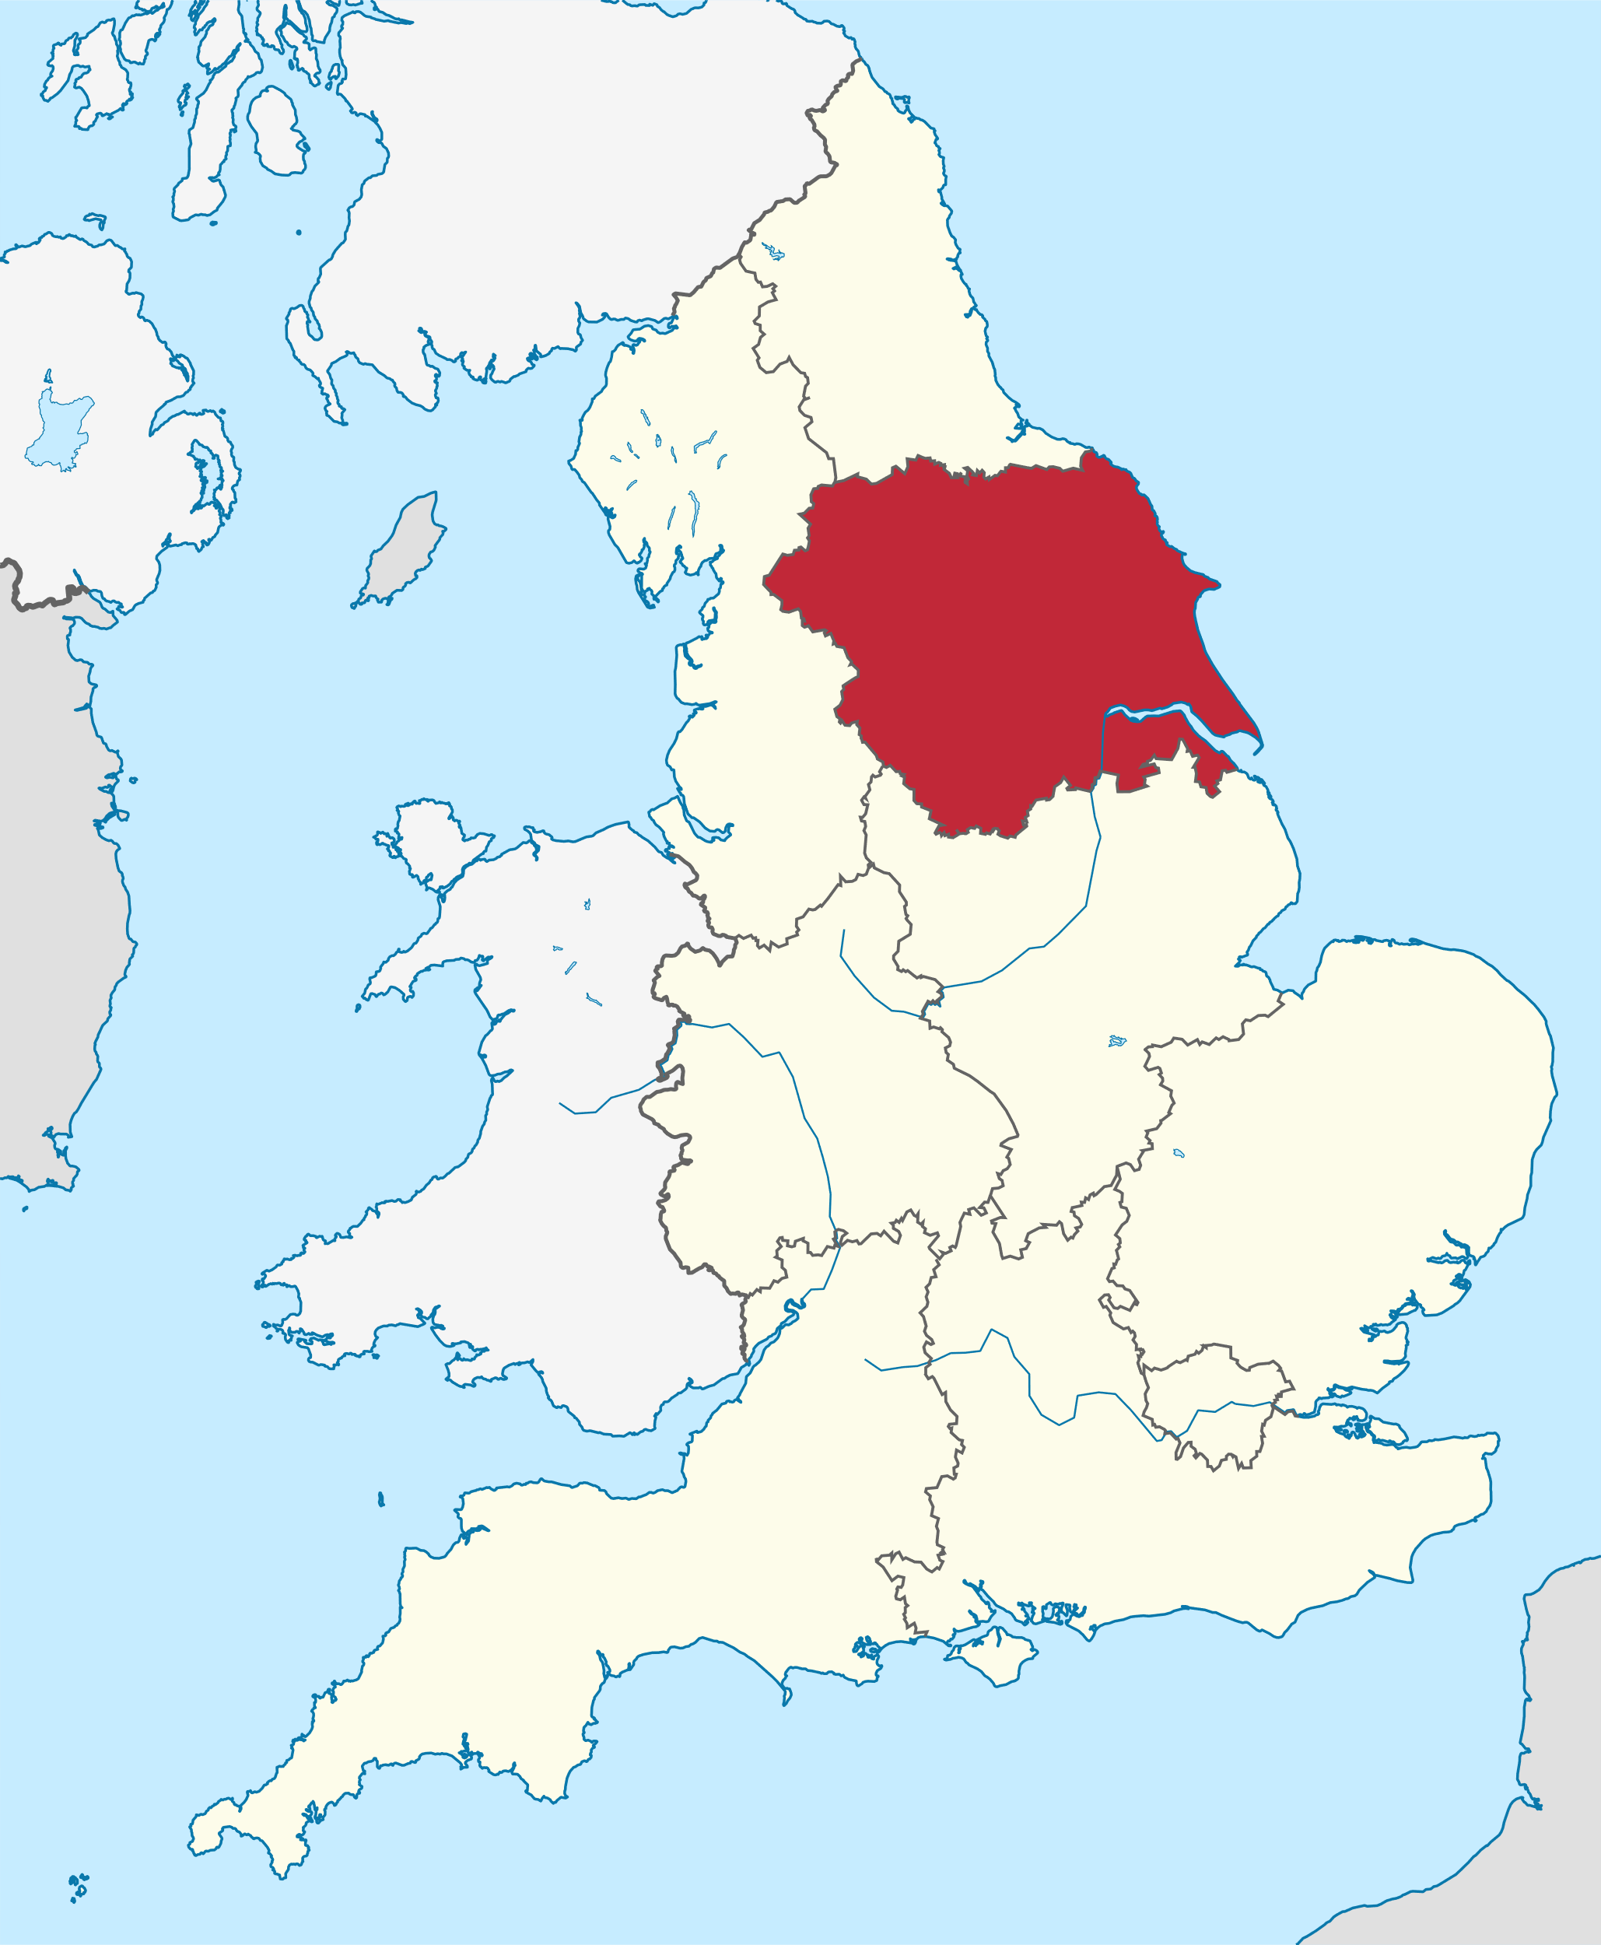
Notes:
Let’s look at exactly where you are on the map. We are one of 7 regions in England and one of 10 including the UK of Wales, Scotland and Northern Ireland.

Slide 6

Notes:
And look at just how beautiful and green it is!

Slide 7
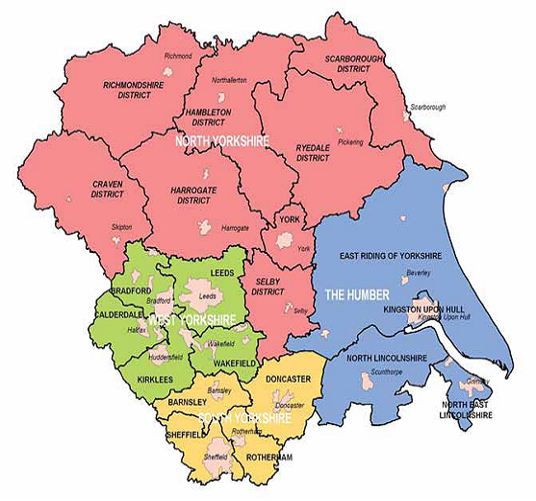
Notes:
The region itself is quite big,
the wilds of North Yorkshire,
the flats of The Humber and
the industrious areas of West and South Yorkshire.

Slide 8

Notes:
This is Leeds!

Slide 9
To Support You
Educational Supervisor
Training Programme Director
Associate Postgraduate Dental Dean
Postgraduate Dental Dean
YH Dental Programme Support Team
Learner Support / Health & Wellbeing / YH website
Mentor
Trust / Occupational Health and Director for Medical Education
General Medical Practitioner
Notes:
To support you:
All trainees have an:
Assigned Educational Supervisor
your close support system to get you through the programme.
They are your pastoral support, guidance and generally your first port of call.
Training Programme Director
A step back from ES. And your local Deanery representative.
They ensure you have curriculum delivery.
They guide and support their team of ESs and oversee your training.
Second port of call.
Maybe within or outside your unit.
Associate Postgraduate Dental Dean
A further step back, who guides and supports the TPD/ESs.
They manage, fund, quality assure and oversees all DCT programmes in the region. (around 101)
If the ADD can’t answer your question, we have the
Postgraduate Dental Dean - James Spencer
who is overall responsible for ALL dental training programmes in Y&H.
Foundation, Core, Specialty and Dental Care Professionals.
We are lucky he is excellent at his job and very approachable.
Helping us all are the Programme Support Team – Dental Support
Seem big on email but there are only 3 in the office, all part time. They are impressive with their support and we are all grateful to them.
They will do whatever they can to help but please do be mindful of their workload when connecting with them.
On our website we have a Learner Support section and a dental specific Health and Well Being document
put together by our Leadership fellows that hones down the effective ways you can access support out there, with excellent suggestions.
You are able to access a Mentor for training related issues.
Instructions on application are on the website and is managed by Programme Support.
You can have a maximum of 3 sessions with any one Mentor.
Within your Trusts you have Occupational Health service – you may be referred or can refer yourself. You also have a Director of Medical Education (employed by the Trust) who oversees and supports ALL medical and dental trainees.
Beyond the above, you have your General Medical Practitioner – support for health.

Slide 10
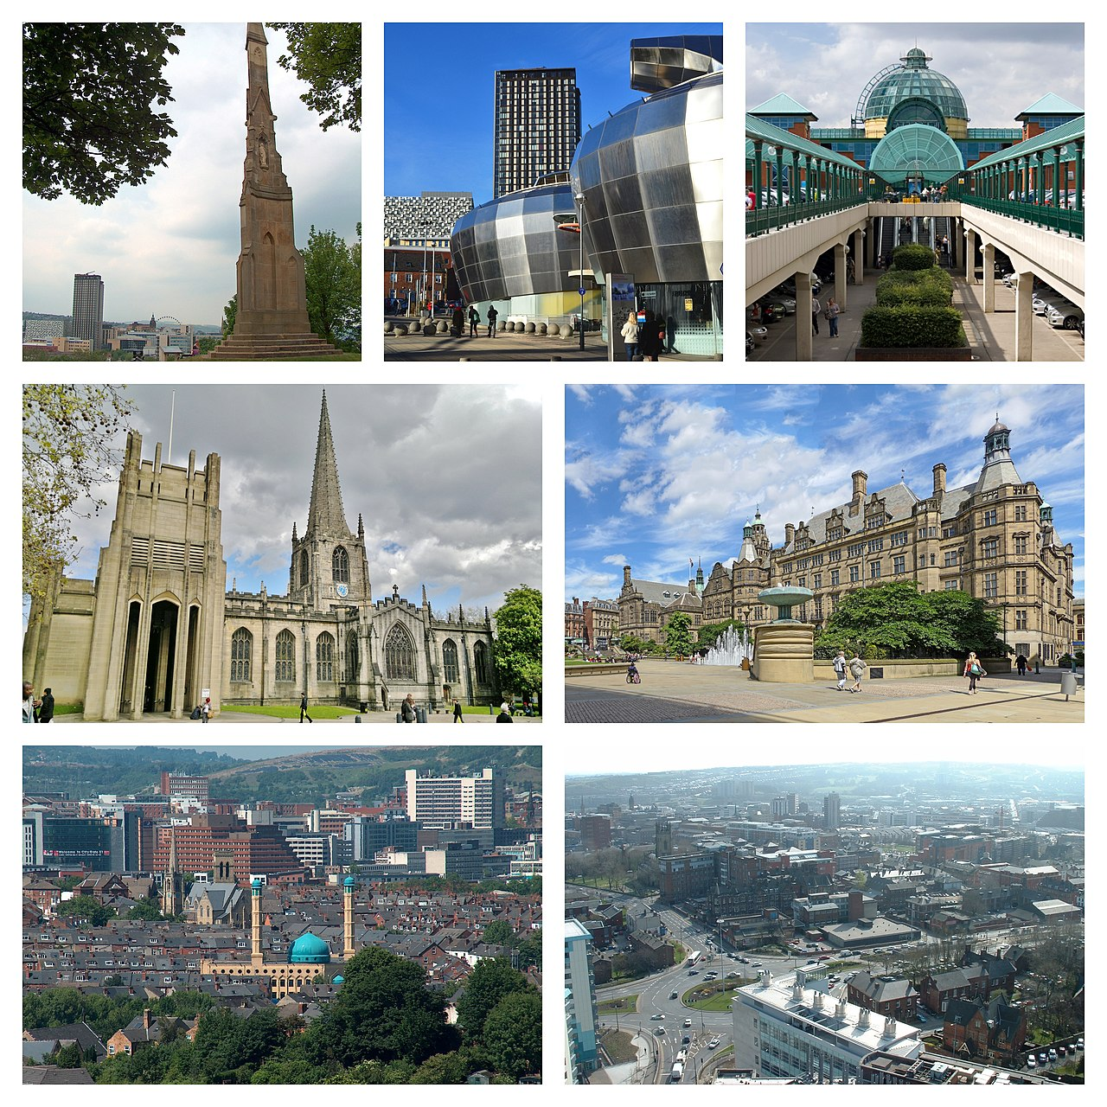
Notes:
This is Sheffield!

Slide 11
Your Resources
DCT Handbook ( Sway document always current)
DCT Curriculum – COPDEND/YH website
Dental Gold Guide; latest edition 2025 – COPDEND website
Axia DCT e-Portfolio – 5 years in - very tailored
Review of Competency Progression Requirements COPDEND/YH website
Trainee Forum – regionwide suggestions / feedback /YH website
Dental National Education and Training Survey (Dental NETS)
October and June – evidence expected in portfolios for RCPs
Notes:
Let’s take a look at the resources available to you, all of which I highly recommend you to explore:

Slide 12
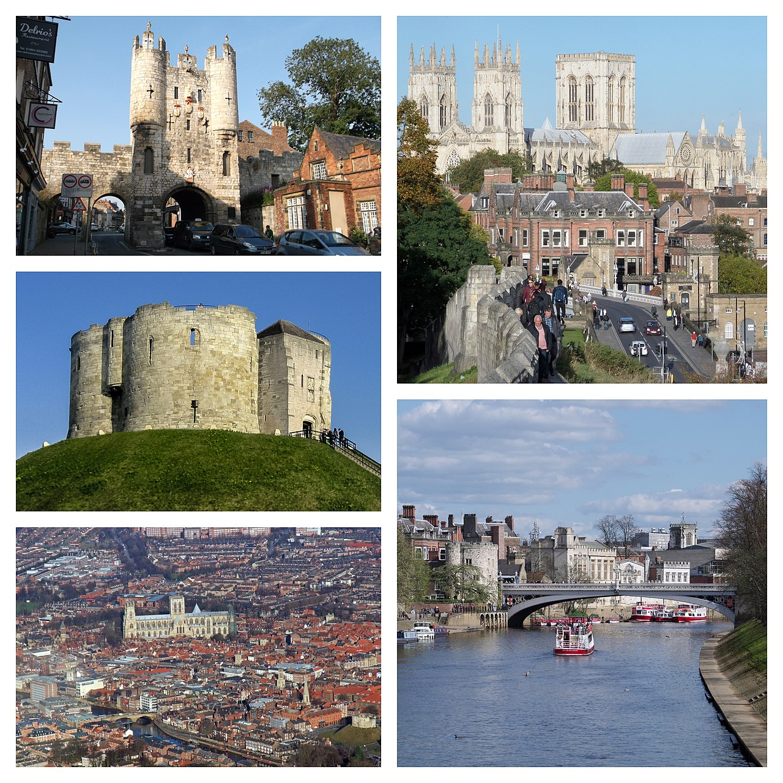
Subhead if needed
Notes:
This is York!

Slide 13
Regional Study Days
Each DCT level has a separate programme, respecting the different learning needs of each level.
All programmes have been emailed to you and your TPD and are on YH Deanery website
They are mandatory and you are expected to attend, please do not book leave in disregard, they are not repeated and do contribute to your RCP process.
You’ll need to register on HELP and Blackboard, instructions have been emailed
Online learning modules – register within 3 months -cert by 6month RCP
Are a mixture of in-person and remote/virtual.
You are expected to give feedback for quality assurance.
Please upload your certificates clearly labelled to ‘Uploads’ on Axia portfolio

Slide 14
Study Leave / Expenses Application
You will need to apply for study leave for study days.
Each DCT level has 10 days study leave of which Regional Study days are included
The balance is what is available to you as set out in the DCT Curriculum Delivery (CDR) Matrix - states what is and isn’t funded / YH Website.
https://www.yorksandhumberdeanery.nhs.uk/dentistry/curriculum/study_leave_policy
Follow the online ACCENT study leave manager guidance. Contact your TPD

Slide 15

Notes:
Waterfall near Malham

Slide 16
Review of Competence Progression
RCP

Slide 17
Overview
DCTs are subject to 2 formal reviews during their training time
6 months Review of Competence Progression (iRCP - March)
Final Review of Competence Progression (FRCP - July)
An outcome will be awarded at each review

Slide 18
Documentation
COPDEND Website
YH Deanery Website
https://www.copdend.org/postgraduate-training/header-dental-core-training/dct-rcp-guidance/

Slide 19
Documentation
Educational Portfolio
Educational Agreement
Structured Educational Supervisor Report – mid-term and final
Clinical Activity log – the use of E-portfolio is acceptable
Evidence of a completed full Quality Improvement/Audit Project
SMART Personal Development Plan (PDP)
Continued Professional Development (CPD) log with reflections and development outcome domains akin to that required by GDC

Slide 20
Documentation
Evidence of at least 24 completed Supervised Learning Events
At least 8 DOPs / 4 CEXs / 4 CB
SLE links to curriculum (at least 2 in each domain)
Evidence of any Teaching (and Research) involvement
All Mandatory Study Day CPD certificates
Multisource Feedback (MSF)
Patient Satisfactory Questionnaire (PSQ)
Notes:
:

Slide 21
Outcomes
Outcome | Description
1 | Predefined competencies successfully demonstrated – satisfactory progress
5 | Incomplete evidence provided (given 10 working days to upload – no more!)
2 (only at iRCP) | Inadequate progress Development required: with specific targeted development for FRCP
3 (only at FRCP) | Inadequate progress – additional training time required with specific targeted development Exceptional circumstances only and under discretion of PDD
4(only at FRCP) | Inadequate progress – released from training without completion
Notes:
:

Slide 22

Notes:
Ribbleshead Viaduct - North Yorkshire

Slide 23
What’s expected of you?
Be well in mind & body– look after yourself and ask for help if you need it
Be safe – know how and when to raise concerns about your training or patient care
Be professional at all times, all the time!
Respect your team – all of them!
Use the resources available to you, be curious and creative
Notes:
:

Slide 24
What’s expected of you?
Be your best!
Respond in a timely manner to communication from Trust and Deanery
Please use your nhs.net email only
Update your portfolio regularly - don’t wait for the deadlines!
Update your portfolio regularly - as you go along!
Notes:
:

Slide 25
What’s expected of you?
Unhappy about your training?
Raise concern in accordance to the Escalation Guide (ES/TPD then ADD)
Unhappy about Patient Care?
Raise concern to your direct supervisor asap or in accordance to the
Escalation Guide
https://www.yorksandhumberdeanery.nhs.uk/dentistry/dental-streams-dental-core-training/escalating-concerns
Dental National Education and Training Survey (Dental NETS)
October and June
Notes:
:

Slide 26
What’s expected of you?
Unsure about anything? Ask your CS, ES, TPD
Notes:
:

Slide 27

Notes:
And when you’re all stressed up, get out there in the green hills, blue skies and inhale the fresh air!

Slide 28
Be Safe, have fun!
Notes:
Above all, be safe and have fun!
Thank you for your attention.

