Slide 1


Educational Supervisor Reports (ESR)
April 2020
Guidance from the School of Paediatrics HEEYH for Educational Supervisors

Slide 2
General Feedback
Appreciation of time spent on reports – especially in current climate
There will be more reliance on the ESR due to fewer training opportunities and the need to identify alternative evidence of training progress
Detail makes ESR more useful to ARCP panel, and also gives recognition of trainees’ efforts and achievements
Trainees also encouraged to provide more detail in their section of ESR
@NHS_HealthEdEng

Slide 3
General Points to Cover
Evidence of regular interaction and knowledge of trainee
Evidence of clear PDP goals and review of progress
Include areas of good practice and constructive suggestions for development
Highlight excellence
Some trainees need additional support re tagging evidence to curriculum domains (see later slides)
Reflection (quality over quantity)
Evidence of training progression
@NHS_HealthEdEng

Slide 4
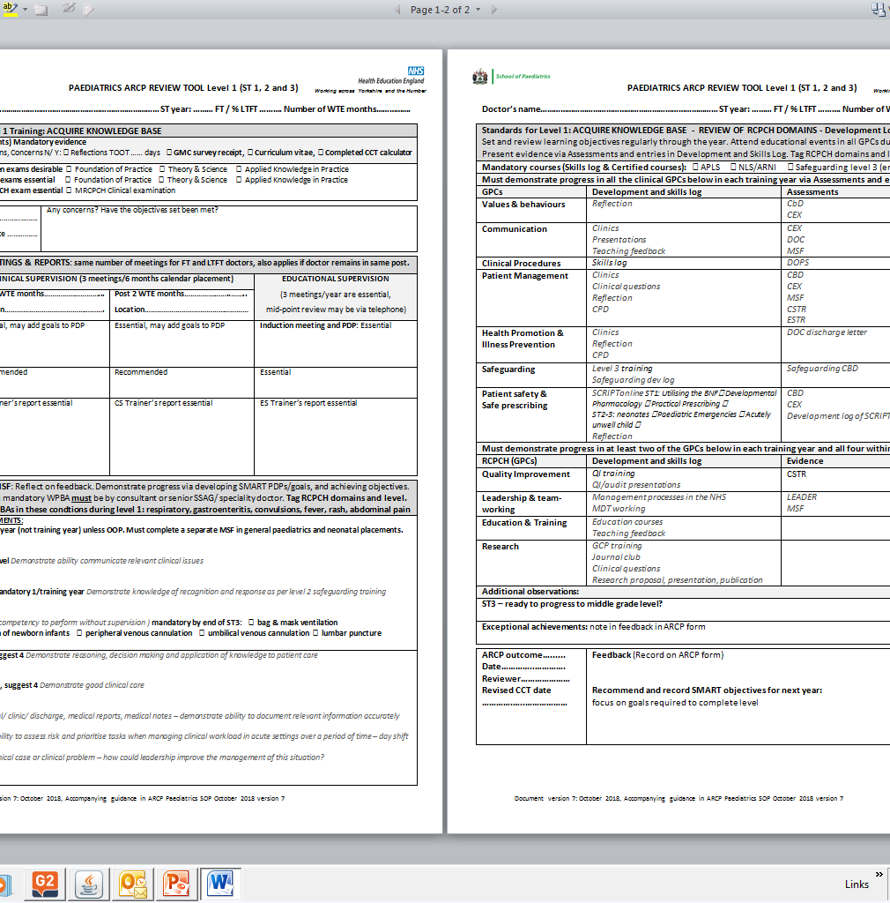
ARCP checklist – will save you time!
Encourage trainees to complete the ARCP checklists available on the deanery website prior to meeting (and upload to portfolio)
Note that this year due to Covid the following minimum requirements apply: View here
@NHS_HealthEdEng

Slide 5
Tools and Guidance available on Deanery website
ARCP checklist – all mandatory evidence for the year should be provided in order to sign off training year, use the RCPCH Covid assessment table for this year
Tables of assessments – numbers required by end of post (however, there will be consideration given to the current situation and impact on training opportunities)
1 MSF required per calendar year NOT training year but for this year requirements have been reduced
Ensure APLS/NLS/Safeguarding training up to date (up to March 2020 due to Covid)
Early CCT guidance and CCT calculator available on the school website
Form R – this is essential for all trainees to complete and upload to portfolio
@NHS_HealthEdEng

Slide 6
ST3 Trainees
ST3 trainees who have been unable to sit clinical exams due to COVID may still move on to middle grade rotas – as long as there is sufficient evidence and documentation within ESR that they have made sufficient training progress and they have achieved other level 1 competencies
A clinical and educational supervisor comment in their report regarding ‘readiness to progress to registrar duties’ will be helpful for the ARCP panel
@NHS_HealthEdEng

Slide 7
Feedback and Wellbeing
START assessment (ST7+)– should review with trainee and ensure reflection and action plan for areas for development
MSF – should be discussed with trainee
Any discussions regarding trainee wellbeing and support available should be documented
Ensure communication with TPDs if training concerns
@NHS_HealthEdEng

Slide 8

Reflection
Some trainees will require further guidance regarding reflection versus description, and should be encouraged to adopt this approach:
@NHS_HealthEdEng

Slide 9
Domains – Include specific examples where possible
01 Professional Values and Behaviours
    Comment on level of responsibility, credibility and quality of reflections, can refer to developmental log and MSF
02 Communication
    General feedback received from assessments, MSF, START
03 Procedures
    Refer to skills log and assessments – particularly important for neonatal posts
Note that this year the ES report is much shorter and you will only need to fill in one section giving an overview of all domains and training progress; ES still need to make a judgement regarding trainee progress on all domains though!
@NHS_HealthEdEng

Slide 10
Domains – Include specific examples where possible
04 Patient Management
    Refer to assessments, MSF, START, developmental log including clinical questions and reflections relating to specific cases
05 Health Promotion
    All trainees should have something in this given current situation re COVID. Other examples are breastfeeding, vaccinations, lifestyle advice etc
06 Leadership and Teamworking
    Especially important for level 3 trainees. Refer to LEADER CBD, MSF, START
@NHS_HealthEdEng

Slide 11
Domains – Include specific examples where possible
07 Patient Safety
    Refer to developmental log, HAT. Any involvement in an SI should have been reflected on and exception report completed and declared on form R
08 Quality Improvement
    Evidence of QI activity, audit, again could use COVID and different ways of working (could link to above domain)
09 Safeguarding
    If no Safeguarding CBD available in the current situation, identify other safeguarding evidence eg reflections in developmental log, attendance at peer review, completion of diploma Safeguarding module
@NHS_HealthEdEng

Slide 12
Domains – Include specific examples where possible
10 Education and Training
    Refer to developmental log. Should also include any feedback received for any teaching given
11 Research
    Include any work on guidelines, GCP, diploma
Summary
This section is very useful to the ARCP panel as gives an overall view of training progress and any areas for development eg exams, and is especially important when completing a training level; for this year this is the only section that needs to be filled in.
@NHS_HealthEdEng

Slide 13
Clinical Supervision
ES please don’t give opinion on areas you can’t comment on – refer to CSR or discuss with CS
CSR – for neonatal and community posts please comment whether competencies have been achieved (regardless of actual time spent in post)
@NHS_HealthEdEng

Slide 14
Other Resources
HEEYH Paediatrics Website Homepage
HEEYH Paediatrics Appraisal and Assessment Webpage
HEEYH Paediatrics ESR Guide 2020
RCPCH COVID-19 Guidance on Managing ARCP’s
National Decision Aid
National Guidance on Coding ARCP’s
Guidance on completion of TOOT on Form R
Derogation to Gold Guide 8
@NHS_HealthEdEng

