Slide 1

Educational and Clinical Supervisors’ Update
School of Paediatrics 2020 -2021
Dr Kay Tyerman TPD
Notes:
Welcome to everyone joining
Please ask questions by raising hand

Slide 2
Overview:
Supervision and ARCP Post-COVID19
Focus on Feedback
RCPCH Updates:
  Exams
  Shape of Training – Progress +
Notes:
Overview of session:
We will highlight current key aspects of curriculum and how we have adapted to deliver supervision and ARCPs post COVID
Discuss challenges and rewards of delivering feedback
And finally provide updates on Exams, START, SPIN, Grid and SOT

Slide 3
Supervision:
Clinical Supervisor | Educational Supervisor
Allocated by Department Work with them, duration of post Facilitate short-term goals Meetings – minimum of 3 x /6 month - Initial Meeting – set objectives - Mid point - End of placement Need to complete CSTR for each 6 month post - Clinical Ability & Progress - Other Professional Activities & Progress eg Governance, Teaching, Research | Allocated by Tutor May have worked with them, continuity through training Career Development & long-term goals Meetings - minimum of 3 x / year - Induction meeting + PDP - Mid-point review - End of year review 4. ESTR – in conjunction with CS
Notes:
Now moving onto supervision.
Each trainee will have an ES and CS – this may be the same person but often as a trainee progresses they are different consultants ad deliver distinct roles in the training framework.
A CS provides the day to day support and assessment in the clinical workplace whereas the ES has an overview of the trainees progress, providing continuity through training.
A trainee needs a CSTR at the end of each calendar 6 month rotation and a ESTR each year prior to ARCP.

Slide 4
Trainers’ Reports:
Type of Report: | CSTR | ESTR
Trainee- led: | Yes | Yes
Frequency: | Every 6 calendar months | Every 12 calendar months
Content: | Objective report based upon: work-based assessments Feed-back from colleagues/MDT Clinical Skills & Performance Professional Attitudes Other Departmental Contributions | In conjunction with CSTR: PDP progress / Goals set at last ARCP ‘Mandatory’ Courses MSF Work-based Assessment Trainee reflection Structured review of progress Curriculum Domains ‘ARCP toolkit’ - use as checklist
Conclusion: | - Has trainee met competencies? Are they able to progress to next level of training / CCT? Are there any specific training needs that need to be addressed? Are there any mitigating circumstances that need to be considered? | As per CSTR Highlight excellence Any specific development/career needs that should be highlighted to ARCP panel? Are they ready to undertake START? Has trainee addressed developmental needs highlighted by START?
 | ‘Mini Reference’
Notes:
These are suggestions for the key aspects that need to be considered when writing an ES and CSTR.
Detailed reports are incredibly helpful for both trainees and ARCP panels in identifying areas of training that are lacking but also in extending more able trainees and also highlighting trainees that can be fast-tracked and may wish to consider early CCT at the end of ST7.

Slide 5
Attaching evidence to Curriculum Domains (ESreport):
- trainee should include specific examples
01 Professional Values and Behaviours
    Comment on level of responsibility, credibility and quality of reflections, can refer to developmental log and MSF
02 Communication
    General feedback received from assessments, MSF, START
03 Procedures
    Refer to skills log and assessments – particularly important for neonatal posts
04 Patient Management
    Refer to assessments, MSF, START, developmental log including clinical questions and reflections relating to specific cases
05 Health Promotion
    All trainees should have something in this given current situation re COVID. Other examples are breastfeeding, vaccinations, lifestyle advice etc
06 Leadership and Teamworking
    Especially important for level 3 trainees. Refer to LEADER CBD, MSF, START
07 Patient Safety
    Refer to developmental log, HAT. Any involvement in an SI should have been reflected on and exception report completed and declared on form R
08 Quality Improvement
    Evidence of QI activity, audit, again could use COVID and different ways of working (could link to above domain)
09 Safeguarding
    If no Safeguarding CBD available in the current situation, identify other safeguarding evidence eg reflections in developmental log, attendance at peer review, completion of diploma Safeguarding module
10 Education and Training
    Refer to developmental log. Should also include any feedback received for any teaching given
11 Research
    Include any work on guidelines, GCP, diploma
Notes:
Trainees now need to ‘attach’ evidence to each domain.
Kaizen has been updated to help supervisors identify gaps in evidence per training level which should help ‘sign off’ of training level.
Trainees can also ‘attach ‘ evidence to higher training levels.

Slide 6
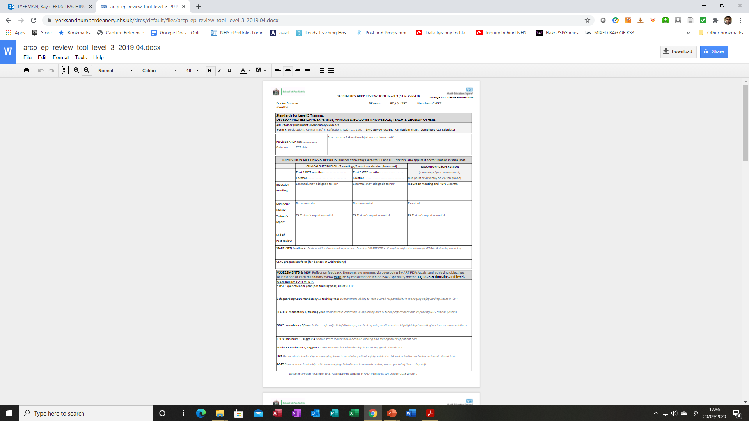
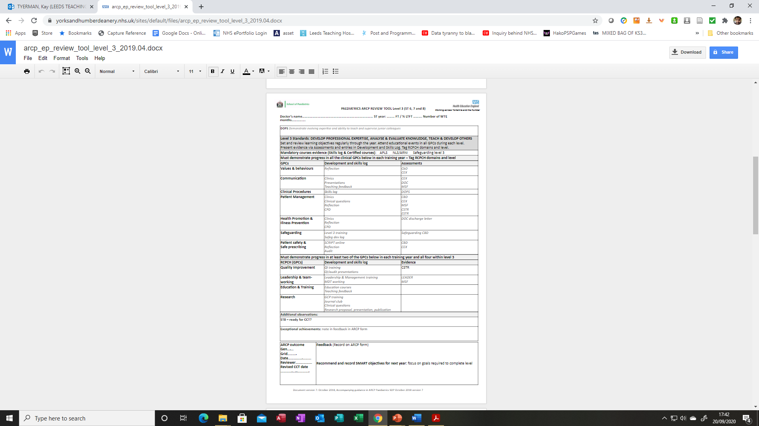
Notes:
ARCP toolkits are published for each training level and we would like you to encourage trainees to complete these prior to ARCPs to ensure they have not missed any key area of assessment such as safeguarding CBD or MSF that need to be completed each calendar year.

Slide 7
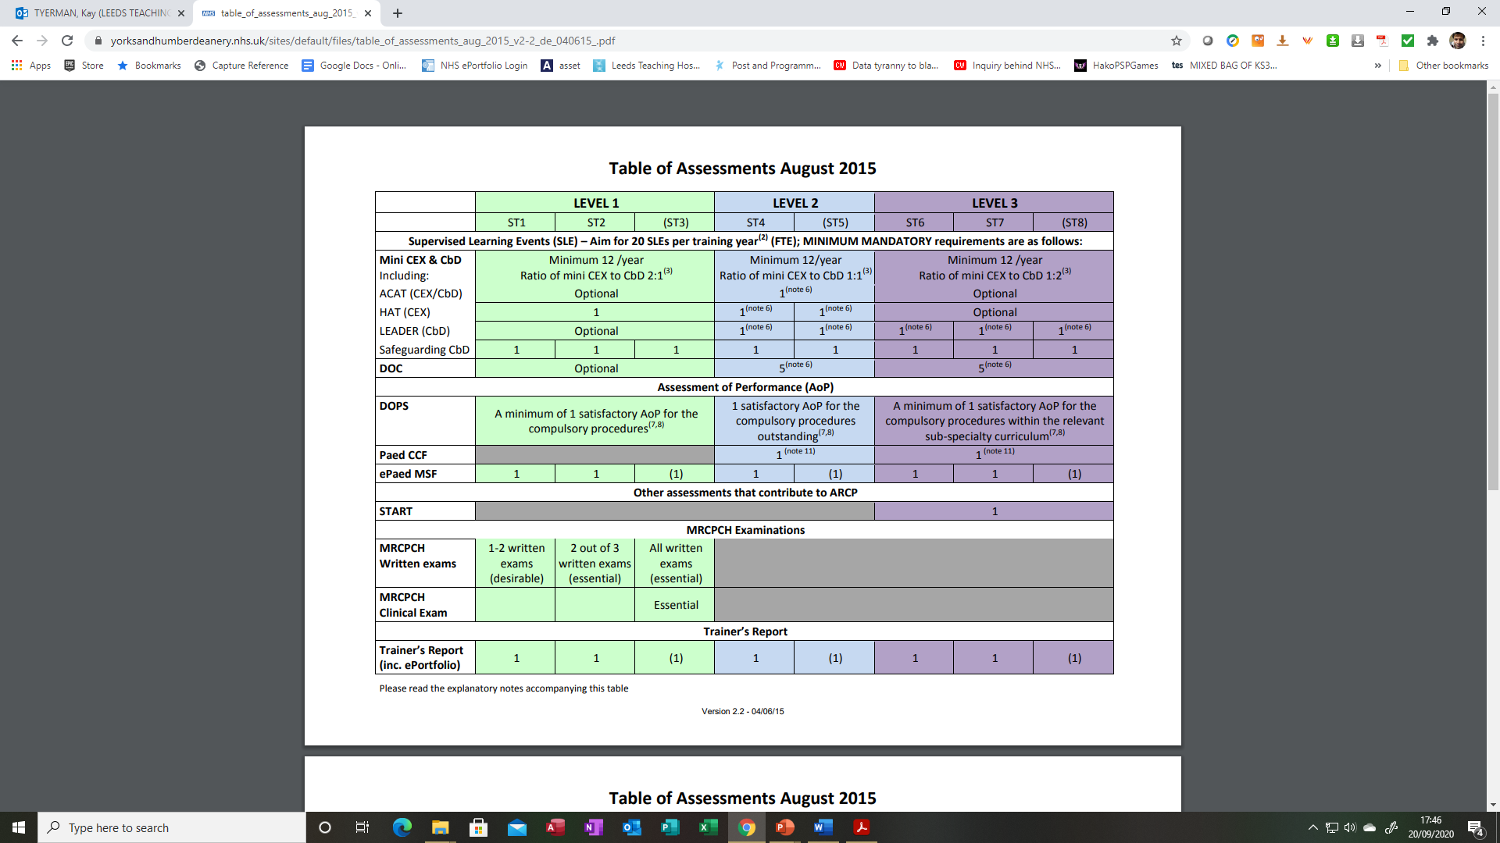
Notes:
A table of expected assessments per training level is also available on SOP @ ‘ARCP’ webpage at HEE Y&H.

Slide 8
Supervision post-COVID19:
Virtual / Face 2 face supervision meetings
SMART PDP – adaptable to potential changes in working environment
Support & Feedback – Reset, Restore and Recover
Flexible opportunities for learning:
                Work based assessments
                Clinical training – remote consultations
                ‘Teams’ teaching sessions/ meetings
                Remote delivery STEPP, Diploma Child Health, SPRAT
                Blackboard Platform
Notes:
How we deliver, assess and appraise training has changed dramatically over the last 10 months.
This has led to challenges but also flexibility in how meet trainees, deliver training and carry out WBAs.
Trainees have been redeployed, changed working patterns, return from OOPs and academic training, faced challenges in progressing training as well as having to shield, home school and being unwell with COVID themselves.
It can all seem relentless even with a vaccine in sight.
We need to ensure trainees know that they are valued and supported. Supervision can provide an opportunity to discuss and reset, restore and recover.

Slide 9
Resources:
HEEYH Paediatrics Website Homepage
HEEYH Paediatrics Appraisal and Assessment Webpage
HEEYH Paediatrics ESR Guide 2020
RCPCH COVID-19 Guidance on Managing ARCP’s
National Decision Aid
National Guidance on Coding ARCP’s
Guidance on completion of TOOT on Form R
Derogation to Gold Guide 8
Notes:
HEE have produced a number of useful resources and hold regular webinars for trainees.

Slide 10
ARCP: Annual Review of Competence Progression
Assess progress
Feedback focussed on development
Review CCT date
Date for next ARCP
Notes:
Despite COVID , we have continued to deliver ARCPs remotely and focussed upon trainees at time critical points in their training.

Slide 11
Outcomes:
Satisfactory Progress:
Outcome 1
Achieving progress and competencies at the expected rate (Clinical)
Achieving progress and competencies at the expected rate (Academic)
Recommendation for completion of training:
Outcome 6
Gained all required competencies (Clinical)
Gained all required competencies (Academic)
Notes:
Trainees progressing satisfactorily will either be awarded an outcome 1 or outcome 6 if they have met all competencies to complete training.

Slide 12
Outcomes:
Unsatisfactory or insufficient evidence (trainee must meet with panel)
Outcome 2
Development of specific competences required - additional training time not required
Outcome 3
Inadequate progress by the trainee - additional training time required
Outcome 4
Released from training programme with or without specified competences
Released from academic programme
Outcome 5
Incomplete evidence presented - additional training time may be required
**Outcome 5 to be reviewed within 2-4 weeks.
Notes:
Unsatisfactory outcomes or where there is incomplete evidence are :

Slide 13
COVID Outcomes:
RCPCH Guidance:
ARCP panels should consider an outcome 10 only when the trainee has been unable to evidence components of the assessment pathway that are mandatory for progression to the next level of training because of COVID-19.
Outcomes 10.1 and 10.2 recognise that progress of the trainee has been satisfactory and acquisition of capabilities by the trainees has been delayed by COVID-19 disruption. These are therefore 'no-fault' outcomes.
Notes:
In response to COVID, we now have two additional outcomes:

Slide 14
Outcomes 10.1 & 10.2:
Outcome: | Description: | Applicable to:
10.1 | 10.1 Progress is satisfactory but the acquisition of competencies/ capabilities by the trainee has been delayed by COVID-19 disruption. Trainee can progress. | 1. Trainee is not at a critical progression point 2. Trainee is at a critical progression point in their programme but the RCPCH has mandated that the capabilities can be acquired at the next stage of training. Note: additional training time necessary to achieve capabilities will be reviewed at the next ARCP.
10.2 | 10.2 Progress is satisfactory by the acquisition of competencies/ capabilities by the trainee has been delayed by COVID-19 disruption. Trainee is at critical point and additional training time is required. | 1. Trainee is at a critical progression point in their programme where there has been no derogation to normal curriculum progression requirements given by the RCPCH (eg RCPCH START assessment). 2. Trainee is at the critical progression point of approaching CCT and additional training time will be required before the trainee can complete their training.
Notes:
10.1 is given if progress is satisfactory but acquisition of competencies has been delayed due to COVID at a time critical point and RCPCH has derogated that the capabilities can be acquired at the next stage of training. Eg lack of clinical exam at the end of ST4
10.2 is given if acquisition of competencies has been delayed at a time critical point but there is no derogation eg START/ approaching CCT

Slide 15
ARCP:
Standard Panel:
COVID Panel:
Minimum 2 panel members including TPD/HOS Chair
3 panel members for previous outcome 3 or anticipated 4
Lay advisor for appeals only
All remote
Outcome 5 only for missing form R
  2 x Educational Supervisors + TPD chair
  Associate Dean (outcome 3 or 4)
  Lay member (10%)
  Remote
  F2F for unsatisfactory outcomes
Notes:
Panels have also been adapted
F2F discussions will happen for all unsatisfactory outcomes , often between TPD/panel chair and trainee
A decision was made that an outcome 5 would only be awarded for missing form R

Slide 16
ARCP Standards:
Standard
COVID
Level 1 – KNOWLEDGE
  exams/ fit for middle grade role
Level 2 – plus AUTONOMOUS PRACTICE
  general paediatrics, community, neonates
Level 3 – plus LEADERSHIP
  ST7 START feedback – senior skills and attitudes
  ST8 – ready for CCT
Outcome 10.1
Trainee can move to ST4 without full MRCPCH if:
All MRCPCH theory exams are achieved.
Two MSFs have been completed during level 1 (ST1-ST3)
All curriculum capabilities for level 1 training have been demonstrated or, in the educational supervisor's report, have been observed in the workplace
There is a satisfactory COVID educational supervisor report declaring trainee is safe to move onto the middle grade (ST4) level at next rotation
The trainee has not completed any required life support training (or their life support certification has expired) but was unable to attend or book on a course due to cancellations
Notes:
RCPCH provided guidance on the requirements for trainees to move from ST3 to ST4 without their clinical exams.

Slide 17
Assessing
E-portfolio Evidence
Form R (TOOT & Declarations), CCT calculator, GMC Survey Receipt, CV
Outcome last ARCP: any specific recommendations?
Supervision Meetings , CSTR x 2 + ESTR
PDP
Work-based assessments (mandatory SLEs)
MSF
Developmental Log, Skills log, Reflection
Exams , mandatory Courses
CSAC Progress Report
START
Notes:
Kaizen now facilitates overview of evidence for ARCP and helps ensure we appraise training in a systematic and objective fashion.

Slide 18
ARCP Outcome Form:
Review:
Plan:
Period assessed, number of WTE months training
ST year reviewed
End of training year review?
Level completion?
Progress satisfactory for this ST training year?
Achieving at level above?
OUTCOME
  Reasons for outcome
  Feedback on e-portfolio and suggestions for development
For LTFT doctors: document evidence required to complete training year/level if this ARCP was not an end of training year review
CCT date (calculate)
  Post-pone
    >14 days out of training/ year
    OOP
  Bring forward if exceptionally rapid progress
ST year next post
Next ARCP date
Notes:
The ARCP Outcome from , completed by the ARCP panel , firstly gives an outcome but also provides the trainee with feedback and suggests areas for development.
It also confirms CCT date, confirms ST year at next post and states when trainee should have next ARCP.

Slide 19
ARCP Outcome Form
Unsatisfactory Outcome:
Reasons for Outcome:
Missing Evidence/ Lack of Engagement:
and/or:
Competencies to be developed:
  Clinical: Exam failure, Knowledge, assessment of patients, decision making, management of patients, technical procedures
  Professional skills: time management, organisation, reliability
  Professional behaviour: communication, team working, leadership
Additional Training time – how much?
Plan:
Strategy to develop competencies
Evidence required for next ARCP for outcome 1
Anticipated outcome if evidence not present
Referral to local TPD + Sign post for support
Date of next ARCP:
  Usually within 6 months
  To review outstanding competencies
  For outcome 3 before the end of the extension
Notes:
Trainees with an unsatisfactory outcome are given a detailed outcome listing missing evidence/ competencies and a strategy as to how this should be addressed to ensure successful progress at next ARCP.

Slide 20
Competencies to be developed | Strategies to develop competencies Signpost to support | Evidence for next ARCP
Single exam failure | Department exam teaching Exam revision courses Exam specific coaching Signpost to exam TPD Chakra Vasudevan | Successful completion of examination
Repeated exam failure | Dyslexia screening and the above Occupational health referral Workplace wellbeing/ Take time | Success in examination
Notes:
Trainees are hopefully signposted to support to achieve their goal.

Slide 21
Competencies to be developed | Strategies to develop competencies Signpost to support | Evidence for next ARCP
Clinical: knowledge assessment of patients clinical decision making ability to execute management plans | Enhanced clinical supervision Additional training (simulation-based training) | CBDs ACAT
Clinical technical skills | Additional training | DOPs
Notes:
Trainees can be advised to complete certain WBAs tailored to the missing competencies

Slide 22
Competencies to be developed | Strategies to develop competencies Signpost to support | Evidence for next ARCP
Professional skills: communication verbal/ written | Communication skills course Additional training Consider dyslexia screening | HAT/ DOC
Professional skills: time management organisation | Time management course Coaching | ACAT, MSF, CSTR, ESTR
Professional behaviours: punctuality, reliability communication team-working respect for colleagues, patients & carers | Coaching Enhanced clinical/educational supervision | Reflective note MSF, CSTR, ESTR
Notes:
Lack of professional behaviour can be the hardest to address but help is available and TPDs can support both trainees and ES/ CS .

Slide 23
Issues identified | Strategies to manage situation Signpost to support | Evidence for next ARCP
Health: physical/ mental | GP, Occupational health Workplace wellbeing/ Time out Consider reducing working hours
Personal circumstances | Workplace wellbeing/ Time out Consider reducing working hours
Notes:
Trainees can self refer to ‘Time out’ to access counselling and there are 24/7 text services and additional support available to trainees experiencing difficulties.

Slide 24
Post ARCP Support:
Communication - ES, CS, TPD (College tutor, DME +/- HR +/- Paediatric Support)
Formal meeting
  Trainee+TPD+/- ES to communicate outcome (unless outcome 1)
  Trainee + ES to make plan
  Clear plan – SMART objectives
  Document in e-portfolio
Regular review with ES
Notes:
Following an adverse outcome, trainees should meet with their ES. They may also need to meet with their TPD. Their PDP should be SMART and they should also understand the outcome is they do not demonstrate satisfactory progress at next ARCP.
An outcome 3 or 4 should not be a surprise.
Trainees on an adverse outcome will need enhanced supervision with more frequent meetings.

Slide 25

Support – What is available?
https://www.yorksandhumberdeanery.nhs.uk/
Exam Support
Paediatric Peer Mentoring Scheme
Paedspeers@gmail.com
Counselling – Workplace Wellbeing/ Take time
Coaching
SuppoRTT ( out of training > 3/12)
https://www.yorksandhumberdeanery.nhs.uk/learner_support/supported_return_to_training
Notes:
This gives a flavour of support and resources available

Slide 26
Feedback
https://youtu.be/c_MdkLzfTDU
https://youtu.be/F506D1PXXSg
Notes:
Feedback deserves an afternoon workshop.
All trainees consistently tell us In GMC, NETS and Grid programme review that they don’t get enough feedback.
The links on this slide are worth watching (at a later date?) and show how its easy to slip into feedback that is not given in the correct setting or manner.

Slide 27

What is feedback?
The giving of specific information regarding observed behaviour …
…with the intention of improving performance

Slide 28
Levels of feedback
Low-level – frequent, brief and informal
Mid-level – as part of the WBA process
High-level – at supervision meetings
Notes:
Trainees value different types of feedback
Affirmative regular feedback ‘ that was a great handover ‘, ‘ you’ve worked hard this week’
Feedback as part of planned work based assessment
Formal feedback within supervision

Slide 29
Limitations and Challenges
Lacking
Ineffective
Excessively positive and avoids negative aspects
Off the cuff – negative
Trainees and trainers are unaware of the benefits
Apprehensive in seeking/giving feedback
Trainers often fail to encourage trainees to seek feedback
Face to face training needed
Notes:
However, there are also many challenges:
We also need to be able to give constructive feedback when a trainee is not making satisfactory progress.
TPDs are there to help and offer advice.
Some trainees may not always recognise that they are receiving feedback.
Trainers may not always encourage trainees to seek feedback and some trainees avoid feedback.
Can we embed feedback into training – may be discuss with a trainee at induction meeting how they would like to receive feedback and make it a standard part of any supervision meetings?

Slide 30
Principles of effective feedback
Establish a positive working relationship
Demonstrate mutual respect
Close and supportive clinical supervision
Accessible and engaged in the learning process
Give clinical independence within trainee’s limits

Slide 31
Process of effective feedback
Guided by self-reflection
Directed towards agreed learning goals
Specific, relevant and descriptive
Non-judgemental and focussed on trainee behaviour
Include a confirmation of the trainee’s understanding of the content of the feedback
Include an action plan for future learning goals

Slide 32
How can we improve Feedback ?
Examples –
Give feedback after a busy shift – verbal/email/whatsapp
Consultant meeting collects trainee feedback and communicates this to trainees
Consultant WBA clinic
WBA for departmental teaching done by trainees

Slide 33
RCPCH Updates
  Exams
  Shape of Training – Progress +
Notes:
Finally RCPCH updates..
The College have been very busy launching the Paediatrician of the future document (worth a read) and adapting to remote working in all that they do.

Slide 34
RCPCH Updates
  MRCPCH
  Written
  - Option 1: test centre social distancing
  - Option 2: at home/private space with online invigilation
  AKP: September, January 21
  FOP/TAS: October, February 21
  Clinical
  MRCPCH COVID Adapted Clinical Exam November 20
  Remote , Practique platform
  https://www.rcpch.ac.uk/resources/mrcpch-covid-adapted-clinical-exam-information-hub#recent-updates-on-mrcpch-clinical-exam
  START
  October 20, April 21
  Remote, Practique Platform
Notes:
Exams were cancelled during first COVID lockdown but have now been delivered remotely with first START in October, Grid Interviews and adapted clinical exam both in November 20 using online platform Practique.
Support from the College has included webinars and improved online resources.
Trainees and trainers have adapted to help trainees prepare for exams and interviews.

Slide 35
RCPCH Updates:
Shape of Training
Two level training programme
7 year indicative training time
  Core
  Speciality – General Paediatrics and Sub-speciality
Increased flexibility + OOPs
Avoid sudden change tier 1 -2 rota
Submission to GMC Spring 2021
Move to Progress + September 2023
Notes:
Finally the future –
The Paediatrician of the future documents lays out the vision for adaptable training that focusses upon trainee patient encounters .
In conjunction with Progress it prepares the way for SOT and adaptation of the curriculum to Progress +
The key differences are that we will move to a 2 level training programme.
Core – ST1-4
Speciality encompassing ST5-7 both general paediatrics and sub-speciality training.
It avoids cliff edge of ST3/4
Trainees have up to 4 yrs to get clinical exam
They can get tier 2 experience in ST3 if deemed able and can fast track if they enter training already with experience and written exams.
There will also be more opportunity for OOPs including OOPPause. Hopefully resulting in less attrition through training.

Slide 36
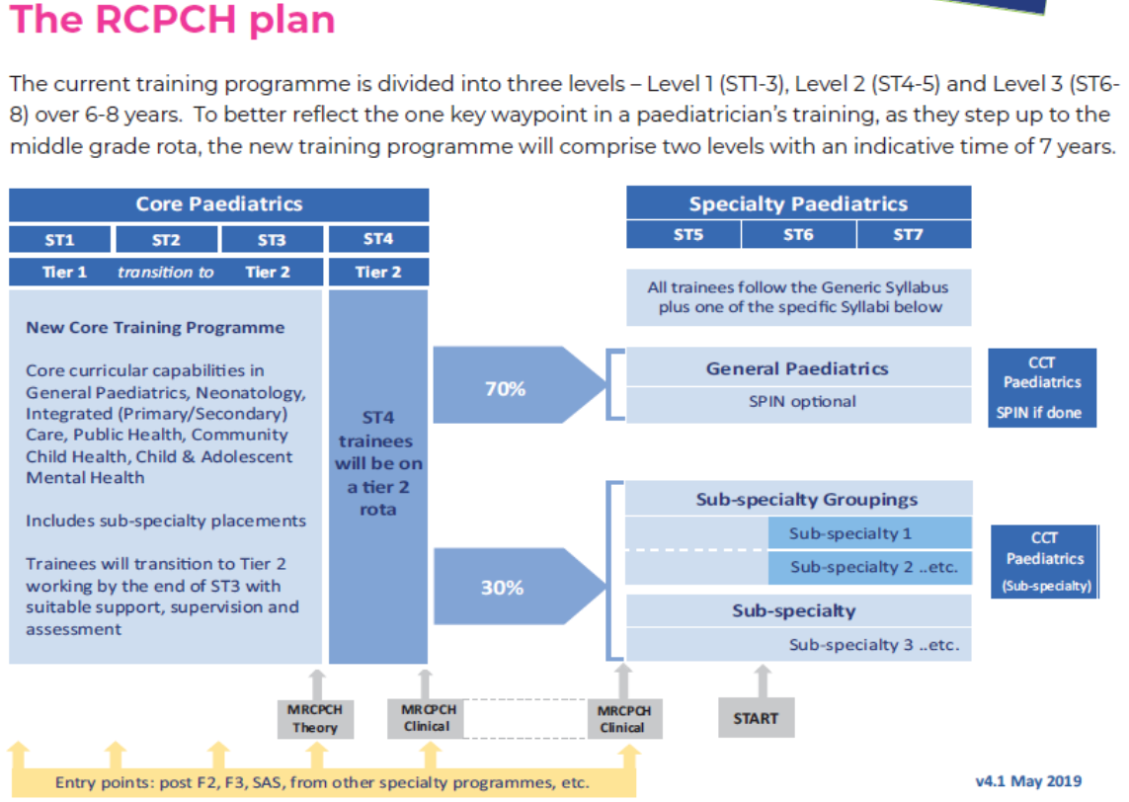

Slide 37




Summary:
Trainees & SOP need you
Feedback
Reset, Restore and Recover
Get ready for SOT
Thank you
Notes:
Thank you very much for joining today
Please look after yourself
Your trainees and TPDs need you ☺

