Slide 1
Assessment Models
RDMp
SKIPE
I-SID
Notes:
Awareness of any of these?

Slide 2
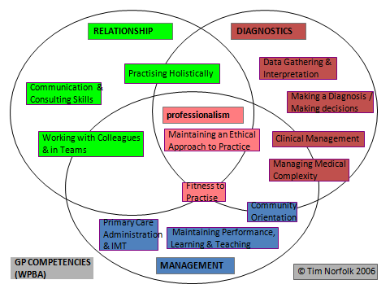
RDMp
Notes:
Useful to know for your interview.
Post it notes to highlight areas of difficulty and forms
Discuss practicalities of how to do it.

Slide 3
SKIPE
Skills
Knowledge
Internal
Past
External
Notes:
Easier tool to use to generate discussion
Internal – personality, attitude, organisational skills
Past – training, culture, past experiences
External – home life etc.

Slide 4
I - SID
I Identify
S Share
I Involve
D Document
use RDMp, SKIPE, other sources
concern with trainee, ES, TPD, performance lead
the trainee - plan together
educator notes on eportfolio
be factual, non judgemental, notify the trainee that you are doing this. Add frequently, include positive and negative
Notes:
System of bringing all information discovered together.

