Slide 1
Joint Royal Colleges of Physicians Training Board (JRCPTB) New Internal Medicine stage 1 curriculum
Peter Hammond Head of School of Medicine, HEE Yorkshire and the Humber

Slide 3
Overview
Drivers for change
New model for physician training
Internal Medicine curriculum
Implementation
Next steps
Further information

Slide 4
Drivers for change
GMC review of curriculum standards and generic professional capabilities (GPCs)
CMT and challenge of medical registrar role
Burden of assessment and ‘tick-box’ approach
Flexibility review
Shape of Training (SoT) review

Slide 5
Shape of Training
Postgraduate medical training curricula must:
Better support needs of patients and service
Produce doctors who can participate in acute unselected take and provide continuity of care
Better support delivery of care in the community
Support a more flexible approach to training
Describe how specialist/ sub-specialist components could be delivered as ‘credentials’
Notes:
Review of postgraduate medical education and training led by Prof David Greenaway
2013 report with 19 recommendations
UK Shape of Training Steering Group set up to advise on implementation

Slide 6
Proposed model for physician training
Wide-ranging consultation with stakeholders
Discussion with UK SoT Steering Group & GMC
Proposed new training pathway with enhanced internal medicine (IM) training
New IM stage 1 curriculum to replace CMT
Phased implementation of new specialty curricula and IM stage 2

Slide 7
Overview
New Internal Medicine stage 1 curriculum
Approved by GMC Dec 2017
Proposed model for physician training
Generic Professional Capabilities (GPCs)
Capabilities in Practice (CiPs)
Inclusion of other medical specialties in AUT
Neurology / Palliative Med / GU Med
Implementation
Build new IM 1-3 year rotations

Slide 8
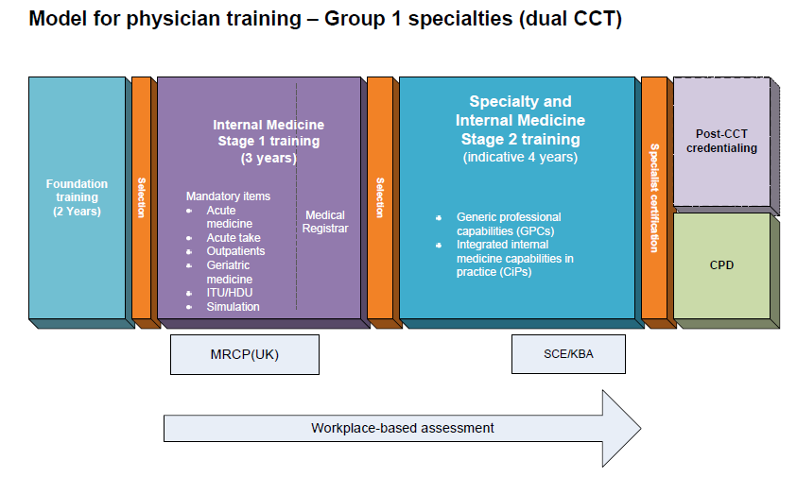

Slide 9
Group 2 specialties
Small specialties which will not contribute to acute unselected take and will not dual train with Internal Medicine
Will select at end of IM2 with full MRCP(UK)
Trainees may wish to complete IM stage 1 to keep options open
Notes:
Needed?

Slide 10
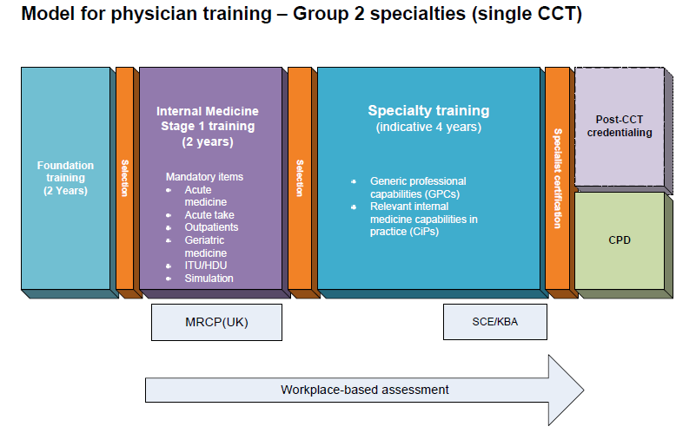

Slide 11
Group 1 specialties (dual train with Internal Medicine) | Group 2 specialties (single CCT)
Acute Internal Medicine | Allergy
Cardiology | Audio vestibular Medicine
Clinical Pharmacology and Therapeutics | Aviation and Space Medicine
Endocrinology and Diabetes Mellitus | Clinical Genetics
Geriatric Medicine | Clinical Neurophysiology
Gastroenterology | Dermatology **
Genitourinary medicine | Haematology
Infectious Diseases* | Immunology
Neurology | Medical Ophthalmology
Palliative Medicine | Nuclear Medicine
Renal Medicine | Paediatric Cardiology
Respiratory Medicine | Pharmaceutical Medicine
Rheumatology | Rehabilitation Medicine
Tropical Medicine* | Sport and Exercise Medicine
*Discussion ongoing re dual programmes with MM/MV **Detail of programme to be determined
Medical Oncology not included - ongoing discussion with UKSTSG

Slide 12
New IM stage 1 curriculum
14 high level capabilities in practice (CiPs) mapped to GPCs
Holistic assessment based on entrustment decisions
Mandatory training components
Meets GMC standards for curricula and assessment (approved 8 December 2017)

Slide 13
Generic CiPs
6 generic CiPs cover professional behaviours and skills that are required of all physicians
Assessment of the generic CiPs will be underpinned by the GPC descriptors
ES will assign global rating for generic CiPs using anchor statements (below, meeting or above expectations)

Slide 14
Generic CiPs
The ability to successfully function within NHS organisational and management systems
Able to deal with ethical and legal issues related to clinical practice
Communicates effectively and is able to share decision making, while maintaining appropriate situational awareness, professional behaviour and professional judgement
Is focussed on patient safety and delivers effective quality improvement in patient care
Carrying out research and managing data appropriately
Acting as a clinical teacher and clinical supervisor

Slide 15
IM clinical CiPs
8 clinical CiPs describe the tasks or activities essential to the practice of Internal Medicine
Mapped to GPC domains and subsections
ES makes a judgement on level of supervision required based on observation and feedback from range of assessors (MCR, MSF, SLEs etc)

Slide 16
Level descriptors
Level 1: Entrusted to observe only – no provision of clinical care
Level 2: Entrusted to act with direct supervision
Level 3: Entrusted to act with indirect supervision
Level 4: Entrusted to act unsupervised

Slide 17
Clinical IM CiPs
Managing an acute medical take
Managing an acute specialty related take
Providing continuity of care to medical in-patients, including management of comorbidities and cognitive impairment
Managing patients in an outpatient clinic, ambulatory or community setting, including management of long term conditions
Managing medical problems in patients in other specialties and special cases
Managing a multi-disciplinary team including effective discharge planning
Delivering effective resuscitation and managing the acutely deteriorating patient
Managing end of life and applying palliative care skills

Slide 20
Group 1 specialties (dual train with Internal Medicine) | Group 2 specialties (single CCT)
Acute Internal Medicine | Allergy
Cardiology | Audio vestibular Medicine
Clinical Pharmacology and Therapeutics | Aviation and Space Medicine
Endocrinology and Diabetes Mellitus | Clinical Genetics
Geriatric Medicine | Clinical Neurophysiology
Gastroenterology | Dermatology **
Genitourinary medicine | Haematology
Infectious Diseases* | Immunology
Neurology | Medical Ophthalmology
Palliative Medicine | Nuclear Medicine
Renal Medicine | Paediatric Cardiology
Respiratory Medicine | Pharmaceutical Medicine
Rheumatology | Rehabilitation Medicine
Tropical Medicine* | Sport and Exercise Medicine
*Discussion ongoing re dual programmes with MM/MV **Detail of programme to be determined
Medical Oncology not included - ongoing discussion with UKSTSG

Slide 21
IM 1-3: From August 2019
Year One (IM1) - Trainees will have exposure to Acute Care (via Unselected Take) but with a concentration upon Continuing In-Patient Care with responsibilities in General Medical and Geriatric Medical wards. Trainees will enter IM1 having completed Foundation competencies
Year Two (IM2) - Trainees will continue to have exposure to Acute Care (via Unselected Take) and critical care but the focus of the year will be Ambulatory Care and Medical Out-Patient management. Entry to IMT2 will be automatic following a successful ARCP at end of IM1 year. Trainees will be encouraged to complete MRCP by the end IM2 (although it will not be mandatory for progression to IM3
Year Three (IM3) -Trainees will have greater involvement in the Acute Unselected Take. They will be expected to “lead” the unselected take in the “medical registrar” role and provide support for IM1 & IM2 trainees as well as other staff involved in the take (eg Foundation trainees, GP trainees, ACCS trainees and others)
Trainees will enter IM3 upon satisfactory completion of IM2 ARCP or via other routes

Slide 22
Acute take
Trainees should be involved in the acute unselected medical take in each year of IM stage 1 (main focus in IM3)
Should be actively involved in the care of at least 500 patients presenting with acute medical problems by the end of IM3

Slide 23
Critical care
Trainees should have significant experience of critical care
Flexibility in how this is delivered providing educational objectives are met
Minimum 10 weeks over 3 years in no more than 2 blocks
Ideally 3 month attachment to ICU in IM2
Possible 2 month attachment IM2 + 1 month IM3
Flexibility for IM1 attachment

Slide 24
Outpatients
Trainees should be actively involved in minimum of 80 clinics
Flexibility in how meet this target but focus on outpatients in IM2
Clinics may be in the parent specialty of attachment or other departmental clinics
Curriculum provides definition of clinics and guidance on educational objectives

Slide 25
Simulation Training
Simulation training throughout IM stage 1
Practical procedures
Clinical scenario training
Resuscitation training and management of the deteriorating patient

Slide 26
Group 2 Specialties
Entry requirements will include successful completion of 2 years of Internal Medicine stage 1 and full MRCP(UK) diploma
IM3 year will be highly focused on acute care and the transition to being a medical registrar running the unselected acute medical take; there is less requirement for this level of training for those trainees wishing to pursue a Group 2 specialty
Trainees wishing to enter group 2 specialty will be treated equally whether completed 2 or 3 years of IM stage 1
Notes:
Needed?

Slide 27
Implementation – Phase one
2018/2019 | Training for supervisors and trainees | JRCPTB will develop training materials and train a core faculty (heads of schools, CMT TPDs and college tutors). The core faculty will cascade training to clinical and educational supervisors and trainees
2019/2020 | First year of IM1 (replacing CT1) | No further CMT recruitment Commence recruitment into three-year IM programmes at IM1 Existing CT2 enter last year of CMT training
2020/2021 | First year of IM2 (replacing CT2) and further recruitment into IM1 | Further intake of IM1 IM1 progress to IM2

Slide 28
Implementation – Phase two
2021/2022 | First year of IM3 First year of ST3 new curricula for group 2 specialties | No further recruitment into ST3 in group 1 specialties - except for GUM, neurology and palliative medicine IM2 progress to IM3 or exit to enter group 2 specialties at ST3
2022/2023 | First year of IM stage 2 training (IM4) First year of ST4 new curricula for group 1 specialties | Trainees exiting IM3 will competitively-enter ST4 specialty plus IM stage 2

Slide 29
Implementation – Phase three
2023/2024 onwards | Assimilation of ‘old-style’ trainees into new curricula | Full implementation of IM stage 1 and stage 2 Existing ST5-7 trainees to transition to new curricula as set out in the transition plan agreed with GMC

Slide 30
Implementation Plan
 |  | Transition Phase 1 |  | Transition Phase 2 |  | Transition Phase 3 |  | New IM curriculum structure embedded
 | 2018-19 | 2019-20 | 2020-21 | 2021-22 | 2022-23 | 2023-24 | 2024-25 | 2025-26 | 2026-27 | 2027-28
GROUP ONE | CT1 | CT2 | IM1 | IM2 | IM3 | IM1 | IM2 | IM3 | IM1 | IM2
 | CT2 | IM1 | IM2 | IM3 | IM1 | IM2 | IM3 | IM1 | IM2 | IM3
 | ST3 | ST4 | ST5 | ST6 | ST7 | IM4 | IM5 | IM6 | IM7 | IM4
 | ST4 | ST5 | ST6 | ST7 | IM4 | IM5 | IM6 | IM7 | IM4 | IM5
 | ST5 | ST6 | ST7 | IM1 | IM2 | IM3 | IM1 | IM2 | IM3 | IM1
 | ST6 | ST7 | ST3 | ST4 | ST5 | ST6 | ST7 | IM4 | IM5 | IM6
 | ST7 | ST3 | ST4 | ST5 | ST6 | ST7 | IM4 | IM5 | IM6 | IM7
GROUP TWO | ST3 | ST4 | ST5 | ST6 | ST3 | ST4 | ST5 | ST6 | ST3 | ST4
 | ST4 | ST5 | ST6 | ST3 | ST4 | ST5 | ST6 | ST3 | ST4 | ST5
 | ST5 | ST6 | ST3 | ST4 | ST5 | ST6 | ST3 | ST4 | ST5 | ST6
 | ST6 | ST3 | ST4 | ST5 | ST6 | ST3 | ST4 | ST5 | ST6 | ST3

Slide 31
Potential routes of entry to IM3:
Trainees who have previously completed CT2
Direct return to training at IM3 level, ideally within their original training Deanery
< 3 years following satisfactory completion of Core Training
International Medical Graduates (IMGs)
In possession of MRCP
Medical Royal Colleges IMG sponsorship scheme / targeted MTI scheme
3. ACCS programmes
JRCPTB to work with other ACCS specialties to determine the future ACCS programme and what additional training would need to be undertaken by those transferring from another specialty route
4. Possible transfer from other programmes
Eg General Practice, Surgery, Psychiatry
Further discussion needed

Slide 32
IM Stage 2
Trainees in all Group 1 specialties must dual-accredit in specialty plus IM
Group 1 trainees can only demonstrate acquisition of GPCs with full IM training

Slide 33
Recruitment Points into Academic Training
Foundation
IM Stage 1
IM Stage 2 and specialty
Consultant
IMT1
IMT2
IMT3
IMT4

Slide 34
Programme planning
Regional implementation groups
Review 2021 expected vacancies from exiting CCTs in group 1 specialties for IMY3
Review recruitment and fill-rates
Identify any training anomalies and new opportunities
Consider length of placements

Slide 35
Local work required CT / IM transition
Identify ICU placements
What constitutes Critical Care?
Resp / Neuro / Transplant / mHDU
Geriatric Medicine experience
Review all current local CMT posts
Identify any training anomalies / new opportunities
Review recruitment / fill-rates
4 month vs 6 month rotations
Seniority on acute take (IM3 leading AUT)
Outpatient experience (80 over 3 yrs)
Ambulatory care experience
Simulation training experience / availability
Other posts to possibly include in future training numbers
Trust grade
Clinical teaching fellows
OOPR posts with ongoing medical input (eg research registrars)
LAS posts
Returning CT2s
IMGs

Slide 36
Local work required Higher Medical Training
Review 2021 expected vacancies from exiting CCTs in Group One specialties
Identify local problems
Review all local HMT posts & programmes
Identify training anomalies / opportunities
Review recruitment / fill-rates
6 vs 12 month rotations
Balance of specialty vs acute training
Especially for craft specialties
Acute take through-out IM 4/5/6/7
Equivalent to 3 months per year
Acute take in blocks through IM 4/5/6/7
3 months per year
6 months in Year 5/7
12 months in Year 6

Slide 37
Possible IM 1-3 rotations

Slide 38
Possible IM1 Year 4-6 month blocks
Specialties
Components
Cardiology
Diabetes & Endocrinology
Gastroenterology
Geriatric Medicine
Renal Medicine
Respiratory Medicine
Rheumatology
Infectious Diseases
Essential
Approx. 20 out patient clinics
Based in ward
AUT
Simulation Clinical Skills teaching
Attending H@N / Arrest Team
Notes:
STRESS POTENTIAL / EXAMPLE

Slide 39
Possible IM2 4-6 month blocks
Specialties
Requirements
Cardiology
Diabetes & Endocrinology
Gastroenterology
Geriatrics
Renal Medicine
Respiratory Medicine
Rheumatology
Infectious Diseases
Medical Oncology
GU Medicine
Neurology
Approx. 40 out patient clinics
Based in ward
AUT
Attending H@N / Arrest Team
ICU/HDU >10 weeks
Split across IM1/2/3
2 blocks max.
Simulation Clinical Skills teaching

Slide 40
Possible pairings IM3 6 month blocks
Specialties
Requirements
ICU/HDU >10 weeks
Split across IM1/2/3
2 blocks max.
Leading H@N team
Leading Arrest Team
Advanced Clinical Skills teaching
Scenario based / SIM man
Approx. 20 out patient clinics
AIM (minimum 6 months)
Cardiology
Gastroenterology
Renal Medicine
Respiratory

Slide 41
IM 1-3 Examples of 4-monthly rotation
Rotation | IM1 | IM1 | IM1 | IM2 | IM2 | IM2 | IM3 | IM3
1 | Rheum | Diabetes | Geri | Renal | Gastro | Resp Med | AIM | Cardio
 |  |  |  | HDU/ICU 6 weeks |  |  | HDU/ICU 4 weeks
2 | Diabetes | Geri | Gastro | Neuro | ID | Med Onco | AIM | Resp
 |  |  |  | HDU/ICU 6 weeks |  |  | HDU/ICU 4 weeks
3 | Geri | Neuro | Resp | Diabetes | Rheum | Renal | Cardio | AIM
 |  |  |  | HDU 10 weeks
4 | Cardio | Geri | Rheum | GU Med | ID | Gastro | AIM | Resp Med
 |  |  |  |  | HDU/ICU 6 weeks |  | HDU/ICU 4 weeks

Slide 42
IM1-3 Examples of 6-monthly rotations
Rotation | IM1 | IM1 | IM2 | IM2 | IM3 | IM3
1 | Diabetes | Geriatrics | Resp | Gastro | Cardio | AIM
 |  |  | HDU/ICU 10 weeks
2 | Geriatrics | Gastro | Rheum | Neuro | AIM | Cardio
 |  |  |  | HDU/ICU 6 weeks | HDU/ICU 4 weeks
3 | Rheum | Geriatrics | GU Med / ID | Gastro | AIM | Resp
 |  |  |  | HDU/ICU 6 weeks | HDU/ICU 4 weeks

Slide 43
Training for supervisors and trainees
Developing distance teaching toolkit
JRCPTB will train a core faculty and provide a flexible teaching programme to deliver training locally
Heads of schools will organise events to train local faculty
College tutors to oversee training in LEPs

Slide 44
Key Issues and Timelines

Slide 45
Immediate
Regular implementation meetings timetabled
Spread the word!
Trust
DME
Directorate meetings
Trainees
Identifying IM3 posts
CT3 posts
LAS posts
Vacant posts
Start discussions
Outpatient opportunities
ICU / HDU blocks in IM1/2/3
Palliative Medicine experience

Slide 46
2018
Prepare for recruitment
Broad descriptions of programmes
No details on IM3 posts required
Develop training for ES / CS / trainees
Keep communicating!

Slide 47
2019
Training programme for supervisors and trainees rolled out to all LEPs
Implementation Aug 2019

Slide 48
2020
2nd year of IM1 recruitment
Review ARCP for likely early exiters
Fine tune IM3 numbers

Slide 49
2021
Review IM2 ARCPs May-June
No further ST3 recruitment in group 1 specialties
1st year of new IM3 programmes
Final year of standard ST3 recruitment in
GUM
Palliative Med
Neurology
Recruitment to new curricula for Group 2 specialties

Slide 50
2022
Training for trainers and trainees for all specialties
1st year of new Group 1 curricula recruitment

Slide 51
Next steps
Training the trainers
Eportfolio development
IM stage 2 curriculum
Specialty curricula to be rewritten and submitted to GMC by December 2020
Implementation, evaluation and monitoring

Slide 52
Further information
www.jrcptb.org.uk/new-internal-medicine-curriculum
Curriculum
Implementation guidance
FAQs
Videos of trainee interviews with Medical Director
Training newsletters

Slide 53
End of presentation
The JRCPTB is part of the Federation of the Royal Colleges of Physicians of the United Kingdom

