Slide 1
Trainees Experiencing Difficulties
KAREN BRADLEY
ELENA PAMPHILON

Slide 2
Plan for the session
-Who is a trainee in difficulty?
-How to identify these trainees
-How to SUPPORT them

Slide 3
trainees Experiencing Difficulties
What do you think of when we say the phrase
‘Doctor in difficulty’
'Trainees in trouble'
Notes:
Can be done as a group

Slide 4
Maslow’s hierarchy of needs
Notes:
Sleeping in car
Syrian trainee
Faith

Slide 5
Language issues

Slide 6
How do we approach trainees in difficulty?

Slide 7
Early Identification sources
SJT scores from selection centre
Admin. Behaviours (Practice and scheme)
NHS naivety
SUIs (serious untoward incidents)
Other sources e.g. GMC conditions
CSR and ESR
MSF feedback
Health / family issues
Notes:
Into groups 3-4 and discuss which of these they are aware of, where they might find the information etc

Slide 8
Later identification
Exam failures AKT (applied knowledge test) & CSA (clinical skills assessment) / RCA (recorded consultation assessment)
Ongoing CSR and ESR concerns
Organisational issues – importance of educators notes
Professional behaviour concerns
Notes:
Wider group discussion

Slide 9
Assessment Models
RDMp
SKIPE
I-SID
Notes:
Useful to know for interview
Consider share screen to show where they can find resources
Send link to forms

Slide 10
SKIPE
Skills
Knowledge
Internal
Past
External
Notes:
Easier tool to use to generate discussion
Internal – personality, attitude, organisational skills
Past – training, culture, past experiences
External – home life, long commutes etc.

Slide 11
I - SID
I Identify
S
Share
I Involve
D Document
use SKIPE, RDMp, other sources
with trainee, CS, ES, Scheme,
Performance team.
the trainee - plan together
Educator notes
Be factual, non judgemental, notify the trainee that you are doing this.
Add frequently, include positive and negative
Concerns from post - Debriefs, WBPAs, MSF, other feedback
Concerns from Scheme / Trust / GMC etc.
Notes:
System of bringing all information discovered together.

Slide 12
Having the Difficult Conversation – giving feedback that is heard and evidenced
RCGP concerns - trainers “failing to fail”
Limitations of the criticism sandwich – consider going carb free!
Importance of using Educator notes as a 'Training Diary'

Slide 13
RECORDING EVIDENCE
Why are you recording?
for trainee, for trainer, for TPD and Performance team, for ARCP
Who should be recording
You, trainee, other trainers in your practice, TPD, Performance team
Where should you be recording
Educators notes, CSR, ESR, WPBA
What would you want to record
Facts, behaviours, skills, knowledge, events
How would you triangulate your evidence
MSF, PSQ, Other posts, Exams, if more than one trainer then 2 x CSR
Notes:
Small groups – looking at headings (animate)

Slide 14
Eportfolio educator notes examples
Notes:
Look at cut and pasting out the examples

Slide 15
ST1 in practice
We reviewed today how you have been managing telephone consulting and looked at the skills that you have been developing over the last 6 weeks.
You have become increasingly more confident with this way of consulting, and have found that you have naturally become a little less doctor centred in your data gathering approach. You have been working on implementing what we covered in tutorial a few weeks ago and letting the patient tell their story at the start and listening more. You have found this much more helpful in eliciting patient expectations which you feels helps when it comes to management. This is evident when we come to debrief as there has been a clear improvement here, and has also been commented on by other GPs who have debriefed you. Well done!

Slide 16
St2 IN HOSPITAL POST
D contacted me to update me that she has not put as many entries on her portfolio as she would like due to a relative receiving some bad health news and having to be in hospital. She feels she is managing and doesn't need time off work but life has got a little busy as a result and therefore struggled more recently to put on entries, I reassured her I am happy with her eportfolio so far. D did not need any further input but knows I'm here if she does

Slide 17
ST3
You have arrived significantly late to work 4 times in the last 2 weeks resulting in your surgeries starting late/other doctors having to see your patients and missing tutorial. There appear to have been a number of reasons for this.
We have discussed how you might mitigate these issues in future. You are going to aim to leave for work earlier. We will review this again in a couple of weeks.

Slide 18
Ed notes – st3 Number of concerns
This is a really good example of how to make your entries factual
Notes:
Look at cut and pasting out the examples
Hope
Vikram
Positive
Constructively positive - chris

Slide 19
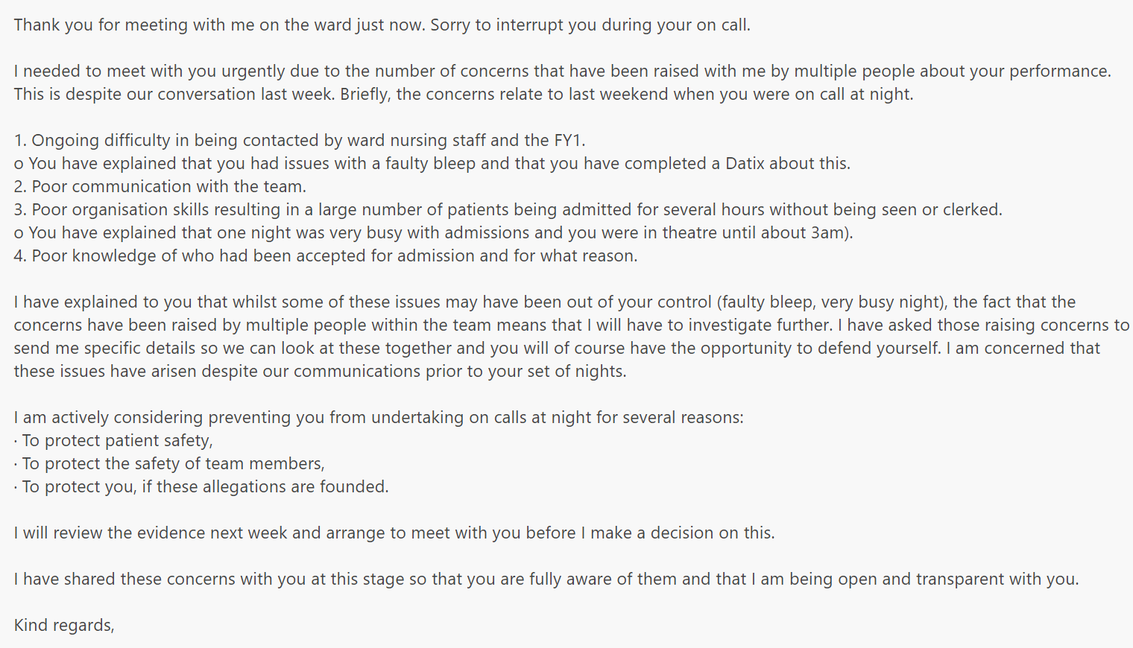
Ed notes – copy of email from hospital consultant (CS)

Slide 20
Ed notes – don’t just document problems!
It is just as important to mention the positives!

Slide 21
Coffee & comfort break

Slide 22
SIT AND Swap surgeries

Slide 23
WHEN AND HOW DO YOU GET THE PERFORMANCE TEAM INVOLVED?!

Slide 24
What is the performance team?
Our aim is to support TPDs and trainers help trainees to achieve a successful CCT at the end of training; enabling them to progress to safe independent practice.
We meet trainees, trainers and TPDs, run courses, signpost, troubleshoot and respond to concerns.
We aim to constantly enrich what we offer, being open to ideas from other deaneries as well as our own educators, in developing our educational programmes.

Slide 25
Who gets referred to the performance team?
Scheme concerns
Persistent non engagement with eportfolio
SUIs
Very early sometimes. (Is the trainee at the expected level for ST1?)
Repeated or significant Exam fails AKT, CSA
Notes:
What might the scheme concerns be
_ use Maryam example
Health concerns
GMC concerns – trainees with no insight
Appropriate self doubt

Slide 26
Who do you contact?
Clinical Supervisor
Educational Supervisor
Training Programme Director (performance lead)
Locality Performance Lead
Head of performance
Deputy head of school

Slide 27
Poor knowledge
Poor motivation
Unable to make decisions
Poorly structured consulting
Top educational difficulties
Notes:
Discuss in the room

Slide 28
How does the deanery support trainees?
Many courses -, enhanced induction programme, Booster course Study skills for busy doctors, study skills for AKT, RCA support, Coaching sessions
Neurodiversity screening/testing– free self screening. Paid full screening if positive.
One to one meetings

Slide 29
Workshop support from peers
TPD support. Performance team support.
Sessions at Spring and Autumn school
Trainer plenaries / workshops
Trainer resources – CSA toolkit subscription for each trainer
Enhanced training grant where applicable
How does the deanery support trainers?

Slide 30
CSA TOOLKIT
Notes:
Live link

Slide 31
Reasons for failing AKT
Taking it at the wrong time
Poorly prepared
Poor technique
Health issues/anxiety
Neurodiversity /Dyslexia

Slide 32
Reasons for failing CSA/RCA
Taking it at the wrong time
Poorly prepared
Poor technique
Health issues/anxiety
Neurodiversity /Dyslexia
(Stamina for a 13 patient surgery – CSA)
Timing issues

Slide 33
Neurodiversity and AKT
AKT regularly unmasks neurodiversity in high achieving doctors due to format of the exam (57 seconds per question)
Neurodiversity can also create challenges in terms of organisation and planning which can be an issue in studying for AKT
Free Screening and assessment available from YH Deanery provided by Genius within
Notes:
Exam been based on abilities of neurotypical sitters.

Slide 34
Akt SUPPORT PATHWAY

Slide 35
RCA SUPPORT PATHWAY

Slide 36
Looking at performance website
https://www.yorksandhumberdeanery.nhs.uk/general_practice
https://www.yorksandhumberdeanery.nhs.uk/general_practice/educators/trainees-experiencing-difficulties
Notes:
Screenshot of performance website to follow

Slide 37
Q&A
Notes:
Trainers interview hints and tips

Slide 38
Thank you and goodbye!

