Slide 1
Interim ESR
Dr Chris Webb - December 2020

Slide 2
For trainees where there are no concerns regarding progress in training, they will now have a ‘light touch’ interim review instead of a full ESR at the midway point of each year

Slide 3
The trainee will meet with their ES at the 6/12 point of the training year and together review their progress since their most recent ESR and the training requirements which will need to be completed before their next annual ESR. As with the full ESR they need to rate their competence against the 13 capabilities, add evidence to support their
rating and generate 3 action plans prior to the meeting. The ES can then decide at the meeting whether they need to complete a full ESR or continue with the light touch interim review

Slide 4
The interim ESR is only appropriate to use between annual ESRs and when there is no ARCP scheduled within the next 2/12. The interim ESR meeting should review progress and ensure that they are well supported. The ES should ensure that there is evidence of appropriate progression in each of the Capabilities across the Clinical Experience Groups appropriate to their placements and stage of training. The Interim ESR is a formative process to ensure they are on track to achieve ‘satisfactory progress’ at their next ARCP

Slide 5
An interim ESR should not be done when:
Their most recent ARCP was an outcome 2 or 3
The panel asked for a full ESR at your most recent ARCP
They have a newly identified or previously declared Significant Event (GMC threshold of potential or actual serious harm to patients, not a Learning Event Analysis), complaint or other investigation which have not been resolved since their most recent ARCP i.e. any declaration made on the last Form R (or SOAR in Scotland) which is outstanding

Slide 6
The sign off for the Interim ESR is slightly different to that of a full ESR. If the supervisor has any sufficient concerns and selects any outcome other than "satisfactory", the portfolio will prompt to switch to a full ESR, where the ES will then be required to grade and evidence each capability and give the full ESR grading at the end

Slide 7
Examples where concerns may be raised:
If concerns raised at a previous ESR have not been resolved
Not all of the expected Workplace Based Assessments (WPBA) have been completed
There are concerns over the ‘Level of Supervision’ needed, or their performance in WPBA tools
There have been concerns identified about a lack of engagement in the Portfolio or additional concerns have been highlighted by the local education team or supervisors in the 'Educator Notes' section
An initial review of the Portfolio suggests that there are insufficient high-quality links made to demonstrate progress in all of the 13 Capability areas
An initial review of the Portfolio suggests a lack of exposure to the curriculum, or (after considering the jobs undertaken) a lack of exposure across the breadth of the Clinical Experience Groups

Slide 8
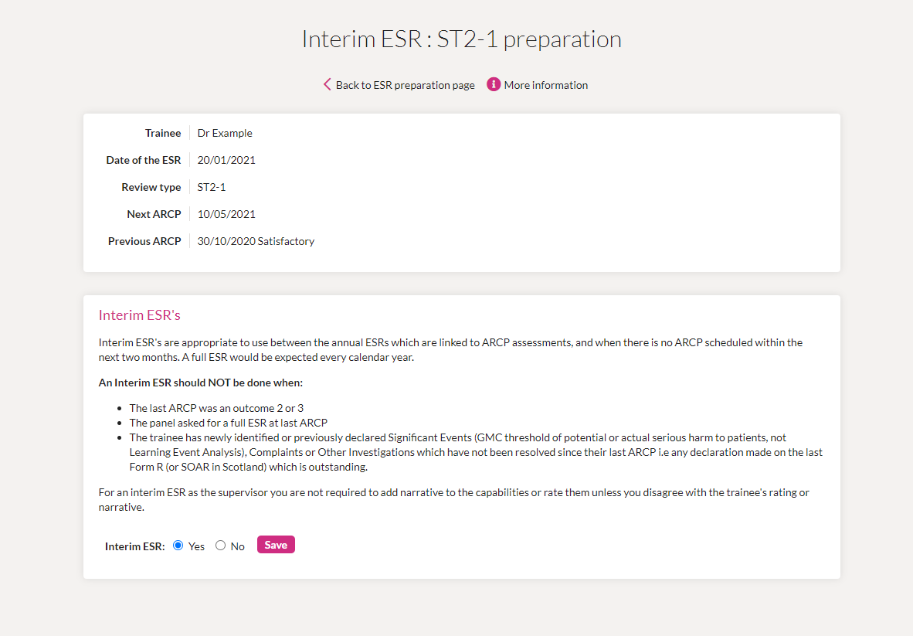
Setting up the interim ESR in the portfolio:

Slide 9
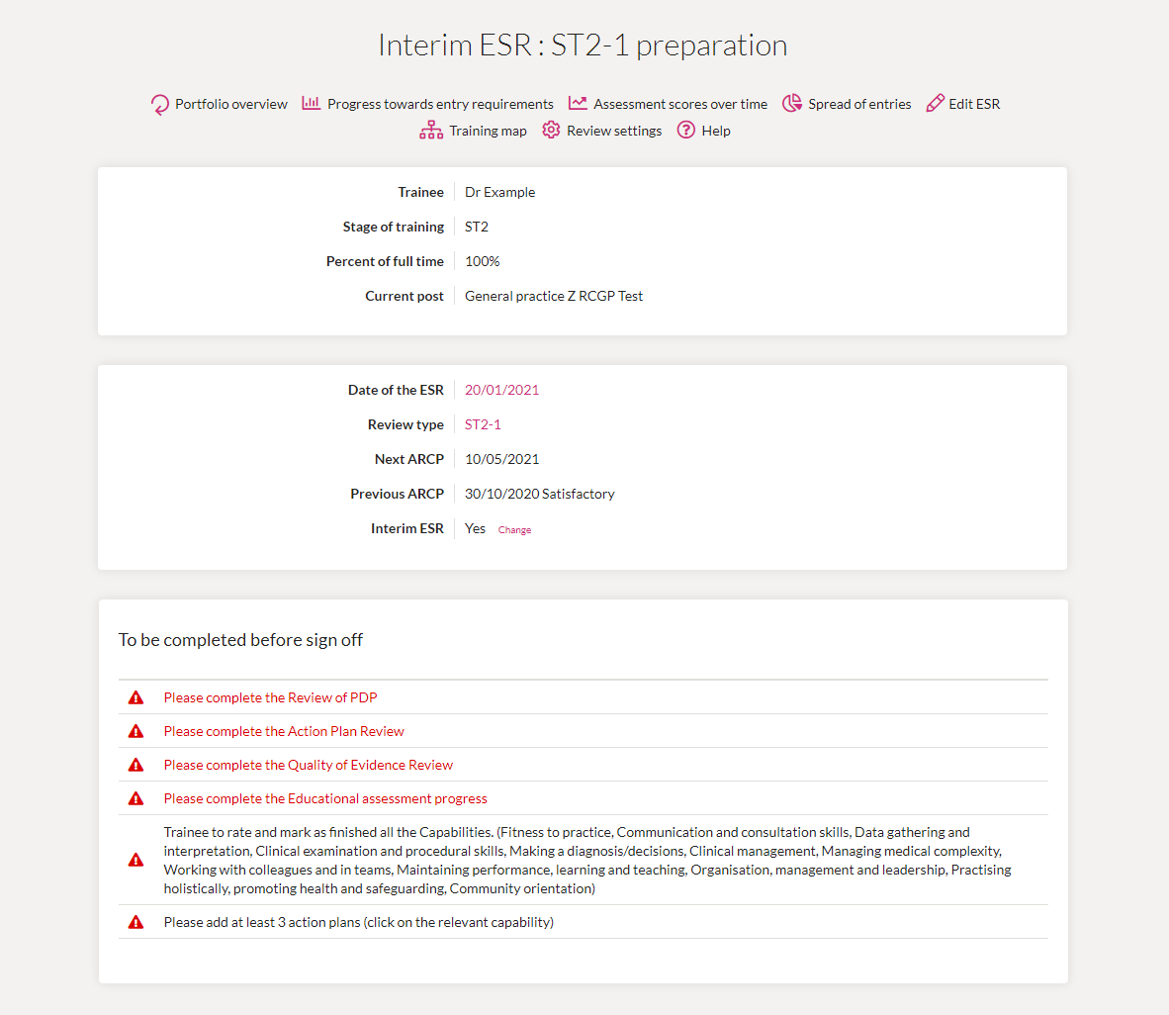
Interim ESR - review preparation page:

Slide 10
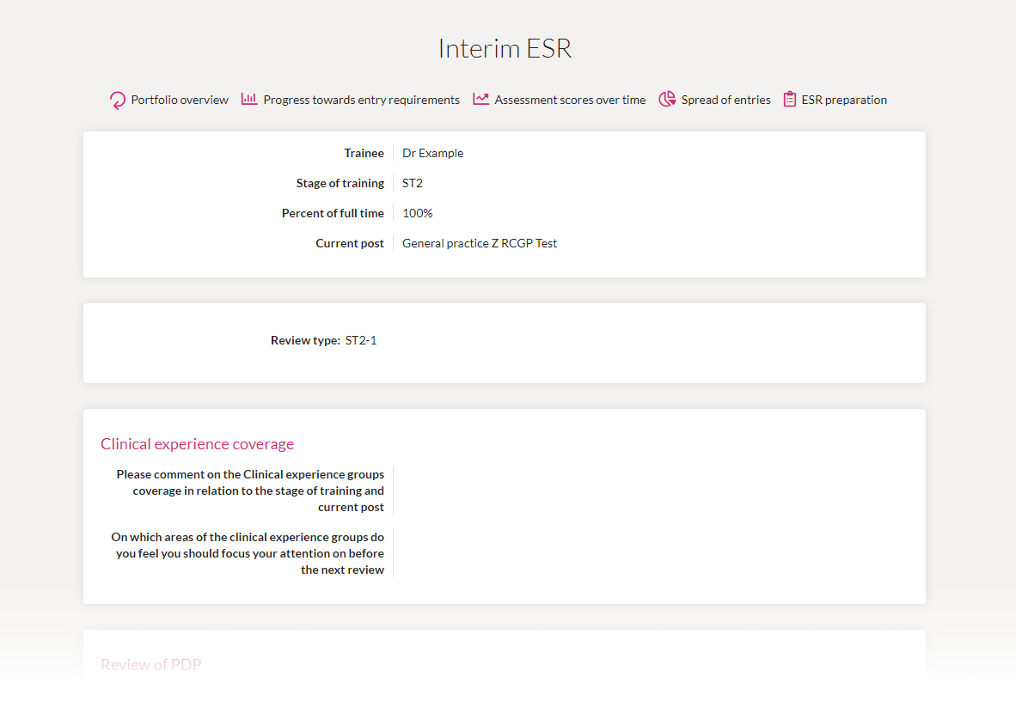
Preview the full interim ESR page:

