Slide 1
The lLp

Slide 2
What this will cover
How to find the relevant bits on the LLP
How to get the curriculum signed off (core v ACCS)
Logbooks
Numbers of assessments
Top tips

Slide 3
How to find everything

Slide 4
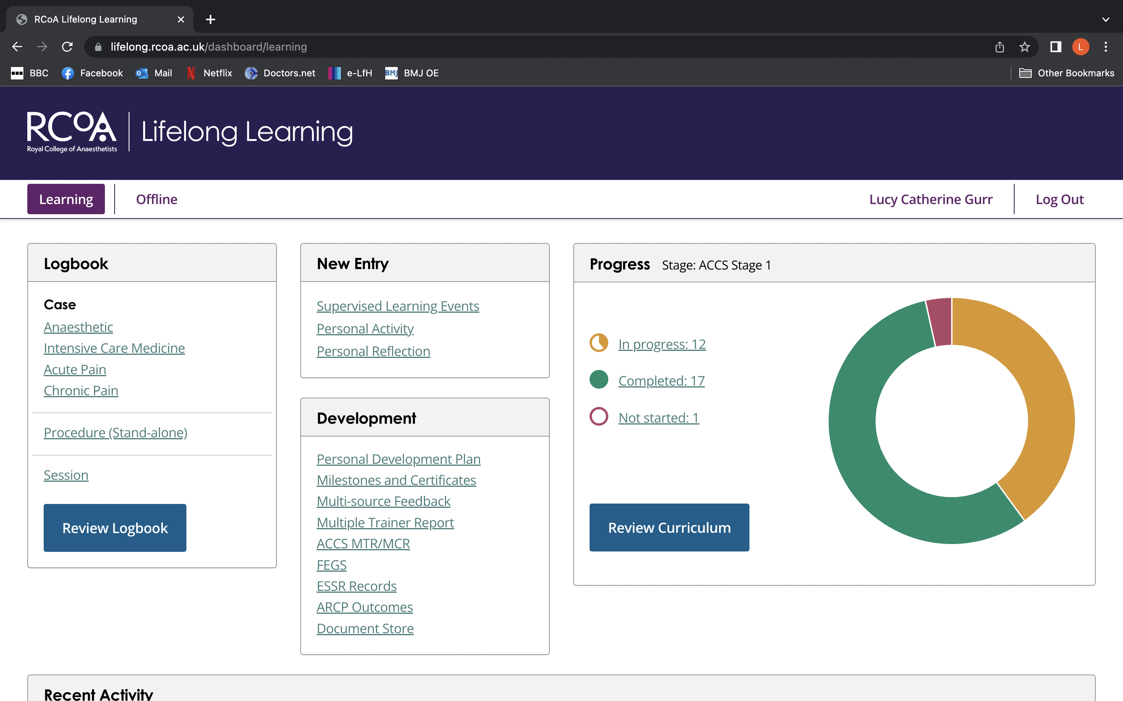

Slide 9
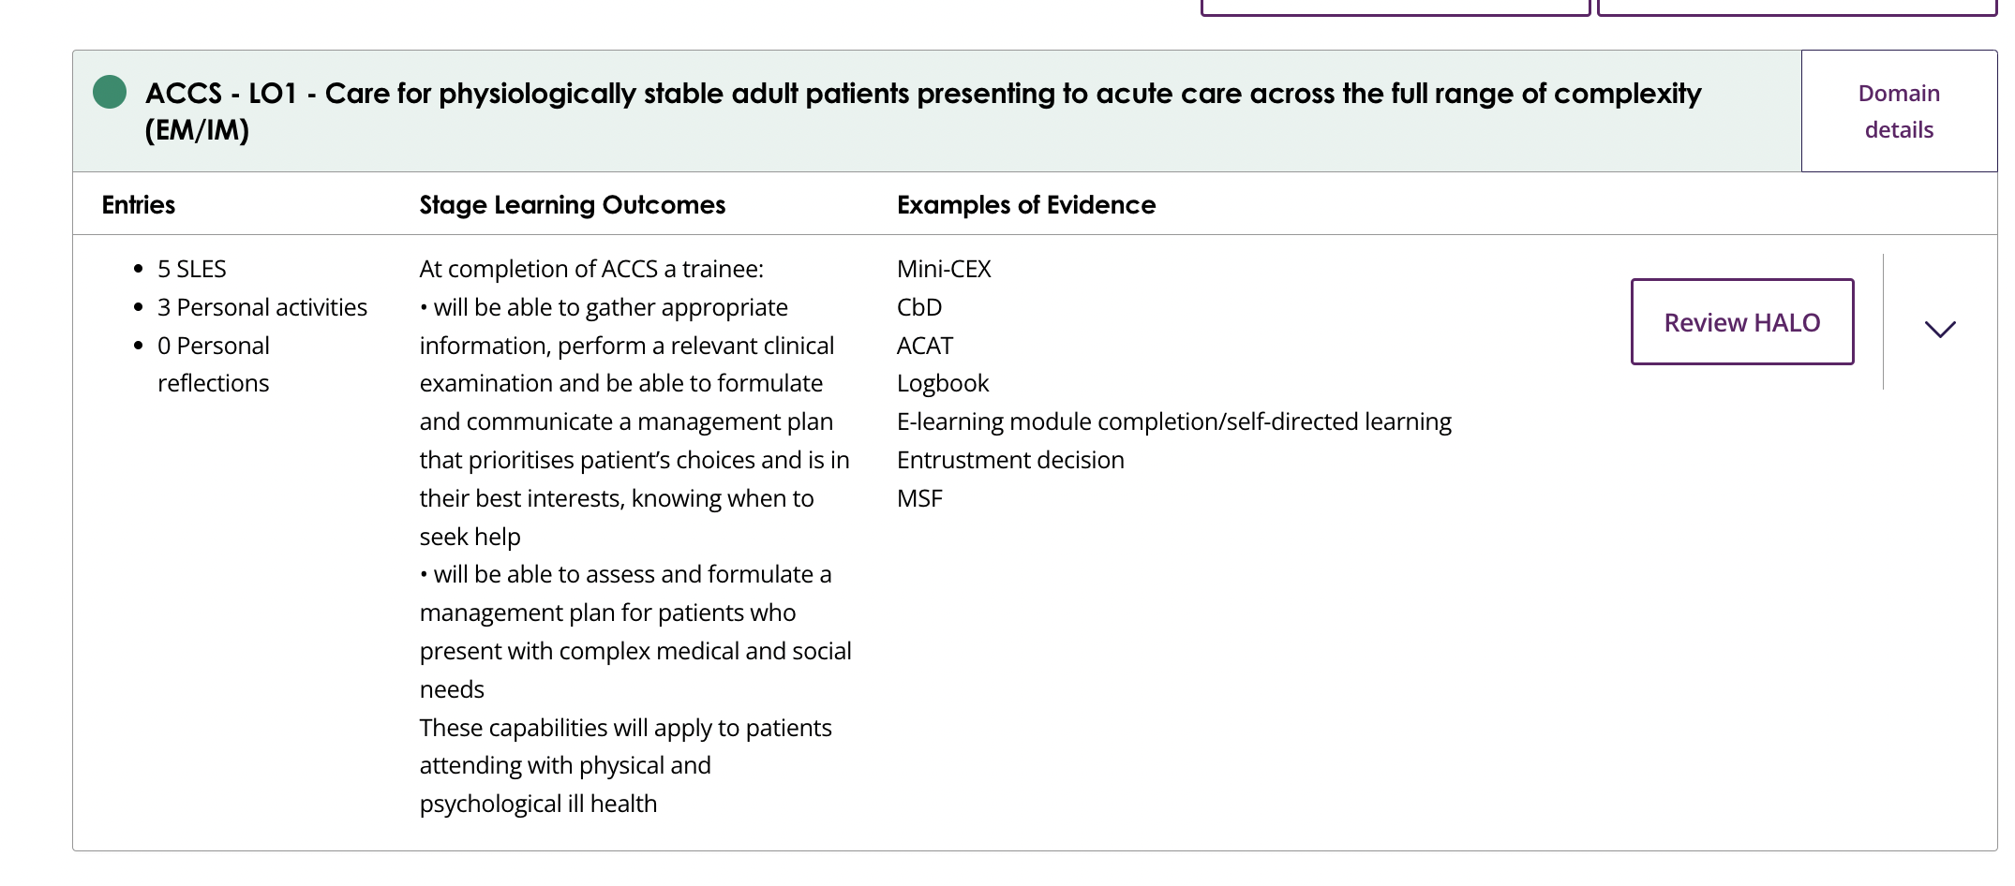

Slide 10
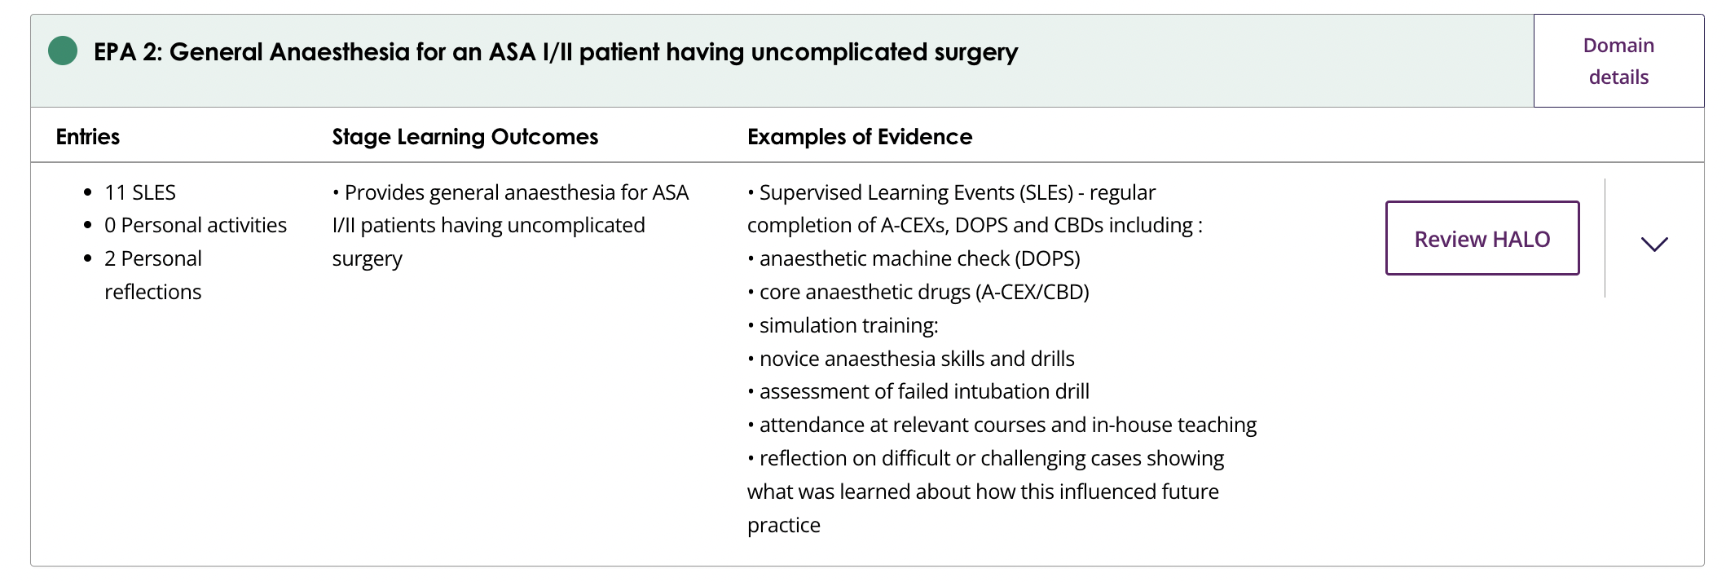

Slide 12
Logbook

Slide 14
Top tips
Do it as you go
Enter paeds cases as a separate speciality, then you can filter it as paediatrics
List iGel as ‘other’
Can list off piste things, TIVA, gas induction

Slide 15
ICU logbook
For anaesthetics, LLP logbook is excellent
For ICU I found it cumbersome
Google - FICM (faculty intensive care medicine) logbook
Double check with supervisor on ICU that this is ok

Slide 16
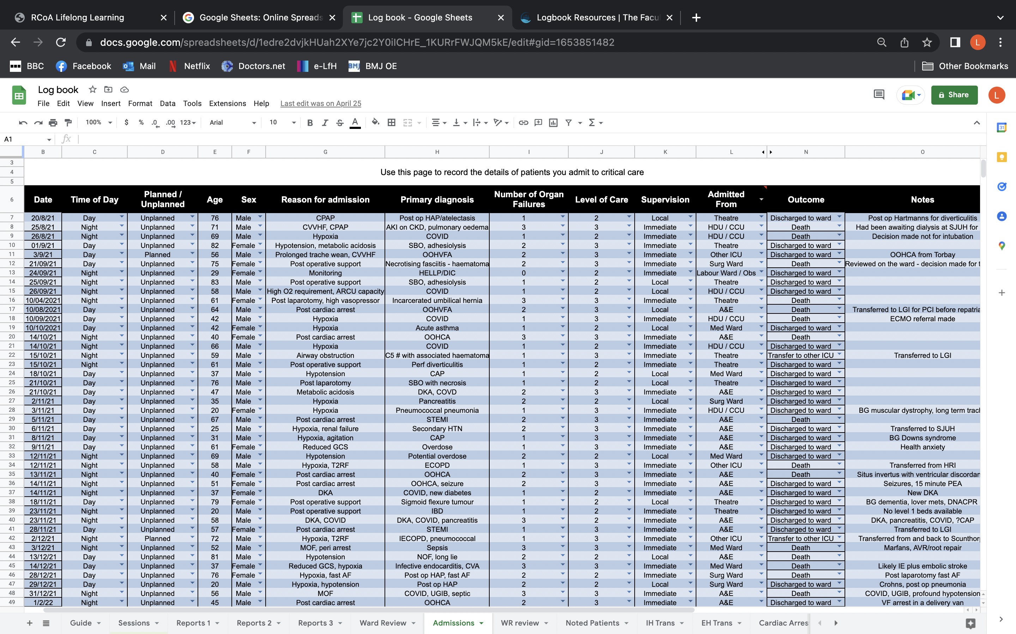

Slide 17
How many assessments do I need?

Slide 18
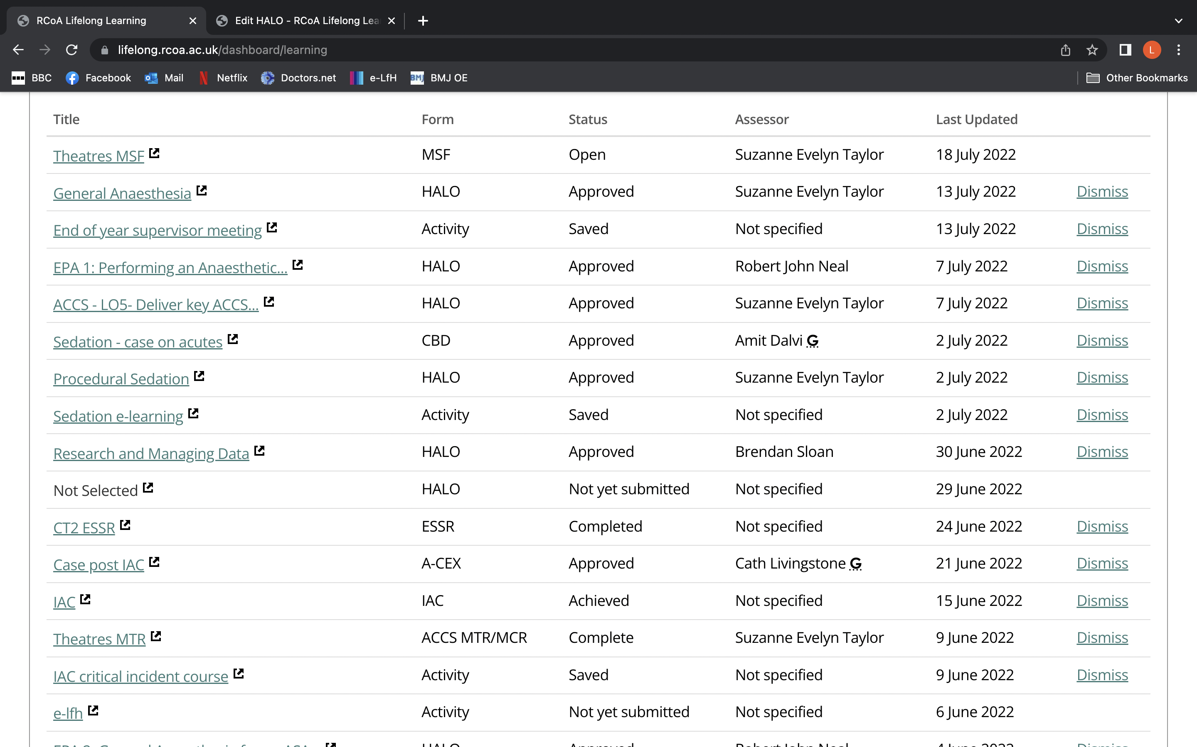

Slide 19
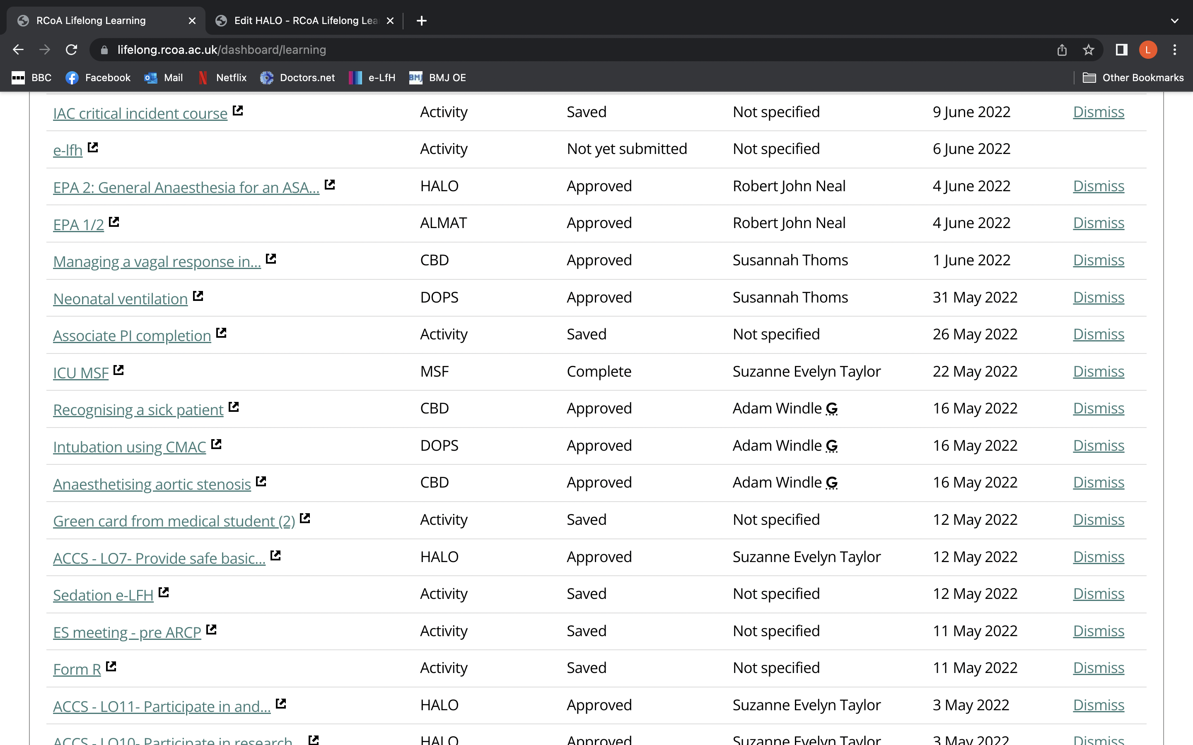

Slide 20
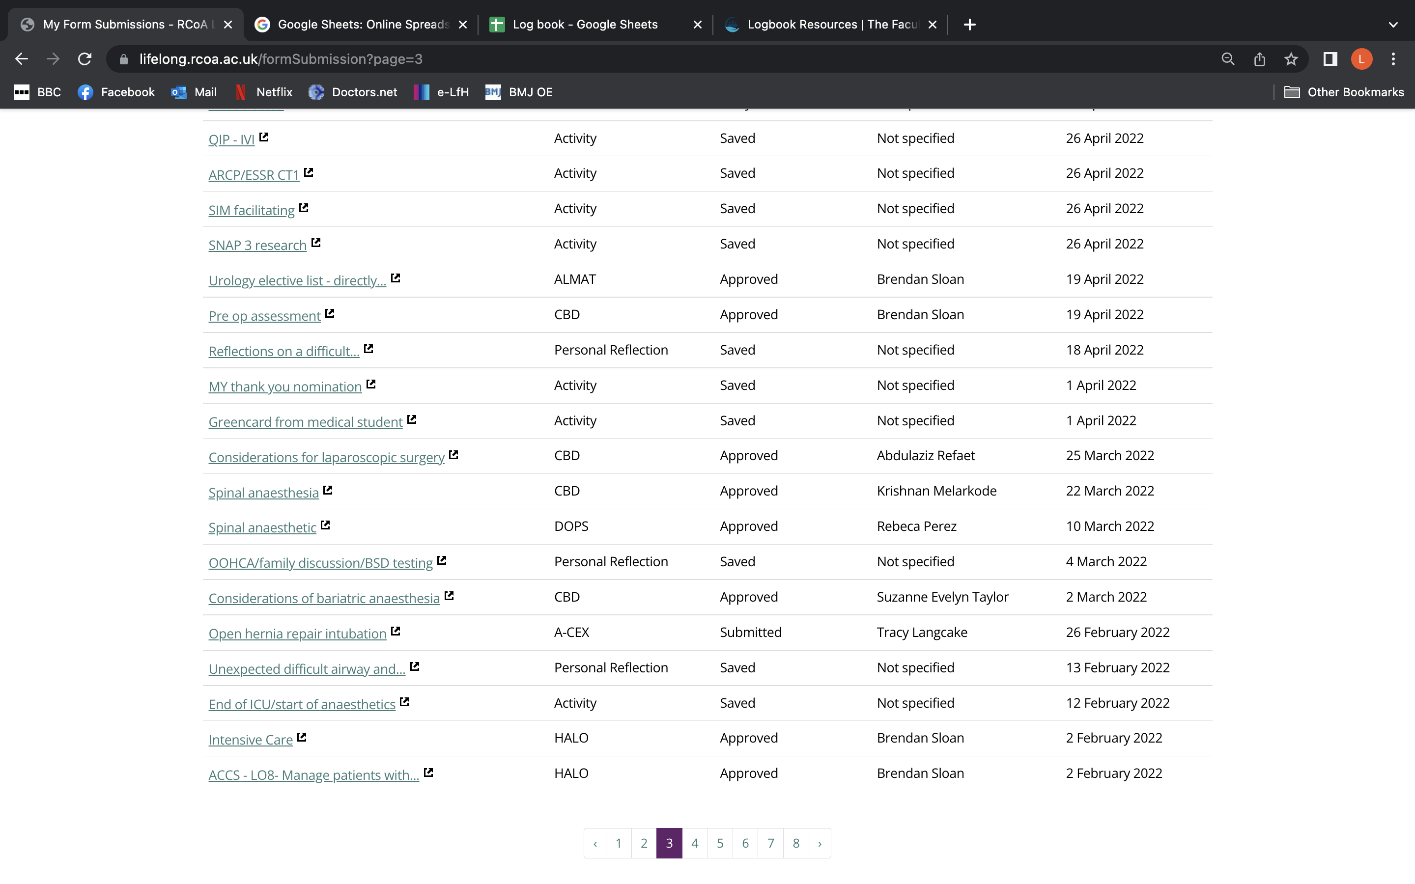

Slide 21
Sedation

Slide 22
Sedation sign off
Sedation can be quite tricky to get signed off
Opportunities
MRI - lists with sedation
Elective cardio version lists
Take opportunities to go down to ED
Bulk it out with e-learning

Slide 23
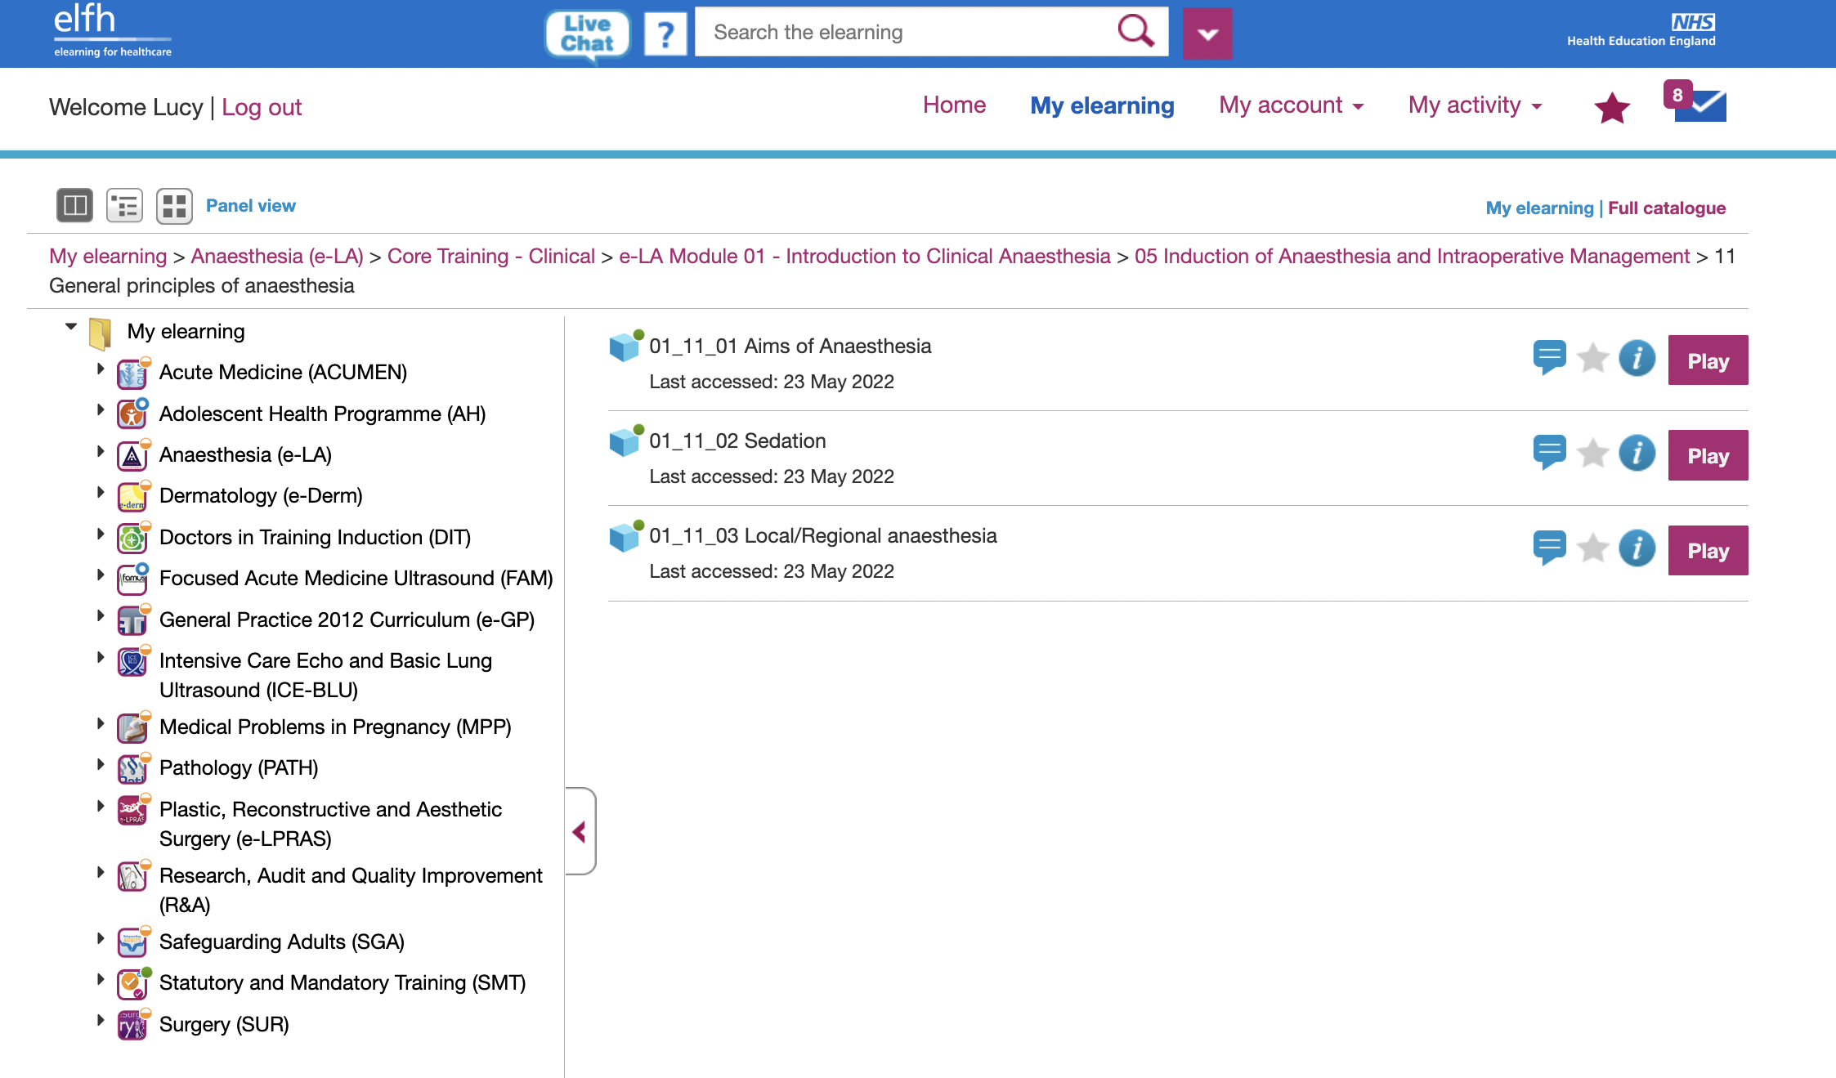

Slide 24
To get signed off
Text
IAC/EPA 1/2
ACCS L0s HALO
ICU/sedation HALO
Logbook
1x MTR per rotation (ICU/theatres)
1x MSF for the year
Form R
ESSR

