Slide 1
Prescribing Assessment
Dr Chris Webb - December 2020

Slide 2
Why you need to know
How and why this assessment came about
How it should be done
What needs to be done
How the data is gathered
How the data is analysed and inputted into the ePortfolio

Slide 3
Prescribing is an integral part of a General Practitioners work and several high profile cases have been published when qualified doctors have made catastrophic errors. In 2017 the GMCs published a document describing Generic Professional Competences. These are competences, which every speciality trainee needs to achieve before the end of training and they include prescribing as one of their key areas. GP trainees are not currently assessed on their prescribing in the workplace and it was felt that this needed to be rectified as a priority

Slide 4
The assessment consists of a self-assessment prescribing review based on the PRACtlCe study and REVIST studies. These were GMC led reviews looking at the number of times errors were found in prescriptions. The results were alarming with 1 in 20 prescriptions containing an error. The REVISIT study looked specifically at prescribing by GP trainees and the error rate rose further to 1 in 10 prescriptions. The RCGP subsequently worked with the Nottingham team to create an assessment suitable for GPs in training

Slide 5
The assessment is a formative exercise to reflect on prescribing practice, which should highlight trends and learning needs within your prescribing. By reflecting on the errors identified it will enable learning plans to be put in place in order to improve your prescribing in the future. There is no set standard as it is designed as a learning exercise; however if no errors are highlighted and if no learning is identified this would raise concerns, as to date this has never been the case

Slide 6
Prescribing Assessment
Self- assessment prescribing review for GP trainees set up in conjunction with Nottingham university
Based on PRACtICe study and REVIST study
Prescribing errors found in 1/20 prescriptions
Prescribing integral part of GP work
Over one billion prescription items issued each year
To date not formally assessed
Agreed that trainees would benefit from support in prescribing

Slide 7
Practicalities of Assessment
To be completed in first half of GP ST3 year
In addition to other ST3 assessments but reducing total number of other assessments in ST3 year
Formative tool, mandatory to complete
Only fail if not completed, no set standard required
Will form part of the data within the ePortfolio on which a summative judgment will be made of the trainees progression

Slide 8
Definition of a prescribing error
A prescribing error occurs when, as a result of a prescribing decision or prescription- writing process there is an unintentional, significant reduction in the probability of treatment being timely and effective, or increase in the risk of harm when compared to generally accepted practice
Suboptimal prescribing:
These are prescribing problems that do not fit the above error definitions but represent less than ideal practice
Legal errors:
Where a prescription has not met the legal requirements for prescribing eg written for wrong patient name

Slide 9
What the review is intended to do
Review prescribing in a sample of prescriptions
Be an educational intervention that will highlight areas of prescribing that could be improved to reduce the risk of harm
Improve communication with patients and those dispensing medication
Encourage reflection and development of good prescribing habits that will protect against errors in long term
Confirm good prescribing practice

Slide 10
What the review is NOT intended to do
Review the diagnosis within a consultation
Set the expectation that all prescribing undertaken in the review must be perfect
Dishearten or discourage the reviewer
Review prescribing primarily on the grounds of cost

Slide 11
What is assessed?
Reflection and learning
An acceptable error rate is not set, numbers are for comparison and context
It is not the rate of errors that is important but how you the trainee responds to them
An assessment with no errors and no learning would not be acceptable as this was never the case in either the PRACtICe or REVISIT study

Slide 13
The trainee review - preparation
Retrospective to capture normal prescribing habits
Either manual review records from date set by supervisor until 50 prescriptions reviewed or
Computer generated search added to spread sheet of 50 consecutive prescriptions

Slide 14
How to assess:
Was the RIGHT DRUG (s) selected for the indication and the patient?
Was the drug prescribed at the RIGHT DOSE for the indication and the patient?
Were the RIGHT DOSAGE INSTRUCTIONS written on the prescription in a way the patient can understand?
Was the RIGHT FOLLOW UP planned, enacted or acted upon with regards to the medication?
Have you provided the RIGHT DOCUMENTATION to support prescribing?
Has the medication been subject to the RIGHT REVIEW before prescribing (including checking adherence to therapy)?
Are there any examples of GOOD PRESCRIBING practice?

Slide 15
How to assess:
Was the RIGHT DRUG (s) selected for the indication and the patient? Is this drug suggested by NICE or other guidelines as first choice are there good reasons to use it if it is second choice? Have allergies or contraindications been considered?
Was the drug prescribed at the RIGHT DOSE for the indication and the patient? E.g. is the dose the one advised by BNF bearing in mind LFT and renal function?
Were the RIGHT DOSAGE INSTRUCTIONS written on the prescription in a way the patient can understand? They should be in plain English (not qid or qds) and should be specific (as needed is never appropriate; which eye or ear should be stated)
Was the RIGHT FOLLOW UP planned, enacted or acted upon with regards to the medication? E.g. if there should be a review of blood tests were these arranged; were arrangements made for review of a trial of treatment ? Etc

Slide 16
How to assess:
Have you provided the RIGHT DOCUMENTATION to support prescribing? Does the documentation make the indication, monitoring and follow up clear; If prescribing does not follow normal guidance is the reason documented?
Has the medication been subject to the RIGHT REVIEW before prescribing (including checking adherence to therapy)? Have any necessary discussions taken place before continuing medications with risks e.g. HRT?
Are there any examples of GOOD PRESCRIBING practice? E.g. following guidelines, clear explanations, clear details on OTC suggestions

Slide 17
Errors
More than one type can apply to a single prescription
Trainee should consider possible reasons why and how to avoid in future
Good practice should make conscious decision to continue
Look for themes and patterns
If significant error this should be highlighted to the supervisor and follow practice procedures

Slide 18
Preparing for the review
Have available reference sources:
BNF and BNF for children
Local formulary guidance
Local clinical guidelines e.g. antimicrobial
The Self- assessment Prescribing review for GP trainees document

Slide 19
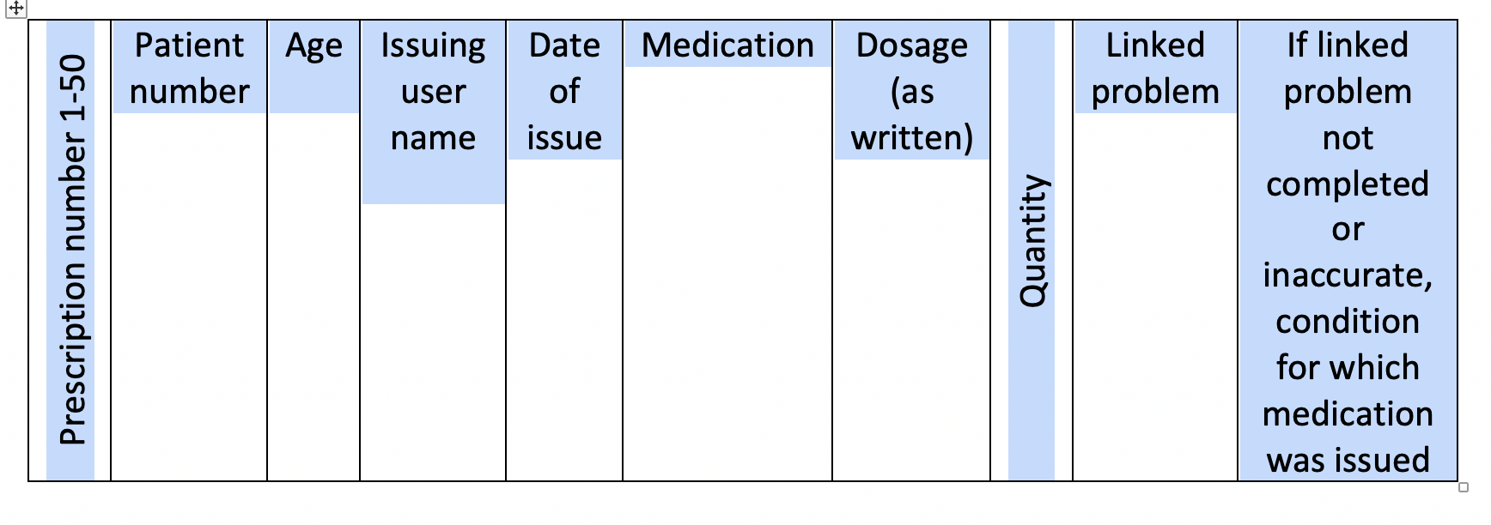
Excel spreadsheet part 1
Direct copy from clinical system or
Completed manually

Slide 20
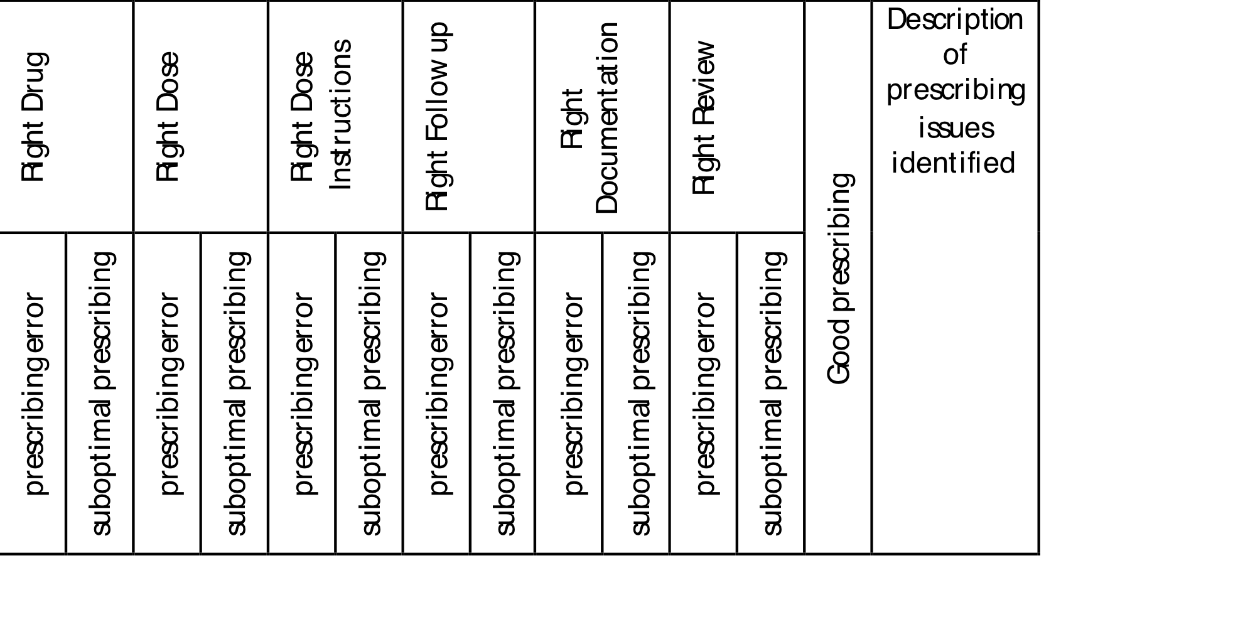
Excel spreadsheet part 2
Place a 1 in relevant box if issue identified
Last box details what should have been done

Slide 21
Excel spreadsheet part 3
Records reflections on possible reasons the issue occurred
Asks about possible strategies that could be used in future to prevent issue occurring again
This section is essential
Numbers alone are not acceptable

Slide 22
GP Prescribing proficiencies
The trainee needs to self assess and to reflect on their performance against the GMC Generic Professional Capabilities for Prescribing safely- called GP prescribing proficiencies
The supervisor needs to assess the trainee against the same proficiencies

Slide 23
GMC Prescribing proficiencies
Assess the risks and benefits including that posed by other medications and medical conditions
Identify when prescribing unlicensed medicines and informs patients appropriately
Adhere to local guidelines and evidence based medicine
Use antimicrobials appropriately
Counsel patients appropriately including instructions for taking medicines safely in line with up to date literature
Review and monitor effects including blood testing at appropriate intervals
Range of ages and clinical areas covered in assessment

Slide 24
Analysing the results
How many prescribing events have been highlighted by you?
Were there any themes that could be identified within these prescribing events?
Which areas of good prescribing did your review identify?
What was the number of prescribing events in each of the prescription categories (new repeat, repeat repeat etc.)?
What was the number of prescribing events in each of the prescribing event categories (right drug, right dose etc.)?
Are there any prescribing events that have occurred more than once (e.g. incorrect dose of an antibiotic)?
Are there examples of good prescribing that have occurred more than once?
When the possible reasons and possible strategies for the future are considered are there recurring themes e.g. need to refer to guidelines, need to document indication. How can this then link to your personal development plan?
Which areas of the BNF cover the majority of the prescribing (e.g. antimicrobial and analgesia)? Would your clinical supervisor consider this typical of current prescribing and that of a post CCT GP?

Slide 25
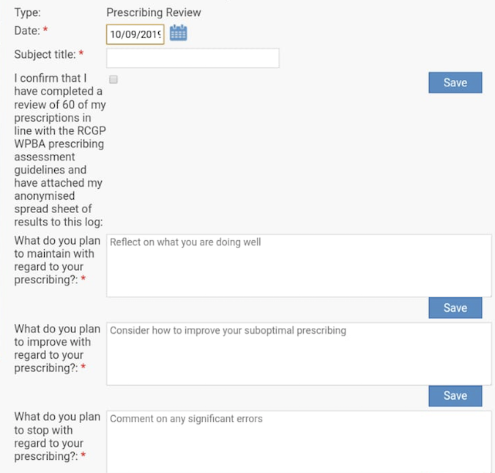
Trainee completes the prescribing assessment form

Slide 26
Questionnaires
Mandatory questionnaires to be completed by trainee and supervisor on completion of assessment
Required to identify any unintended consequences in introducing a totally new assessment into GP training
Further evaluated by GMC after initial year

Slide 27
Evidence forms
Trainee needs to complete a new learning log type “prescribing assessment” and attach:
Excel spreadsheet - having removed any identifiable ID numbers
The trainer will complete a new Prescribing assessment form
Both need to complete on line surveys:

Slide 28
Additional information
Right Drug
Evidence for use in the indication
Allergies
Contra-indications/Cautions
Interactions with co-prescribed medication
Local and national prescribing guidelines
Local formulary
Social issues (e.g. carers, inclusion in a monitored dosage system)
Formulation
Duplication or omissions in therapy.
Correct use of brand prescribing for safety reasons

Slide 29
Additional information
Right Dose
Renal or hepatic function
Age / weight
Local and national prescribing guidance (including MHRA)
Is the dose correct for the indication?
Has increasing or reducing dosing been done appropriately?
Most appropriate strength of tablet prescribed for the required dose

Slide 30
Additional information
Right Dosage Instructions
Clear and unambiguous (avoiding “as directed”)
Up to date (with current usage/latest letters from secondary care)
Include route of administration/area of application/treatment eye or ear
Are the instructions able to be read and understood by the patient?
Right follow up
Has the necessary monitoring has been planned/taken/acted upon e.g. blood tests, BP
Has the item been placed on repeat appropriately so that it cannot be continued without a necessary review?

Slide 31
Additional information
Right Documentation
Is the indication for prescribing clear?
If prescribing does not follow normal guidance is the reason documented?
Is the plan for any necessary monitoring or follow up documented?
Right Review
Where the medication has been used before, has under or over-ordering been addressed before supplying (adherence to therapy)?
Have any necessary discussions taken place before continuing medications with risks e.g. HRT?

Slide 32
Additional information
Good prescribing
Does prescribing show that local guidelines have been referred to e.g. antimicrobial guidelines?
Is the prescribing plan in the notes and thought process accurate and clear for the next clinician to follow?
Is the OTC advice that has been given very clear with regards to medication dosage and further advice?

Slide 33
Results of prescribing assessment pilot 2019
71.5% uncovered a prescribing error
98.5% found at least one incident of sub optimal prescribing
The mean prescribing error rate was 8.3%
The mean suboptimal prescribing rate was 40.6%
90.2% of trainees, reported that completing the assessment altered their prescribing practice
56.4% of trainers mentioned that the assessment highlighted knowledge gaps and areas for improvement for their trainee that they were not aware of
Trainees and trainers agreed that the prescribing review was helpful for assessing and learning about prescribing
It was viewed by both as an acceptable prescribing assessment

Slide 34
The purpose of the mandatory pilot was to gather data of the acceptability and utility for all trainees
The pilot provided larger numbers with over 1700 trainees, this found that it was a fair assessment
There was no evidence that the prescribing review adversely affected non-white participants
There was no evidence that people with a declared disability were at a disadvantage in completing the task
There was no evidence that people who trained outside the UK were at a disadvantage
There was no relationship between the type of practice, ARCP outcome and of the outcomes measured in the questionnaire
There was a slightly higher number of trainees from Scotland, Wales and NI combined that found the review not as easy but this was a pretty small correlation

