Slide 1
PRIMARY FRCA HINTS AND TIPS
Morwenna Read and Elizabeth Ribey

Slide 2
Contents
When to start thinking about the exam (not yet!)
Format of the exam
How to start revision
Resources available
Hints and tips

Slide 3
When should I start thinking about the primary FRCA?
Learn how to give an anaesthetic first
Start reading around things you encounter at work (concepts, drugs etc)
Make notes and get to grips with resources that work for you
MCQ (written) in September, November and Feb each year (approx)
OSCE/VIVA in November, Jan and May

Slide 4
Format of the exam
Primary FRCA consists of 3 exams in 2 different sittings
Primary MCQ (written) and OSCE/SOE (aka viva)
Content roughly divided into
1/3 Physiology
1/3 Pharmacology
1/3 Physics and equipment
Small amount of clinical stuff thrown in linked to one of the above

Slide 5
MCQ
Currently (Sept 22) 30 MTF and 60 SBAs
Probably all SBAs (likely Sept 23) by the time you sit the exam (?90 questions)
Single best answer: question stem and 5 plausible options, choose the “most correct” answer
Most resources by RCOA are still in MTF format
No negative marking
Probably still online testing
No set pass mark

Slide 6
OSCE/SOE
2 exams – need to pass MCQ first
As you get nearer to taking the MCQ think about when you want to take the OSCE/SOE
SOE (viva) needs a lot of practice, OSCE needs less revision
Have to take both the first time, can pass each exam separately and retake just one if needed
Viva – 15 minutes each on pharmacology, physics, physiology, clinical station (3x 5 minute questions, scored 0,1,2)
OSCE – 16x 5 minute stations (technical skills, resus, anatomy, communication etc)
Viva pass mark 37/48, OSCE has no set pass mark

Slide 7
How to “Revise” (/learn completely new information)
6 months revision generally advised
A lot of new material with limited clinical relevance (Logarithms? Lasers?)
Plan how much revision you can realistically fit in
How much are you actually going to do after work?
Can you do any revision at work?
Have a look at practice questions relatively early so you know what level of detail you’re aiming for

Slide 8
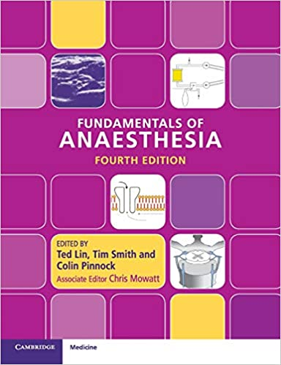
Resources - General
https://www.rcoa.ac.uk/sites/default/files/documents/2019-08/TRG-CCT-ANNEXB.pdf
The FRCA curriculum, Tl;dr everything is on it
https://www.e-lfh.org.uk
https://frca.co.uk
Dr Podcast
‘Fundamentals of Anaesthesia’ by Lin et al
‘Primary FRCA in a box’

Slide 9
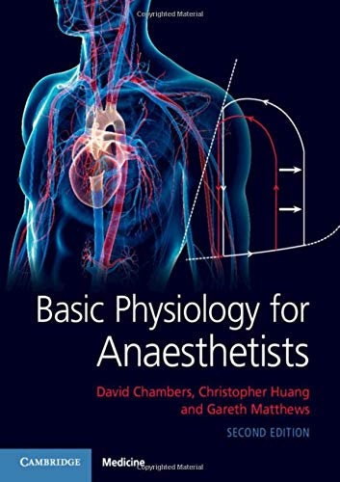
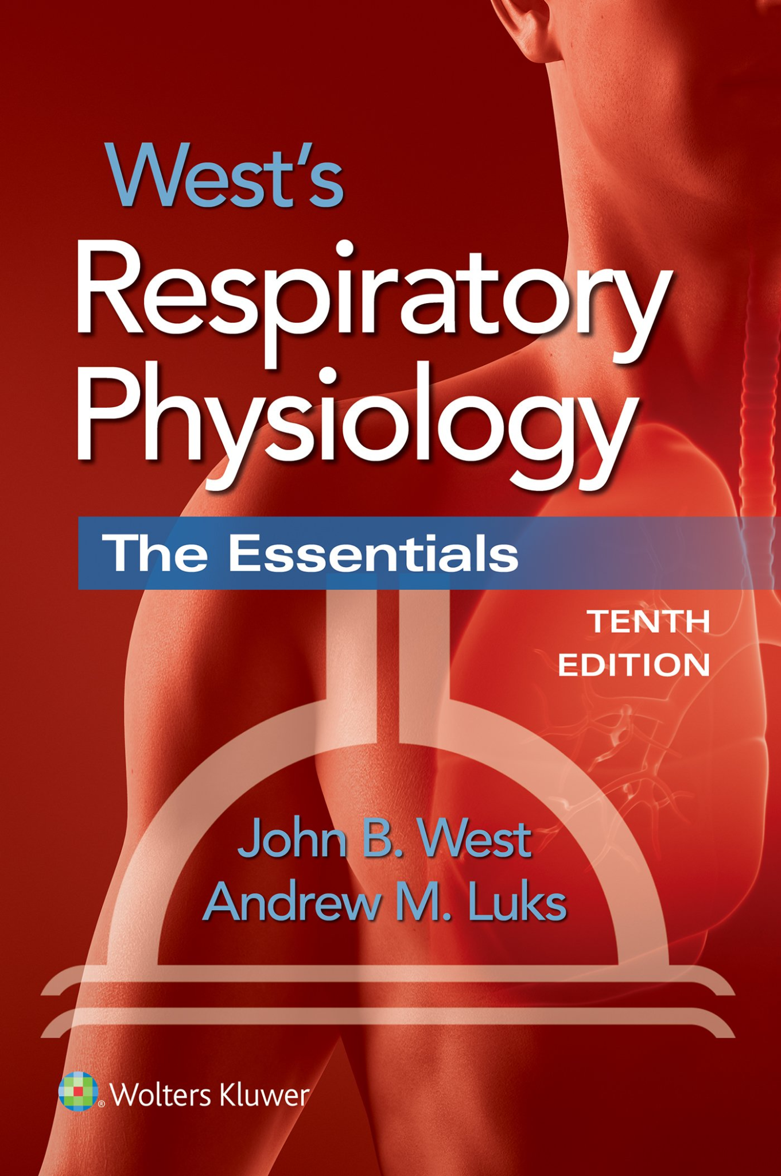
Resources - Physiology
Basic Physiology for Anaesthetists by Chambers et al - the physiology textbook used by most trainees, detailed (but this is what you need)
West’s Respiratory physiology - if you want some extra respiratory physiology detail!
https://derangedphysiology.com - Australian website designed for their exams but gives some alternative explanations

Slide 10
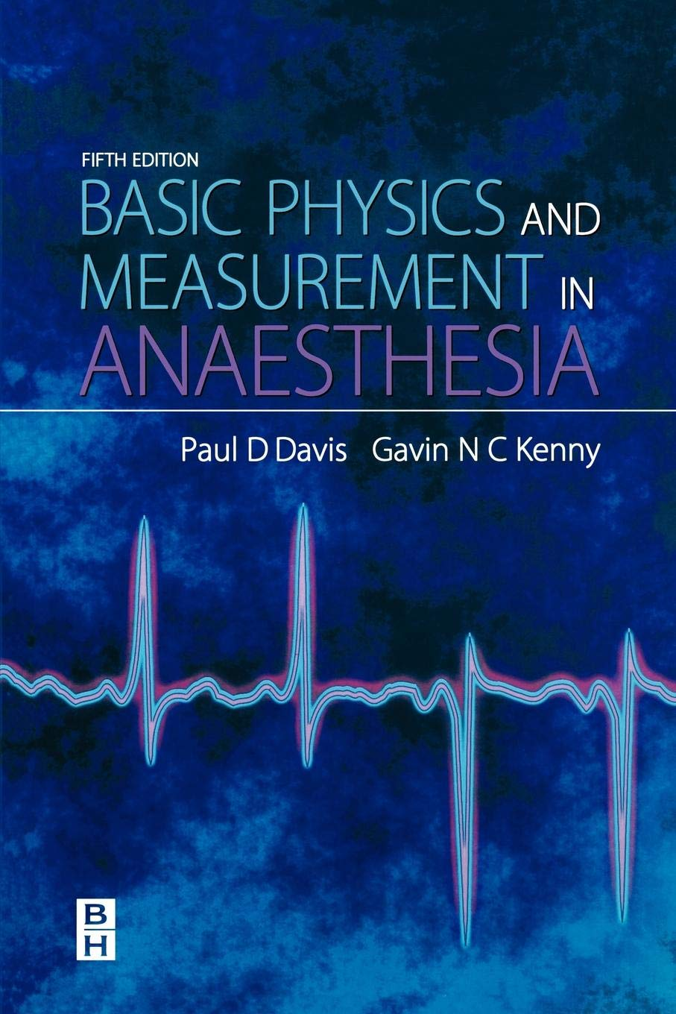
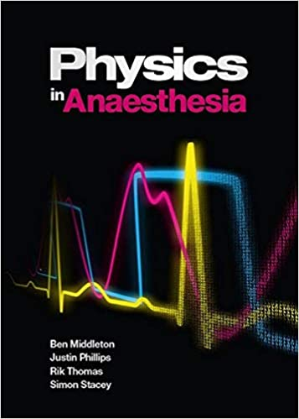
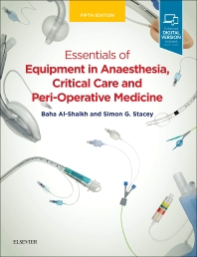
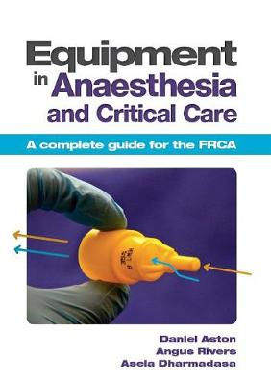
Resources - Physics and Equipment
‘Basic Physics and Measurement in Anaesthesia’ by Davis and Kenny
‘Physics in Anaesthesia’ by Middleton et al - clear explanations, but errors in the questions
‘Essentials of Equipment in Anaesthesia, Critical Care and Perioperative Medicine’ by Al-Sheikh
‘Equipment in Anaesthesia and Critical Care’ by Aston et al - clear, reproducible diagrams
https://physics4frca.com - excellent resource but does not cover the whole curriculum

Slide 11
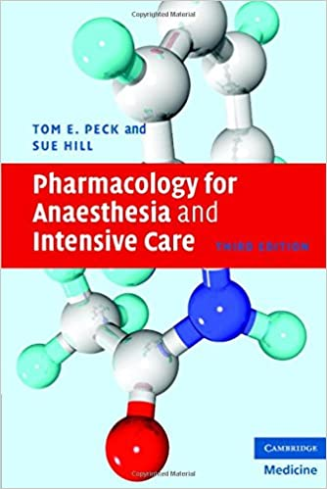
Resources – pharmacology
‘Pharmacology for Anaesthesia and Intensive Care’ by Peck and Hill - the book used by most trainees, covers most of the curriculum but very dry
Supplement with eLfH modules/pharmacology textbooks from university

Slide 12
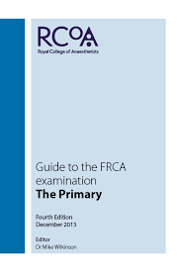
Resources - Questions
eLfH - lots of questions, mostly in the MTF format, but often exact questions used in exams
‘Guide to the FRCA examination, The Primary’ - contains a whole practice exam of questions written by the college
https://criticalcarenorthampton.com has a bank of practice MCQs and SBAs for the primary (in FRCA resources)
https://frca.co.uk lots of MTF questions (but no explanations)
Pastest, onexamination etc - variable quality/relevance but have apps which are useful for use in hospital

Slide 13
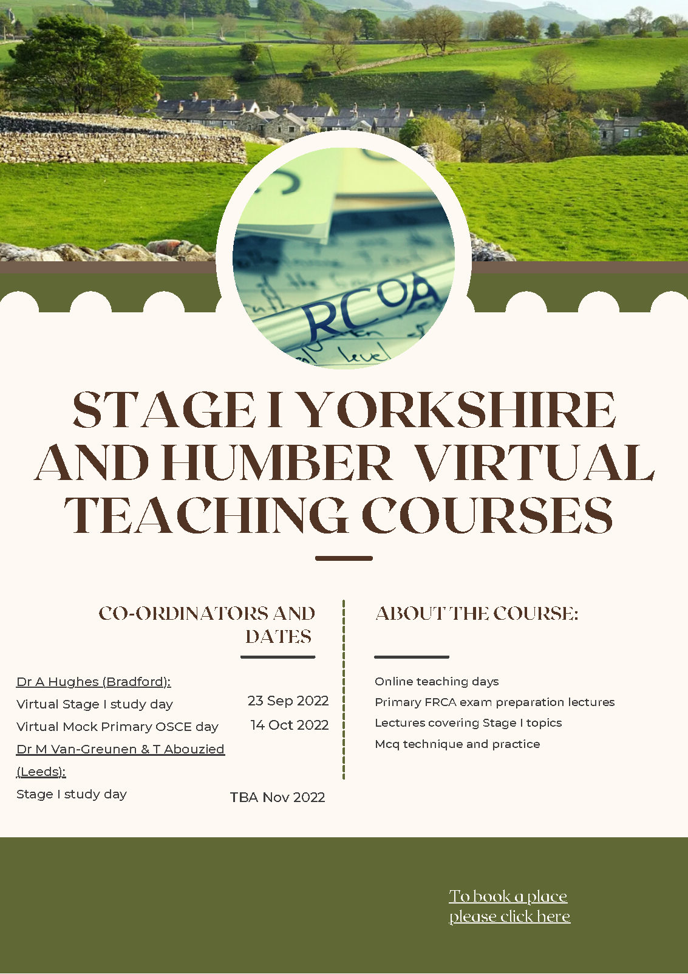
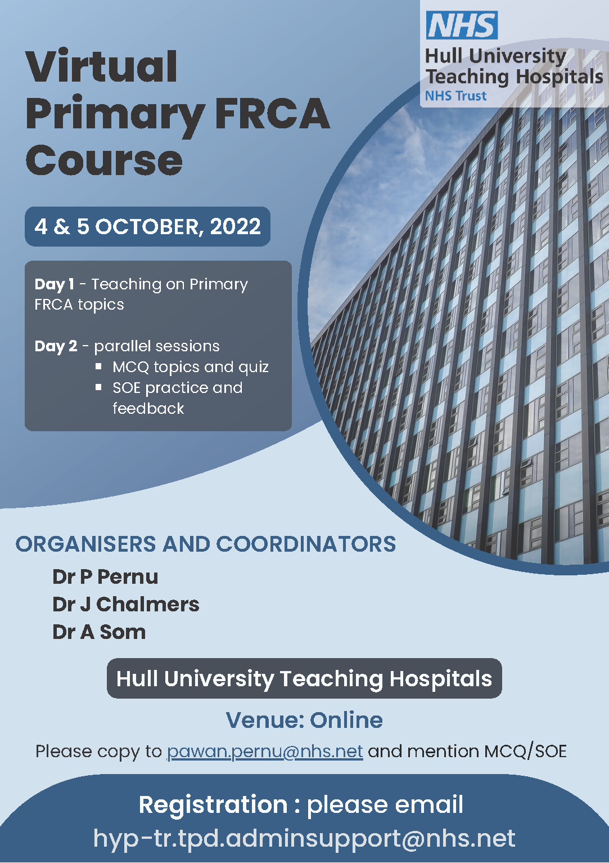
Resources - COURSES
Primary preparation courses are run in the South and combined West and East courses
Information on courses and contacts: https://www.yorksandhumberdeanery.nhs.uk/anaesthesia/regional-teaching-courses-and-study-leave/exam-preparation-courses

Slide 14
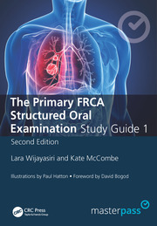
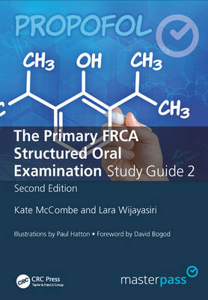
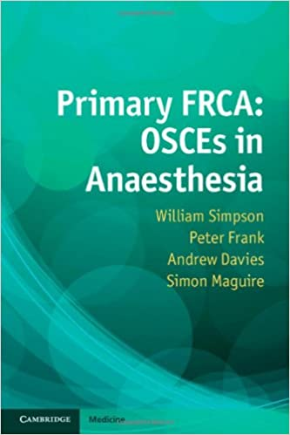
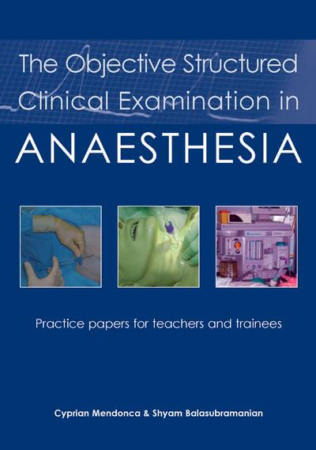
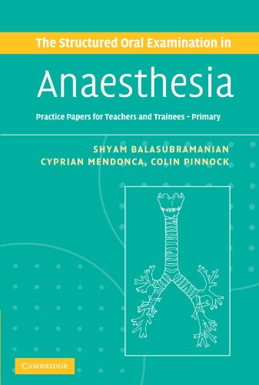
Resources - SOE/OSCE
Lots of textbooks - ask colleagues who have finished the exam to lend copies
Yorkshire primary VYVA course (email:yorkshiredeanery.frcaexam@gmail.com) - you will get reminders about this nearer the time
Local OSCE/SOE preparation courses - check the deanery website

Slide 15
Hints and Tips
People pass the exam → you can pass the exam
People fail, doesn’t mean you’re a failure
Find a motivated revision buddy, talk to people sitting it at the same time
Talk to people who’ve just sat it

Slide 16
Hints and Tips
Look at when you need to apply for the exam
Don’t underestimate costs
£370 for MCQ, £685 for OSCE/Viva
£??? On books/revision aids
£??? On travel to london
Claim tax relief
Can usually claim a few days study leave/SPA before the exam for revision – check locally
Utilise your study leave for primary courses etc

Slide 17
QUESTIONS?
P.s. Don’t think about the exam for at least 3 months

