Slide 1
Patient Satisfaction Questionnaire
PSQ
Dr Chris Webb - December 2020

Slide 2
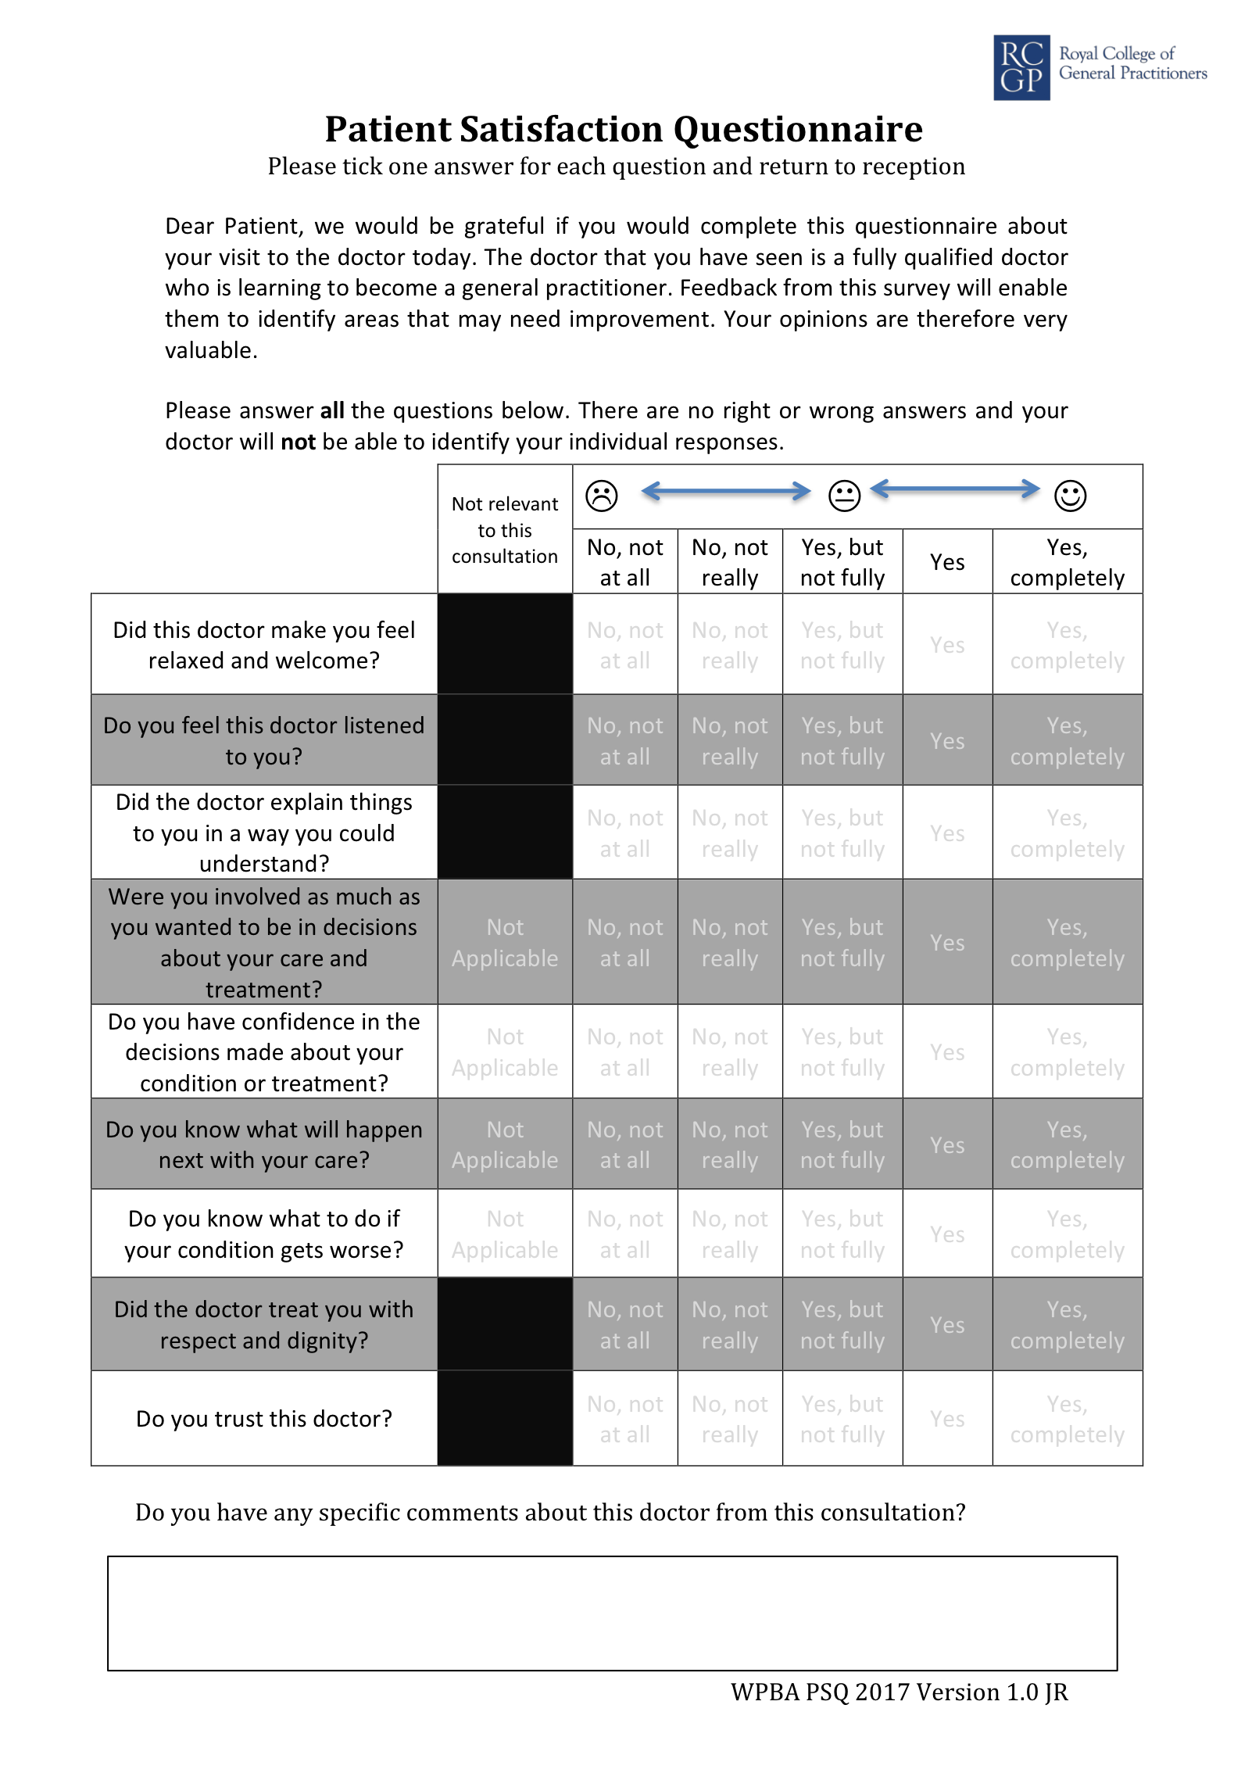

Slide 3
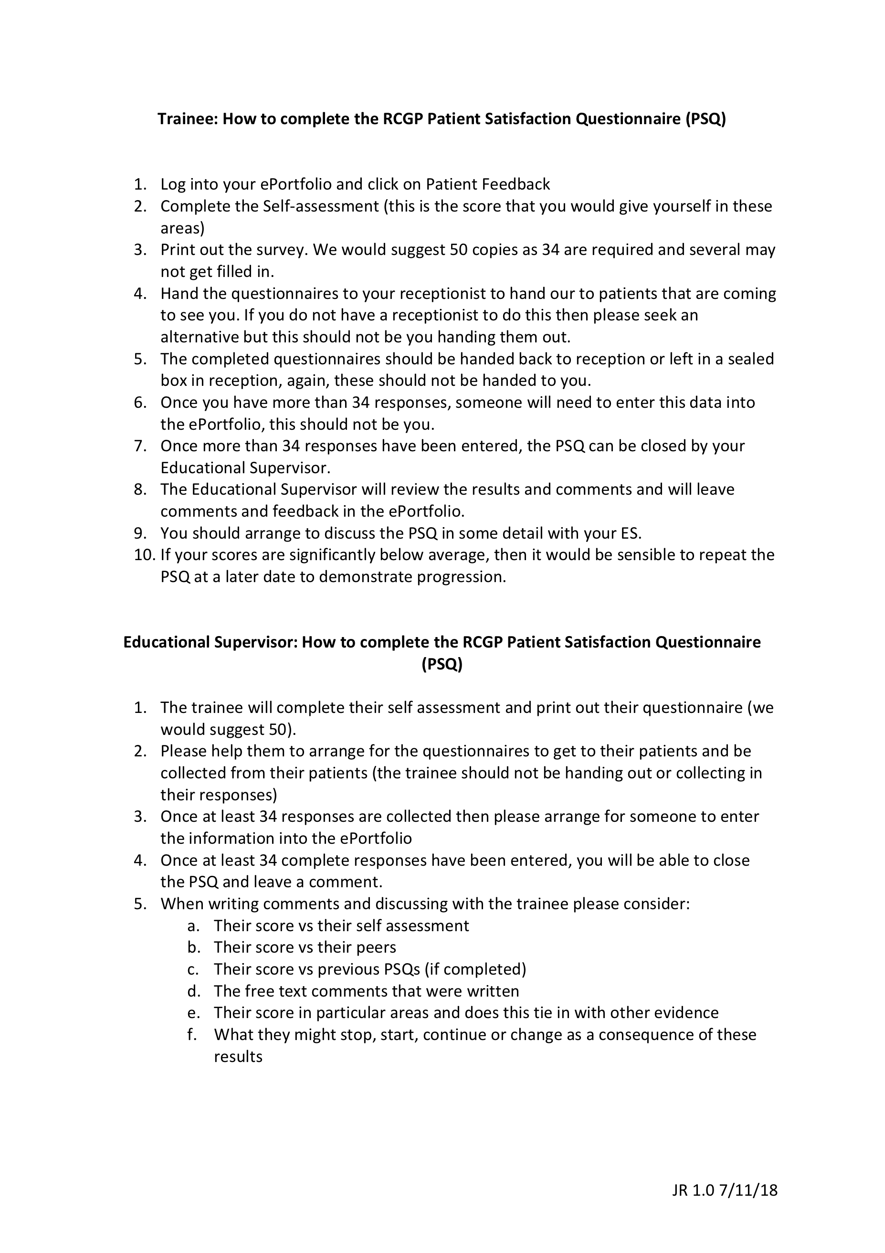

Slide 4
How many PSQ’s require completion?
One PSQ during ST3 containing at least 34 responses

Slide 5
How is the data collected?
There are several ways to do this
From the Portfolio the trainee can send the patient a link to complete the questionnaire online or they can download a paper copy and ask reception staff to hand out the questionnaire to patients

Slide 6
Uploading paper forms
The paper forms should be collected by an administrator (not the trainee)
The trainee will need to invite an administrator to enter the data to the Portfolio. To invite an administrator, go to the survey and scroll to the bottom of the page, where the section for printed forms is located. There are instructions explaining how the paper forms can be uploaded to the system. The trainee can email the instructions to an administrator who will be able to add the PSQ forms for them using the provided ID and password

Slide 8
Completion of the PSQ
A number count is displayed on the survey page in the Portfolio so the trainee knows how many have been returned
The administrator is able to add paper forms. Any forms uploaded by an administrator will be added to the questionnaires completed electronically
The trainee receives an email notification when they have obtained the minimum of 34 responses, which is when they can close the survey. To close the PSQ, go to your survey and click "close survey" in the "your progress" section. This will send the PSQ results to the Supervisor for analysis

Slide 9
The results
Once the trainee has closed their PSQ, the results will be released to the Supervisor
They will then be able to review the results, comment on these and release them to the trainee

