Slide 1
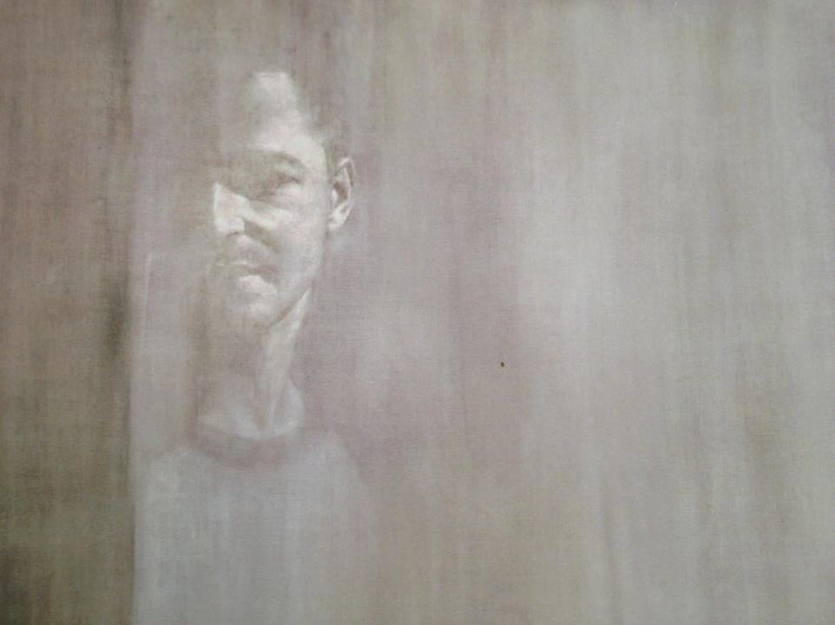

Slide 2
Reflection

Slide 3
Intended Learning Outcomes
To gain a deeper understanding of what we mean by reflection and the reflective learning cycle.
To apply that understanding to reflective writing.

Slide 4
Definition
Johns
Reflection is a personal process which enables the practitioner to assess, understand and learn through their experiences. This results in some change for the individual in their perspective of a situation or creates new learning for the individual.

Slide 5
Levels of Reflection
4 Areas:
1 information; enough to paint a picture of the events
2 self awareness; open and honest about what occurred
3 critical analysis; looking at the bigger picture and then analysing the smaller parts to understand the whole
4 evidence of learning; synthesis, judgment and evaluation

Slide 6
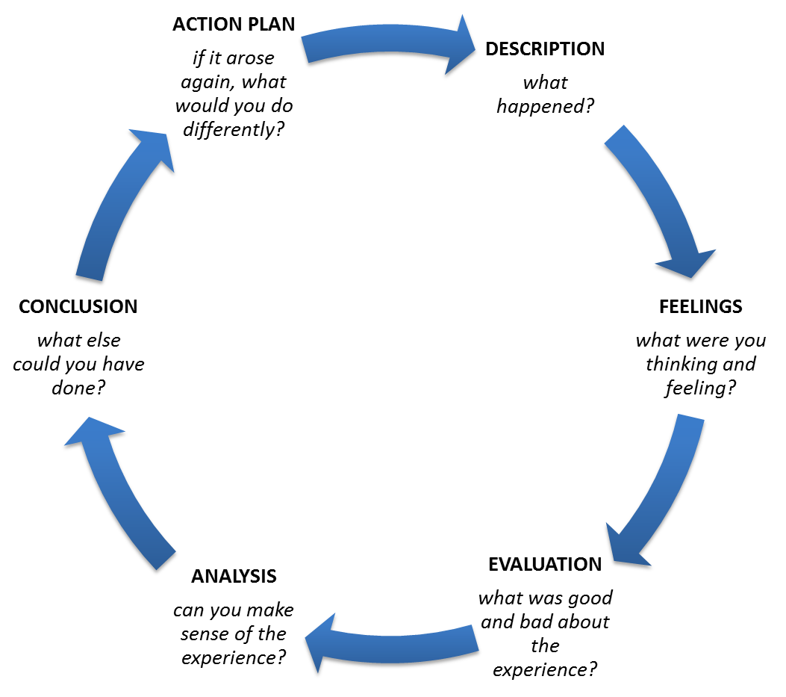
Gibbs Reflective Cycle

Slide 7


