Slide 1
Specialist Training Committees
Trevor Rogers
Deputy Head of School
March 2018

Slide 2
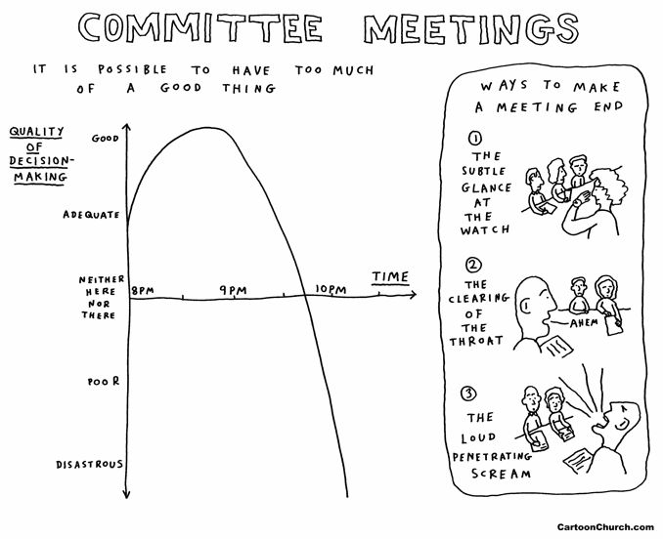
Specialist Training Committees
Gold Guide defines an STC as the committee that advises and manages training in a specialty within a locality in HEE
JRCPTB defines it as ‘committee of the postgraduate dean which has delegated to it many of the dean's duties for the specialty’
They feed into the School of Medicine
STCs are responsible for the management and quality assurance of training within a specialty

Slide 3
Roles and functions of an STC
The essential role is to manage and develop the specialist training programme of the individual specialty and to ensure the delivery of the highest standard of training
It needs to ensure that the training programme meets the requirements of the Gold Guide and coverage of the training curriculum

Slide 4
Constituent members:
Personnel recommended:
STC chair/ TPDs
Relevant deputy head of school of medicine
Trainee representative
Training leads for individual Trusts or local education providers
Academic representative

Slide 5
Deanery-wide
Most specialties now closely integrated across the deanery
Many always meet as a pan-deanery committee
Remainder should do so at least annually

Slide 6
Deputy Heads of School
3 –Ian Wilson, Sunil Bhandari, me
Medical specialties divided between us –no longer on a geographic basis

Slide 7
Deputy Heads of School
TKR:
Respiratory
Oncology
GU Med
Occupational Med
Dermatology
Palliative medicine
GIM/ CMT in South
SB:
Renal
AIM
D&E
Gastro
ID
GIM/ CMT in East
IW:
Cardiology inc paediatric
Geriatrics
Genetics
Nueurophysiology
Haematology
Immunology
Neurology/ stroke
Rheumatology
GIM/ CMT in West

Slide 8
Administration and management
To identify appropriate training placements
  have appropriate approval
  appropriate for the level of training
Lead and participate in the ARCP
Ensure interests of :
  LTFT trainees
  academic trainees
  trainees who are out of programme
  LAT post holders

Slide 9
Delivery of training
The STC chair/TPD(s), provide leadership on the actual delivery of training within the training programme
Establishment, with the involvement of STC members, of an appropriate training programme
? flexible training lead with experience and expertise related to LTFT trainees

Slide 10
Support the TPD if needed in
OOP
Counselling trainees experiencing difficulties
Interdeanery transfers
Contributing to the annual specialty report (ASR) of the school of medicine
  key activities within the training programme
  response to the annual GMC trainee and trainer surveys
  deanery quality management requirements.
The ASR in turn enables the school of medicine to report to the JRCPTB and national specialty reports are forwarded to the regulator

Slide 11
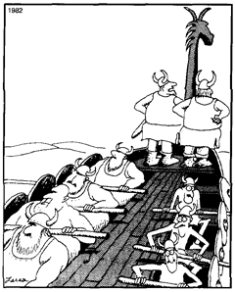
Monitoring and inspection
STCs should monitor quality of the training programme
Should address local training
  If serious, then should escalate to the relevant deputy head of school.
Trust issues might necessitate involvement of the DME and may trigger QM visit.
STCs can refer trainees needing extra support for review and planning of required interventions or remedial targets.
"You know, Omar, I've got it, too. The feeling that we're just going in circles. (Gary Larson)

Slide 12
Trainee representatives
Have a key role within STCs:
  delivering a trainee representative report at each STC meeting that allows trainees within the programme
  contribute to the organisation of training days /curriculum mapping
  encouraged to develop innovative ideas that can be incorporated into the training programme.

Slide 13
Recruitment to the specialty
Approval of the wording of advertisements for recruitment to the specialty
Interview process
Allocating the successful candidates to the vacant placements

Slide 14
Questions?

