Slide 1
HEE YH:
Trainee Update Webinar
03.11.2020

Slide 2


Slide 3

Contact details
@TMackrell
@viggars2107
@19claire23
@Jonny1Cooper
@NHSHEE_NEY
Heeyh.faq@hee.nhs.uk

Slide 4
Ground rules
All questions sent into the webinar will be anonymised
Please avoid using acronyms or abbreviations
Please use Q&A board
Webinar continues to be available for 180 days after the event

Slide 5

Agenda
1. Wellbeing
6. ARCP
OOP
2. Clinically vulnerable trainees
7. Trainee Engagement
FiY1
3. Redeployment
8. Trainee Forum
4. Independent
Sector
9. Dental Update
10. Visa Issues
5. Specialty recruitment

Slide 6
Wellbeing
Any questions?
Heeyh.faq@hee.nhs.uk

Slide 7


Slide 8
Wellbeing
https://www.yorksandhumberdeanery.nhs.uk/covid-19-hee-yh-information
Psychological support
South Yorkshire: workplace.wellbeing@shsc.nhs.uk,
West Yorkshire, North Yorkshire, and East coast:
taketime@leeds.ac.uk
Coaching
Coaching.yh@hee.nhs.uk
Please include your full name, Trust, Grade, Specialty
Peer support
Peersupport.yh@hee.nhs.uk
Please include your full name, Trust, Grade, Specialty

Slide 9
Clinically Extremely Vulnerable Trainees
FiY1
Dr L Marshall (CT2 Psychiatry) &
Dr S Chiu (ST5 Ophthalmology)
Any questions?
Heeyh.faq@hee.nhs.uk

Slide 10
CEV Trainees
CEV Trainees
iY1
https://www.yorksandhumberdeanery.nhs.uk/learner_support/supported_return_to_training
SuppoRTT
Supported Return to Training
Supported Return to Training (SuppoRTT) is a centrally funded Health Education England (HEE) programme which aims to support ALL trainees to safely and confidently return to training after a sustained period of absence.
supportt.yh@hee.nhs.uk
HEEYH COVID 19
Trainee Update Webinar
Any questions?
Heeyh.faq@hee.nhs.uk

Slide 11
CEV Trainees
CEV Trainees
FiY1
National Webinars Available at:
www.hee.nhs.uk/our-work/doctors-training/
supporting-doctors-returning-training-after-time-out/supportt-digital-online-resources
Not receiving emails? Please email: supportt.yh@hee.nhs.uk
Shielded trainees WhatsApp group (not official): schiu@doctors.org.uk
HEEYH COVID 19
Trainee Update Webinar
Any questions?
Heeyh.faq@hee.nhs.uk

Slide 12
CEV Trainees
FiY1
Gov.uk Guidance on shielding & protecting people who are clinically extremely vulnerable from Covid 19
Updated advice available at
https://www.gov.uk/government/publications/guidance-on-shielding-and-protecting-extremely-vulnerable-persons-from-covid-19/guidance-on-shielding-and-protecting-extremely-vulnerable-persons-from-covid-19
and at
https://www.gov.uk/guidance/new-national-restrictions-from-5-november
HEEYH COVID 19
Trainee Update Webinar
Any questions?
Heeyh.faq@hee.nhs.uk

Slide 13
CEV Trainees
CEV Trainees
FiY1
Pregnancy
RCOG Occupational health advice for employers & pregnant women version 3.4 10/8/2020
- Archived
RCOG Statement Occupational health advice for employers & pregnant women 9/9/20
https://www.rcog.org.uk/globalassets/documents/guidelines/2020-09-10-occupational-health-statement-rcog-rcm-fom.pdf
Clinical advice of the RCOG:
- Pregnant women >28 weeks’ gestation have an increased risk of becoming severely ill with Covid-19, therefore social distancing is particularly important
- For pregnant women with other underlying health conditions, they should be considered on a case-by-case basis
Employer has a legal responsibility to ensure the workplace is safe, and therefore the employer needs to consider the clinical advice of the RCOG in your individualised workplace pregnancy risk assessment
HEEYH COVID 19
Trainee Update Webinar
Any questions?
Heeyh.faq@hee.nhs.uk

Slide 14
Redeployment
Any questions?
Heeyh.faq@hee.nhs.uk

Slide 15
Independent Sector
Any questions?
Heeyh.faq@hee.nhs.uk

Slide 16
Acquiring training in the independent sector
Employing NHS trust approval
Employing NHS trust indemnity cover
Information private indemnity provider
https://www.gmc-uk.org/education/standards-guidance-and-curricula/guidance/programme-and-site-approvals
HEE should approve any training prospectively
If you are concerned re: training please let HEE know

Slide 17
Specialty Recruitment
Any questions?
Heeyh.faq@hee.nhs.uk

Slide 18
Changes this year……
No face to face interviews in any specialty
No interviews at all for General Practice, Core Psychiatry or Child and adolescent psychiatry- MSRA only
Increasing reliance on MSRA (multi-specialty recruitment assessment)
Interview windows longer than previous due to increasing time needed for non-face to face interview.
Round 2 applications (generally HST applications) brought forward to November
New version of Oriel (oriel 2) this year- you will need to re-register

Slide 19
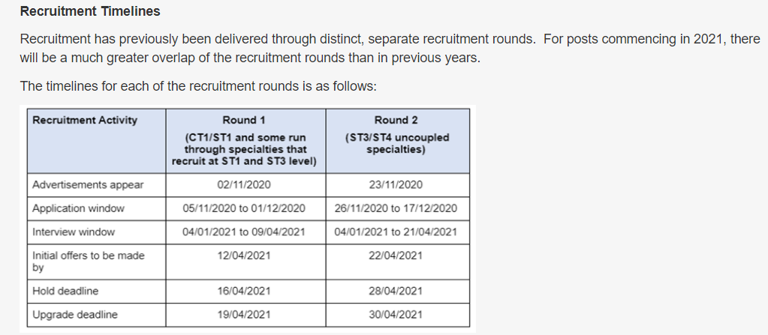
Key dates (medical recruitment)

Slide 20
https://specialtytraining.hee.nhs.uk
https://new.oriel.nhs.uk/Web/Home

Slide 21
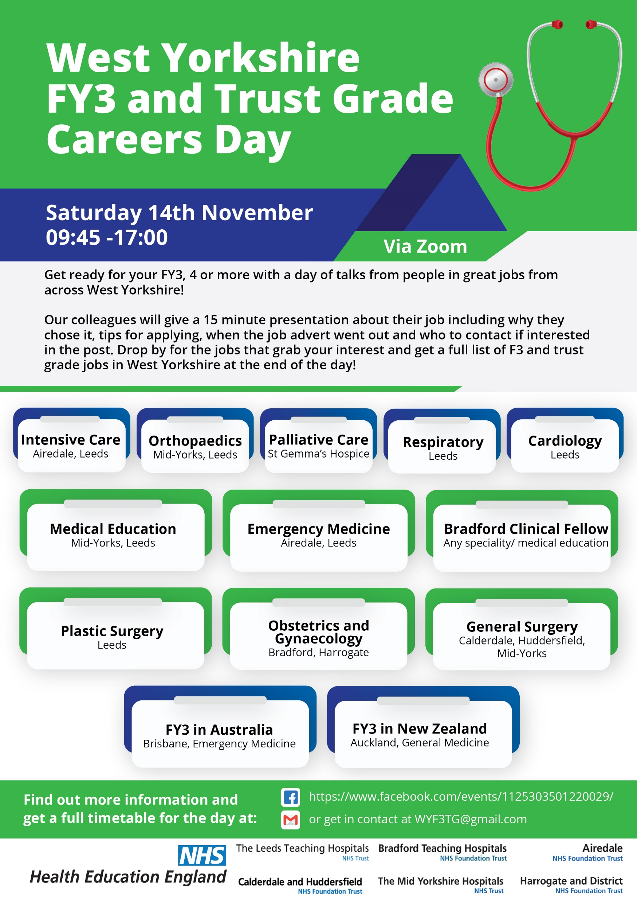
F3 opportunities

Slide 22
ARCP
Any questions?
Heeyh.faq@hee.nhs.uk

Slide 23
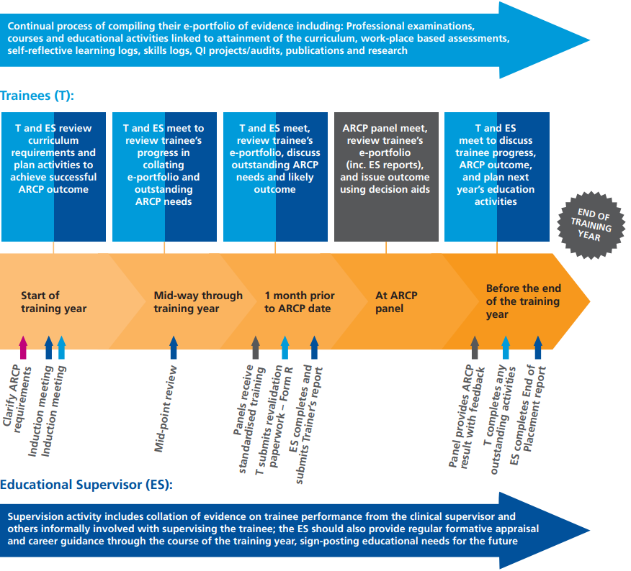
https://specialtytraining.hee.nhs.uk/ARCP

Slide 24
Trainee Engagement

Slide 25


Slide 26
Quality Update
Quality Team Email: Qualityteam.yh@hee.nhs.uk
Any questions?
Heeyh.faq@hee.nhs.uk

Slide 27
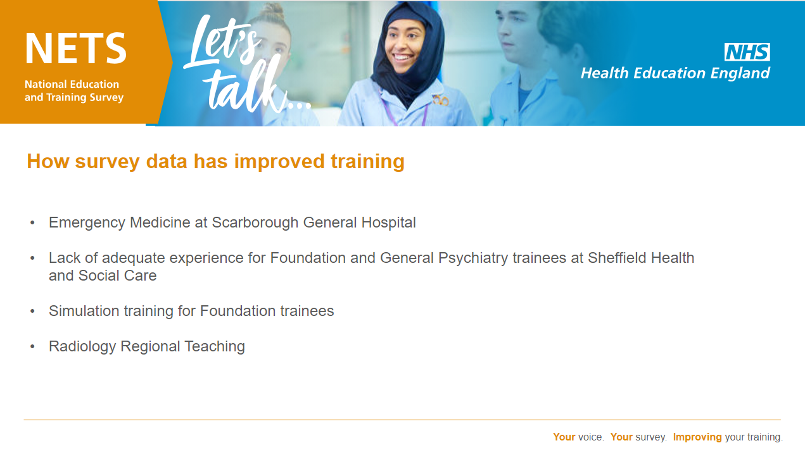

Slide 28
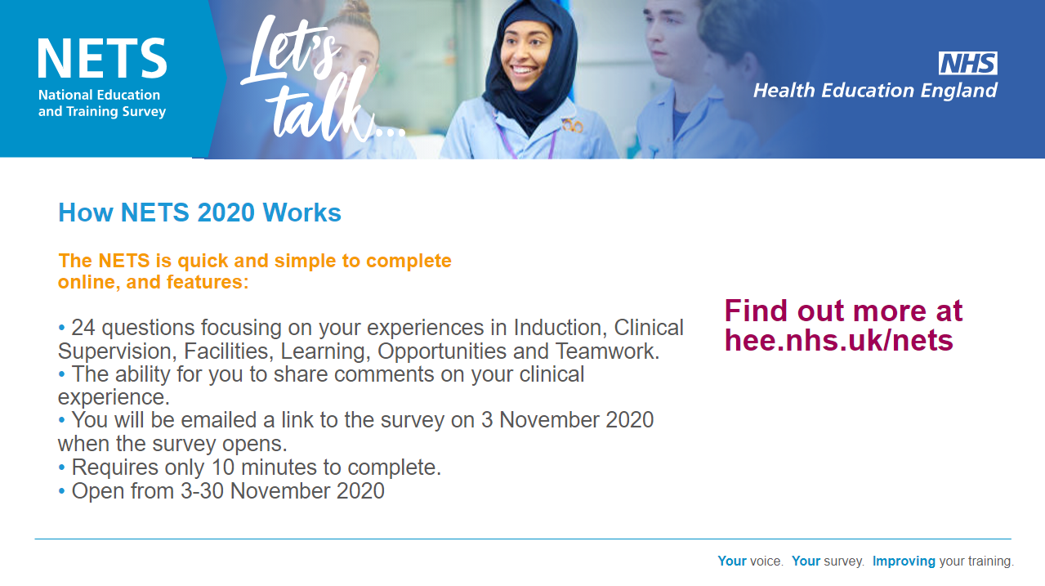

Slide 29
Trainee Forum
Any questions?
Heeyh.faq@hee.nhs.uk

Slide 30
Dental Update
Any questions?
Heeyh.faq@hee.nhs.uk

Slide 31
Visa Issues

Slide 32
Questions

