Slide 1
Registrars Experiencing Difficulties
KAREN BRADLEY
ELENA PAMPHILON

Slide 2
Eportfolio concerNS educator notes writing adverse CSRs, ESRs triangulation of evidence

Slide 3

Sharing stories
Identifying common themes
Notes:
2 small groups – identifying common problems/themes (likely relationship, not wanting to upset, liking your trainee, wanting them to pass, avoidance of conflict)

Slide 4
Having the Difficult Conversation – giving accurate feedback
  Ways of giving feedback exercise
  RCGP concerns - trainers “failing to fail”
Notes:
Golf ball exercise – need 3 victims

Slide 5
Recording this is the most important slide!
Why are you recording?
  for trainee, for trainer, for TPD and Performance team, for ARCP
Who should be recording
  You, trainee, other trainers in your practice, TPD, Performance team
Where should you be recording
  Educators notes, CSR, ESR, WPBA
What would you want to record
  Facts, behaviours, skills, knowledge, events
How would you triangulate your evidence
  MSF, PSQ, Other posts, Exams, if more than one trainer then 2 x CSR
Notes:
Discussion in small groups
Ngozis ed notes – Hope
Story of male trainee with damming ESR at CCT ARCP

Slide 6
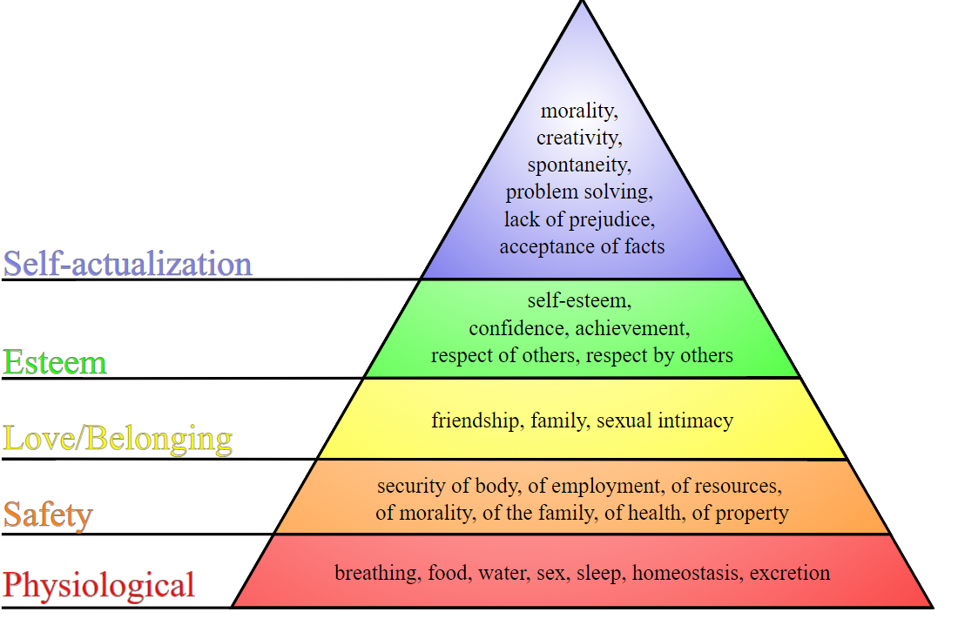
Maslow’s hierarchy of needs
Notes:
Trainee who sleeps in a car,
Faith -

Slide 7
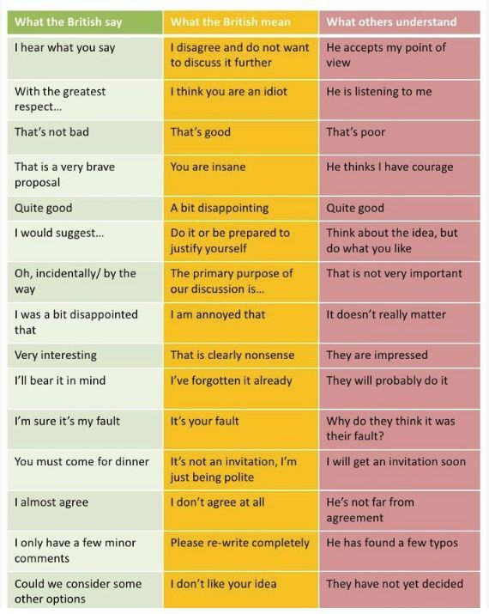
Language issues

Slide 8
identification in established trainees
Exam failures AKT (applied knowledge test) & CSA (clinical skills assessment)
Ongoing CSR and ESR concerns
Organisational issues – importance of educators notes
Professional behaviour concerns

Slide 9
Assessment Models
RDMp
SKIPE
I-SID

Slide 10
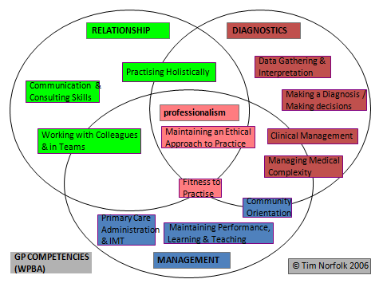
RDMp
Notes:
Have any of them used tool, when, was it useful?
What might pitfalls be (using in ST1?)

Slide 11
SKIPE
Skills
Knowledge
Internal
Past
External
Notes:
Easier tool to use to generate discussion
Internal – personality, attitude, organisational skills
Past – training, culture, past experiences
External – home life etc.

Slide 12
I - SID
I Identify
S Share
I Involve
D Document
use RDMp, SKIPE, other sources
concern with trainee, ES, TPD, performance lead
the trainee - plan together
educator notes on eportfolio
be factual, non judgemental, notify the trainee that you are doing this. Add frequently, include positive and negative
Notes:
System of bringing all information discovered together.

Slide 13

Coffee break

Slide 14
Supporting your trainee taking AKT

Slide 15
AKT Breakdown of scores
Clinical medicine 160 questions
Average score 72%
Evidence interpretation 20 questions
Average score 74.5%
Organization 20 questions
Average score 72%

Slide 16
Reasons for failing AKT
Taking it at the wrong time
Poorly prepared
Poor technique
Health issues/anxiety
Dyslexia

Slide 17
Reasons for failing CSA
Taking it at the wrong time
Poorly prepared
Poor technique
Health issues/anxiety
Dyslexia
Stamina for a 13 patient surgery
Timing issues

Slide 18
Identifying trainees' weaknesses
RCGP curriculum
GP curriculum: overview
RCGP content guide AKT content guide
GP curriculum self assessment tool
Self assessment tools
PUNs and DENs, Trainer feedback
AKT summary reports
AKT sample questions and answers
MRCGP | Applied Knowledge Test (AKT)
Fourteen Fish AKT package mock AKT
RCGP -GP SelfTest Home: GP SelfTest
Notes:
IMG – commonality areas of difficulty - statistics, GP administration and working of NHS, DVLA rules.

Slide 19
Fourteen fish AKT package
Mock AKT – strongly predicts score in the exam. If scoring 70% here, should pass the exam.
Knowledge based videos on targeted areas that perform poorly
Written by AKT examiners
Research shows increased pass rates by trainees using this.
Timing of watching videos – not 3am!

Slide 20
dyslexia
Regularly unmasked by the AKT exam
Referral by deanery for formal testing if screening is suggestive/borderline

Slide 21
How to practice using the information in preparation for the exam?
I remember:
5% of what I hear
10% of what I read
15% of what I hear and read
30% of what I’m shown
50% of what I discuss
75% of what I do
90% of what I teach others

Slide 22
Exam Tips
Careful Question reading - such as “single most likely”
Be ruthless with your timing (just under 1 minute per question)
Trust your instinct and you will often be correct with your first choice.
Do NOT omit any question – no negative marking. GUESS!
Make use of the ‘cover test’.
Only mark 20 answers approximately to revisit

Slide 23
How much work?
3 months
One hour a day approx.
Choose the right job to sit the exam
Time it when it fits best with home life.

Slide 24
On the AKT exam Day
Make
Make sure you have watched the Pearson Vue tutorial video so you know what to expect
Take
Take your passport/ID documents
Check
Check journey time/parking info/take money
EAT
EAT! Take a drink. Get up and stretch.

Slide 25
Joint surgery discussion
Notes:
Split into 2 groups – what is being done currently. Pros/cons.

Slide 26
Joint surgeries
Vitally Important
Watching trainers and other GPs
CSA Mark Schemes
Prioritising CSA not COTs
Notes:
Our common theme in trainees coming to performance team

Slide 27
Trainees requiring additional support
WHEN AND HOW DO YOU GET THE PERFORMANCE TEAM INVOLVED?!

Slide 28
Who do you contact?
Clinical Supervisor
Educational Supervisor
Training Programme Director
Locality Performance Lead
Head of performance
Deputy head of school

Slide 29
Our aim is to support TPDs and trainers help trainees to achieve a successful CCT at the end of training; enabling them to progress to safe independent practice.
We meet trainees, trainers and TPDs, run courses, signpost, troubleshoot and respond to concerns.
We aim to constantly enrich what we offer, being open to ideas from other deaneries as well as our own educators, in developing our educational programmes.
What is the performance team?

Slide 30
Who gets referred to the performance team?
Exam fails AKT, CSA
Scheme concerns
Very early sometimes. (Has the trainee achieved foundation competency? Referral to the NRO? Extra training grant?)
Persistent non engagement with eportfolio
SUIs / GMC conditions

Slide 31
Poor knowledge
Poor motivation
Unable to make decisions
Poorly structured consulting
Top educational difficulties

Slide 32
How does the deanery support trainees?
Courses - Study skills for busy doctors, study skills for AKT, CSA support course, Coaching sessions, 1:1 CSA examiner sessions, enhanced induction programme for IMGs.
New resources – CSA toolkit/SOX Programme, AKT package for all trainees. CSA package for SOX trainees.
Dyslexia testing – paid self screening and paid full screening if positive.
One to one meetings
Regular review – eportfolio and personally

Slide 33
Workshop support from peers
TPD support. Performance team support.
Sessions at Spring and Autumn school
Trainer plenaries
Dedicated afternoon workshops
New resources – CSA toolkit
Extra training grant
How does the deanery support trainers?

Slide 34
Package that has been purchased from the NW Deanery following marked success
Offered to trainees who have had a CSA fail
3 recorded consultations with simulated patients
Each trainee allocated a tutor who will work with trainee and trainer
CSA sox
Notes:
Will be covered in afternoon

Slide 35
AKT Pre-Exam Considerations
Is the trainee ready to sit the exam? AKT usually sat in either ST2 or 3-consider delaying till later When is the best time for this trainee? | Trainee | Trainer/ES Support | Educational Support for trainee
 | Ethnicity and English as a second language | Good communication ES/CS through previous trainer, TPDs | ES/Trainer- 14 fish AKT, BNF, check RCGP AKT resources PUNs and DENs through debrief highlighting areas for learning
 | Educational- previous difficulties with MCQ exams? DYSLEXIA screening Debrief highlights lack of knowledge. SEAs and complaints EXAM technique – don’t just do passmedicine questions ( written by Med Regs) TIMING – not during an A&E post! | Educators notes used to document anything useful for training including performance issues Trainees often sit AKT whilst in hospital posts, but increasingly delaying to early ST3 Single best answer is unfamiliar. Exams written by jobbing GPs – do questions together Tutorials of GP admin. | Dedicated AKT sessions through VTS Study groups less used in AKT RCGP AKT resources are comprehensive GP Self-test (RCGP, free) to highlight learning needs
 | Pastoral -illness and Mat leave PT/FT working, child care implications for studying Hotel the night before? | Trainers workshops and spring/autumn school | Y&H deanery support New 14 fish AKT support package

Slide 36
AKT fail
Is there time to re-sit the exam and be successful? Does the trainee need to be considered for an extension due to significant fail? | Trainee | Trainer/ES | Educational support available
 | TPD/Trainer/ES contact trainee and discuss the exam and exam prep. Why do they think they failed? Exam harder than expected, inadequate time and preparation, only using passmedicine, sitting it during arduous hospital post. BUT also they could have worked very hard, and be desolate. | If in ST3, Trainer may contact TPDs if they wish to discuss how to review the exam ES can do the same. | Trainer/ES Discuss exam prep and timing for re-sit. Ensure that there is time to study - 200 hours, approx. 3 months 14 fish AKT support PUNS/DENS discussion at debrief
 | Pastoral considerations- does the trainee need additional support? Is anxiety a factor? DYSLEXIA screening | Trainers workshop for support and learning AKT 14 fish package guide to AKT RCGP AKT resources | VTS AKT sessions looking at various aspects of exam. Tutorial and topic-based sessions STATS – online resources, with peer group, arrange VTS session
 | Financial implications FT/PT work-life-educational balance- sick leave Trainee own GP if necessary Take time/ work place wellbeing input GP health service | Trainer support through Y&H deanery Spring and Autumn schools | Y&H deanery support- Performance team meeting Study skills for busy doctors course Study skills for AKT course Coaching sessions for organization Dyslexia screening

Slide 37
CSA Pre-Exam Considerations
Is the trainee ready to sit the CSA exam? When is the best time for this trainee? | Trainee | Trainer Support | Educational Support for trainee
 | Ethnicity and English as a second language | Good communication with trainer through previous trainer/CS/TPD | Trainer- Joint surgeries, CSA practice videos- timing & 14 fish CSA support
 | WPBA – competent or NFD? Any organizational issues – in practice admin. OOH sessions, ARCP preparation? Any pertinent MSF comments? Anxiety an issue? Overconfidence an issue? | Educators notes used to document anything useful to training, including performance issues Triangulate assessments if possible – realistic feedback is essential, and difficult within a closer relationship | VTS CSA mocks RCGP CSA course – useful to experience the venue Encourage peer CSA exam groups Many useful websites with cases and videos – 14 fish, Pennine, Bradford International GP recruitment resources – “Spend a penny “ booklet
 | Pastoral –illness, Mat leave, PT/FT working, child care implications for studying, Family abroad? | Trainers workshops and spring/autumn school Understanding of Maslow’s hierarchy – where is your trainee sleeping? -where is their family? | Y&H deanery support -CSA prep. course, Coaching sessions. Study skills for busy doctors course New 14 fish CSA support package

Slide 38
CSA fail
Is there time to re-sit the exam and be successful? Does the trainee need to be considered for an extension due to significant fail? | Trainee | Trainer | Educational support available
 | Trainer meets with trainee to discuss the exam- review CSA examiner feedback and marking schedule. RDMP and SKIPE tools may help | Trainer can discuss trainee with TPDs and/or performance team. Add educator note from CSA debrief. | Trainer- concentrate on consulting skills and tasks in joint surgeries, role play, video analysis. Trainers – be watched! Demonstrate! 14 fish CSA toolkit and support
 | Pastoral considerations- As above; does the trainee need additional support? | Trainers workshops/plenaries for support and learning Attend the CSA exam as an observer | VTS – mock CSA Peer CSA exam groups
 | Financial implications – tier 2 visas FT/PT work-life-educational balance- sick leave Does the trainee have their own GP? Work place wellbeing, Take time or equivalent NHS GP Health service – confidential mental health support. | Trainer support through Y&H deanery via Spring and Autumn schools | Y&H deanery support- Performance team review, possible meeting. 1-2-1 sessions with CSA examiner, Coaching sessions for organization Study skills for busy doctors course CSA support course / SOX

