Slide 1
Training for purpose: Community placements for GP trainees
An Introduction

Slide 2
‘Your work as a family doctor is determined by the make-up of the community in which your practice is based….GPs may need to take additional steps to understand the issues and barriers affecting their communities.’ (RCGP Curriculum 2019)
Notes:
The new GP curriculum recognises that GPs need to understand the potentials and limitations of the community in which they work and its character in terms of socio-economic and health features. The GP is in a position to consider many of the issues and how they interrelate, and the importance of this within the practice and the wider community.

Slide 3
What are community placements?
Allow trainees to learn about the communities in which they are working in and the third sector organisations supporting the community.
ST1 GP trainees (or ST2 if this is their first GP post) will spend a minimum of two half days observing, shadowing and working alongside a community or voluntary organisation of their choosing, that is relevant to the community they are working in.
Trainees will organise the placement themselves.
The placements are to be completed in personal study mornings/afternoons or when there is no scheduled VTS session/HDR. Trainees may also use tutorial time if agreed with their trainer.
‘It’s an opportunity to get out of the surgery, to go into the community, to see how people live and to learn about what services are available to help people.’ (Scarborough trainee, 2020)

Slide 4
What are third sector organisations?
Organisations that are not governmental (i.e. not the NHS, council etc) and not for profit (not businesses).
Typically refers to charity or voluntary organisations.
Examples of organisations that trainees have visited include:
National charities, e.g. Age UK, Barnardo’s
Local charities, e.g. art groups, social groups, dementia groups, community allotments, exercise groups
Regional organisations, e.g. Housing associations
Organisations supporting specific groups such as such as refugees and asylum seekers, ethnic minorities, homeless people, sex workers, people with drug and alcohol problems or people with learning disabilities

Slide 5
Why have community placements ?
Community orientation is a key competence in the RCGP curriculum
Social prescribing is an increasingly important part of general practice
Allows trainees to step outside the consultation room and get to know the community they are working in
‘We need to be moving away from just using a medical model, we need to think about our patients as part of a community, with social factors impacting their health and the support out there to help people.’ (York trainee, 2020)
‘This has helped me understand the local community that I work in and how social issues such as poor housing, problems with benefits, and social isolation can have an impact on mental and also physical health. It is difficult to manage this as a doctor as I can’t provide support for these issues, so it’s really good to see there is a service available to address these issues for people.’ (Sheffield trainee, 2019)
Notes:
‘Community orientation’ in the RCGP curriculum states that all trainees should be able understand the communities they are working in; this includes the cultural, occupational, epidemiological, environmental, economic and social factors and the relevant characteristics of ‘at-risk’ groups. It also includes understanding the health inequalities that exist within and between communities.
There has recently been an increased emphasis on social prescribing. With the introduction of primary care networks, all practices should have access to a social prescribing link worker. For social prescribing to be of maximum benefit, it is important that GPs understand the context in which patients live and have an understanding of the process of social prescribing and the organisations supporting patients in the community.
A pilot of community placements in Rotherham in 2018 received positive feedback from the trainees and organisations.

Slide 6
‘I shadowed the social prescriber linked to our practice, we visited four patients at home, and I got to see the all different challenges they were facing and the ways in which they could be helped and supported. In between patients we chatted about the different groups out there and how GPs can best refer.’ (York trainee, 2020)
‘I spent my placement with an organisation supporting people with drug and alcohol problems, they were really welcoming and keen to explain what support they could offer, they’d never had any one from the GP surgery visit before, so seemed pleased about that. They showed me round, explained their services and I sat in on part of a session.’ (Airedale trainee, 2020)

Slide 7
‘I visited a community forum near to our practice, I had no idea about the huge range of groups and services available in our area, and neither did my GP colleagues. After spending time with the manager of the forum we decided to work together booklet to create a booklet with all the groups and services listed, so that the GPs, nurses and pharmacists could use it to direct patients.’ (Sheffield trainee, 2020)
‘I spent time at a social group run by a hosing association, supporting people who are isolated and lonely. When I first arrived they seemed a little unsure about why I was there, but when I explained who I was and that I wanted to learn about what support they had to offer and who could access the group so that I could help signpost people in future, they thought it was a great idea. Everyone wanted to tell me their story of how they came to the group and how it helped them.’ (York trainee, 2020)

Slide 8
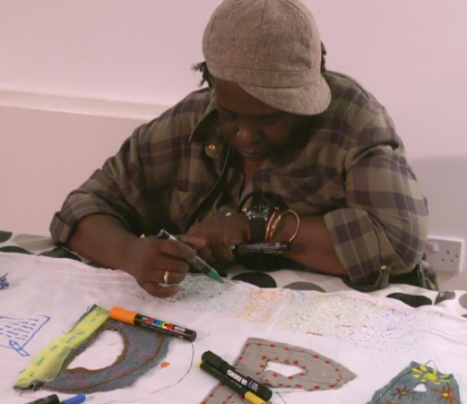
Jacqueline’s story
A video demonstrating the benefits of the third sector
https://vimeo.com/283913323/2f718c6952
Credit to Dragon Cafe and Rosa Productions
Notes:
This video demonstrates the positive impact third sector organisations can have on patients and communities.

Slide 9
Top tips on arranging a community placement
Start early
Think about the population your practice serves and what you would like to gain from the placement
Initially talk to those around you, in practice, including your trainer, other GPs, nurses and reception staff and research online
If possible, make contact with your social prescribing link worker, they will know about all organisations in the area
Use the community placements guide you have been sent
‘I would say start arranging early, find something that you're interested that is relevant to the community. Talk to the people in your practice, your trainer, the other staff, the social prescriber if you have one.’ (Wakefield trainee, 2020)
Notes:
Some trainees may opt to spend half day with a the social prescribing link worker (assessing patients, triaging referrals etc) and one half day with an organisation as opposed to two half days with an organisation
The community placements guide has advice on making contact with the organisation, advice on getting the most out of community placements and on how they will be assessed

Slide 10
How will community placements be assessed?
Reflective piece to be uploaded to your Eportfolio
Present your experience and learning back to your VTS/HDR groups
Feedback to your practice.
Notes:
- Trainees will be sent a pre and post placement questionnaire, this should only take a couple of minutes to complete. Sent via email. This is the first year community placements are taking place, we are keen to hear your feedback, if you have any particularly positive or negative experiences please feed this back to that we can use this information to improve community placements.
- Trainees will be required to complete a reflective piece about their experience of community placements using a standardised form and this must be uploaded to their Eportfolio. This is an NOE workbook requirement. You will be sent a template of the form to use.
- All trainees will present their experience and learning back to their VTS/HDR groups at a designated session.
- Trainees will be expected to feedback their experiences and learning to their practice.

Slide 11
Summary of community placements
Minimum of two half days spent with a community or voluntary organisation in your practice community.
Will be required to complete a reflective piece.
All trainees will be provided with a guide to community placements with advice and a draft email to send to organisations.
Enjoy! Community placements allow you to step outside the consulting room and get to know the communities you are working in.

