Slide 1
WBPA - Overview
Dr Chris Webb - December 2020

Slide 2
Purpose of WBPA
Evaluates trainee's progress in areas of professional practice best tested in the workplace
Looks at the trainee's performance in their day to day practice to provide evidence for learning and reflection based on real experiences
Supports and drives learning in important areas of capability with an underlying theme of patient safety
Provides constructive feedback on areas of strength and developmental needs, identifying trainees who may be in difficulty and need more help
Evaluates aspects of professional behaviour that are difficult to assess in the AKT and RCA
Determines fitness to progress towards completion of training

Slide 3
Format of WBPA
WPBA is designed to support trainees’ development, providing feedback on progress and helping identify any areas of difficulty
Throughout training, the trainee collects evidence related to 13 areas of professional capability and records it in their Portfolio. This evidence is used to inform 6/12 reviews and - at the end of training - to make a judgement about their readiness for independent practice
August 2020 - WPBA requirements changed
Current assessments have been updated along with introduction of new assessments. Reflects and responds to changes in General Practice, the new RCGP curriculum, and mandatory requirements of the GMC. Some assessments have changed completely, others have undergone minor modifications
WBPA Competency descriptors have not changed, the basis on which they are judged, and the level required to be attained by end of their training remains unchanged. Competences have been renamed as Capabilities to fit with the new curriculum

Slide 4
Capabilities

Slide 5
13 Capabilities
Fitness to Practice
Maintaining an ethical approach
Communication and Consultation Skills
Data Gathering and Interpretation
Clinical Examination and Procedural Skills
Making a diagnosis / decisions
Clinical management
Managing medical complexity
Working with colleagues and in teams
Maintaining performance, learning and teaching
Organisation, Management and leadership
Practising Holistically, Promoting health and safeguarding
Community orientation

Slide 6
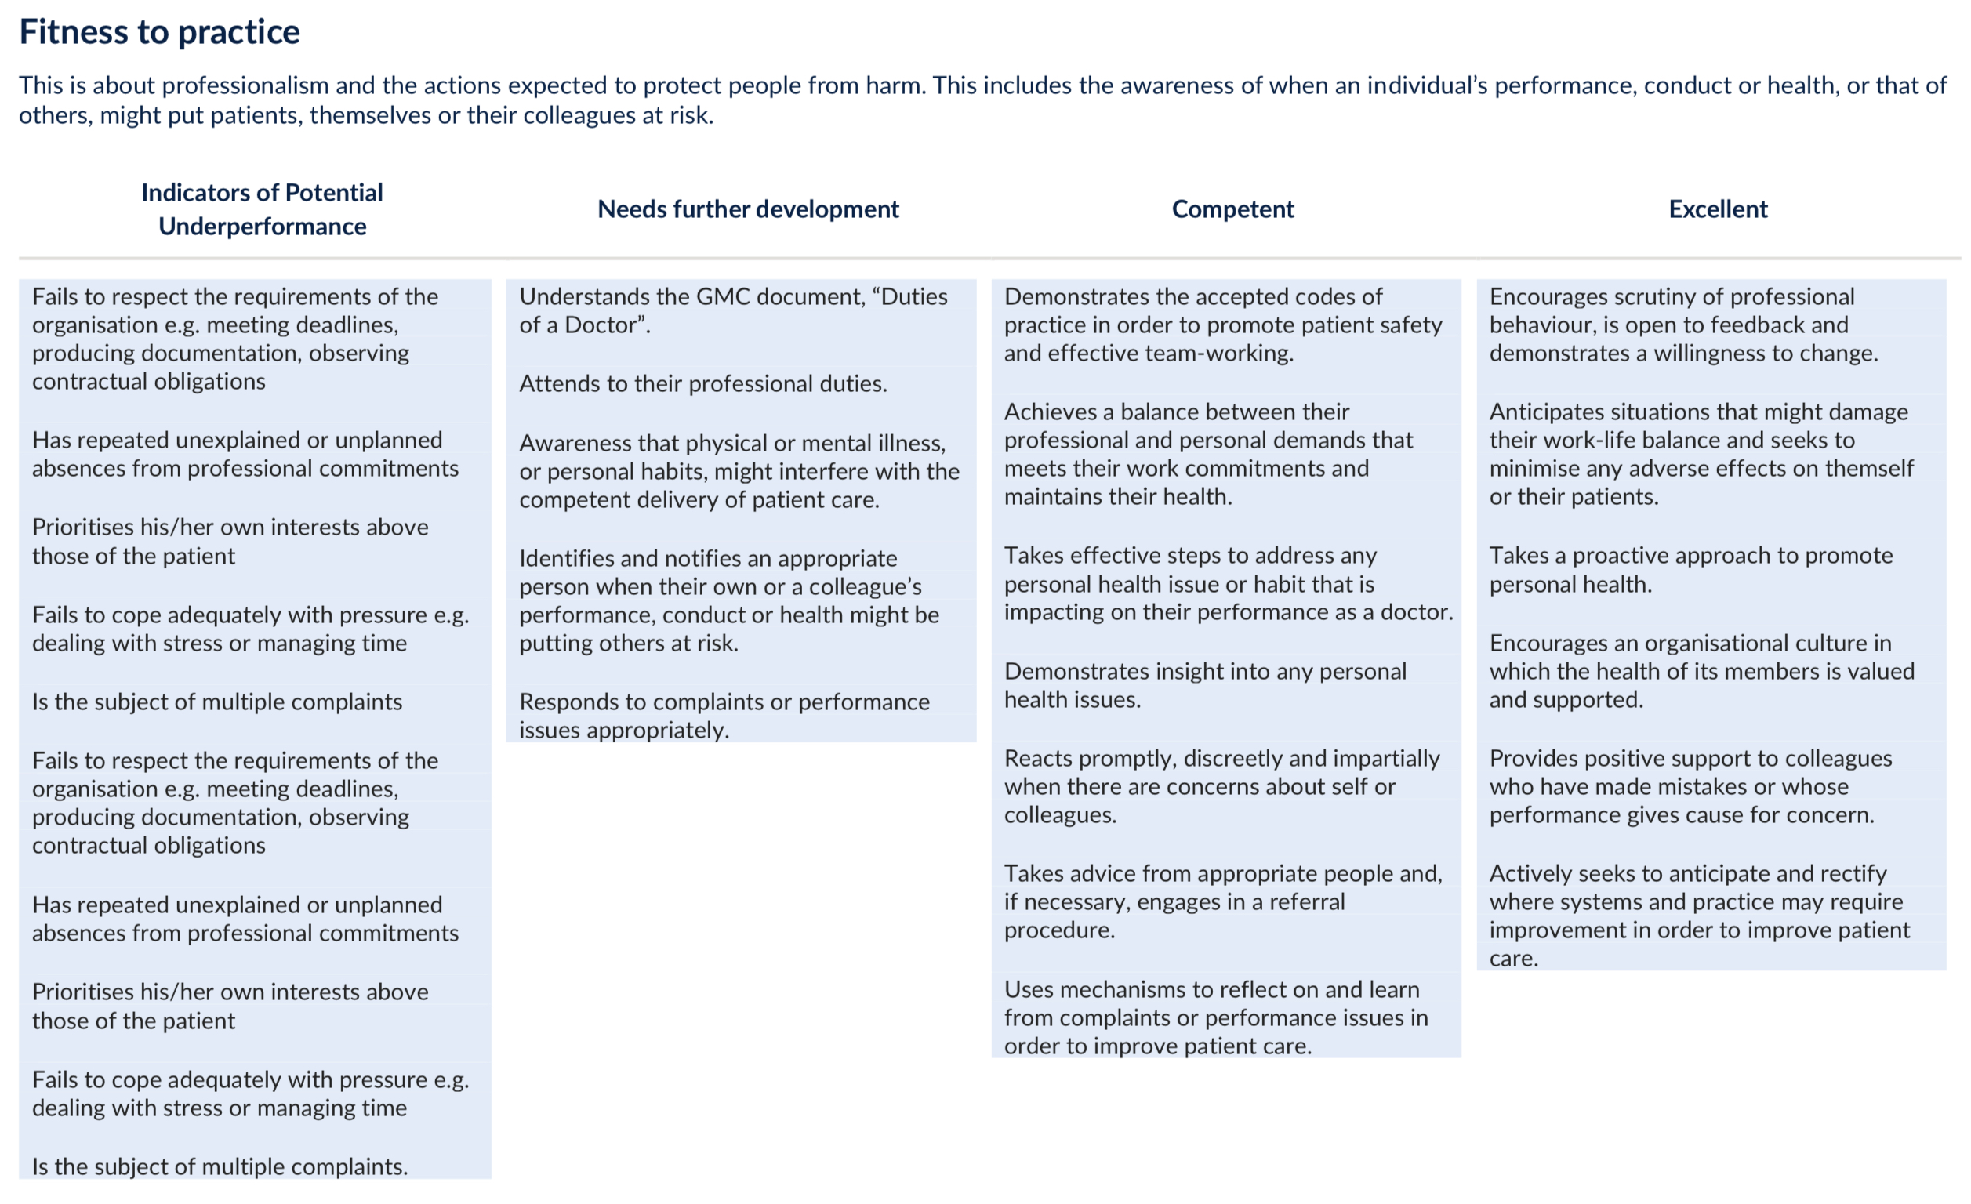

Slide 7
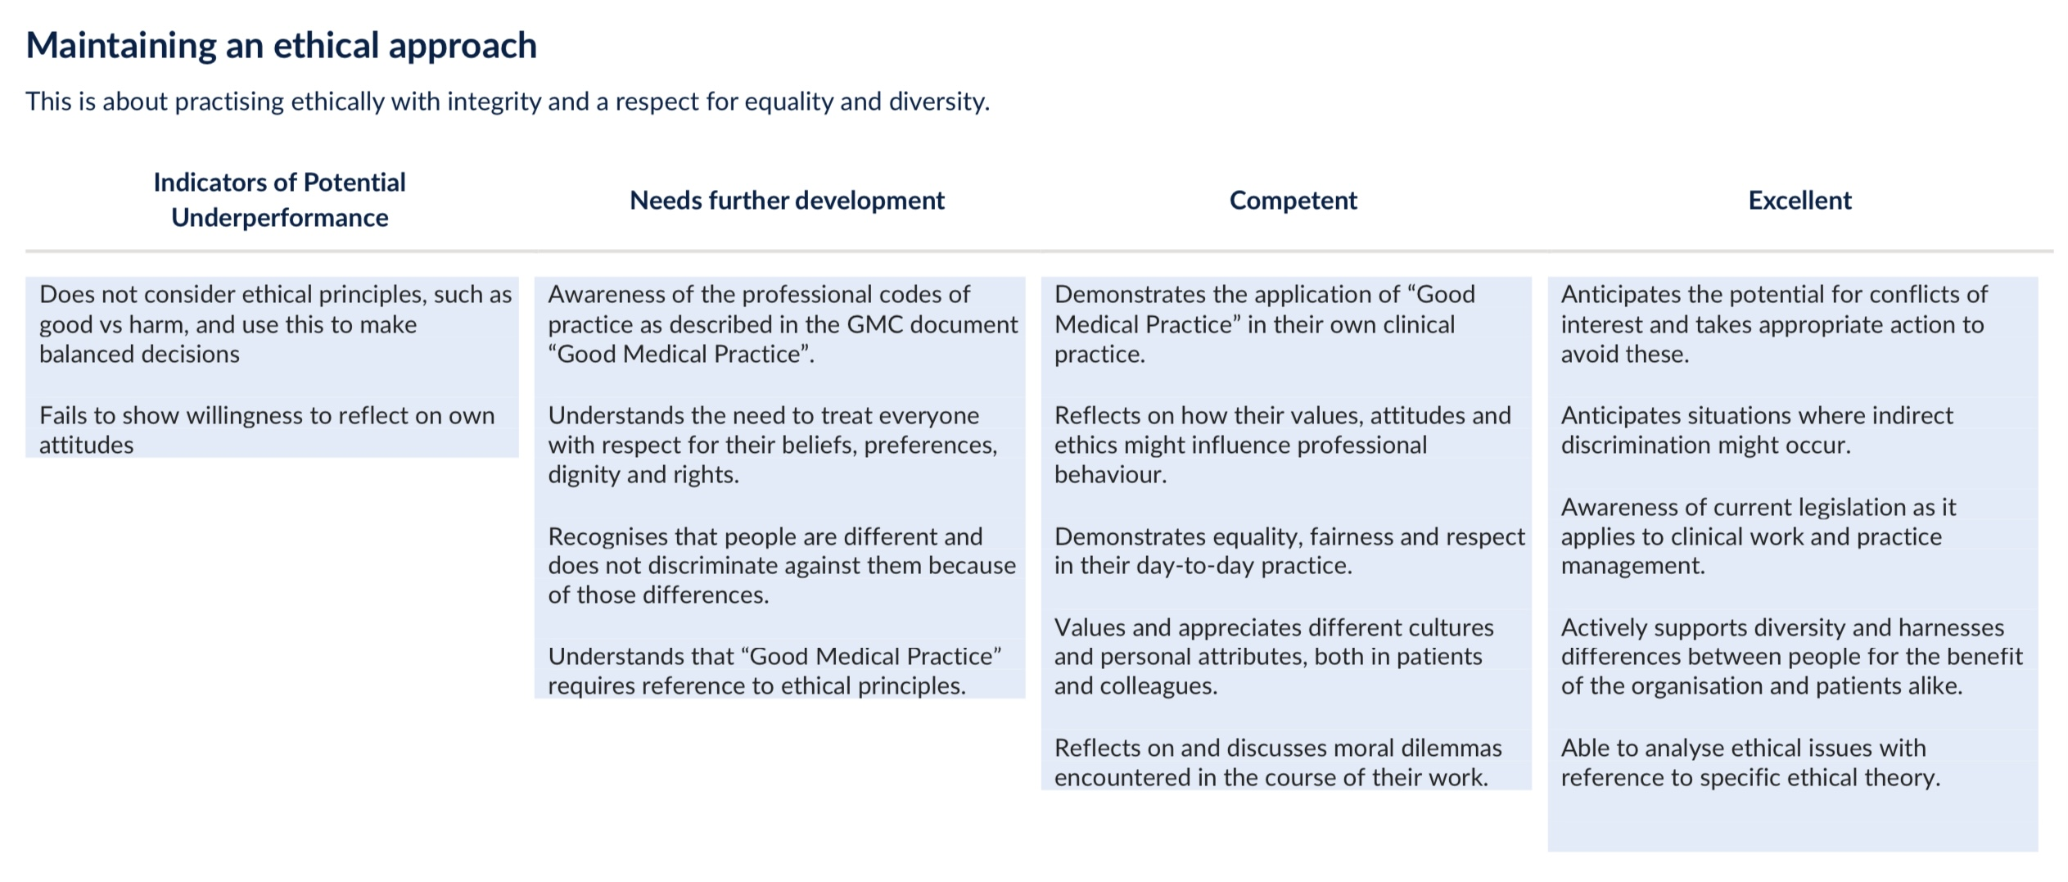

Slide 8
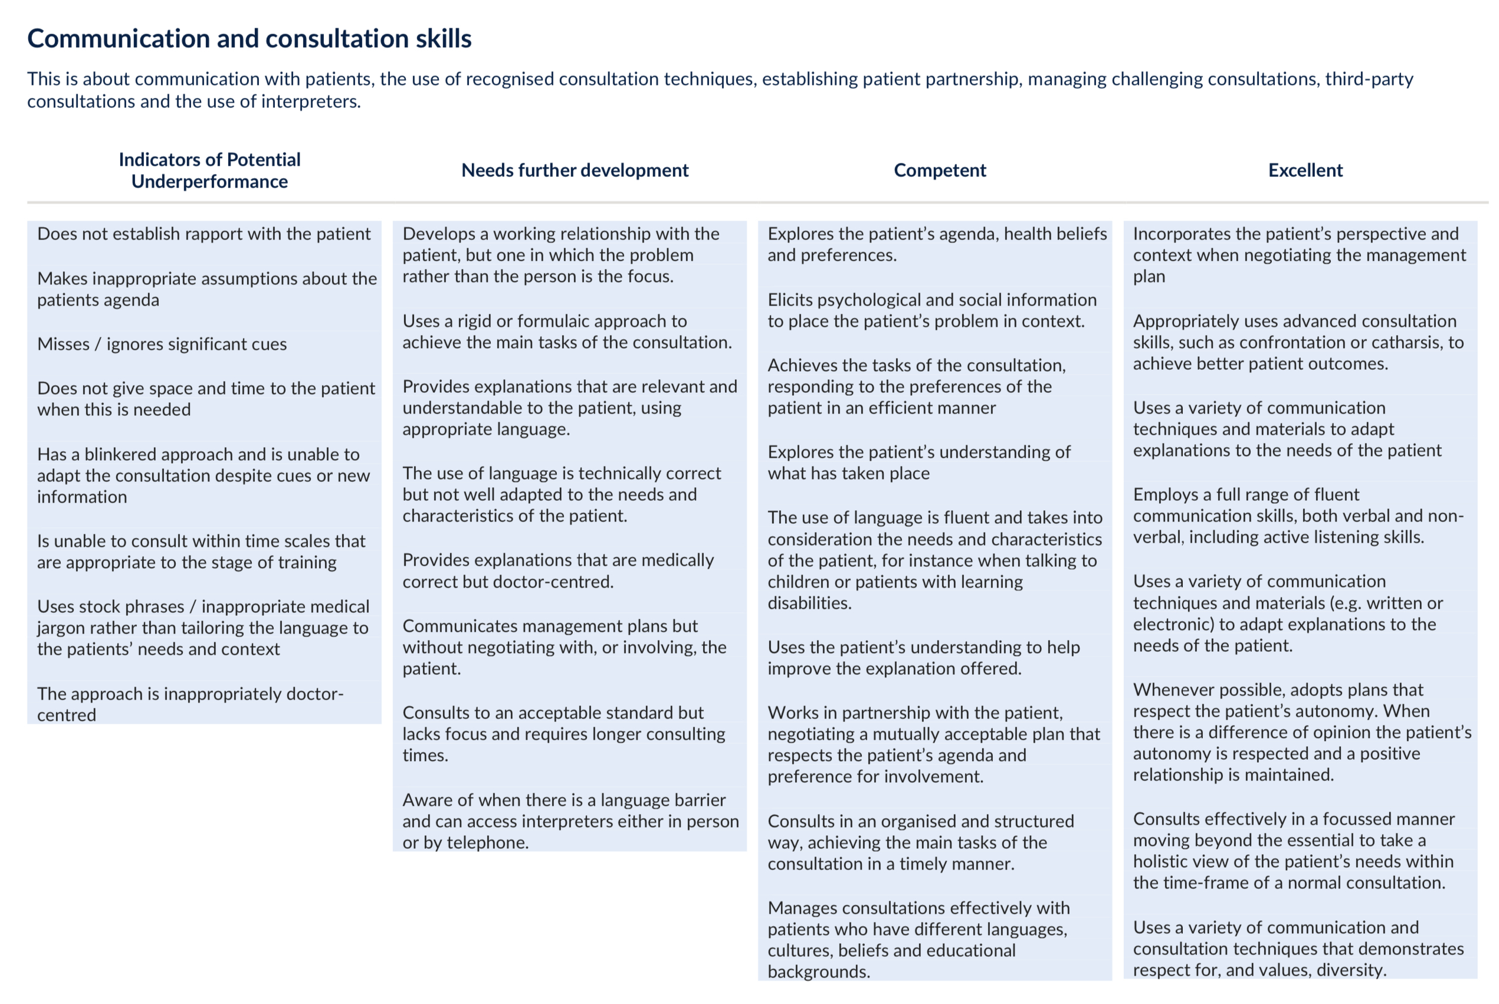

Slide 12
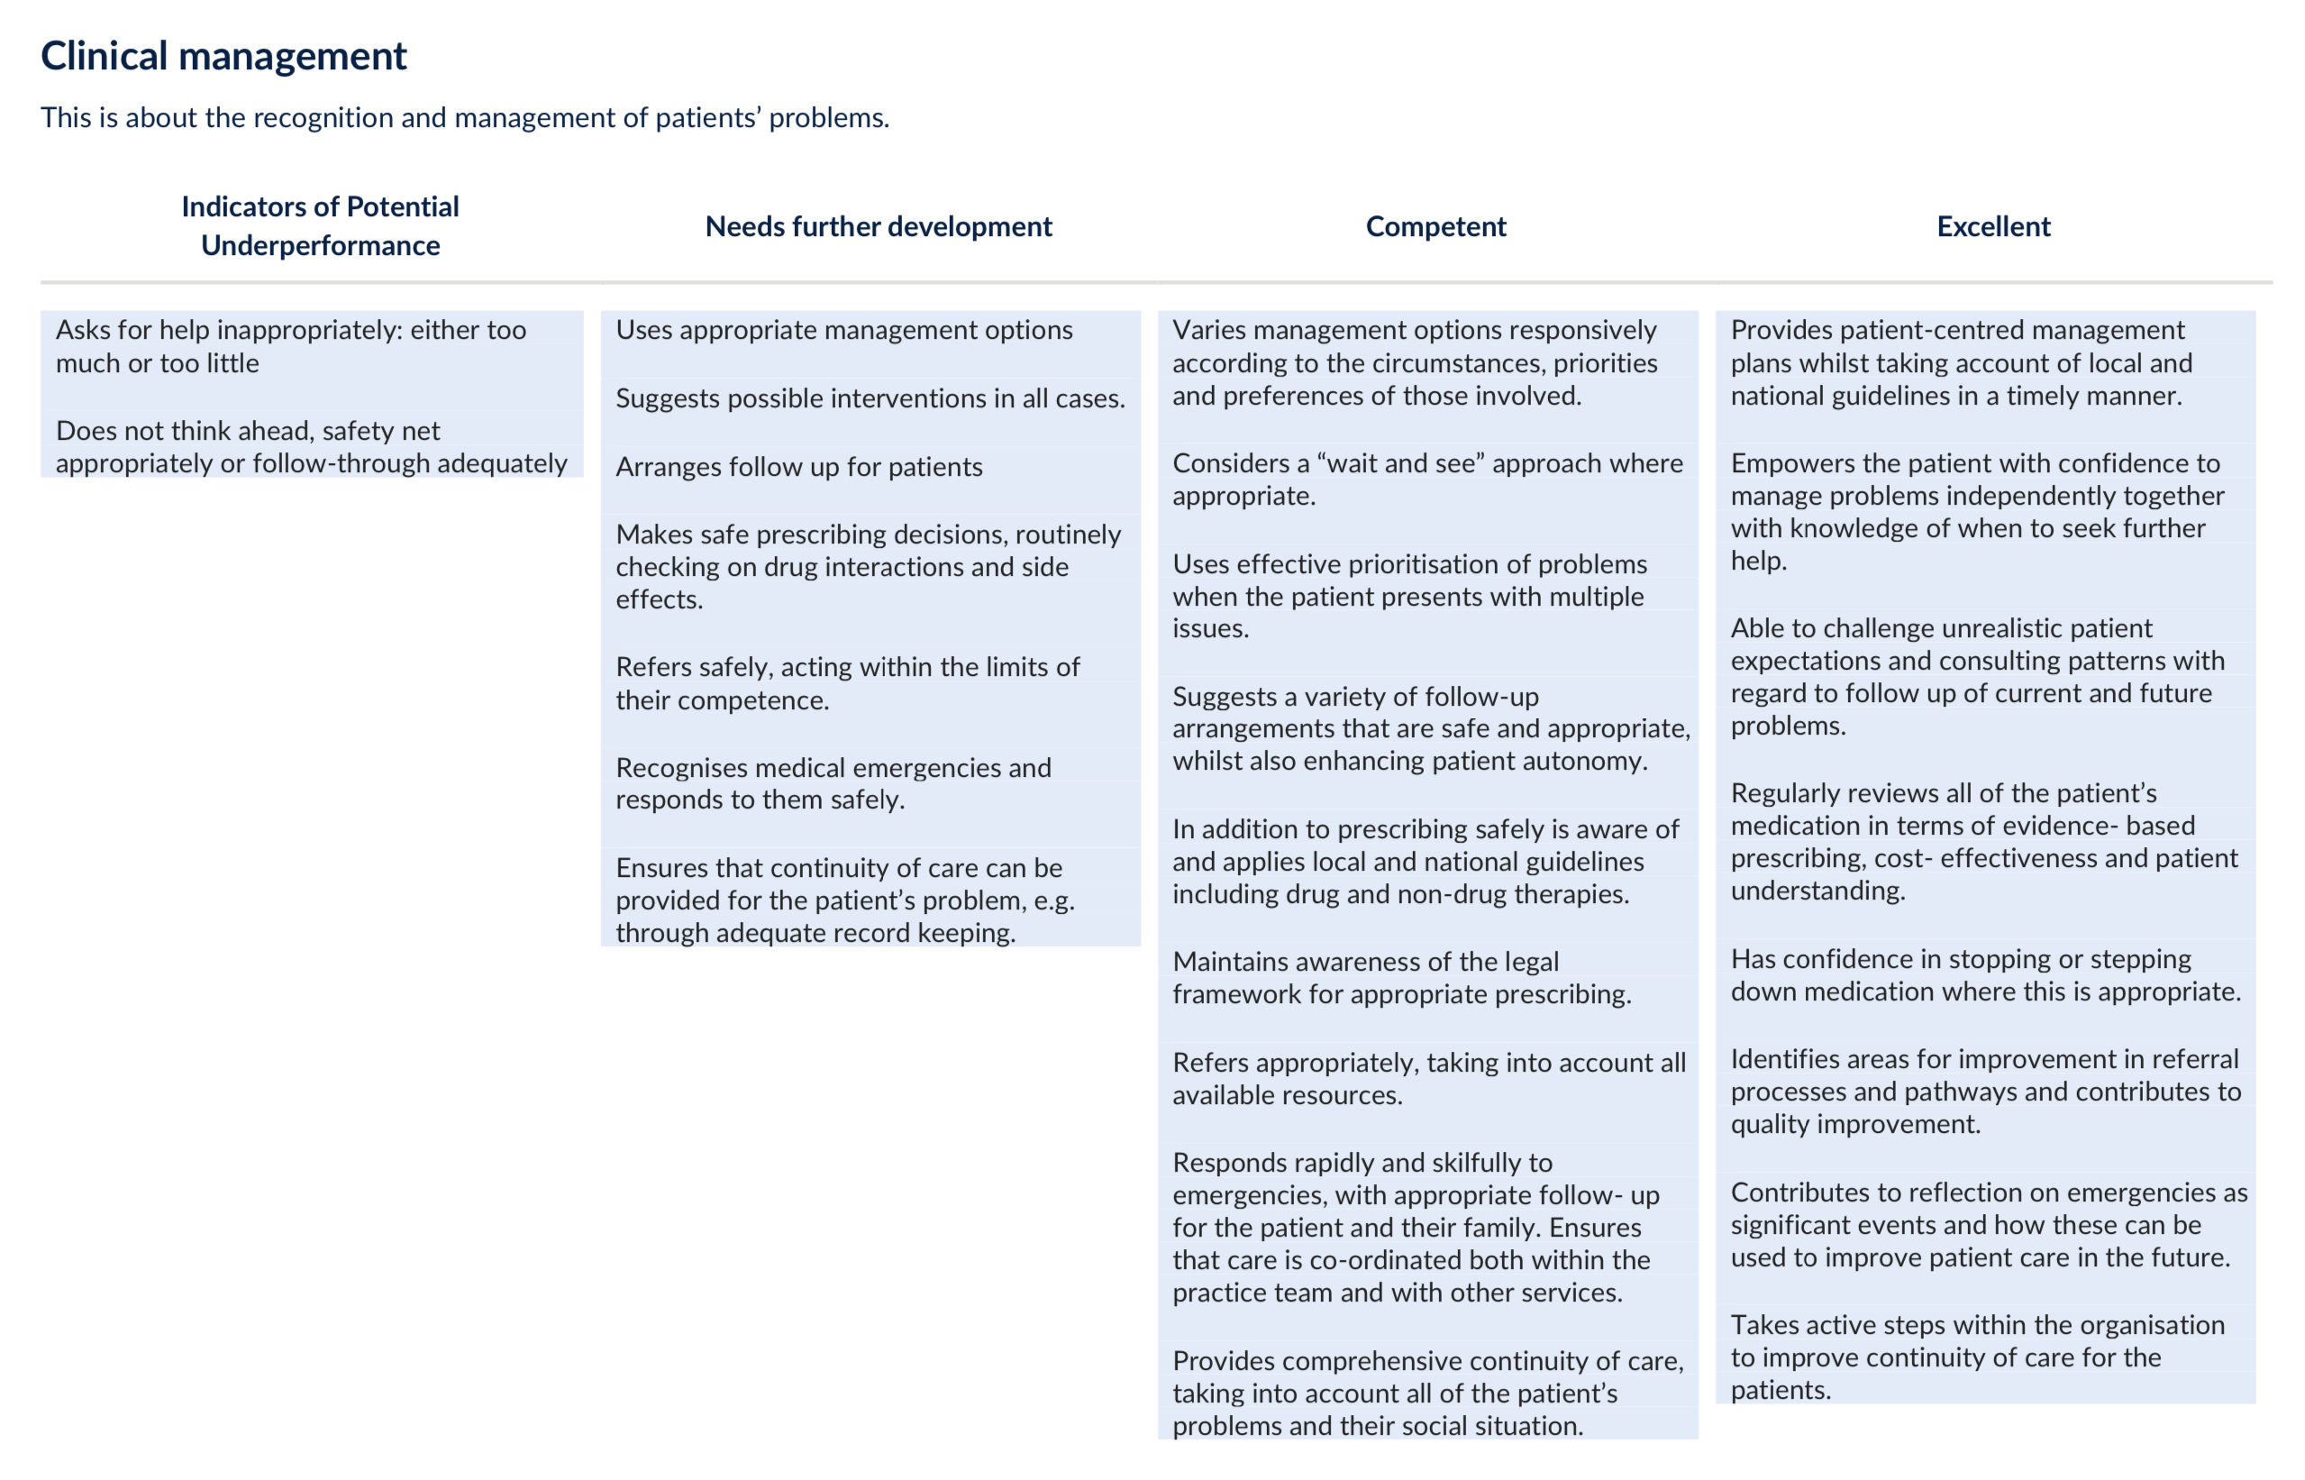

Slide 17
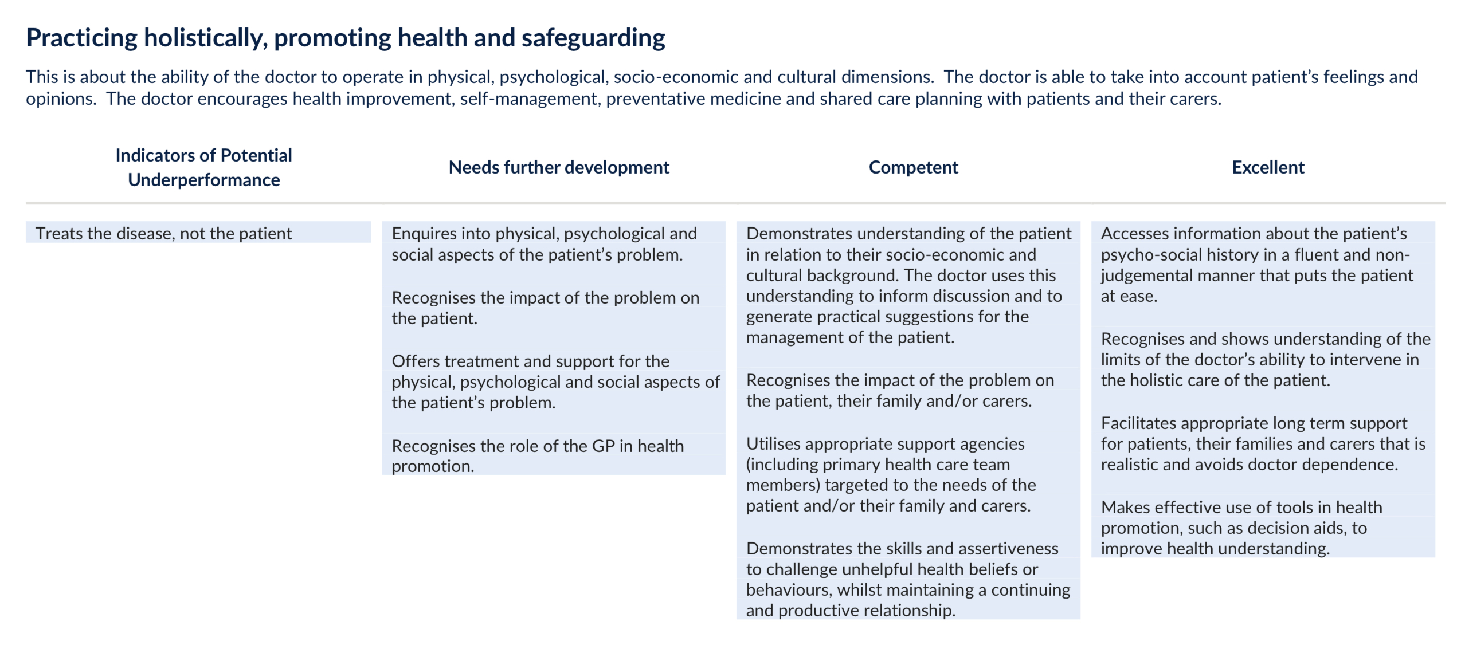

Slide 19
WBPA numbers for each training year

Slide 20
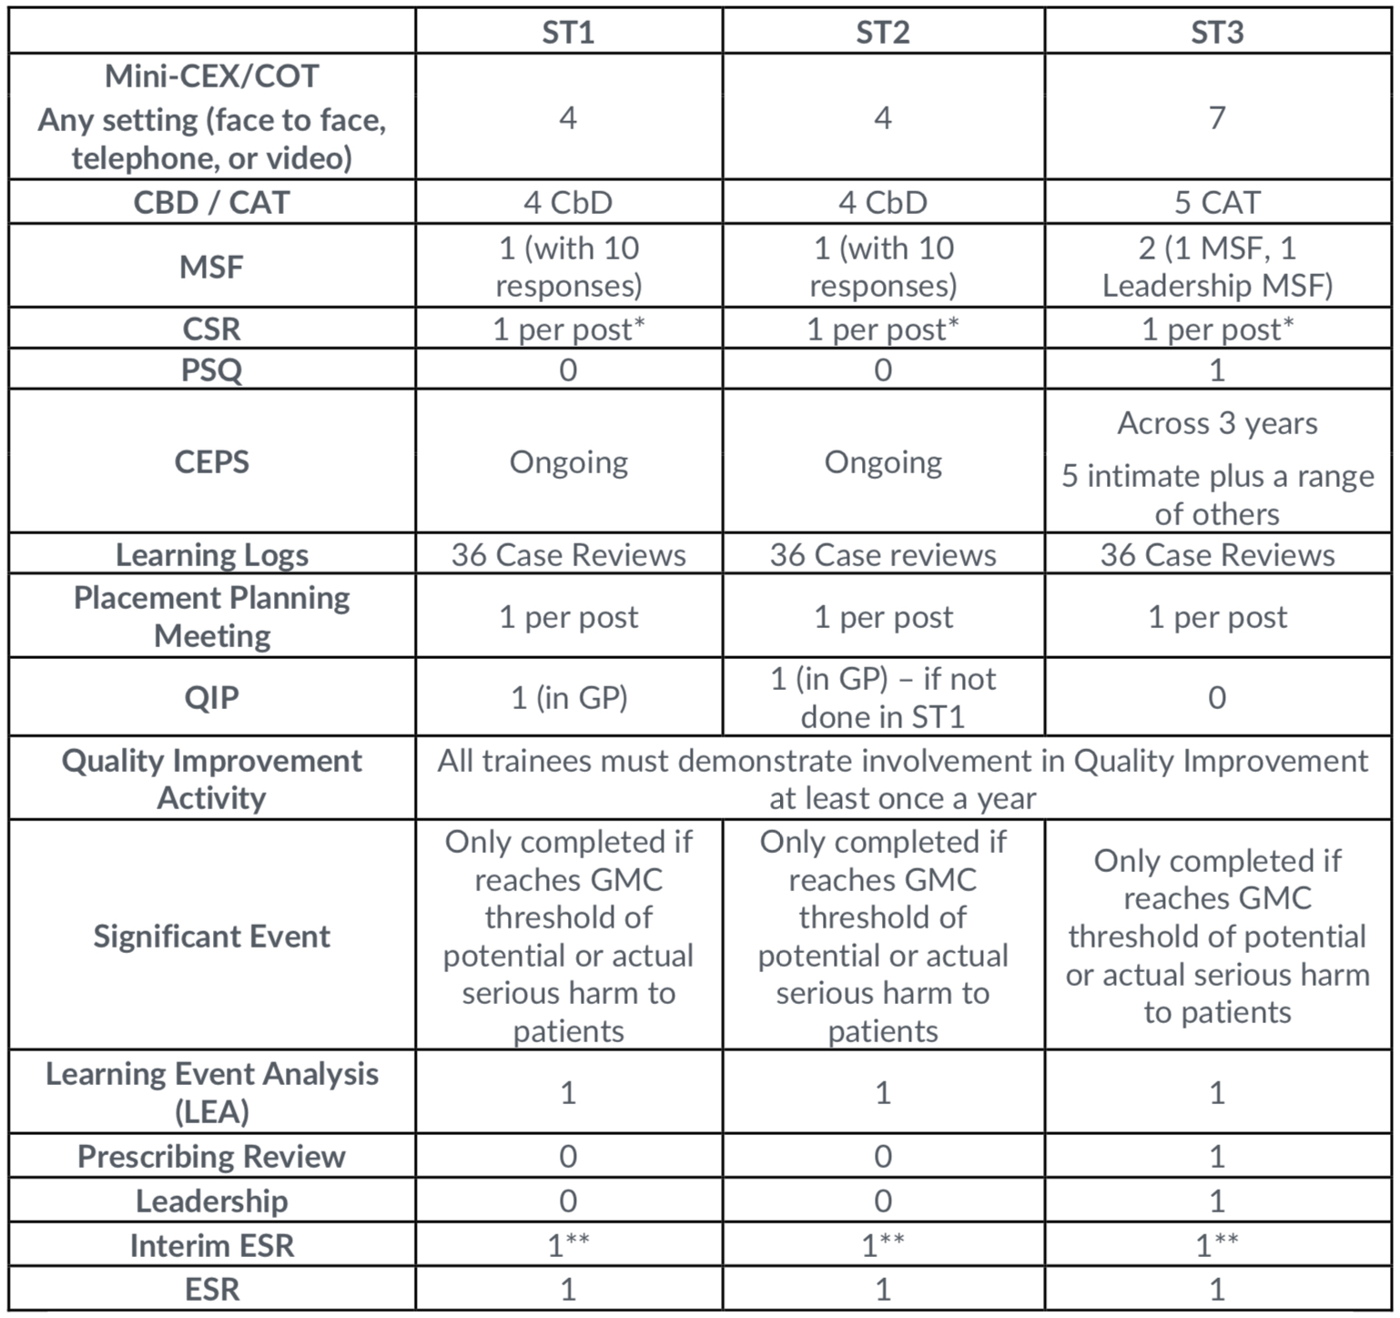

Slide 21
*CSR to be done in a primary are post if any of the following apply: The Clinical Supervisor in practice is a different person to the Educational Supervisor, the evidence in the Portfolio does not give a full enough picture of the trainee and information in a CSR would provide this missing information, or either the trainee or supervisor feel it is appropriate
** The Interim ESR can only be completed if the trainee is progressing satisfactorily - see interim ESR guidance. Otherwise a full ESR is required at the midpoint of each calendar year

Slide 22
The Assessments
Bold indicates the assessments to be discussed today
Case Based Discussion (CbD)
Care Assessment Tool (CAT)
Mini-Clinical Evaluation Exercise (MiniCEX)
Consultation Observation Tool (COT)
The Audio-COT (Audio-COT)
Clinical Examination and Procedural Skills (CEPS)
Multi-Source Feedback (MSF)
Patient Satisfaction Questionnaire (PSQ)
Leadership Activity and MSF
Quality Improvement Project (QIP)
Prescribing Assessment
Clinical Supervisors Report (CSR)
Interim Educational Spervisors Report (Interim ESR)
Educational Supervisors Report (ESR)

