Slide 1
Yorkshire & Humber Anaesthetic Trainee Committees
Sophie Lawton
ST6 Anaesthesia West Yorkshire
Co-Chair West Yorkshire Committee of Anaesthetists in Training
Notes:
Trainee committees in each of the 3 regions
Structure is different in each region
Hospitals reps and regional reps.
Serve a common purpose to help with any problems with training
Just one point of access for trainees to the school
Answer questions, imorive training and conditions
Act as intermediate between trainees and the school
Attend STC & board meetings.

Slide 2
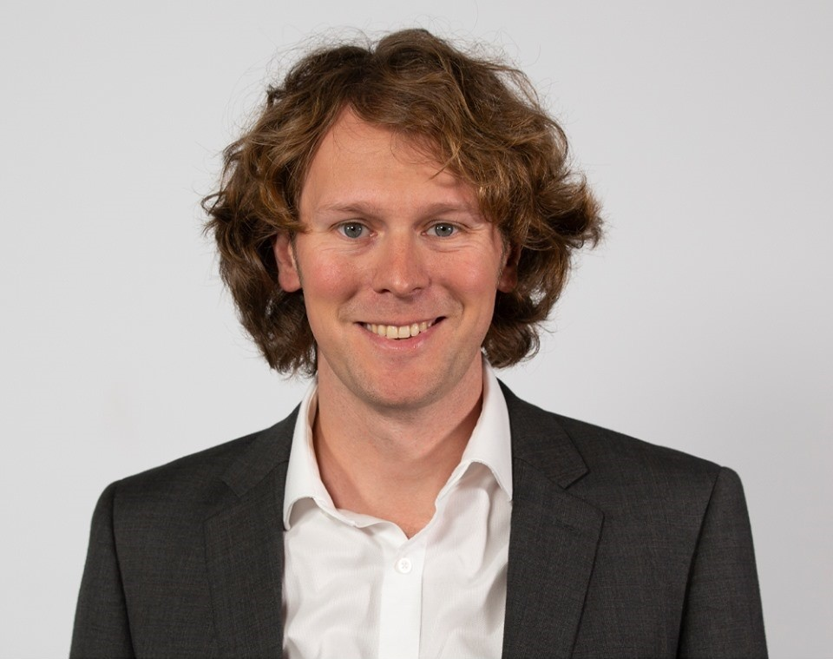
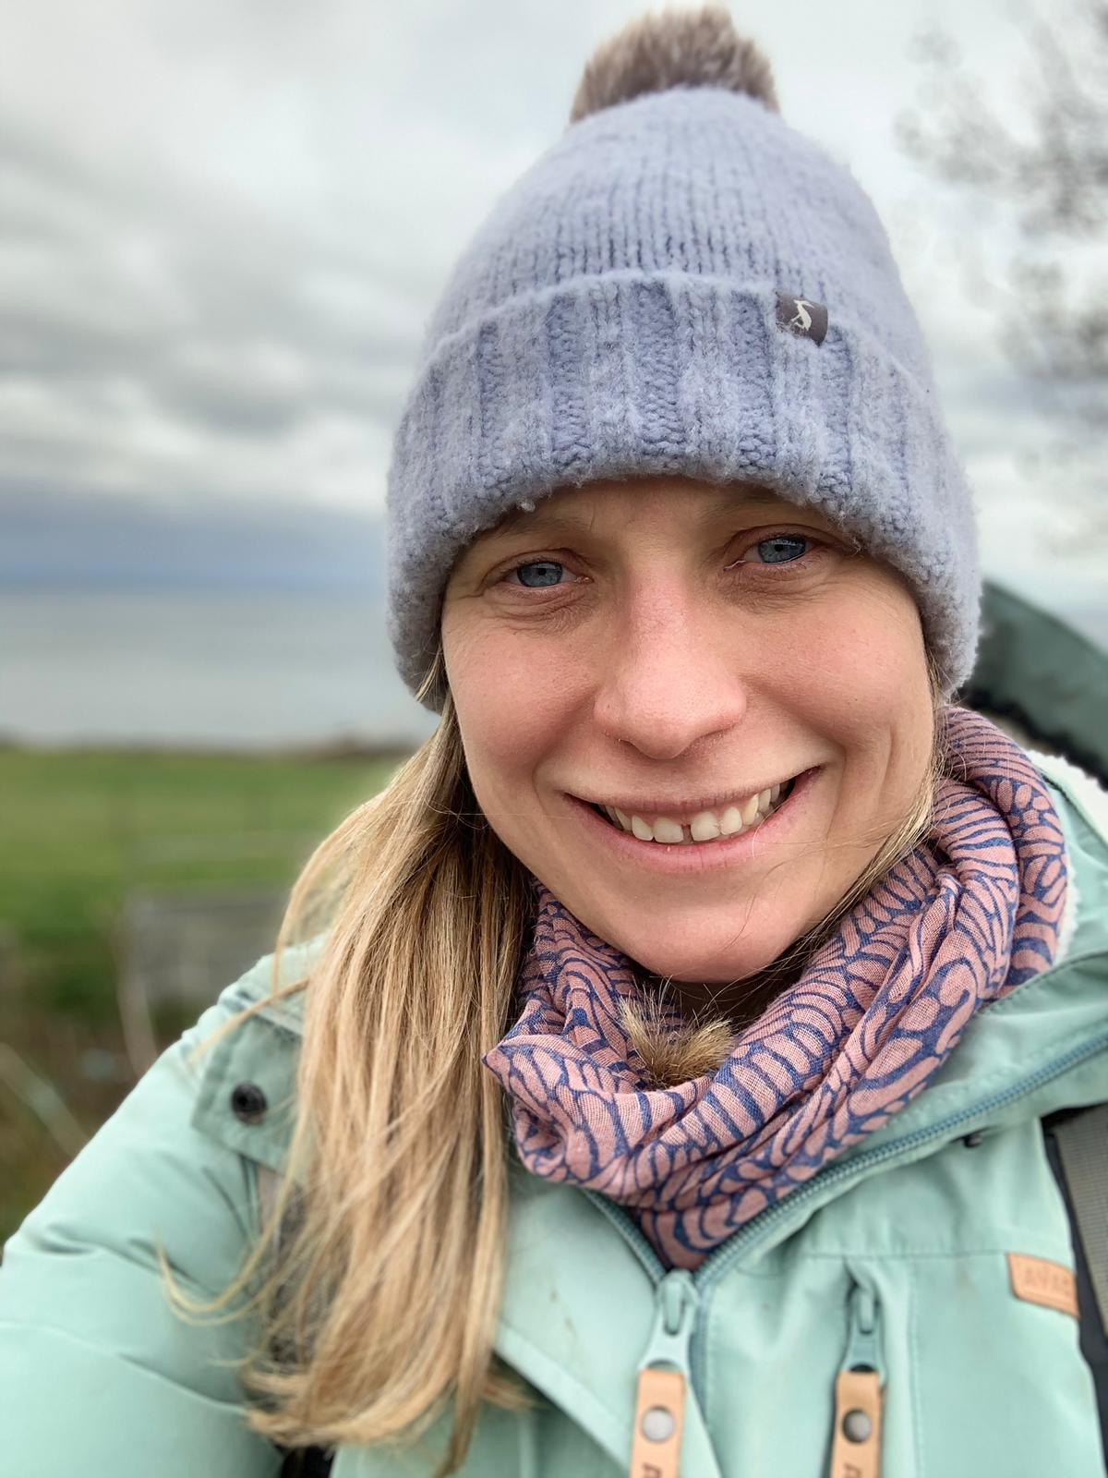
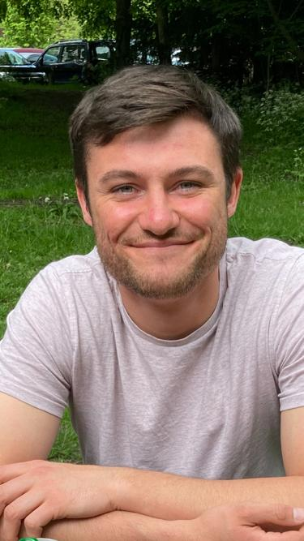
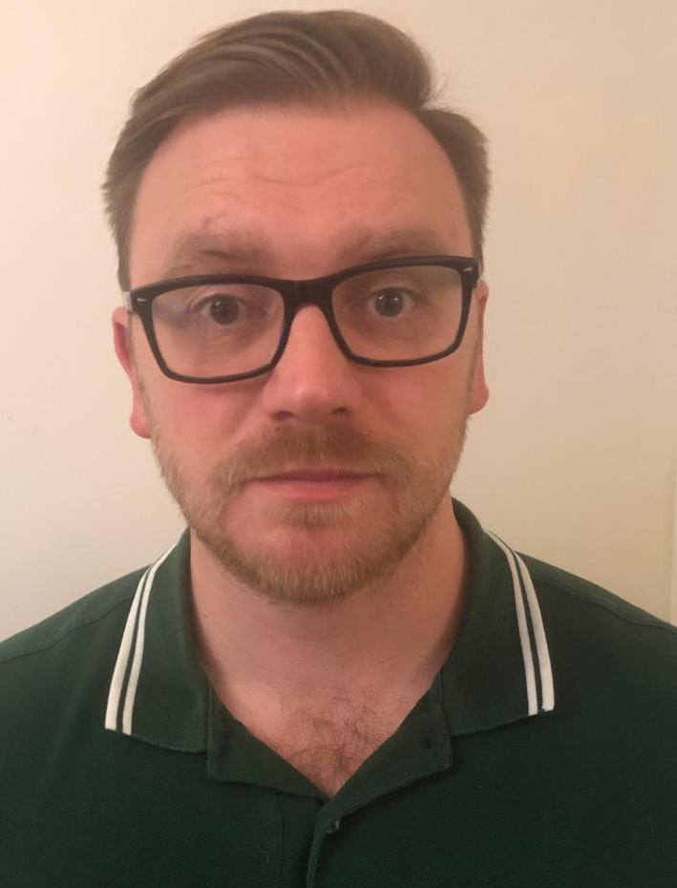
West Yorkshire Committee of Anaesthetists in Training (WYCAT)
ST5+ trainees (Co Chair)
Phil Atkinson
phil.atkinson1@nhs.net
ST3/4 trainees
Marc Fadden
m.fadden@nhs.net
Less Than Full Time (Co-Chair)
Sophie Lawton
sophie.lawton1@nhs.net
Core/ACCS (CT1-3)
Ed Knights
edward.knights1@nhs.net

Slide 3
North & East Yorkshire
Core/ACCS Anaesthetics
Claudia Dyball claudia.dyball@nhs.net
Dan Greenwood daniel.greenwood@doctors.org.uk
Higher (ST3+)
Stephanie ‘Clare’ Bailey stephanie.bailey1@nhs.net
Sandhya (Sandy) Od sandhya.od1@nhs.net

Slide 4
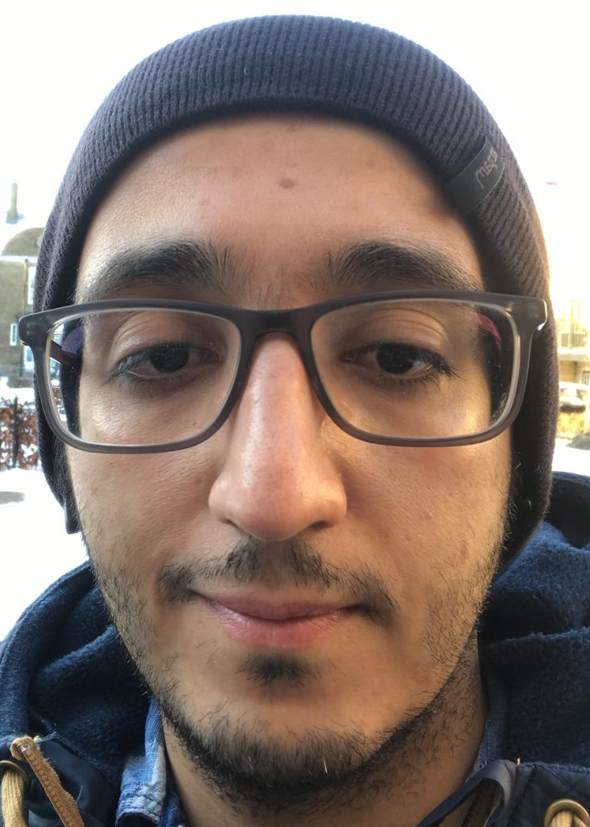
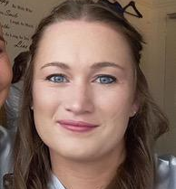
South Yorkshire Committee of Anaesthetists in Training (SYCAT)
ST reps/ Co-chairs: Ahmed Atewah Julia Brown
Contact shefgascat@gmail.com
Core/ACCS: Morwenna Read

Slide 5
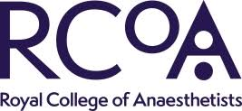
ATRG – Anaesthetic trainee representation group
AiT – Anaesthetists in training committee
Representation at the school meetings
Yorkshire Anaesthetic Trainee Awards
Notes:
The Anaesthetists in Training Representative Group (ATRG) was formed in July 2014 and consists of one trainee representative from each School of Anaesthesia along with co-opted members from the Faculties of Intensive Care Medicine and Pain Medicine. The objectives of the ATRG are:
Enable a more sustainable and operable system to ensure true representation of trainee concerns and views and ensure the College has an effective, UK wide means of seeking trainee input.
Effectively inform and alert trainees to issues affecting them and to be able to address grass roots concerns.
Encourage greater trainee engagement with the College.
The Anaesthetists in Training Committee consists of two trainee members of Council, four members elected from the Anaesthetist in Training Representative Group and co-opted members. This committee provides trainee representation across all activities of the College and also to external groups such as the Academy of Medical Royal Colleges' Trainee Doctors Group (ATDG) and the Association of Anaesthetists Trainee Committee.

