Slide 1
Whanganui, New Zealand
Out of Programme Experience 2020 - 2021

Slide 2
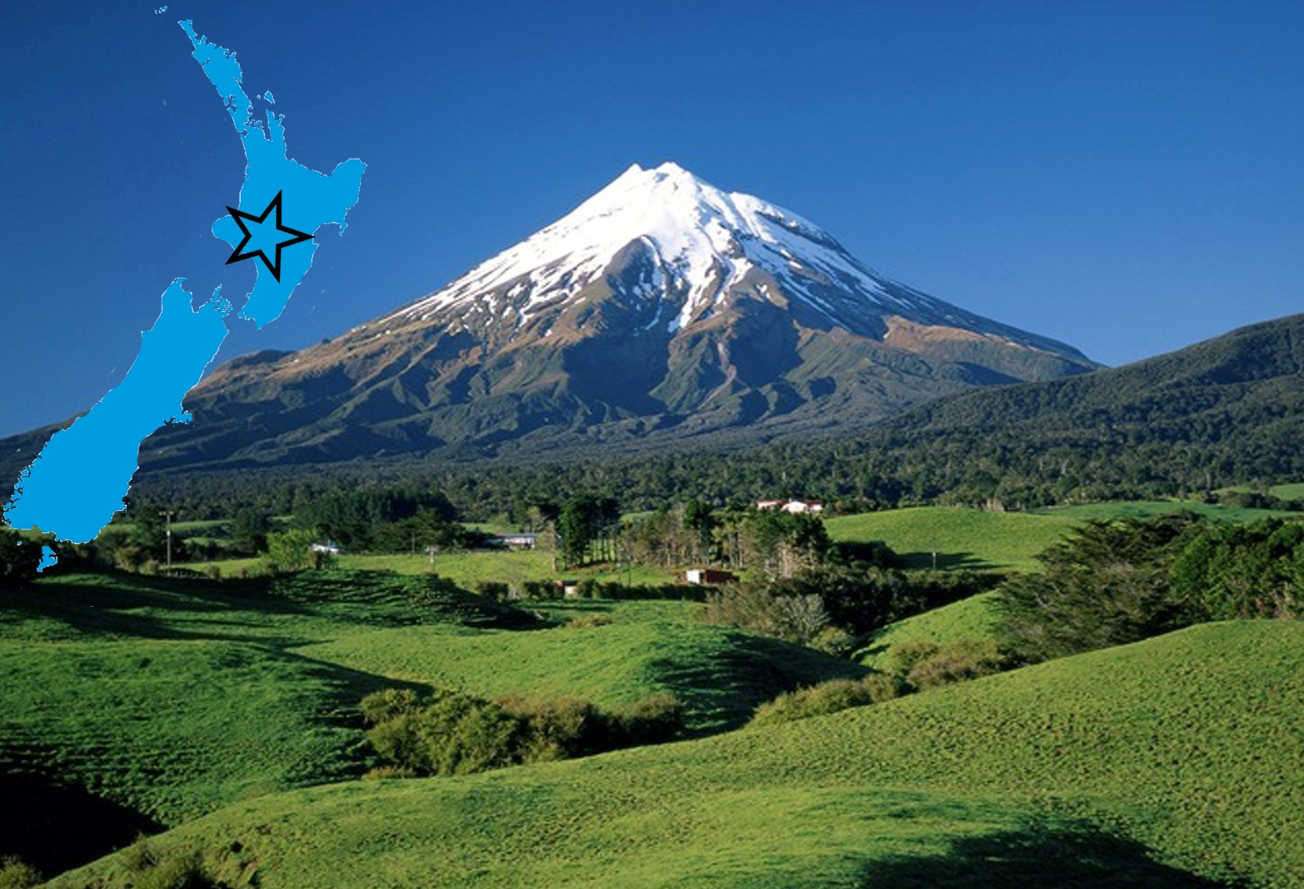

Slide 3
Whanganui
West coast of New Zealand’s North Island, situated at the mouth of the famous Whanganui River.
Water activities including rafting, sailing, canoeing, waterskiing, windsurfing and rowing.
Easy access to Mount Ruapehu, home to New Zealand’s two largest ski fields, Whakapapa and Turoa.
Vibrant arts scene with fine arts, graphic design, and fashion
Summers are warm and dry - 18 to 30°
Winters are mild - 4 to 14°.
2 hours north west of Whanganui is the coastal city of New Plymouth, where you can tramp, climb, snowboard, ski, water ski and surf all in the same day

Slide 4
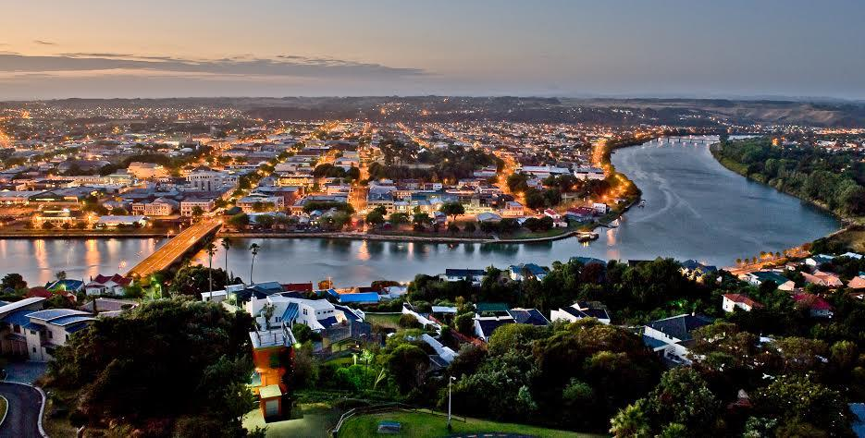

Slide 5
Whanganui District Health Board
Whanganui DHB in total employs in excess of 1000 staff
27 junior doctors and 8 registrars
Covers a population of approx. 60,000
Large percentage of Maori (23%)

Slide 6
The Hospital
120 bed – including psych, ENT and Eye
4 rotations of 3 months
Medical / Geriatric Services
Surgical & Orthopaedic Services
Paediatric Services / Obstetrics & Gynaecology Services
Emergency Department
Relief (covering for people on holiday)

Slide 7
The 2019 offer includes...
Whanganui District Health Board will provide:
Reimbursement of half return air fares from the UK to Wanganui upon production of GST receipts, at completion of the 12 month contract.
Good support from consultants
Plenty of teaching (daily)
One on one with consultants
The nights are 3 & 4 split, thus being 4 week nights Mon 10pm – Friday 8am (x 2 sets per 13 week run) and 3 weekend nights Friday 10pm - Monday 8am (x 2 sets per 13 week run). These are on duty shifts and not on call
ED roster is similar but may include another set of nights depending on the roster
Weekends are worked 1:2 on the ED roster and 1:3 on the general roster
House Officers are generally expected to do a 1:7 after hours call.

