Slide 1


Study Leave/
Curriculum Delivery
Lesley Izzard – Medical Education Manager
Sheffield Teaching Hospitals
NHS Foundation Trust

Slide 2

Study leave forms have to be approved by your TPD and Rota Organiser at least 6 weeks prior to taking leave. Please ensure all boxes are completed (even if you have to estimate costs) as retrospective claims will not be authorised
Lesley Izzard – Medical Education Manager
Sheffield Teaching Hospitals
NHS Foundation Trust

Slide 3


All forms should be sent to the Medical Education Centre, NGH either by post or email (DrsStudyLeave@sth.nhs.uk) . It is your responsibility to ensure the form is sent and received by Medical Education, NGH prior to taking leave.
Study Leave Coordinator
Medical Education Centre
Northern General Hospital
Herries Road
Sheffield
S5 7AU
Once received you will be sent an acknowledgment e-mail confirming the leave and any expenses you have requested.
Lesley Izzard – Medical Education Manager
Sheffield Teaching Hospitals
NHS Foundation Trust

Slide 4

If you wish to take leave at short notice (eg if you are given a place on a course taking place within 2 weeks) you must contact Medical Education NGH on 0114 2714076, to let them know before you take any leave.
Lesley Izzard – Medical Education Manager
Sheffield Teaching Hospitals
NHS Foundation Trust

Slide 5

Study leave form and guidance
Lesley Izzard – Medical Education Manager
Sheffield Teaching Hospitals
NHS Foundation Trust

Slide 6
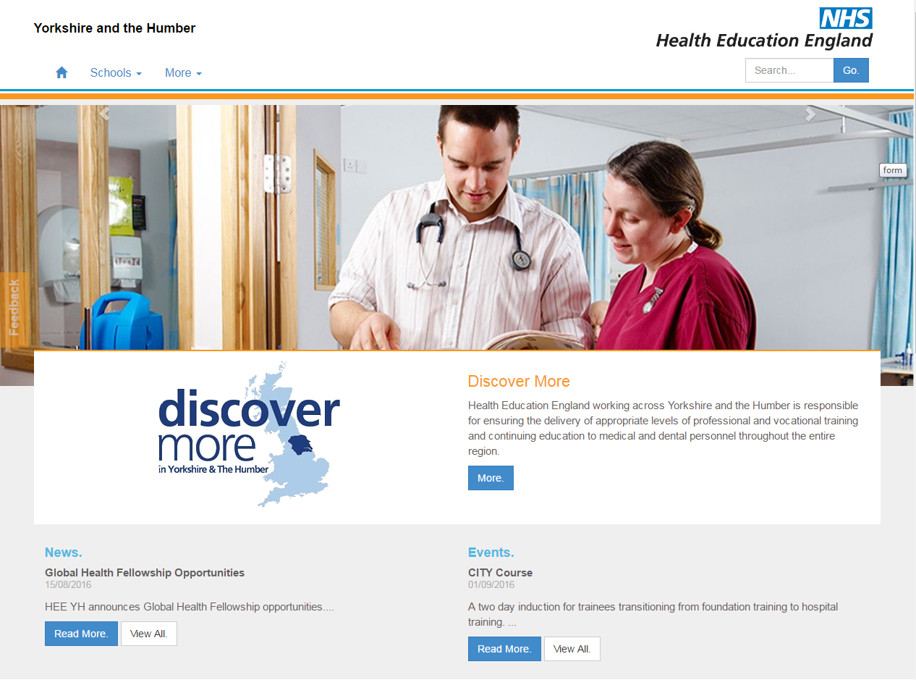
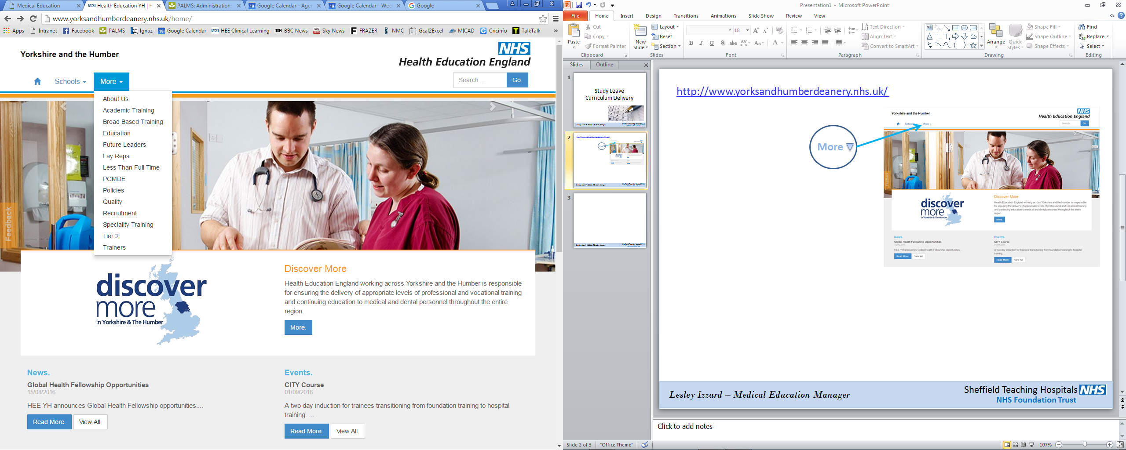
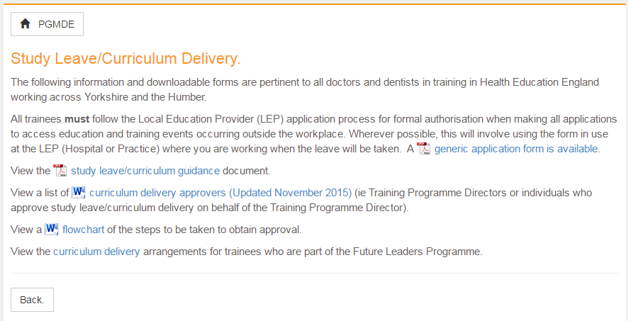
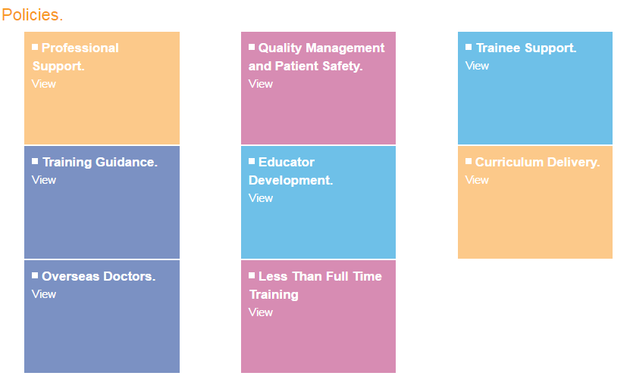
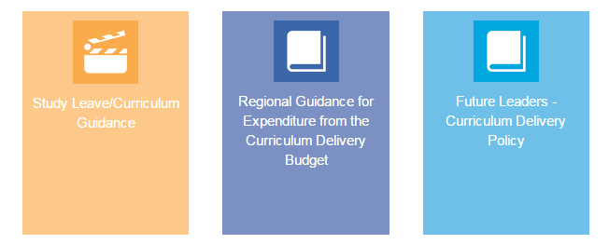
http://www.yorksandhumberdeanery.nhs.uk/
Lesley Izzard – Medical Education Manager
Sheffield Teaching Hospitals
NHS Foundation Trust

Slide 7
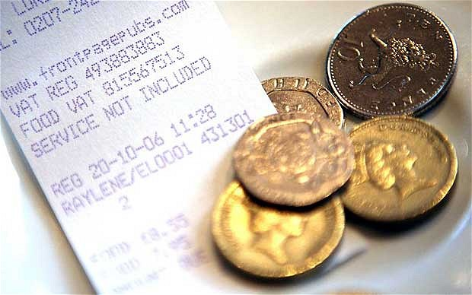
e-Expenses
Lesley Izzard – Medical Education Manager
Sheffield Teaching Hospitals
NHS Foundation Trust

Slide 8
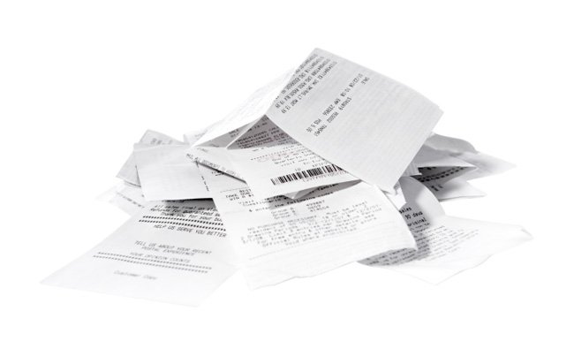
When you have taken the leave you should upload your claim and receipts onto the e-expenses system
Lesley Izzard – Medical Education Manager
Sheffield Teaching Hospitals
NHS Foundation Trust

Slide 9

To register, please send details of your full name, payroll assignment no., department and work email address to expensesadmin@sth.nhs.uk
Lesley Izzard – Medical Education Manager
Sheffield Teaching Hospitals
NHS Foundation Trust

Slide 10
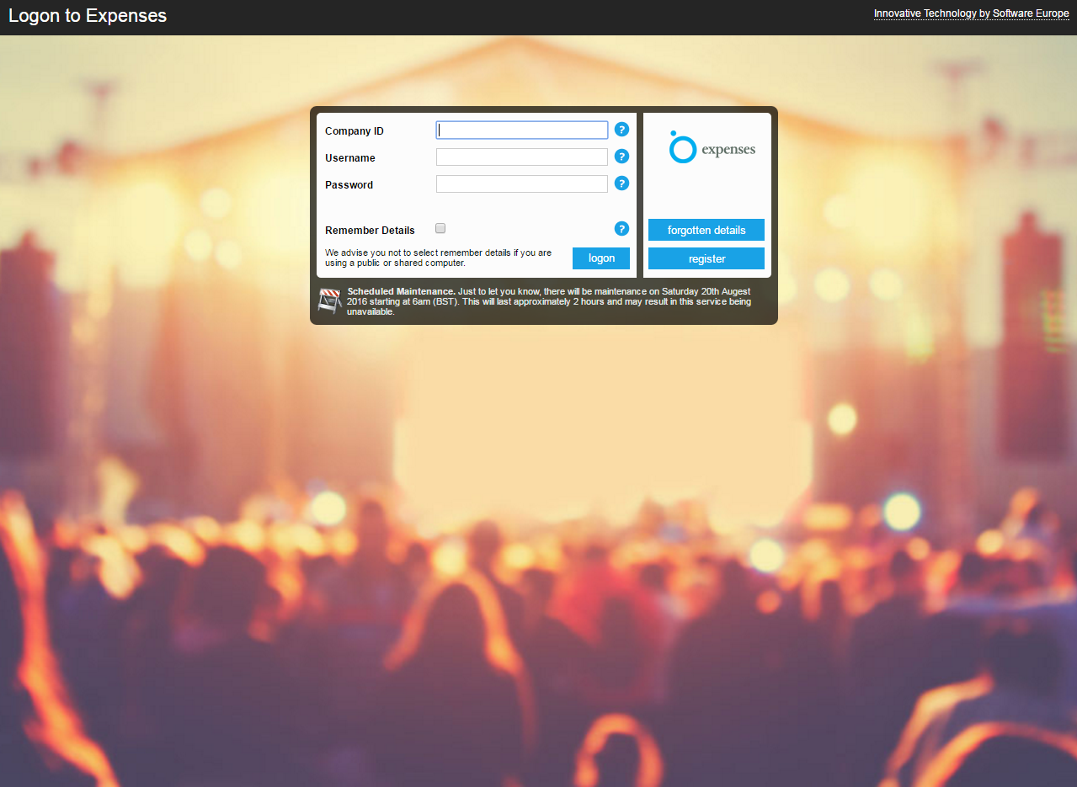
www.sel-expenses.com
Lesley Izzard – Medical Education Manager
Sheffield Teaching Hospitals
NHS Foundation Trust

Slide 11

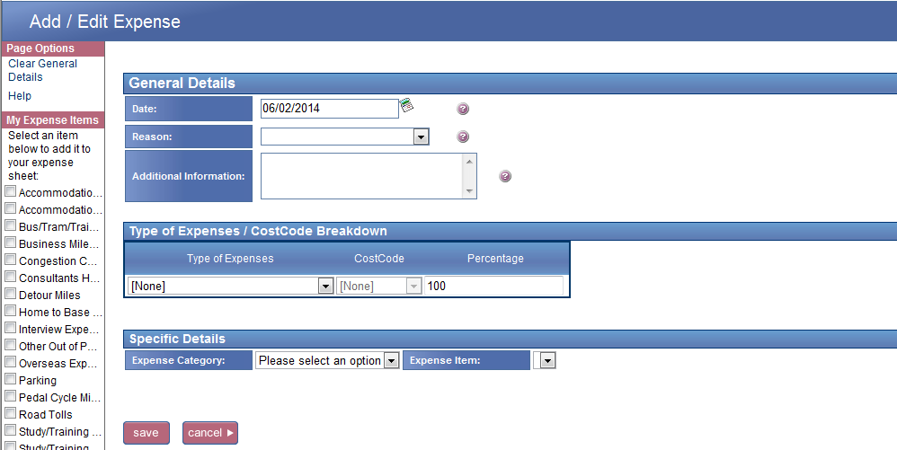
Adding my expense items
All expense items are added through the Add / Edit Expense page. Adding my expense items
The Add / Edit Expense page is accessed by clicking Add New Expenses from the Welcome page.
It is imperative that the Type of Expenses box below is completed to ensure your claim reaches the correct Approver.
Lesley Izzard – Medical Education Manager
Sheffield Teaching Hospitals
NHS Foundation Trust

Slide 12
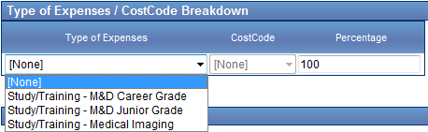
Adding my expense items
If you wish to make a claim for an item that is not listed in your My Expense Items menu please contact your administrator by emailing expensesadmin@sth.nhs.uk.
save
Study/Training – M&D Junior Grade: To be used by all junior doctors in training (F2, SHO’s, StR’s, SpR’s) who have attended study leave approved by Medical Education
Lesley Izzard – Medical Education Manager
Sheffield Teaching Hospitals
NHS Foundation Trust

Slide 13
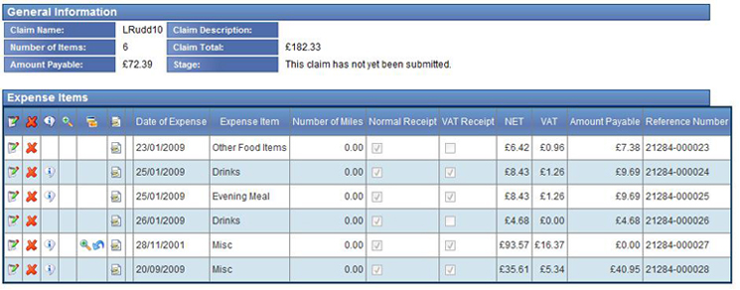
Current Claims screen
At this point you can still edit or delete these items
Edit
Delete
You can add claim items from different days, visits or activities to the same claim form before you submit it for reimbursement. The Add / Edit Expenses page can be accessed either from the Add New Expenses menu button on the Welcome page or from the Current Claims page. You can click Add Item from the page options menu on the left hand side.
Lesley Izzard – Medical Education Manager
Sheffield Teaching Hospitals
NHS Foundation Trust

Slide 14
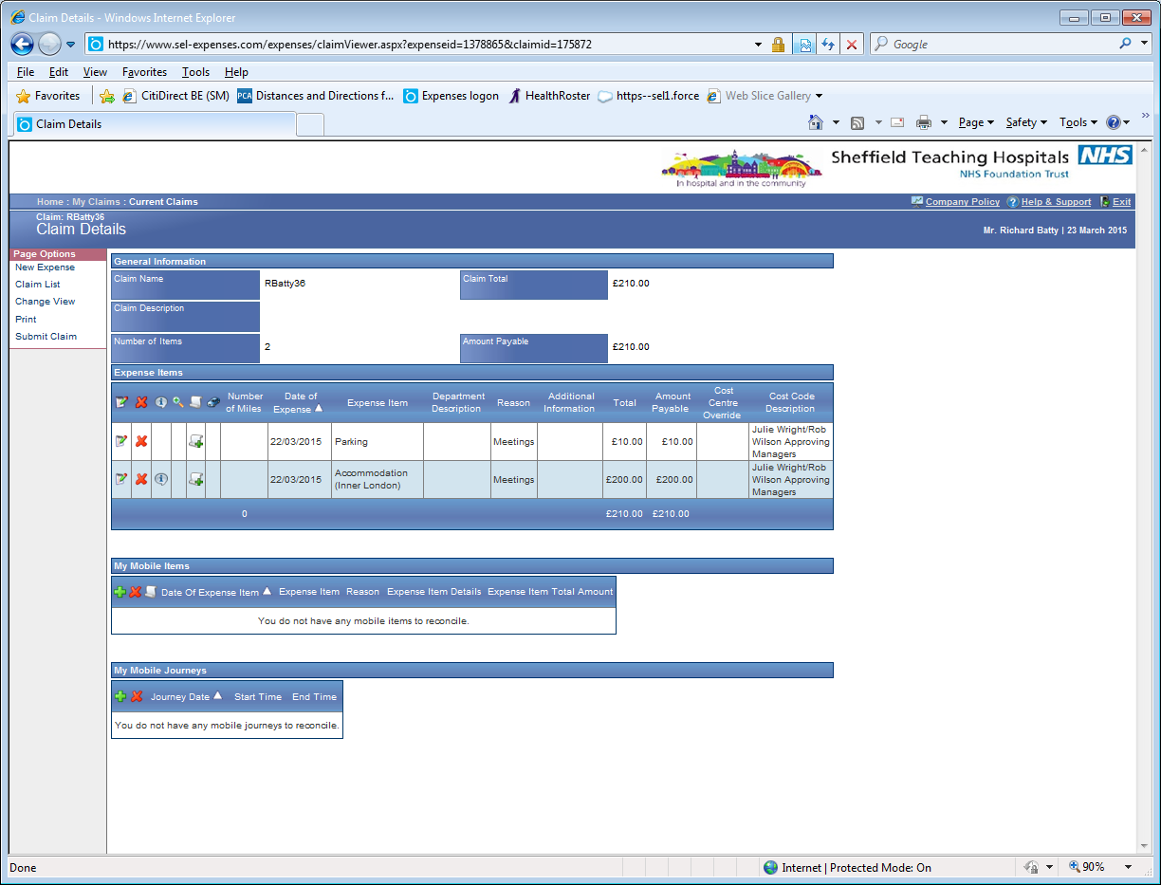
How to attach a receipt using a scanner
Welcome page clicking My Claims, then click Current Claims. If you only have one claim you will automatically be presented with it. Alternatively select the claim form you would like to submit from the list provided.
Access the Expense Claim Details page:
Receipt Icon
Lesley Izzard – Medical Education Manager
Sheffield Teaching Hospitals
NHS Foundation Trust

Slide 15
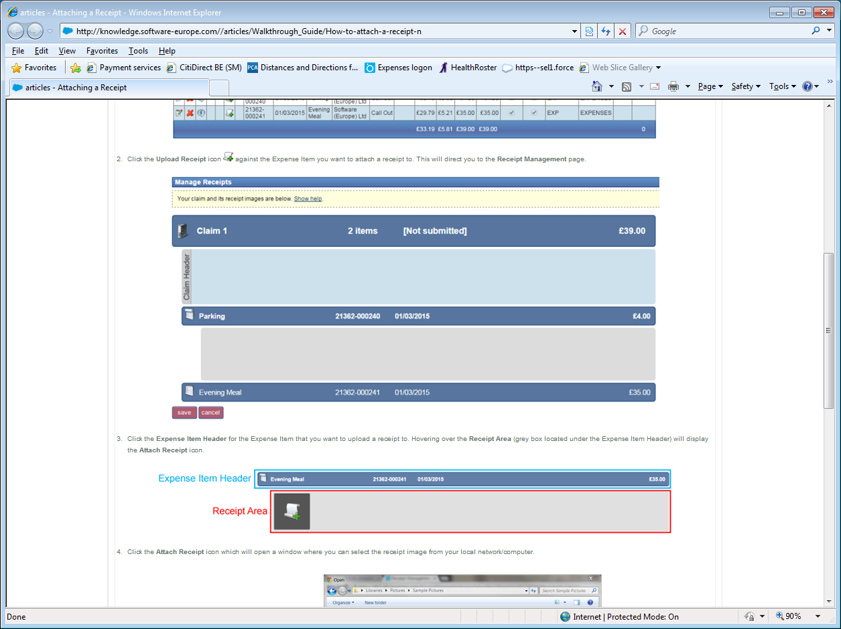
This will direct you to the Receipt Management page
Click the Expense Item Header for the expense item that you want to upload a receipt to
Hovering over the Receipt Area (grey box under the Expense Item Header) will display the Attach Receipt icon.
Lesley Izzard – Medical Education Manager
Sheffield Teaching Hospitals
NHS Foundation Trust

Slide 16
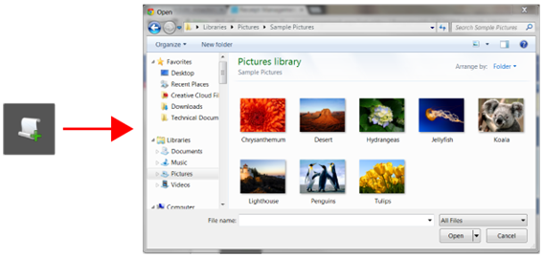
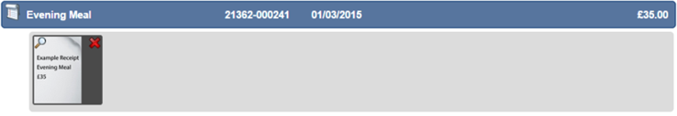
Click the Attach Receipt icon which will open a window where you can select the receipt image from your local network/computer.
Double click the receipt image that you want to attach. The image will appear in the Receipt Area below the Expense Item Header.
To upload additional receipts to other expense items, repeat the above steps as required
Lesley Izzard – Medical Education Manager
Sheffield Teaching Hospitals
NHS Foundation Trust

Slide 17
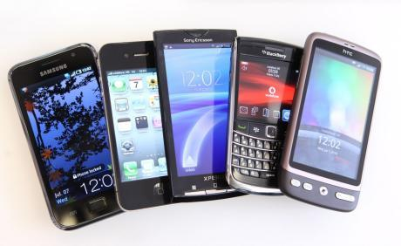
Expenses360 on your mobile
For registered users of e-Expenses:
Available on iPhone, Android and BlackBerry smartphones from your App Store:
Add travel expenses whilst on the move and use your device’s camera to capture receipts. A simple ‘sync’ to your on-line Expenses account will have them ready for you to submit when you next log-in
Lesley Izzard – Medical Education Manager
Sheffield Teaching Hospitals
NHS Foundation Trust

